Slide 1
#20 – The Story Behind the Palestine Pictorial Issues

Slide 2
Background on Palestine Pictorial Issues
To begin with, from the time the Egyptian Expeditionary Forces occupied Palestine, all stamps issued, starting with 1918, bore an E.E.F. inscription. Later on, when the Military Administration phased out, and the country came under Civil Administration, these E.E.F. stamps were overprinted with the 3 official languages of the country.
As early as 1923, Sir Herbert Samuel wrote a letter to the Acting High Commissioner suggesting that for new postage stamps for Palestine, they use some conventional Arabesques as in the case of Hejaz. Alternatively, the Mufti or Bezalel should make some proposals, or suggestions might be publicly invited in England.
This was referred to the Postmaster General of Palestine, who suggested that new stamps carry views of buildings and places of historical interest, such as the Tower of David, the Zion Gate, interior view of the Golden Gate, Dome of the Rock, and Tiled Ornaments. His reasoning was based on general public acceptability, and that such stamps would advertise the attractions Palestine offered tourists. Finally, he suggested that competitive designs be obtained from the Bezalel Art School and from England.
After a number of consultations, it was decided to hold an open public competition for photographs of local interest. A group of three Senior British Officers was formed as a judging committee, but the final selections were left to the High Commissioner. Prizes were offered and a great deal of interest was created. Large numbers of photographs poured in from all over the world. Of course, each community submitted pictures of special interest to themselves. Most of the photos from Moslems showed views of the Mosque of Omar, and of purely Arab cities like Nablus and Ramleh. Jewish entries consisted of the Western Wall, Rachel’s Tomb, and the Mount of Olives. Christians sent in only pictures of Christian holy places.
Finally, 16 pictures were selected by the judging committee as suitable for postage stamps, and prizes were awarded accordingly. Of these, Sir Herbert Samuel chose 4 photographs which depicted: 1. The Tower of David; 2. Rachel’s Tomb; 3. The Mosque of Omar; and 4. A view of Tiberias overlooking the Lake of Galilee.

Slide 3
Background on Palestine Pictorial Issues
This matter was then referred to the Colonial Office, which expressed its desire to postpone printing them until arrangements for new Palestinian currency were completed. The High Commissioner raised objections, and in a letter dated Nov. 11, 1924, wrote: “The current issue, introduced as a wartime measure, be it noted is in many respects unsatisfactory. The design is somewhat crude, the values are shown in two of the three official languages, and the letters E.E.F. have long since been meaningless. Furthermore, the necessity for overprinting each stamp with the words Palestine in English, Arabic and Hebrew makes the production expensive.”
A correspondence exchange followed, and objections were raised that by placing the Arabic and Hebrew translation of Palestine side by side beneath the picture of the Mosque of Omar, an impression would be conveyed that the Dome of the Rock belonged equally to Jews and Moslems. This argument was refuted by the High Commissioner’s reply in which he stated: “I do not consider that there is any real foundation for this objection which I am inclined to place in the same category as an editorial article that appeared some time ago in a newspaper, accusing the Palestine Post Office of engaging in Christian propaganda by including a Maltese Cross in the design of a date stamp. The date stamp in question was a standard pattern of the British Post Office. In any case, whatever objection may be raised to the Arabic and Hebrew lettering on the grounds quoted, it ceases to carry weight since the same arrangements will be adopted for all other designs.”
In the meantime, the current issue of overprinted E.E.F. stamps was the cause of an unusual law case in 1925, when a certain Jamal Effendi al Husseini, described on the charge sheet as “…an Arab gentleman resident in Palestine, a citizen of the country,” accused the High Commissioner’s government of contravening the provisions of Article 22 of the British Mandate. The basis of the complaint was that to the Hebrew word “Palestine” in the overprint, were added the letters Alef and Yod – the initials of Eretz Yisrael. The plaintiff acted as Secretary of the Executive Committee of the Moslem-Christian Association in Palestine. The Chief Justice was of the opinion that the addition of these initials did not constitute a danger to the interests of any part of the population, but the court considered that the points raised should be examined further. However, the court allowed the case to die by dropping it. It is to be noted that when new stamps did finally appear, the Hebrew inscription still contained the letters which had been the subject of the complaint. But perhaps as a compromise, they were enclosed in brackets.
Because of the prevailing political situation in Palestine, the Colonial Office succeeded in postponing the issuance of new stamps until 1927, when the change to Palestinian currency was effected.

Slide 4
Background on Palestine Pictorial Issues
These stamps were printed on a very thin semi-transparent paper. The first ones to go on sale were the 3 mil and 13 mil values, which were issued on June 1, 1927. The rest of the set went on sale August 14, 1927.
Little publicity was given to this issue, because the existence of First Day covers is still unknown. However, stamp dealers of that period stocked up on enough mint sets to more than meet current demand, so that mint copies are not too difficult to find. The real challenge is to locate used copies, because of what followed.
The Palestinian postal authorities discovered that due to the hot and dry climate, these first issued stamps curled very badly, and were very difficult to handle. Consequently, complaints were forwarded to the Crown Agents in England. This matter was resolved by having all future printings made on a thicker paper with a ribbed appearance. This ribbing was affected by machine during the drying process after the paper had been gummed, and can be seen as alternating small wavy impressions running vertically in the paper. This is also quite visible on the gummed side of mint stamps. This solved some of the curling problem. According to Hoexter, the earliest date know on this type of paper is March 1928, but a fellow collector informed me some years ago that he found a 3 mil value with a February 17th date. I now have a copy with a February 28th date. It is reasonable to assume that this value was placed on sale much earlier than any other.
Since this minor paper change did not materially alter the appearance of these stamps, no one paid much attention at the time, and consequently most of them were used postally, making the mint copies quite a bit more elusive today than used copies.
Since its usage was rather limited, the 90 mil had a relatively short life (a total of 4.5 years). It was withdrawn from sale on January 16, 1932. Also, in 1932 there were some minor postal rate changes, with the consequent issuance of a new 15 mil value, and a change of color on four of the then existing values. On June 1st, the 7 and 8 mils in the old colors were withdrawn, and issued as 7 mil violet and 8 mil red. On August 1st, the 13 mil ochre and 15 mil pale blue were issued. The 4 mil purple replaced the 4 mil pink on November 1, 1932.

Slide 5
NEW DISCOVERIES IN PALESTINE EXPERIMENTAL COILS
The first known coil stamp used in Palestine was the 5 mil value. Until this day, the most authoritative sources list the year of its appearance as 1936. To some extent this is true, however, quite recently I have made some startling discoveries pertaining to some experimental coils.
My story really goes back to a collection that I purchased many years ago. When I examined 2 vertical pairs of the 5 m mounted and annotated as coils, I also measured the perforations, and found these to be the regular 12.5 X 14.5. Besides, I remember saying to myself that these stamps were on ribbed paper, as I tucked them away among my duplicates. Only a few weeks ago, I was examining my collection for shades, when I referred to these stamps again. They looked somewhat different and closer examination showed that these stamps had been vertically cut out of sheets, so I said to myself, “maybe from booklets?” Then I noticed that the two pairs had actually at one time been a strip of 4. Peculiar, I thought. But now I noticed that the cuts were on both sides of the strip, and hence the stamps couldn’t have come from a booklet. Critically pursuing my examination further, I looked at the gummed side and noticed that although the paper was ribbed, it was much thinner than the normal ribbed paper variety, and that the paper was almost semi-transparent. Now began the exciting part of the search.
The used 5 m pictorial stamp is by far the commonest of all Palestinian stamps, always relegated to packet material. I have them by the hundreds, and I have seen them by the tens of thousands.
For several evenings, I looked through my accumulations of this stamp, paying particular attention to older accumulations. The task was tedious, and I felt as if I were looking for a needle in a haystack. Luck was on my side. Of the small number I culled out as possibles, I found 4 used experimental coils! Two were damaged (short or pulled perfs) due to the early type vending machines. I have similar examples of the regular used 5 mil coil. One was perfect, and the fourth was an example of a paste-up! Of these, I could determine postmarks from Tel Aviv, Jerusalem and Haifa, proving usage in the three major cities. One shows a clear postmark date of 1 JA 33, proving use of these experimental coils beginning at least on that day. There is always the possibility of earlier usage.

Slide 6
NEW DISCOVERIES IN PALESTINE EXPERIMENTAL COILS
My conclusion is that a special printing of the 5 mil was requested by the Postal authorities in early 1932, on a thinner paper, reserved only for the make-up of these experimental coils. The sheets were cut and pasted up into rolls for use in vending machines, which were placed only in the large post offices for a number of years.
The regular 5 mil coil was printed by a different process, and cut from continuous rolls into rolls of 500 stamps. Many printings were made, and consequently we have many shades. A well-known variety is the inverted watermark, which appeared about 1938. Since there was no curling problem, the paper was not ribbed. A peculiarity common to all Palestinian coils is that they are perforated all around, but these differ and measure 14.5 x 14 instead of 13.5 x 14.5 for stamps in the regular sheets.
The only mention of the existence of the 15 mil coil is found in the Hoexter & Lachmann catalogue on page 42, which states: “In 1940, the 15 m stamp on very thin semi-transparent paper with a ribbed appearance came out (probably for the make-up of coils).”
However, the complete story on these elusive coils is yet to be discovered and documented. Some years ago, I purchased another collection of Palestine stamps and covers, which was obviously formed by someone whose interest in the stamps of Palestine dated back to the early 30’s, for he had many covers from Palestine and later Israel addressed directly to him. In particular, there was a lot of correspondence from a dealer who lived in Tel Aviv, who franked his letters with interesting material, such as the 5 and 10 mil coil values, gutter pairs, and other interesting combinations. I found one cover franked with a pair of the 15 mil coil, with additional pencil markings on the lower left hand corner. But inside the cover, I found a mint pair of this unusual item. This cover is registered and postmarked 14 DE 37.

Slide 7
NEW DISCOVERIES IN PALESTINE EXPERIMENTAL COILS
Recently, I acquired a used pair of this stamp, and I further noticed that this particular item bears evidence of the paste-up variety. It seems that these stamps were printed on special paper in the normal sheet size, with normal perforations. These in turn, like the 5 mil experimental coil, were manually cut into strips, and then by using the sheet margins pasted into rolls for use in coil vending machines in only a few of the larger post offices. They were probably used from 1937 until mid-1941 (latest date seen is 15 JUNE 1941) on a limited basis, until new postal rates were introduced.
The 10 mil coil made its appearance in 1938, and like the 5 mil coil, is perforated 14.5 X 14. Many shades (at least 3) also exist of this value. Note: a mint pair of the 15 mil experimental coil exchanged hands from a dealer to a collector last year at a price of $70.
Along in 1937 and during the early part of 1938, a few values were processed to make the ribbing in the paper run horizontally instead of vertically. This was done on an experimental basis to see if this process would improve the stamp handling problem at the post offices. Known values with horizontally ribbed paper are the 2, 3, 5, 6, 7, 8, 10 and 15 mil values. Again, nobody noticed any difference in these stamps at the time, so very few mint copies are known to exist. Processing was resumed in the old way of manufacture without anyone paying much attention.
The Second World War brought about certain economy measures in stamp production. Nobody knows exactly when this took place, but all new printings were made on a smooth plain very white wove paper. As far as I can determine, a cover with the earliest known date of usage for any of these bears a pair of 20 mil stamps on this white wove paper, and is clearly cancelled on June 7, 1940. Maybe earlier dates will show up someday.
War also brings with it inflation, and new postal rates. On January 15, 1942 three new stamps appeared. These are the 250, 500 mil and 1 pound values. First Day covers of these are known to exist. Although the design looks very much like the earlier high values, there are minor differences (1 mm wider design). These were the last ever issued for Palestine under the British Mandate.

Slide 8
Notes:
Picture post card of Rachel’s Tomb, which is located on a small rise near Bethlehem.

Slide 9
Notes:
The Tower of David forms part of the Old City of Jerusalem.

Slide 10
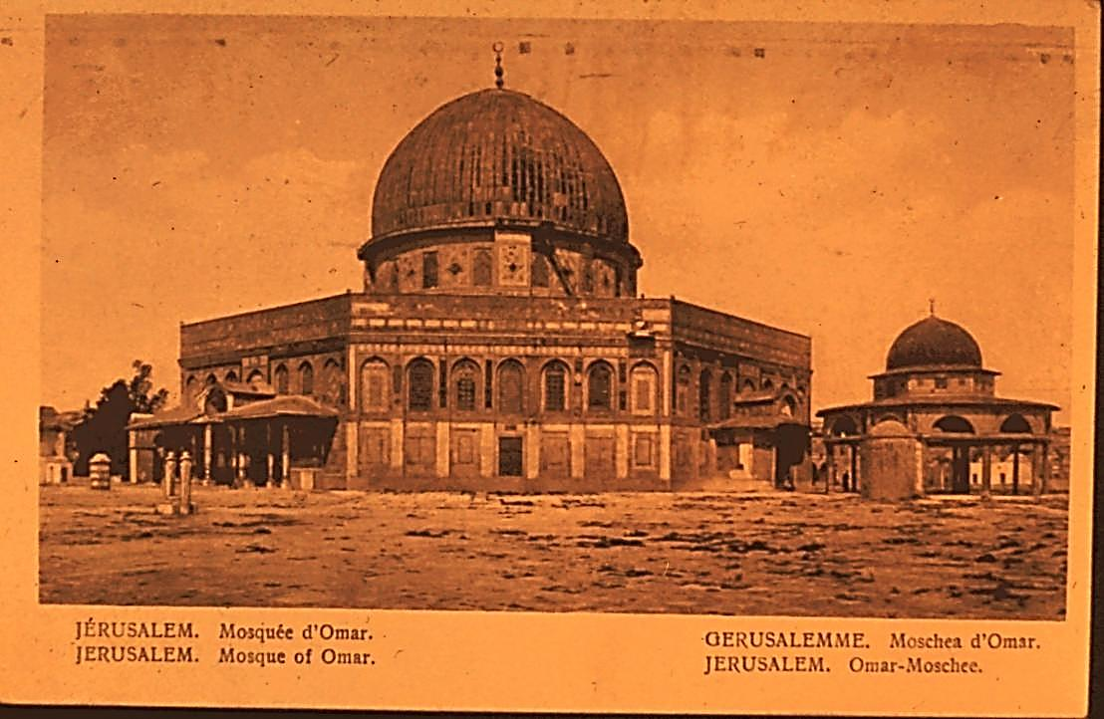
Notes:
The Mosque of Omar, or the Dome of the Rock in Jerusalem is a Moslem holy place.

Slide 11
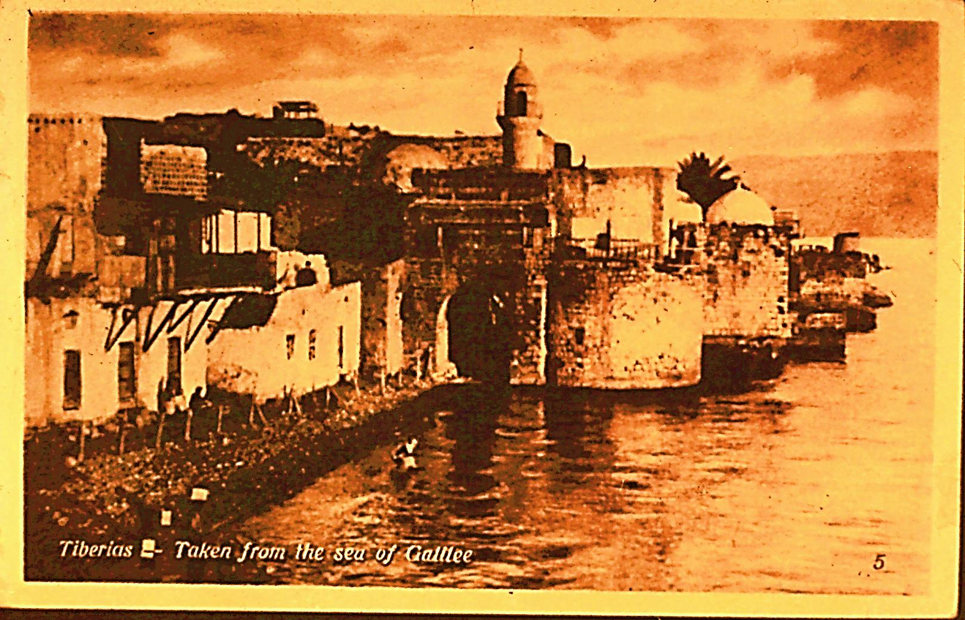
Notes:
Old Tiberias on the Lake of Galilee. The Hebrew name for the lake is Kinneret, meaning a harp, which it vaguely resembles. The old city of Tiberias was founded about 20 A.D. by Herod Antipas. Tiberias is a holy city of Judaism. Among its shrines are memorials to Maimonides, the noted philosopher of medieval times, and to Rabbi Meir, Talmudic sage of the 2nd century.

Slide 12
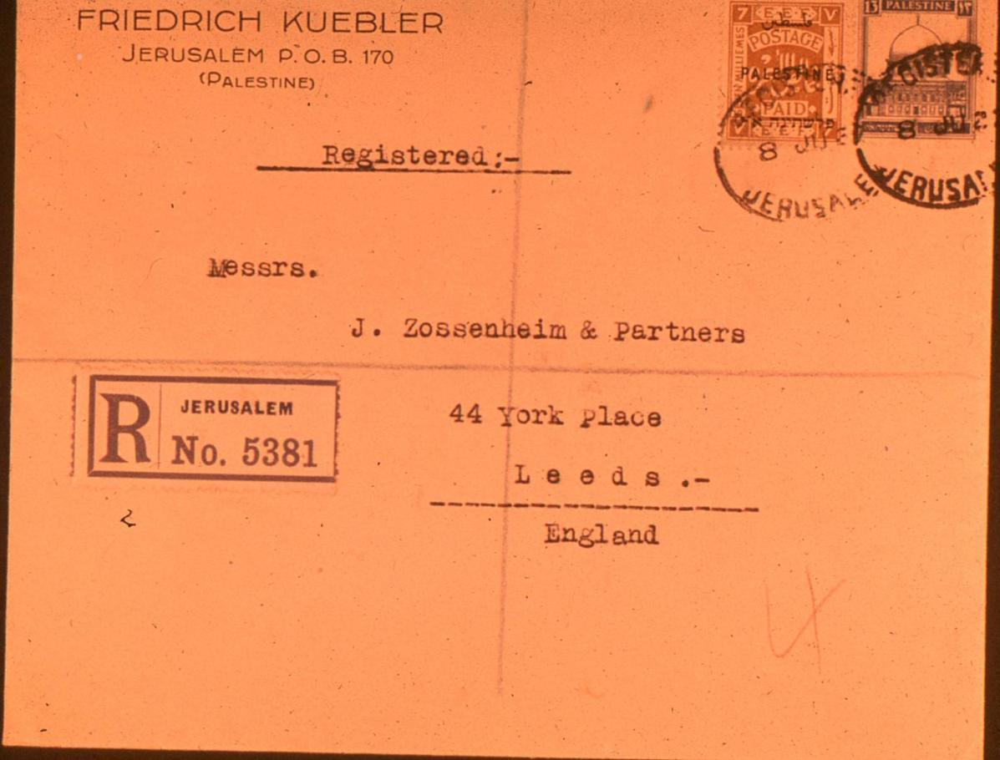
Notes:
A mixed usage registered cover, franked with the 13 m of the new pictorial set, and a 7 m of the Waterlow issue. The postmark is 8 June 27, or 1 week after date of issue.

Slide 13
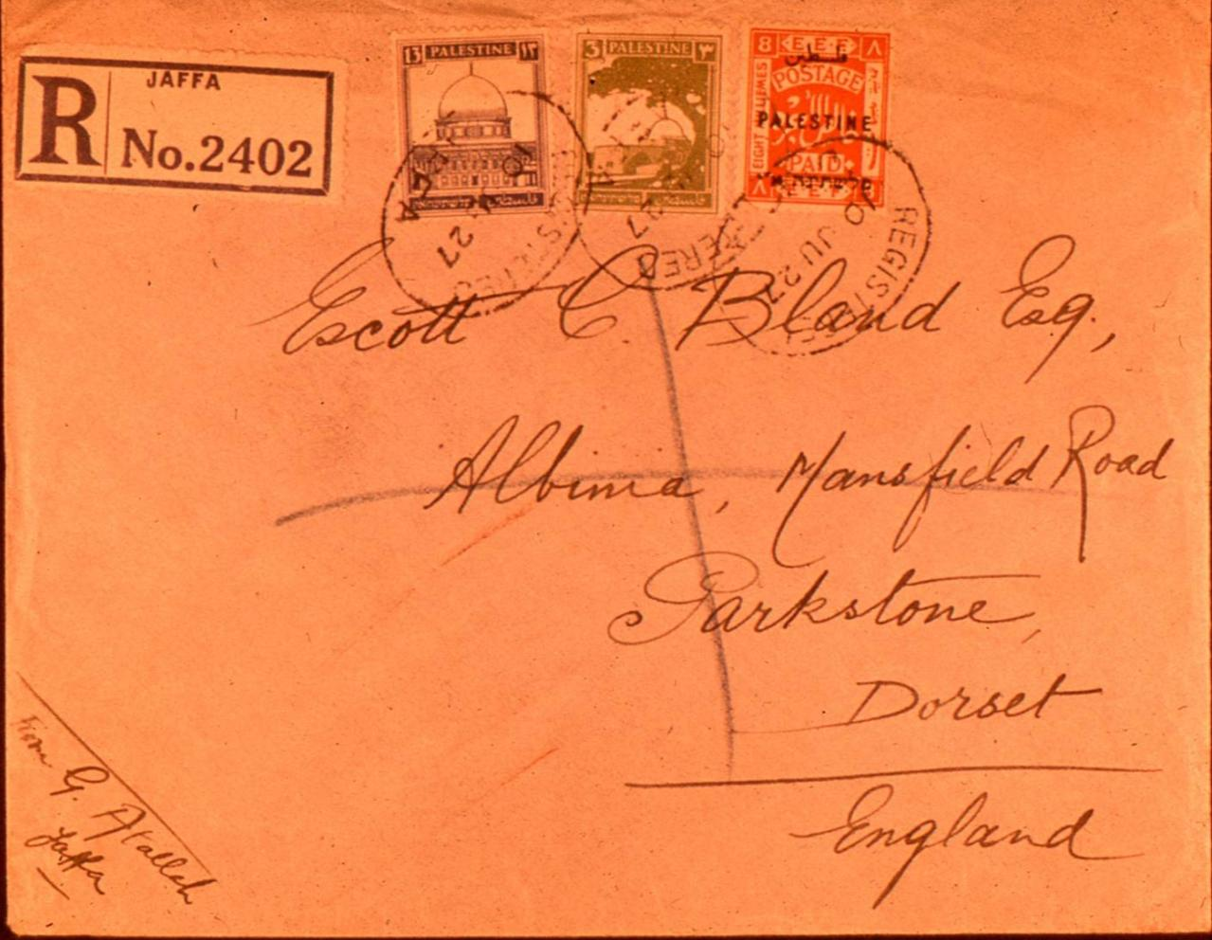
Notes:
Another registered mixed usage cover, bearing both the 3 m and 13 m of the pictorials, and an 8 m of the Waterlow issue. Posted at Jaffa on 10 June 27.

Slide 14
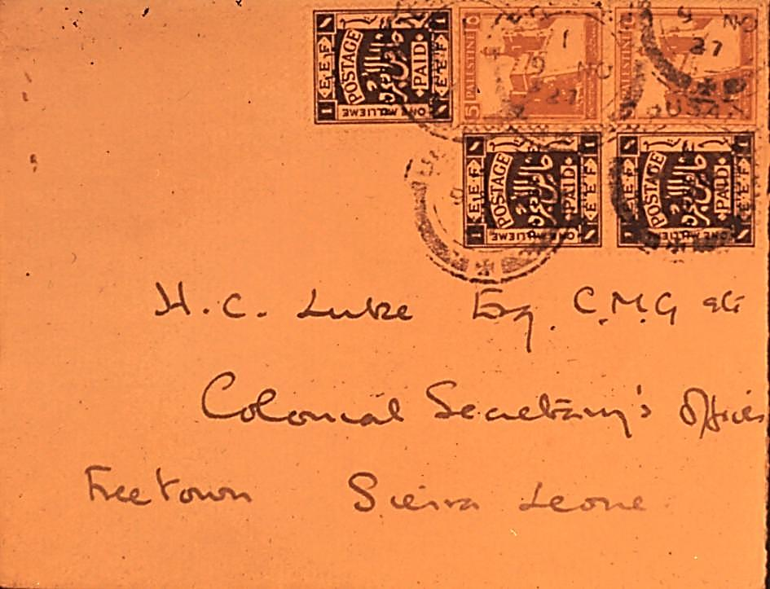
Notes:
A mixed usage cover franked with two 5 m pictorials, and three 1 m of the Waterlow issue. Posted at Jerusalem 9 November 27.
A mixed usage cover franked with two 5 m pictorials, and three 1 m of the Waterlow issue. Posted at Jerusalem 9 November 27.
A mixed usage cover franked with two 5 m pictorials, and three 1 m of the Waterlow issue. Posted at Jerusalem 9 November 27.
A mixed usage cover franked with two 5 m pictorials, and three 1 m of the Waterlow issue. Posted at Jerusalem 9 November 27.
A mixed usage cover franked with two 5 m pictorials, and three 1 m of the Waterlow issue. Posted at Jerusalem 9 November 27.
A mixed usage cover franked with two 5 m pictorials, and three 1 m of the Waterlow issue. Posted at Jerusalem 9 November 27.
A mixed usage cover franked with two 5 m pictorials, and three 1 m of the Waterlow issue. Posted at Jerusalem 9 November 27.
A mixed usage cover franked with two 5 m pictorials, and three 1 m of the Waterlow issue. Posted at Jerusalem 9 November 27.
A mixed usage cover franked with two 5 m pictorials, and three 1 m of the Waterlow issue. Posted at Jerusalem 9 November 27.
A mixed usage cover franked with two 5 m pictorials, and three 1 m of the Waterlow issue. Posted at Jerusalem 9 November 27.
A mixed usage cover franked with two 5 m pictorials, and three 1 m of the Waterlow issue. Posted at Jerusalem 9 November 27.
A mixed usage cover franked with two 5 m pictorials, and three 1 m of the Waterlow issue. Posted at Jerusalem 9 November 27.
A mixed usage cover franked with two 5 m pictorials, and three 1 m of the Waterlow issue. Posted at Jerusalem 9 November 27.

Slide 15
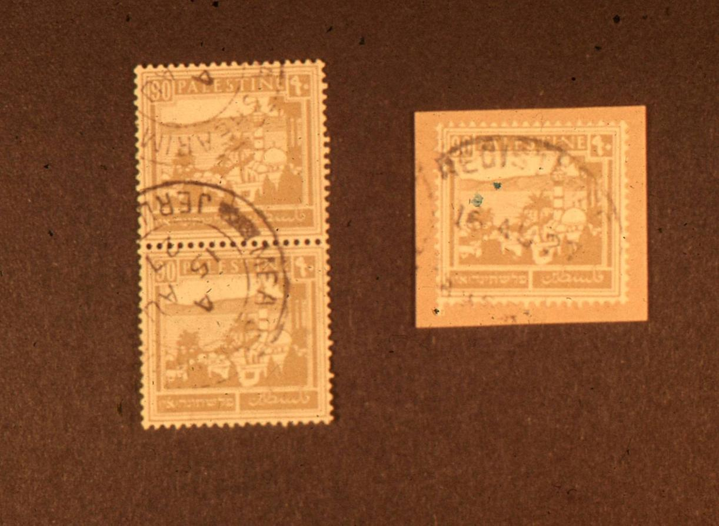
Notes:
A vertical pair of the 90 m bearing a postmark of 15 Aug 27, and a single on piece of the same stamp postmarked 16 August 27. These are 2nd and 3rd day of issue.

Slide 16
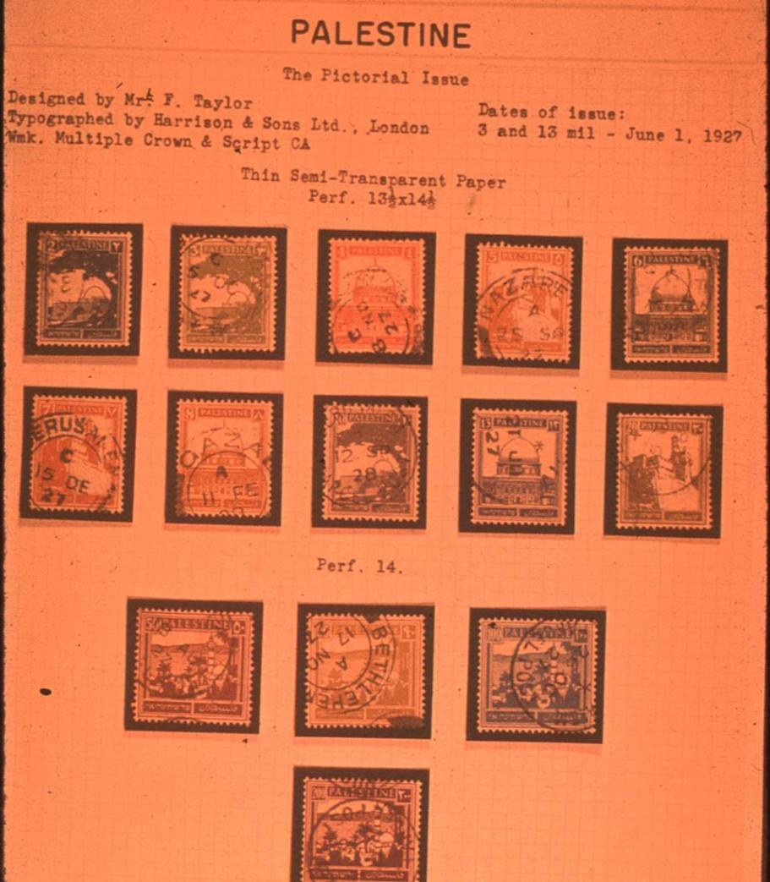
Notes:
An album page showing all used values of the 1st issued pictorial set, with carefully selected postmarks, all showing dates of 1927 or early 1928.

Slide 17
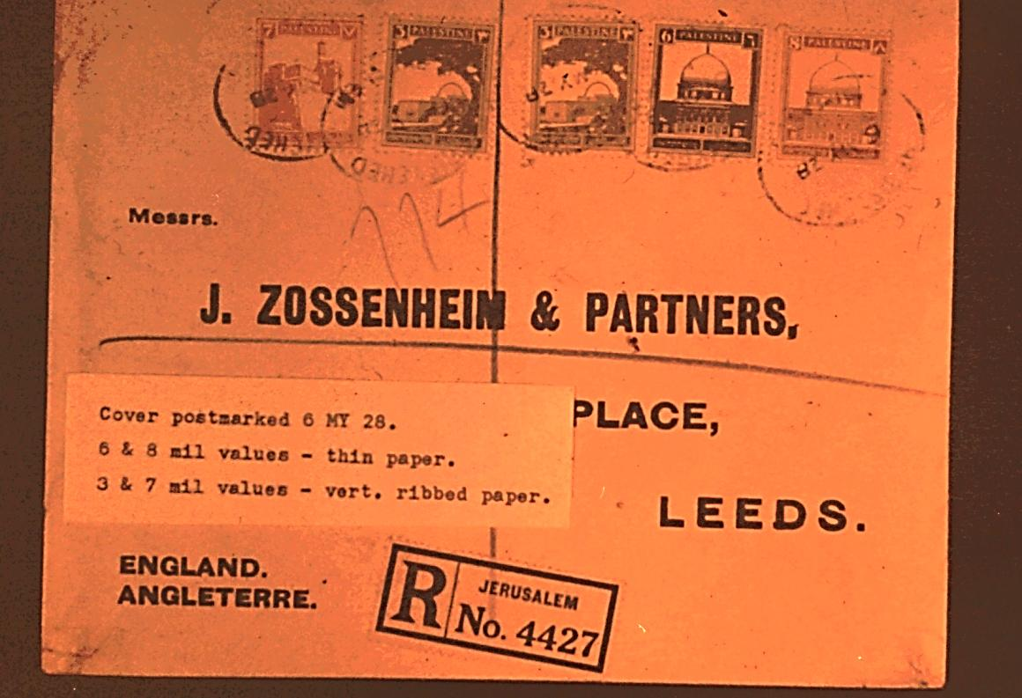
Notes:
A registered cover bearing mixed paper types, during the transition period in 1928.

Slide 18
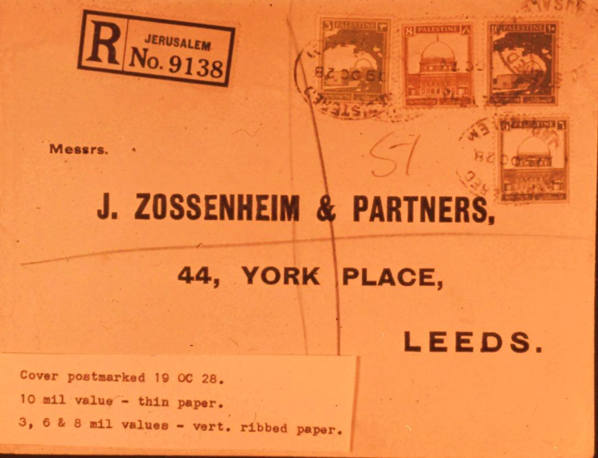
Notes:
Another registered cover postmarked 19 Oct 28, during the later transition period.

Slide 19
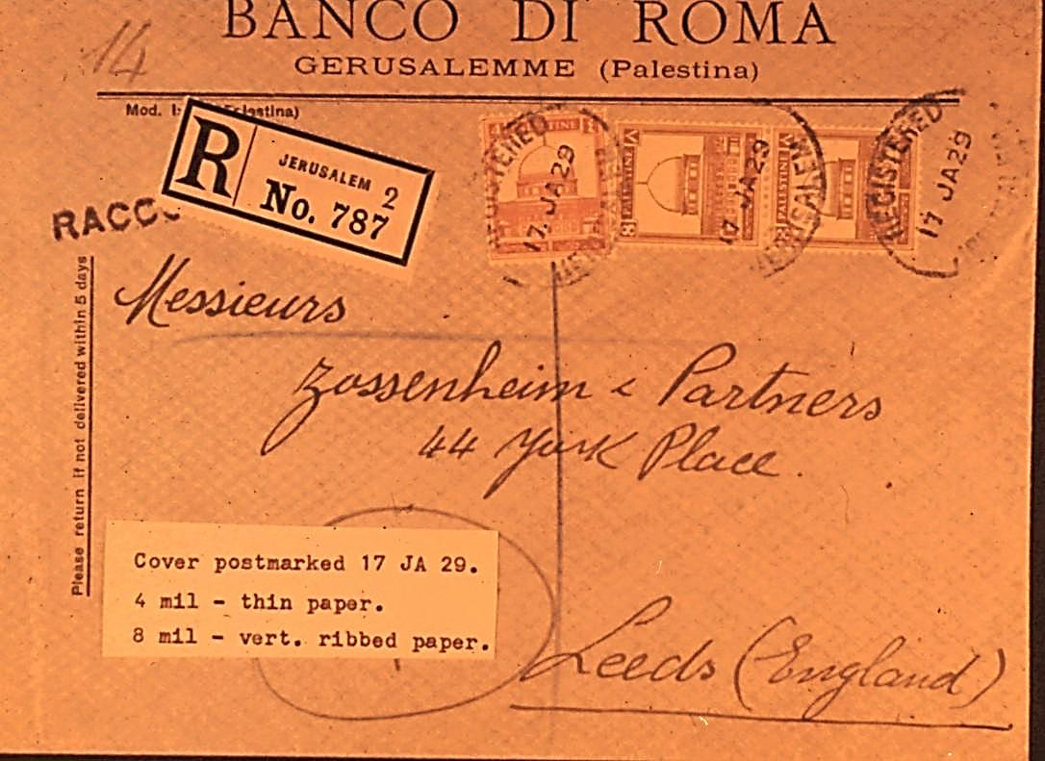
11
Notes:
Some values on thin paper lasted much longer than others. Here is a registered cover dated 17 Jan 29. The 4m is still the thin paper variety.

Slide 20
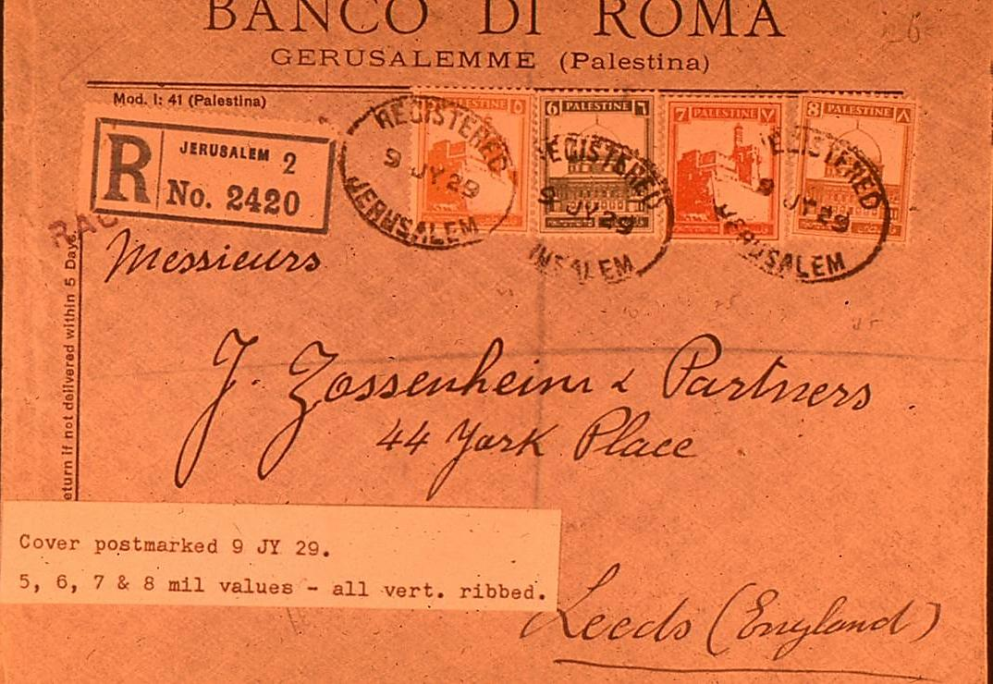
Notes:
A registered cover postmarked 9 July 29, bearing four different values all on vertically ribbed paper.

Slide 21
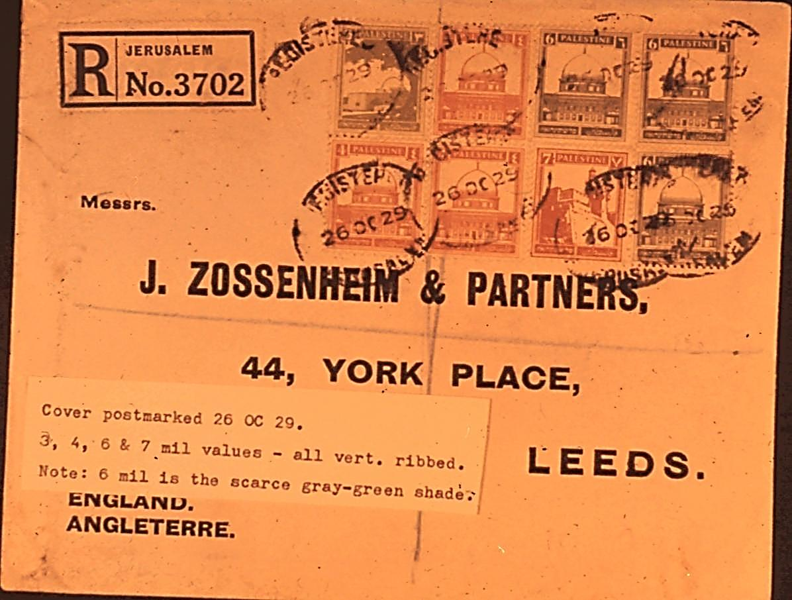
Notes:
A registered cover postmarked 26 Oct 29. The 6 m values are the scarcer grey-green shade.

Slide 22
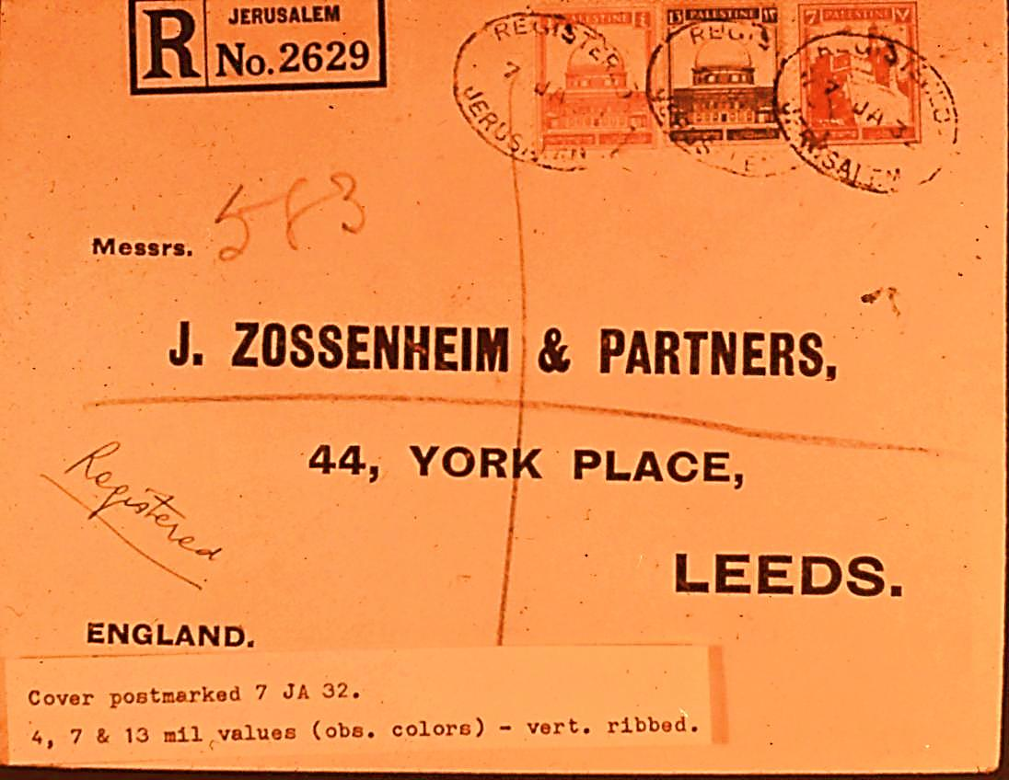
Notes:
A registered cover postmarked 7 Jan 32, bearing 3 of the 4 values replaced later the same year.

Slide 23
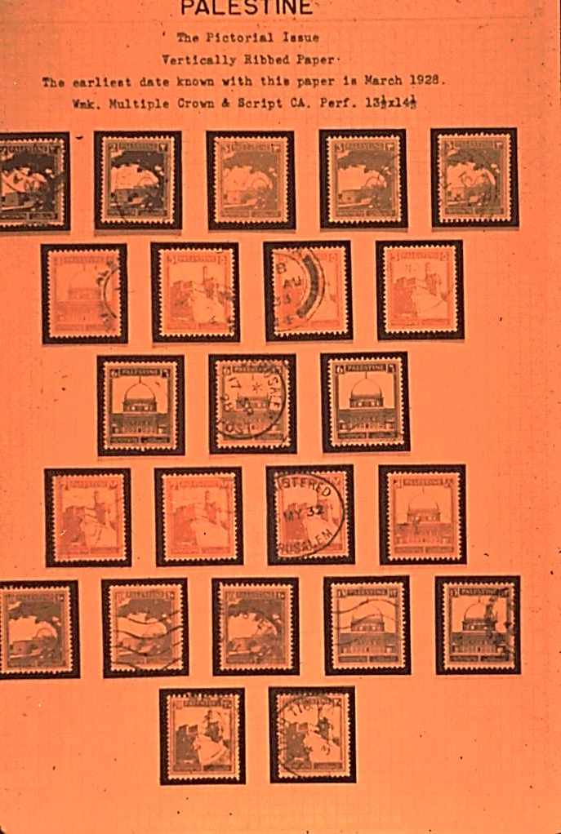
Notes:
An album page showing the low values and various shades of the vertically ribbed paper variety.

Slide 24
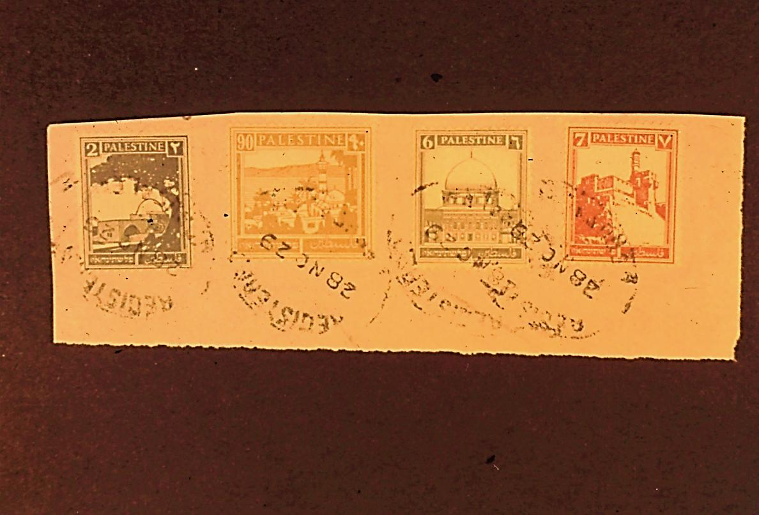
Notes:
A piece postmarked 28 Nov 29, showing the 90 mil vertically ribbed paper variety.

Slide 25
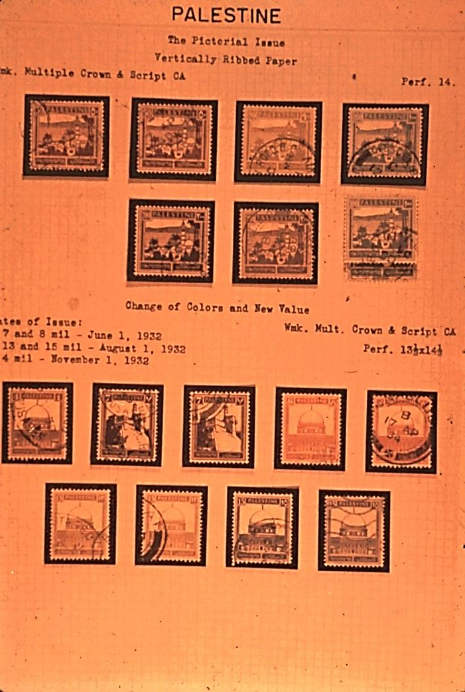
Notes:
An album page showing the high values on vertically ribbed paper, and various shades, as well as the change of color issues and new value of 1932.

Slide 26
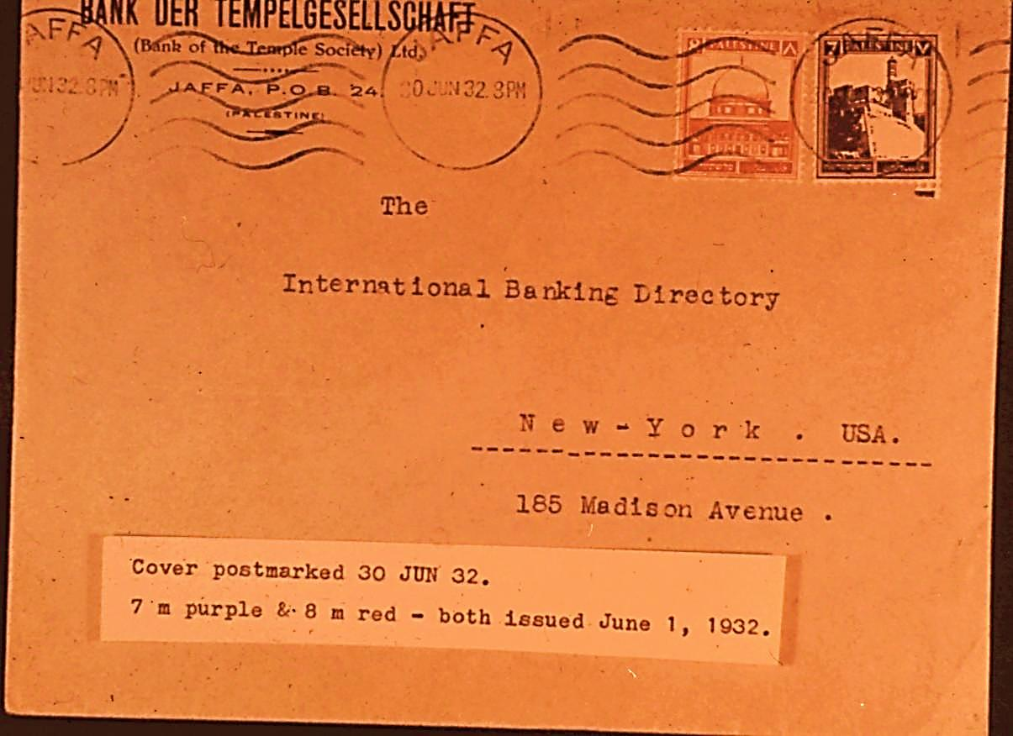
Notes:
A cover bearing the 7 and 8 m of the new colors, postmarked within the month of the date of issue.

Slide 27
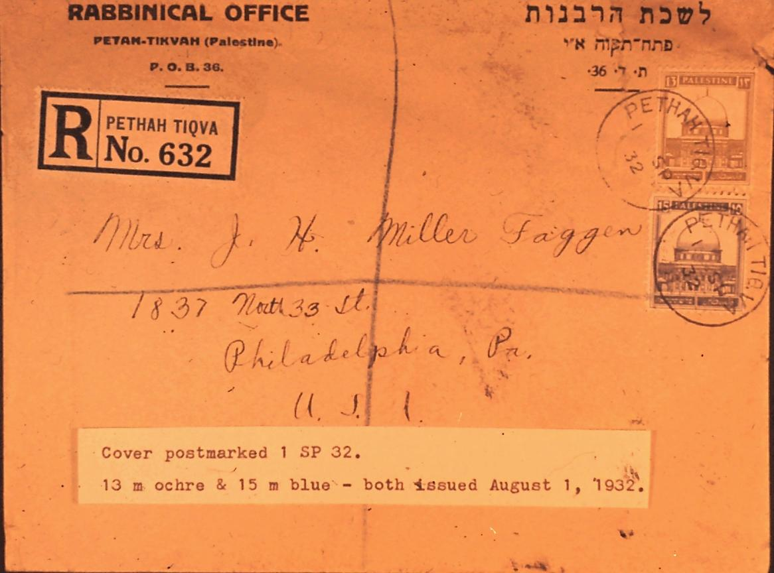
Notes:
A registered cover franked with the 13 & 15 m of the new color and value, postmarked exactly one month from the day of issue.

Slide 28
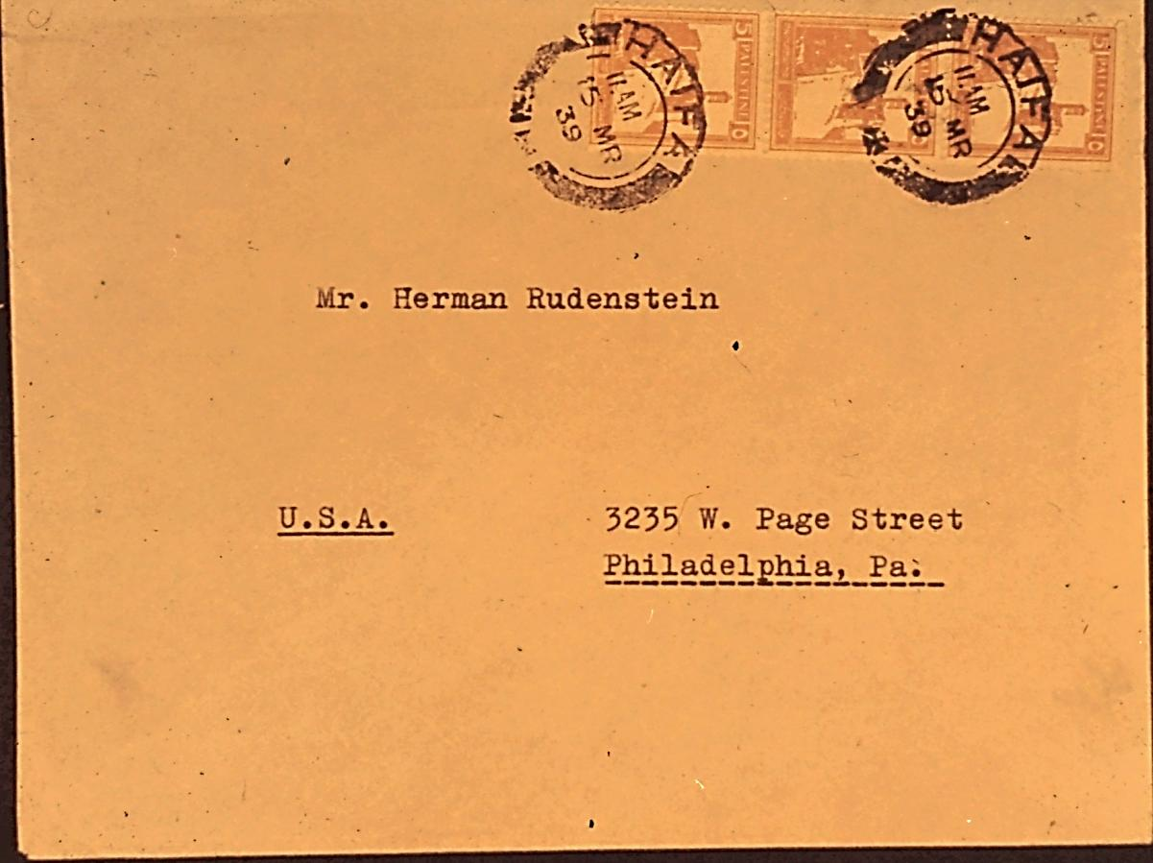
Notes:
Cover with a strip of three of the 5 m coil – red orange shade.

Slide 29
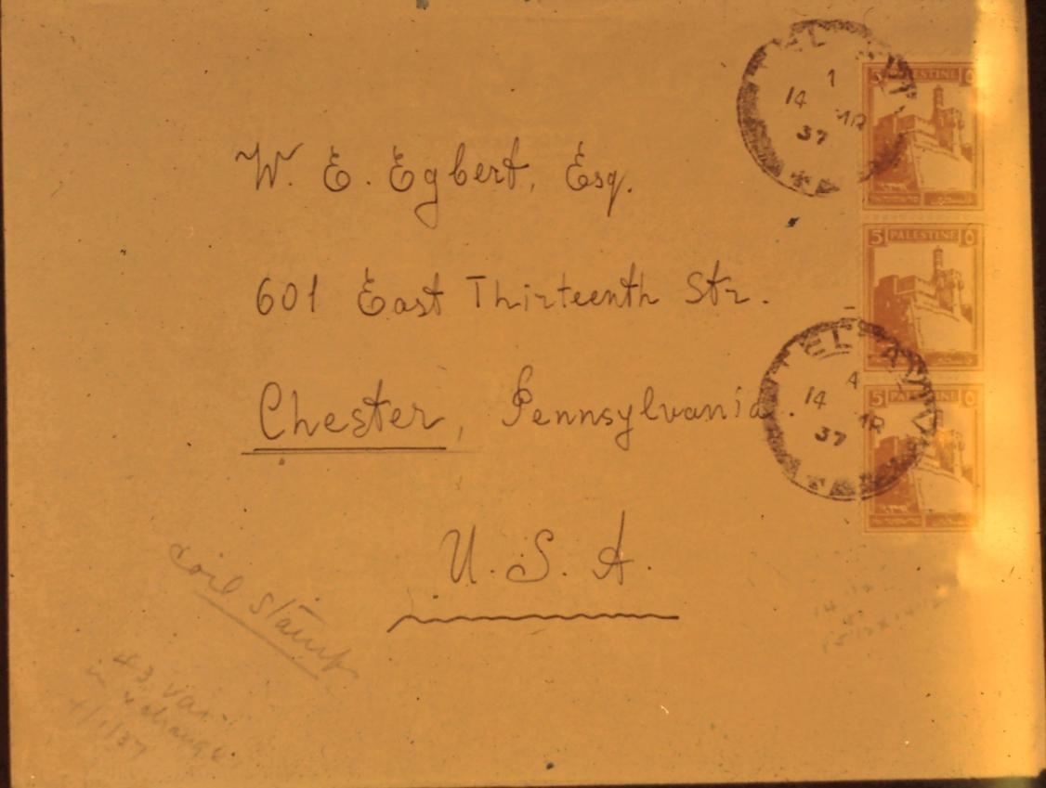
Notes:
Cover with a strip of three of the 5 mil coil – orange shade

Slide 30
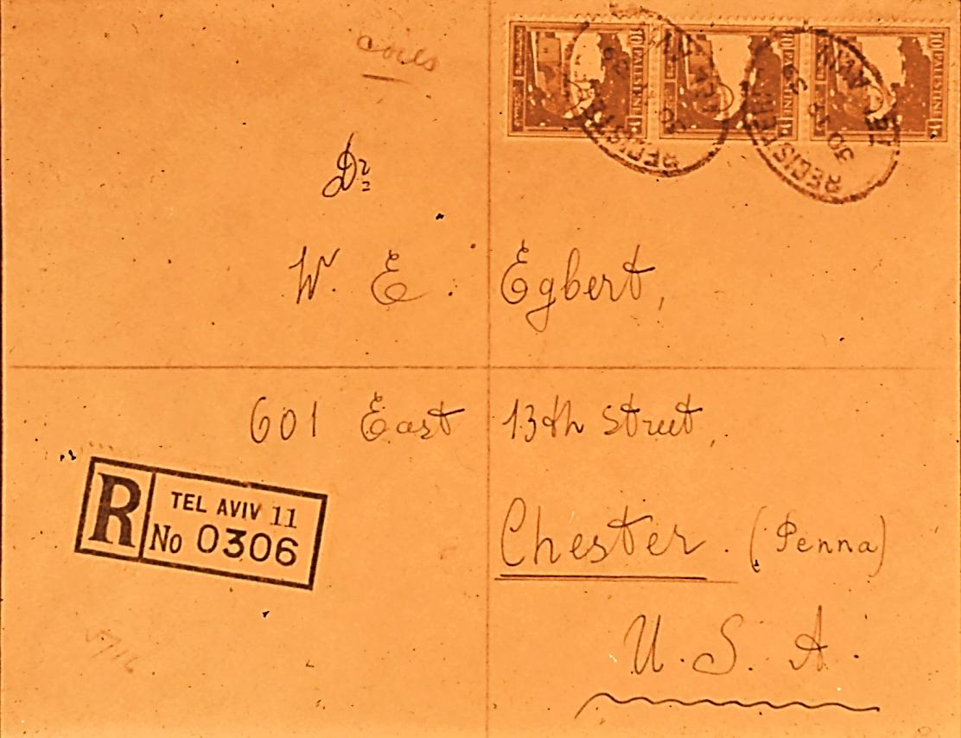
Notes:
Registered cover with a strip of three of the 10 mil coil.

Slide 31
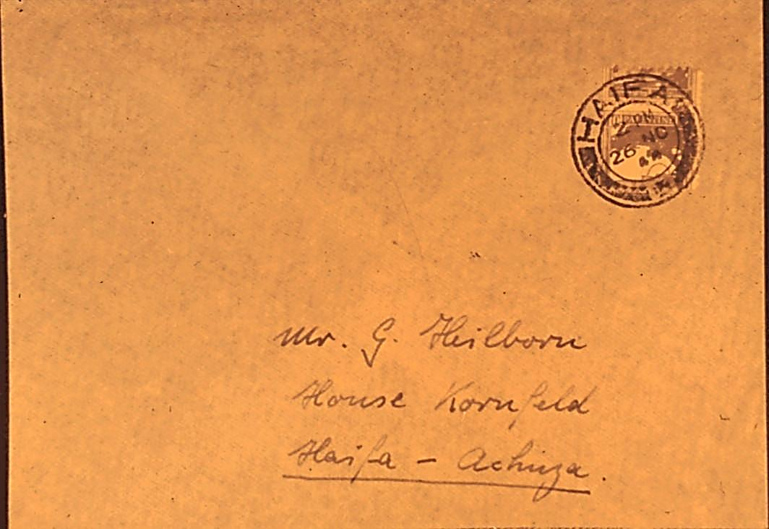
Notes:
Split 10 m coil on cover – Haifa. This was due to malfunction of the vending machine at Haifa. Have seen similar covers where the user carefully severed the item at the perforations, and put them together on the cover to give the appearance of a whole stamp.

Slide 32
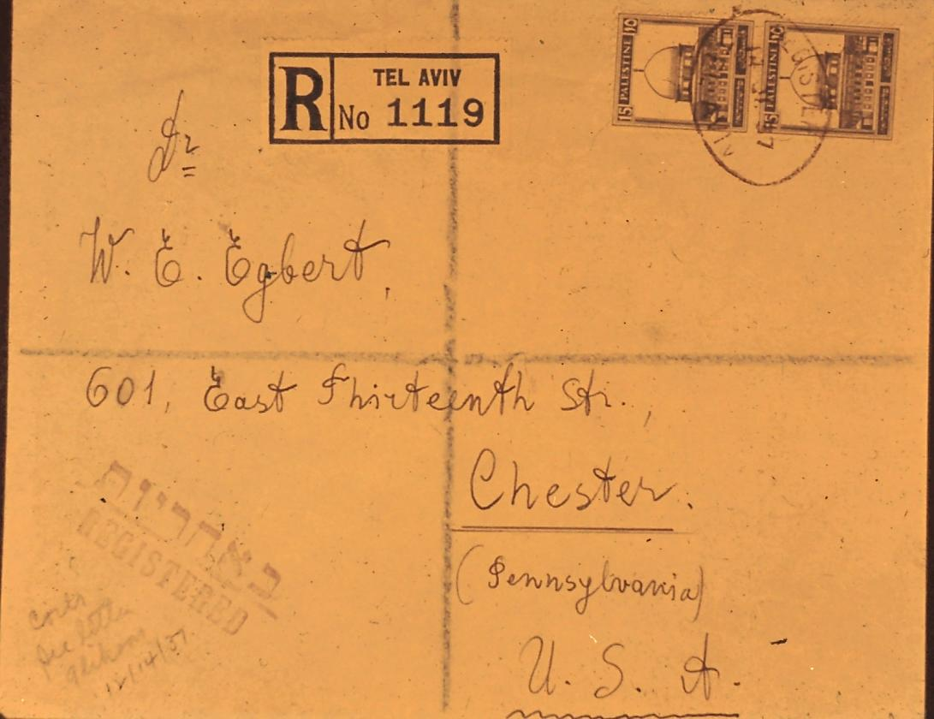
Notes:
Registered cover with a pair of the 15 m experimental coil. Notice the very deep blue color of these coils.

Slide 33
Notes:
A close-up showing a mint pair of the 15 m experimental coil; the reverse of a normal used pair of the 15 m in center, and the reverse of a used pair of the 15 m coil on the right. Please note the semi-transparent paper of the used pair, and the paste-up at the top.

Slide 34
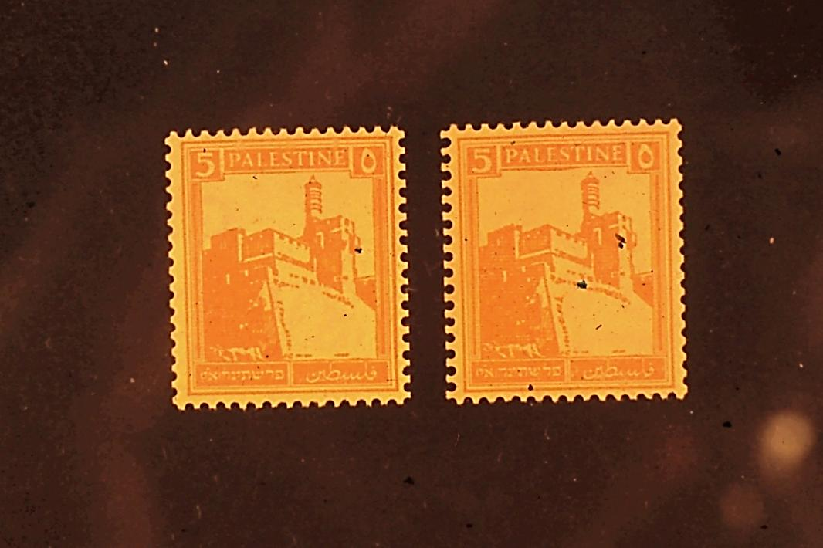
Notes:
Two unused 5 m coils. The one at the left was dispensed form a vending machine. Note the pinholes near the top of the left hand stamp over the PA and over the E in Palestine. Quite frequently these pins would cause severe damage to the stamps. The coil on the right was taken from a roll.

Slide 35
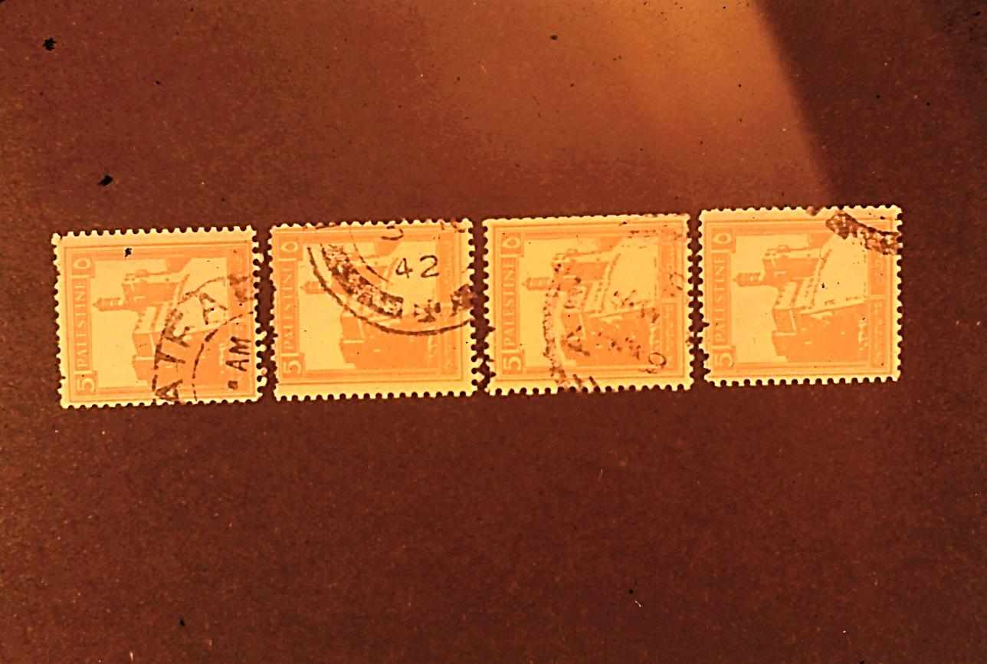
Notes:
Four used coils showing the damage caused by the pins the vending machine, and the pulling and tearing made by customers who used these machines.

Slide 36
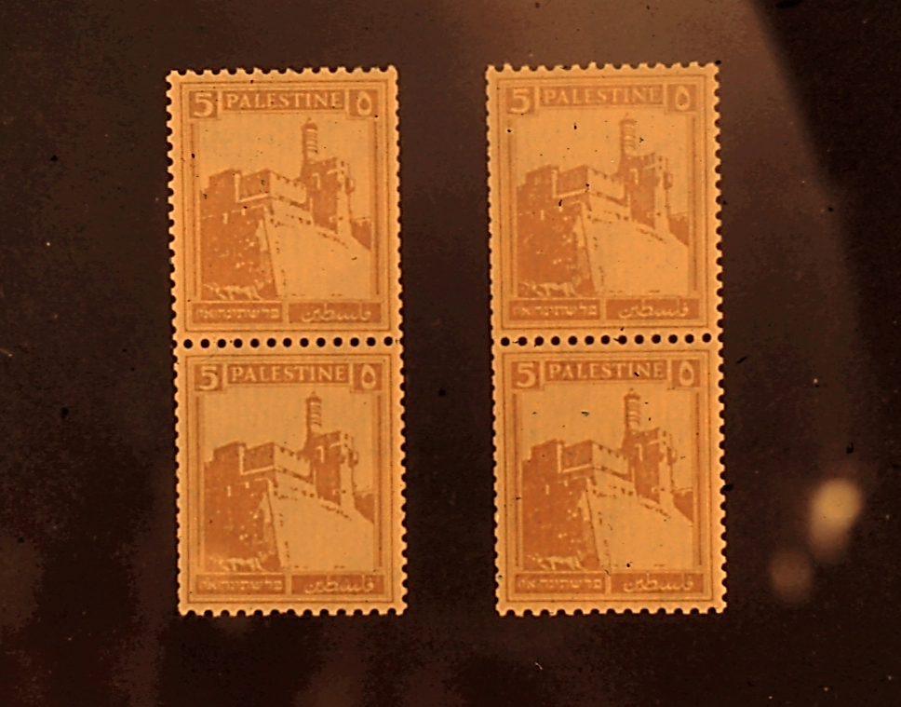
Notes:
A close-up of two mint pairs of the 5 mil experimental coil.

Slide 37
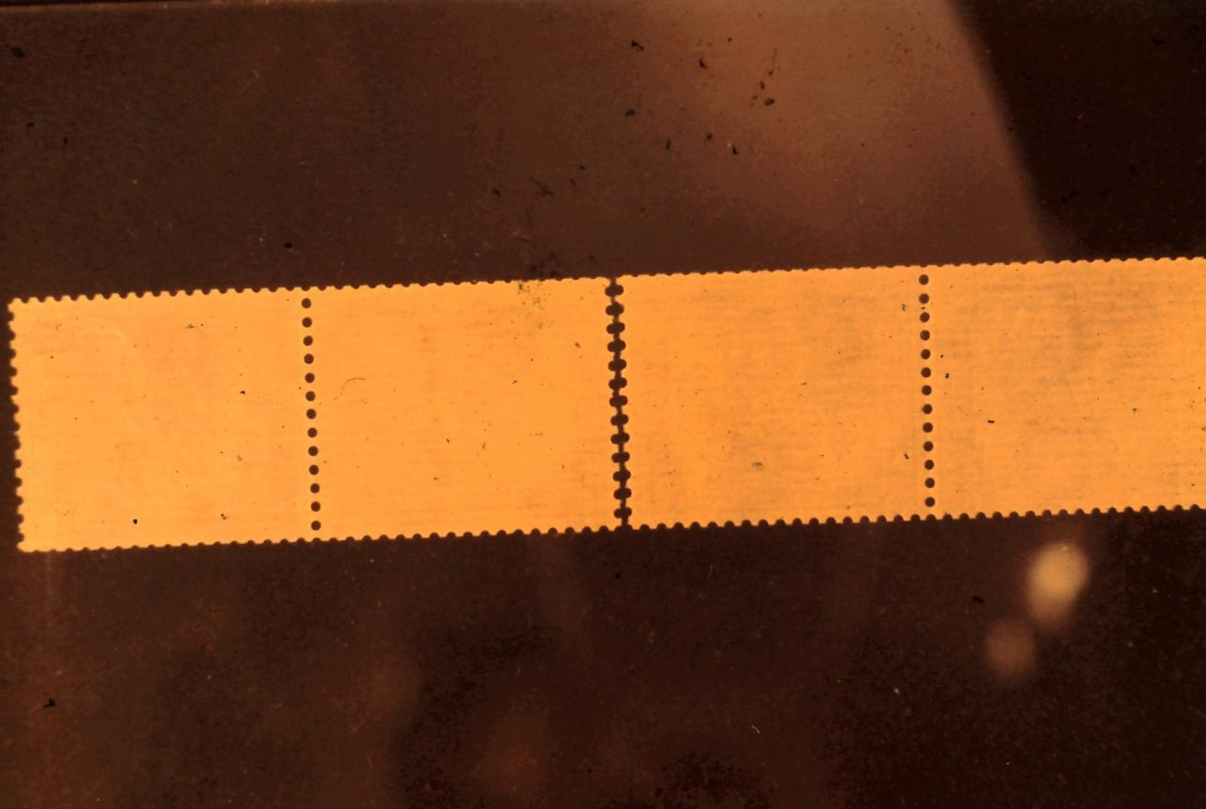
Notes:
The reverse of the same pairs showing how at one time they formed a strip of 4. Notice the cuts along both vertical edges, and the somewhat transparency of the paper.

Slide 38
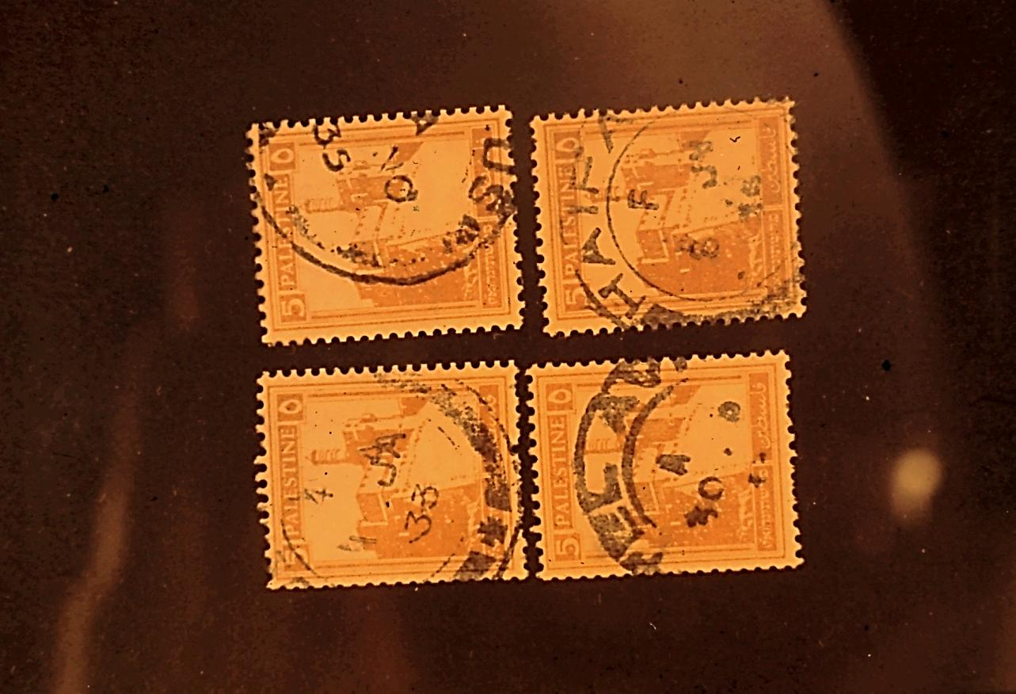
Notes:
The four used copies of the 5 m experimental coil discovered. Notice the pulled perforations on the two at the left. Also, the clear date of 1 JAN 33 on the one at the upper left.

Slide 39
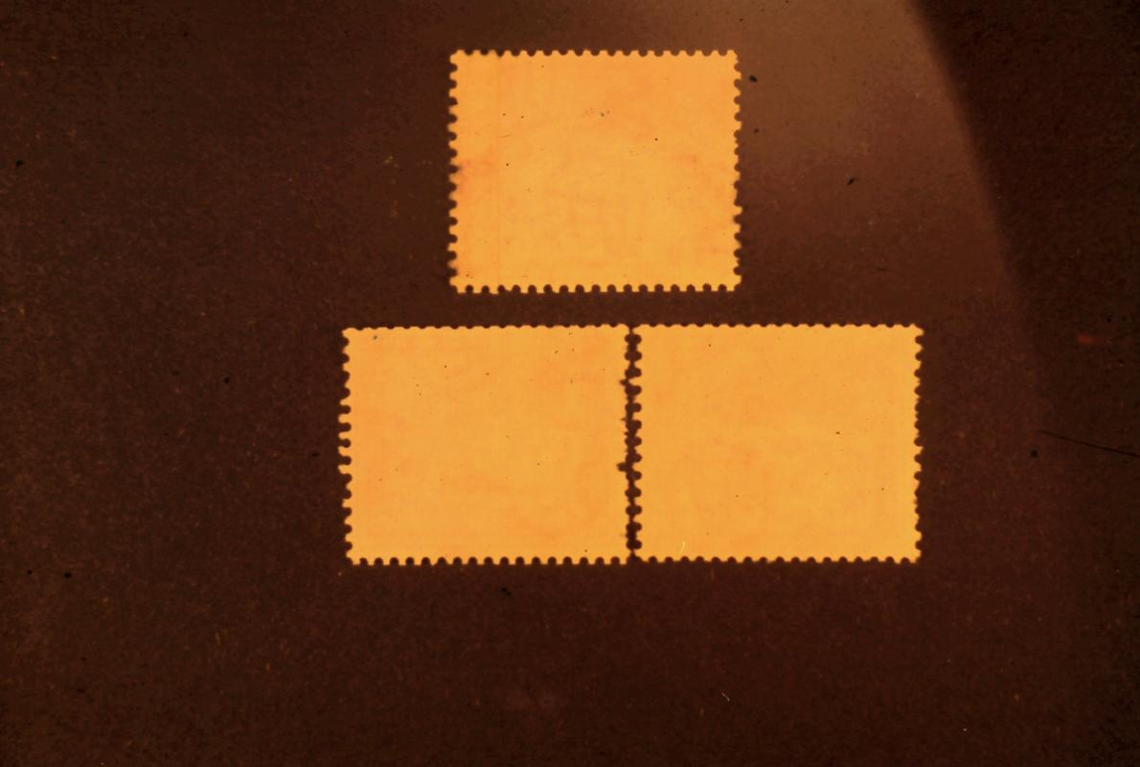
Notes:
The reverse side of three of these 5 m experimental coils. Notice how the pattern of longer perfs at the top fill the gaps at the bottom. The single at the right is a paste-up.

Slide 40
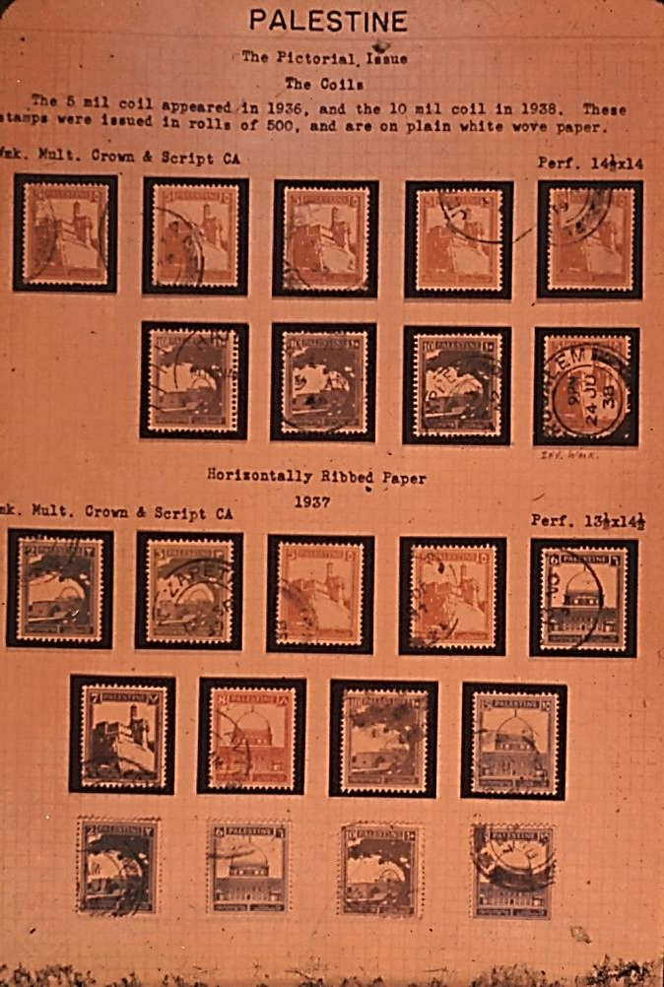
Notes:
An album page showing various shades of the 5 and 10 mil coils, and various shades of the stamps on horizontally ribbed paper.

Slide 41
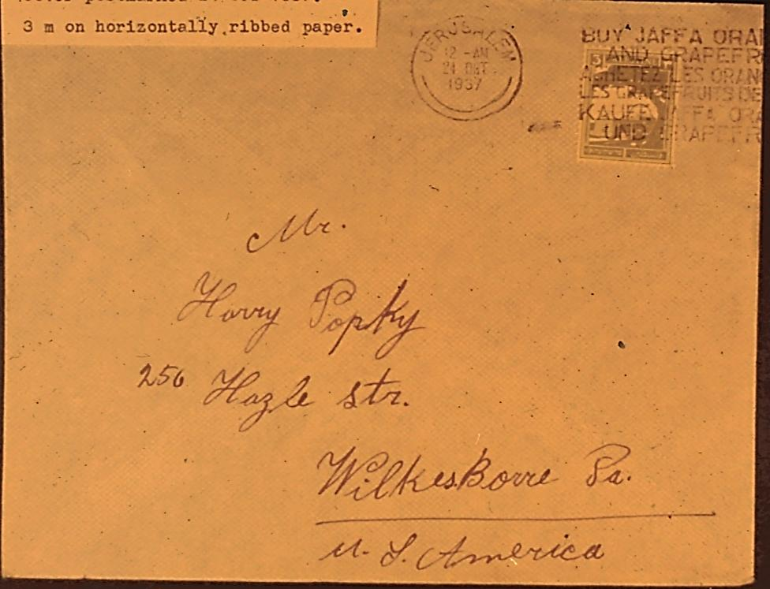
Notes:
Cover bearing a 3 m on horizontally ribbed paper. This is the scarcest of all values on horizontally ribbed paper.

Slide 42
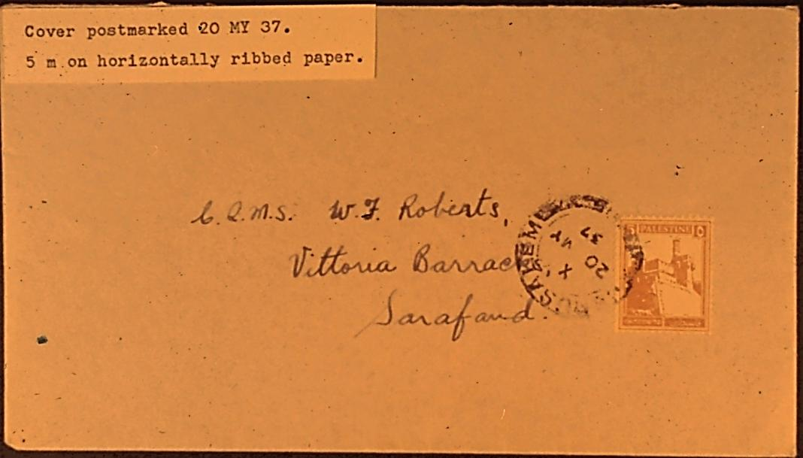
Notes:
Cover bearing a 5 m on horizontally ribbed paper.

Slide 43
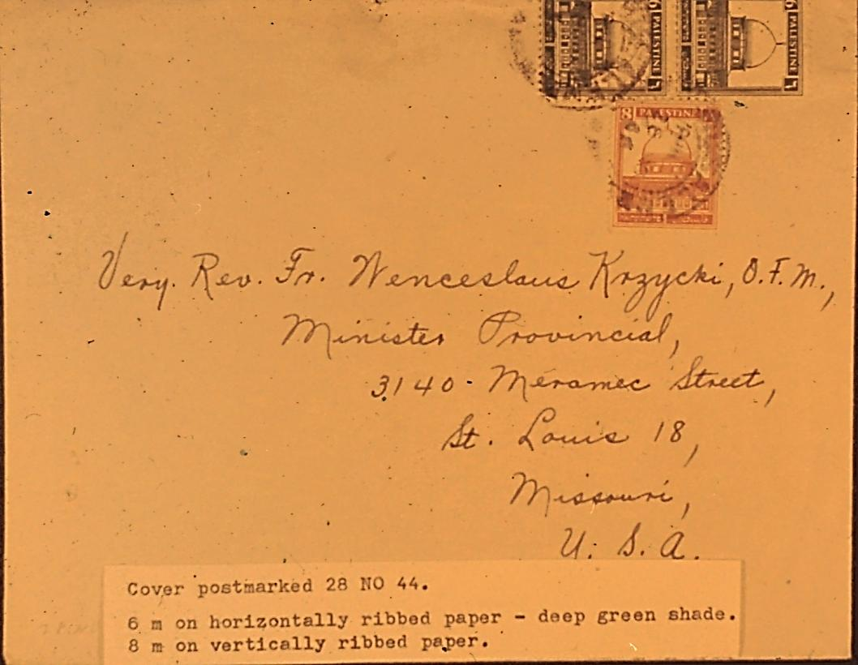
Notes:
Cover franked with a pair of the 6 m on horizontally ribbed paper, and an 8 m on vertically ribbed paper.

Slide 44
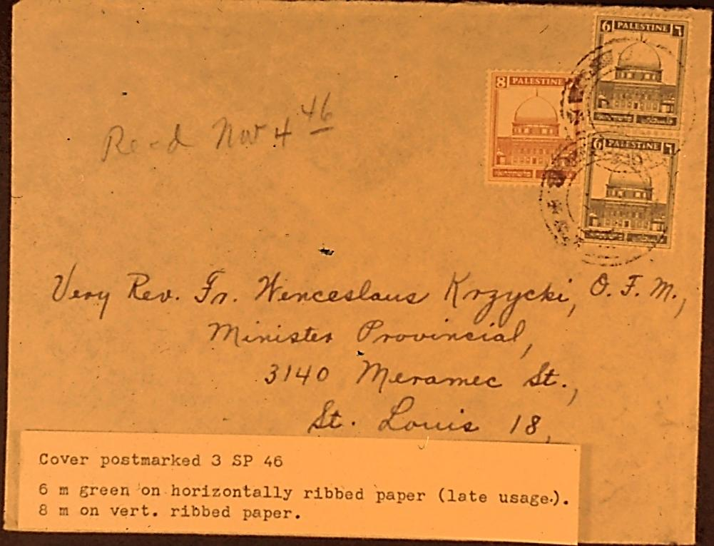
Notes:
Similar cover, late usage, but different shade of color for the 6 m stamps.

Slide 45
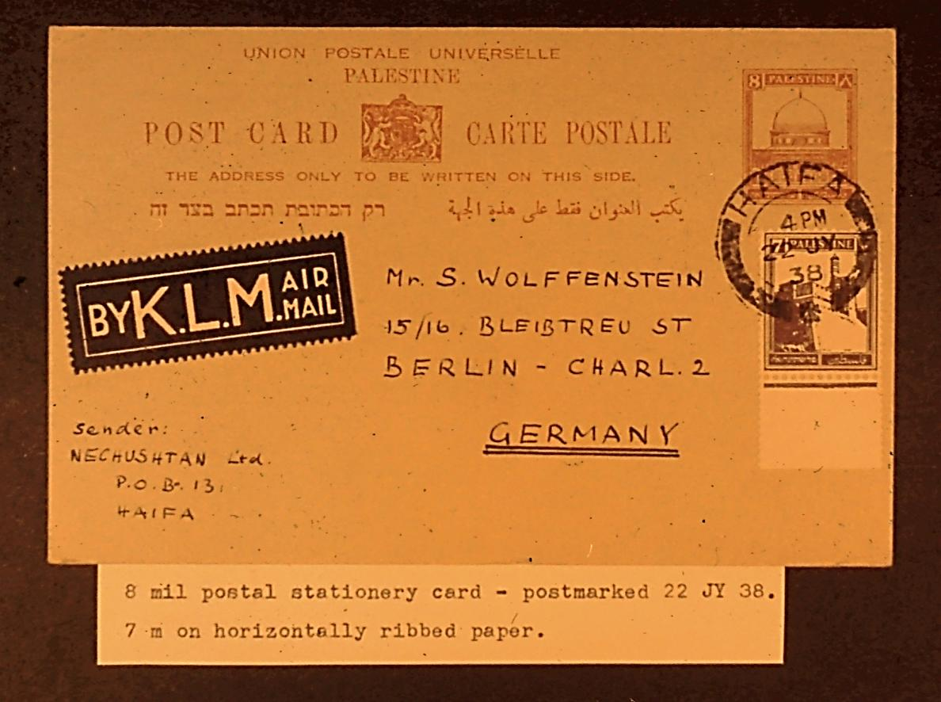
Notes:
Postal stationery card with a margin copy of the 7 m on horizontally ribbed paper.

Slide 46
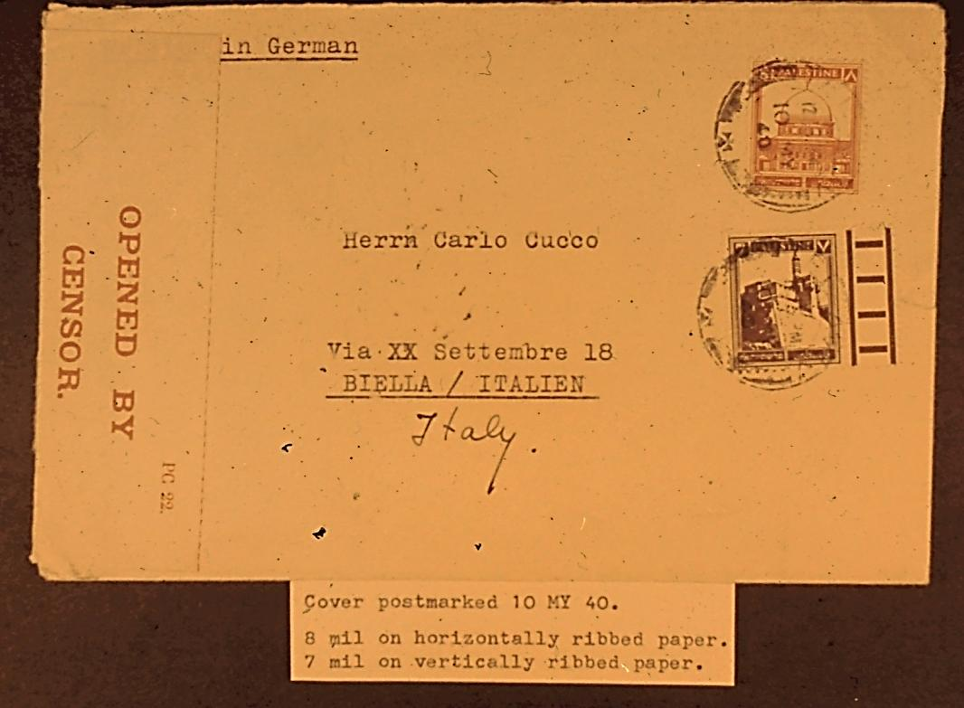
Notes:
Censored cover with an 8 m on horizontally ribbed paper, and 7 m on vertically ribbed paper.

Slide 47
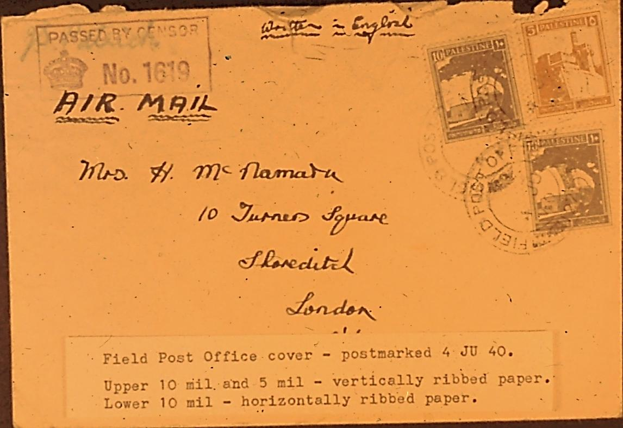
Notes:
An air mail F.P.O. cover. The lower 10 m value is on horizontally ribbed paper.

Slide 48
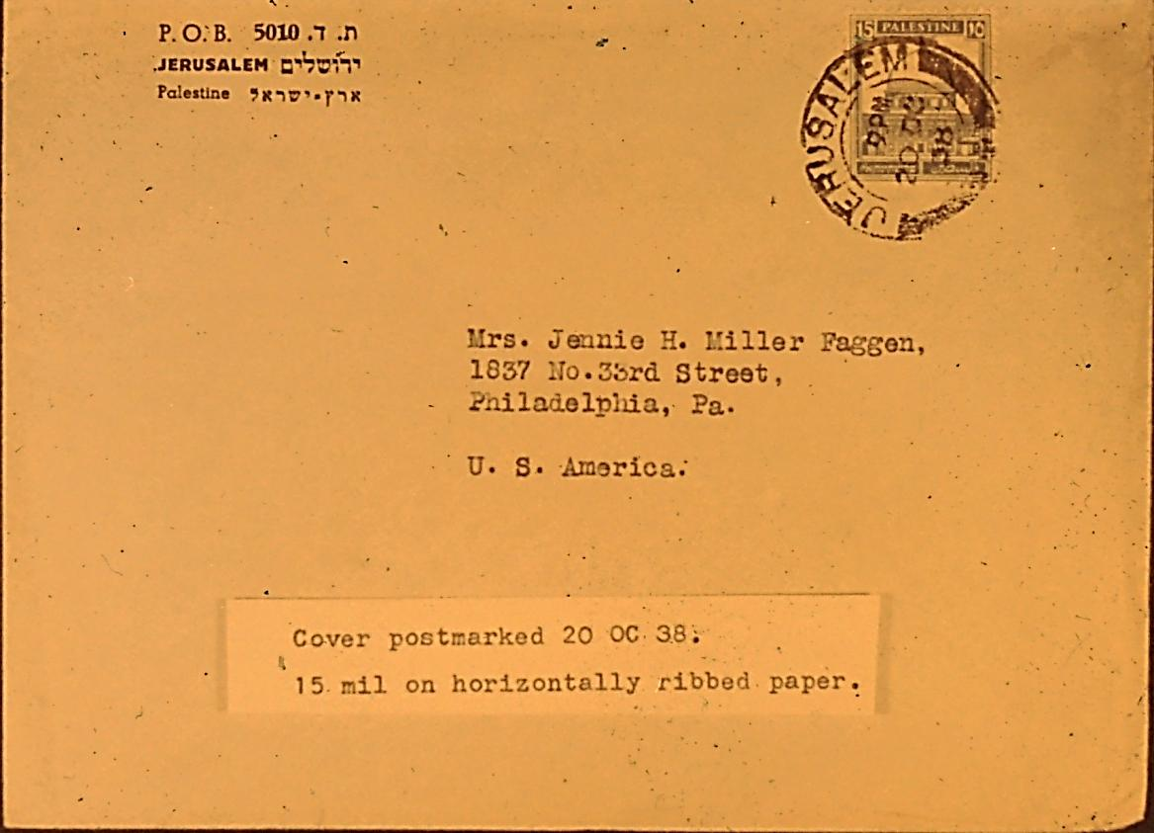
Notes:
A cover franked with a 15 m on horizontally ribbed paper.

Slide 49
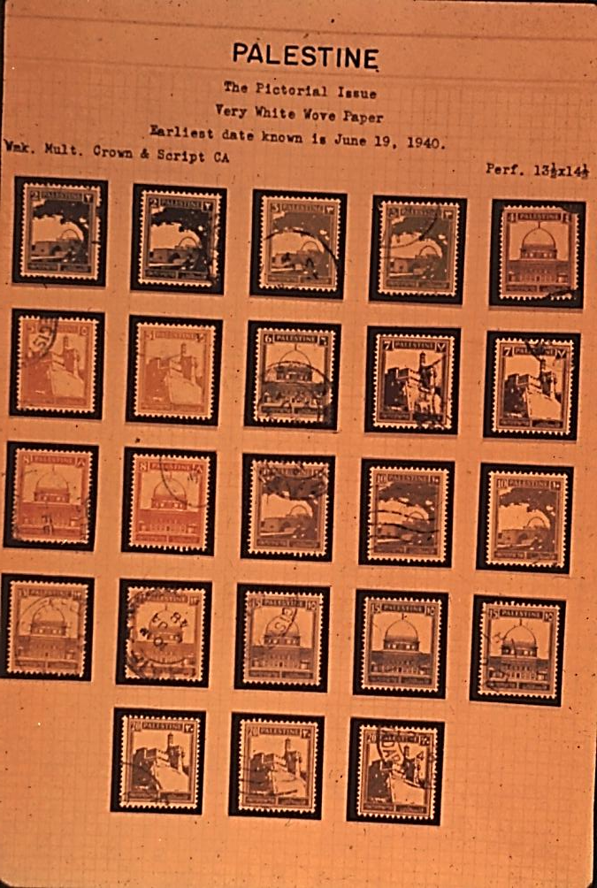
Notes:
An album page showing various shades of all low values on white wove paper.

Slide 50
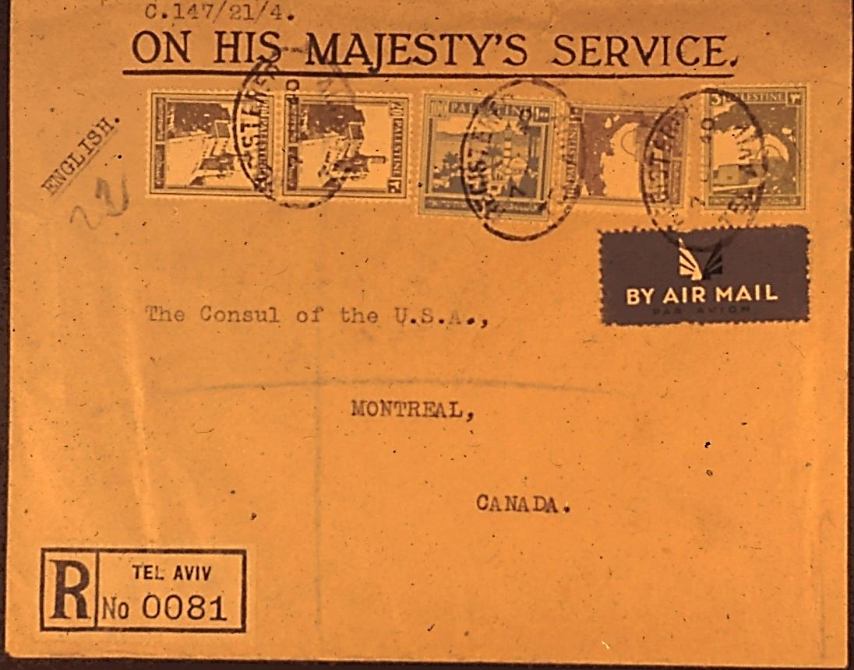
Notes:
A registered cover bearing the earliest known usage of white wove paper, postmarked 7 JUNE 40. The pair of 20 m is on white wove paper; the others vertically ribbed paper.

Slide 51
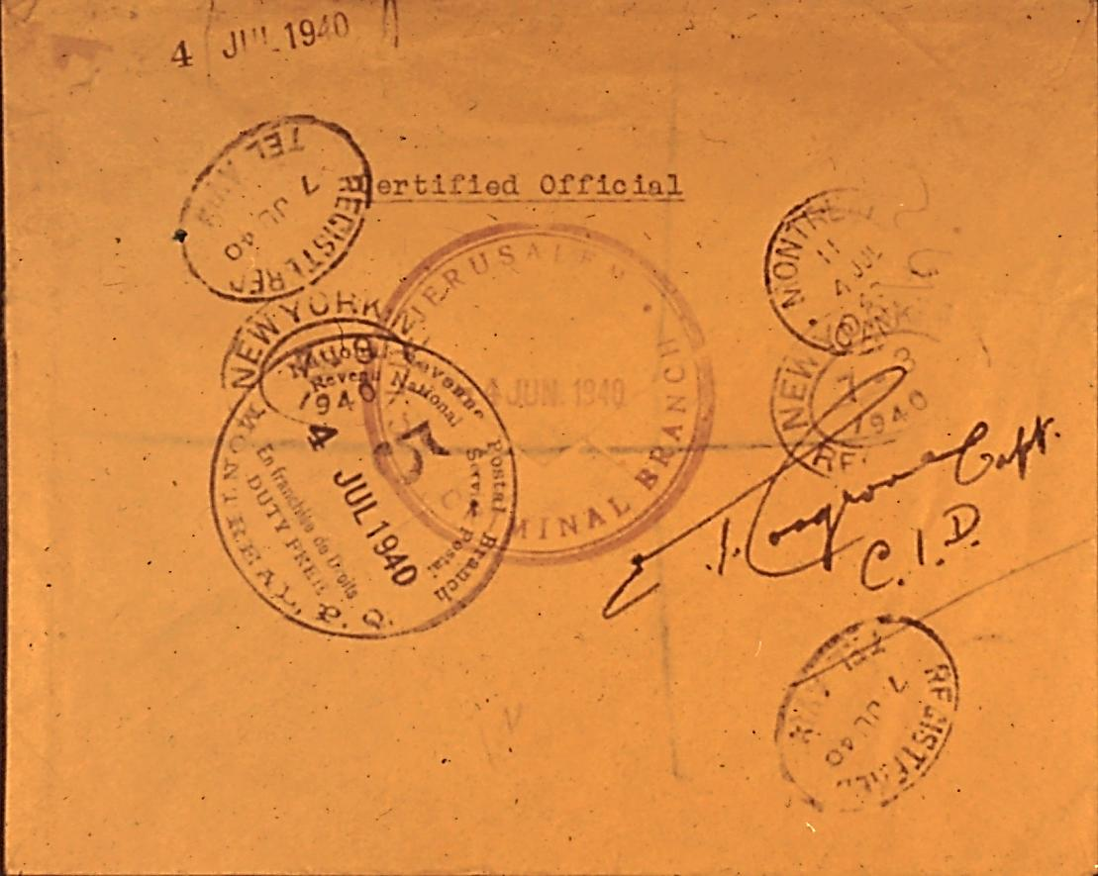
Notes:
The reverse of the same cover showing interesting marking from the Criminal Investigation Dept. at Jerusalem.

Slide 52
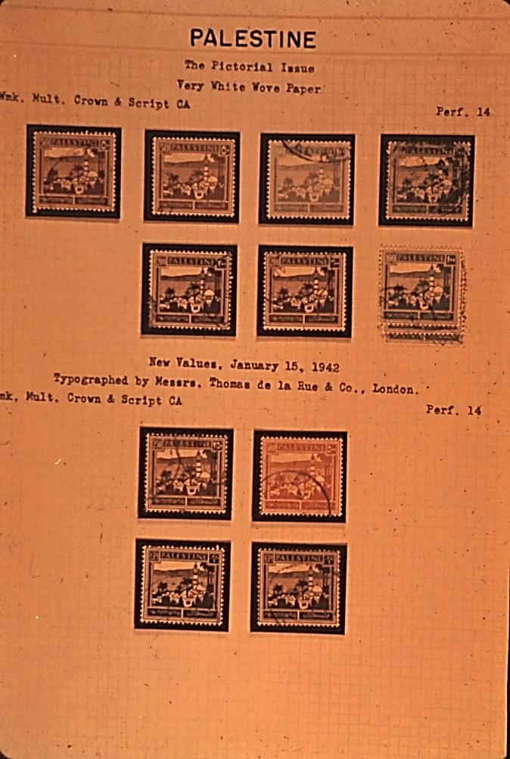
Notes:
An album page showing the high values on white wove paper. Please note the various interesting shades.

Slide 53
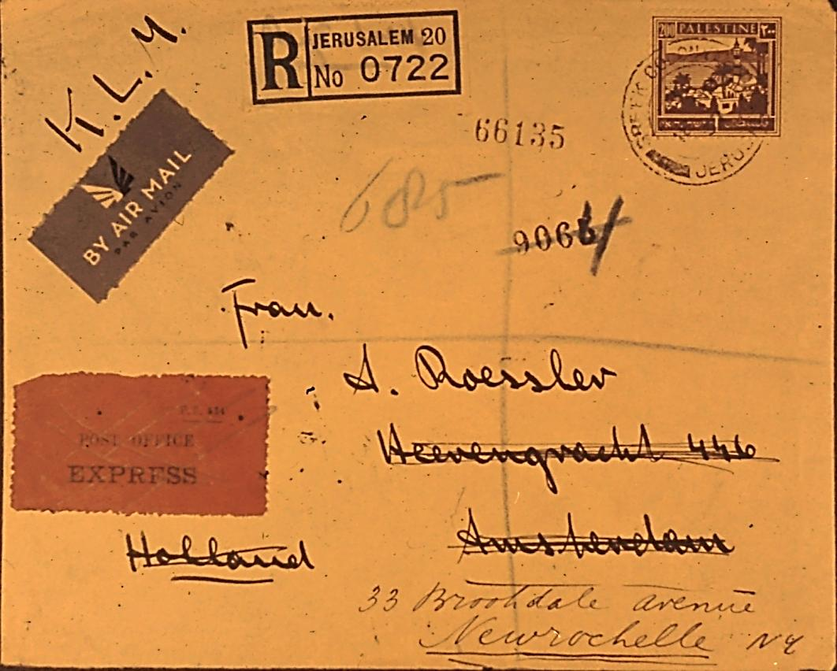
Notes:
A registered air mail cover franked with the 200 m value, with the unusual and scarce GREEK COLONY JERUSALEM cancellation.

Slide 54
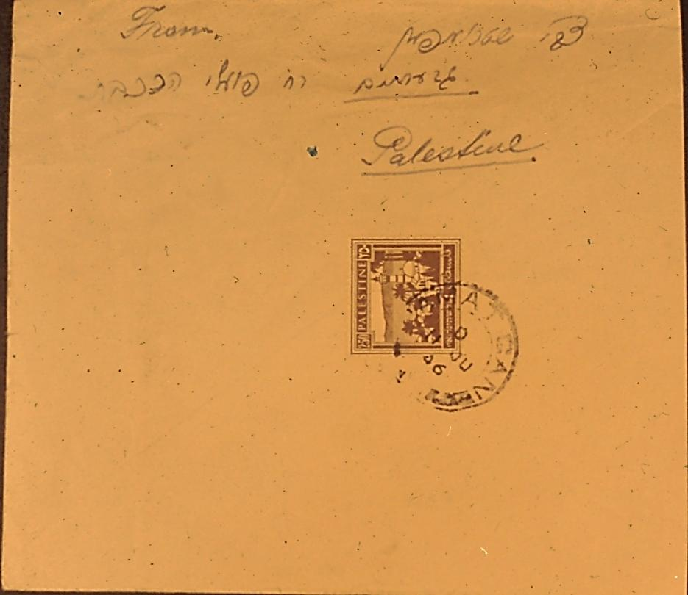
Notes:
A cover bearing a copy of the 250 m value cancelled at RAMAT GAN.

Slide 55
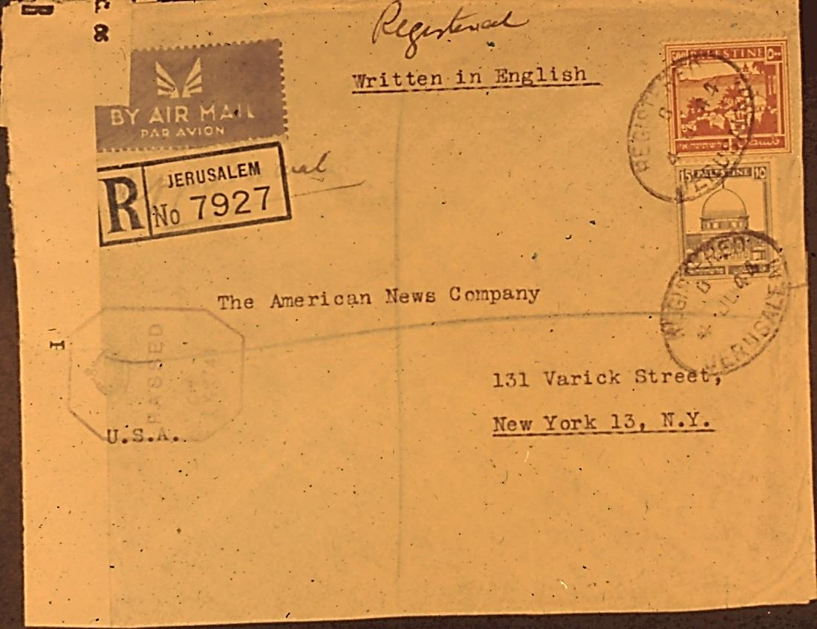
Notes:
A registered air mail cover sent during the War to the U.S. via Clipper Mail, bearing a copy of the 500 m value.

Slide 56
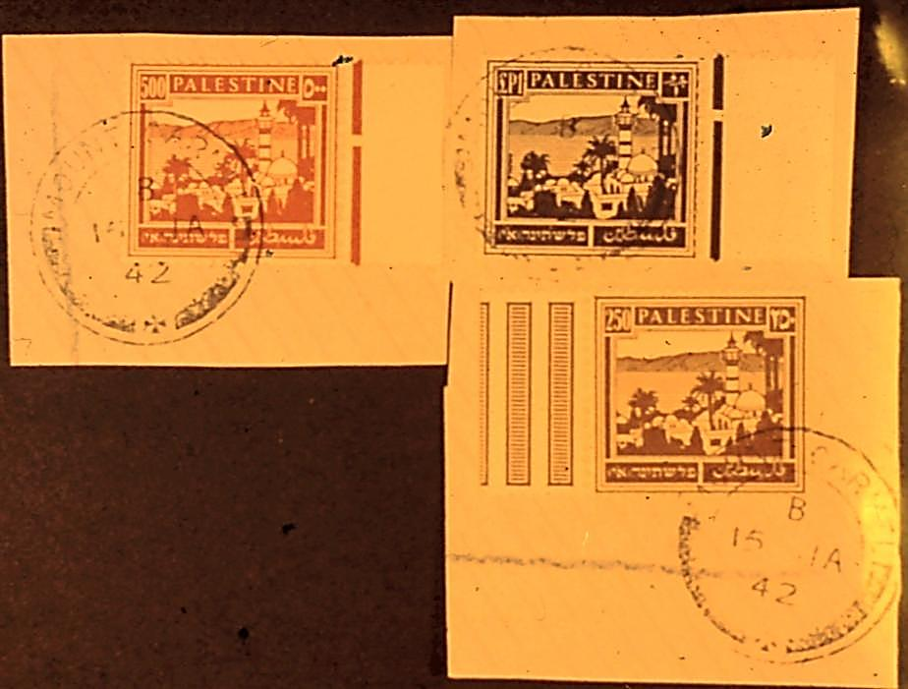
Notes:
Three pieces that were cut out from the same First Day Cover with all 3 high values, postmarked 15 JAN 42.

Slide 57
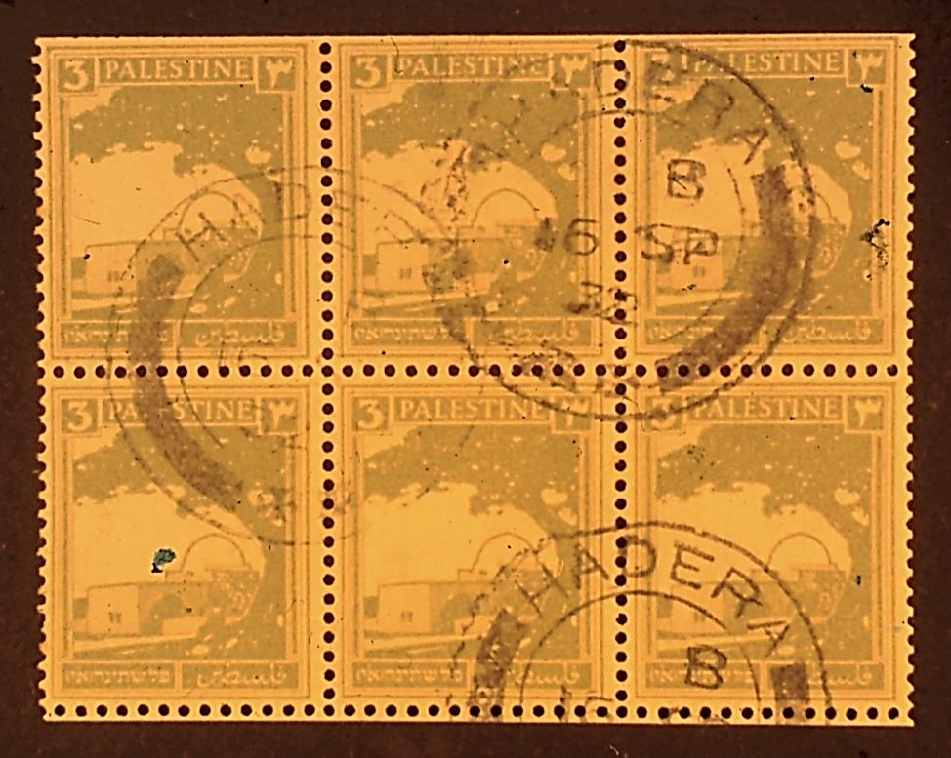
Notes:
A complete used 3 m booklet pane. A great deal of research remains to be done in this field.

