Slide 1
#133 Jewish History Overview of Palestine and Israel through Holy Land Stamps
By Sid Morginstin 2010
Society of Israel Philatelists
www.israelstamps.com

Slide 2
#133 Jewish History Overview of Palestine and Israel through Holy Land Stamps
Background
This slide show will touch on both the history of Palestine and Israel and on the philately of Palestine and Israel.
The slides were auction lots in past NEGEV HOLYLAND auctions. The maps were taken from various web sites.
Holy Land Philately is a most interesting and challenging part of the hobby of stamp collecting. There is room in it for the novice collector as well as the most advanced philatelist. It also shows the history of the area. The Holy Land is defined as the area on the Eastern Shore of the Mediterranean Sea stretching to the Jordan River. Holy Land Philately includes Palestine prior to 1948, the modern State of Israel, the West Bank of the Jordan River from 1948 to date, and (by extension) the Sinai and Gaza from 1948 to date.
There are distinct periods involved: Ottoman, Mandate, Interim, and Israel. The actual postal history (that is, the history of the mails) is very extensive. I will just skim over the topics. Otherwise we could be here all night and still not get done.

Slide 3
#133 Jewish History Overview of Palestine and Israel through Holy Land Stamps
Ottoman Empire 1580
Slide 1
Notes:
Slide 1: Ottoman Empire 1580. Prior to World War One, most of the area now known as the Middle East was part of the Ottoman (or Turkish) Empire. The empire lasted from around 1300 to the end of World War One

Slide 4
#133 Jewish History Overview of Palestine and Israel through Holy Land Stamps
Ottoman Empire Largest Borders
Slide 2
Notes:
Slide 2: Ottoman Empire Largest Borders. Prior to World War One, most of the area now known as the Middle East was part of the Ottoman (or Turkish) Empire. The empire lasted from around 1300 to the end of World War One

Slide 5
#133 Jewish History Overview of Palestine and Israel through Holy Land Stamps
Ottoman Empire in 1683
Slide 3
Notes:
Slide 3: Ottoman Empire in 1683. Prior to World War One, most of the area now known as the Middle East was part of the Ottoman (or Turkish) Empire. The empire lasted from around 1300 to the end of World War One

Slide 6
#133 Jewish History Overview of Palestine and Israel through Holy Land Stamps
Map of Ottoman Empire in 1885
Slide 4
Notes:
Slide 4: Ottoman Empire in 1885. Compared to other areas, Palestine was a dusty, sparsely populated backwater of the Ottoman Empire. Turkey had its own post offices in Palestine. Many Europeans frequently were in Palestine for business or religious purposes. As modes of travel improved, this trend grew. As the Ottoman Postal System had very poor service, the visitors preferred that their own governments handle the mails.

Slide 7
#133 Jewish History Overview of Palestine and Israel through Holy Land Stamps
Forerunner Period - Petach Tiqvah
Slide 5
Notes:
Slide 5: Petach Tiqvah. One of the earliest Jewish communities in Palestine was Petach Tiqvah. It was founded in 1878 by a group of pioneers from Jerusalem. The local government issued its own stamp PETACH TIQVAH. Rishon Le Zion was founded in 1882 by Russian Jewish immigrants.

Slide 8
#133 Jewish History Overview of Palestine and Israel through Holy Land Stamps
Forerunner Period - Austria
Slide 6
Notes:
Slide 6: Forerunner – Austria. During the latter half of the 19th century, as the Ottoman Empire grew weak, the European powers were able to obtain Capitulation Treaties from Turkey. Under these treaties, five nations (Austria, France, Germany, Italy, Russia, and Egypt) were able to expand their postal systems into Palestine. The first such post office opened around 1850. This is called the FORERUNNER PERIOD. These nations either overprinted their regular stamps or issued stamps for usage in Palestine

Slide 9
#133 Jewish History Overview of Palestine and Israel through Holy Land Stamps
Forerunner Period - Italy
Slide 7
Notes:
Slide 7: Forerunner – Italy. During the latter half of the 19th century, as the Ottoman Empire grew weak, the European powers were able to obtain Capitulation Treaties from Turkey. Under these treaties, five nations (Austria, France, Germany, Italy, Russia, and Egypt) were able to expand their postal systems into Palestine. The first such post office opened around 1850. This is called the FORERUNNER PERIOD. These nations either overprinted their regular stamps or issued stamps for usage in Palestine

Slide 10
#133 Jewish History Overview of Palestine and Israel through Holy Land Stamps
Forerunner Period - Russia
Slide 8
Notes:
Slide 8: Forerunners – Russsian. During the latter half of the 19th century, as the Ottoman Empire grew weak, the European powers were able to obtain Capitulation Treaties from Turkey. Under these treaties, five nations (Austria, France, Germany, Italy, Russia, and Egypt) were able to expand their postal systems into Palestine. The first such post office opened around 1850. This is called the FORERUNNER PERIOD. These nations either overprinted their regular stamps or issued stamps for usage in Palestine

Slide 11
#133 Jewish History Overview of Palestine and Israel through Holy Land Stamps
Forerunner Period – Last Christmas in 19th Century
Slide 9
Notes:
Slide 9: Forerunner period – last Christmas in the 19th century. During the latter half of the 19th century, as the Ottoman Empire grew weak, the European powers were able to obtain Capitulation Treaties from Turkey. Under these treaties, five nations (Austria, France, Germany, Italy, Russia, and Egypt) were able to expand their postal systems into Palestine. The first such post office opened around 1850. This is called the FORERUNNER PERIOD. These nations either overprinted their regular stamps or issued stamps for usage in Palestine

Slide 12
#133 Jewish History Overview of Palestine and Israel through Holy Land Stamps
Forerunner Period – Turkish
Slide 10
Notes:
Slide 10: Forerunner – Turkish. During the latter half of the 19th century, as the Ottoman Empire grew weak, the European powers were able to obtain Capitulation Treaties from Turkey. Under these treaties, five nations (Austria, France, Germany, Italy, Russia, and Egypt) were able to expand their postal systems into Palestine. The first such post office opened around 1850. This is called the FORERUNNER PERIOD. These nations either overprinted their regular stamps or issued stamps for usage in Palestine

Slide 13
#133 Jewish History Overview of Palestine and Israel through Holy Land Stamps
Forerunner Period – French
Slide 11
Notes:
Slide 11: Forerunner – French.During the latter half of the 19th century, as the Ottoman Empire grew weak, the European powers were able to obtain Capitulation Treaties from Turkey. Under these treaties, five nations (Austria, France, Germany, Italy, Russia, and Egypt) were able to expand their postal systems into Palestine. The first such post office opened around 1850. This is called the FORERUNNER PERIOD. These nations either overprinted their regular stamps or issued stamps for usage in Palestine

Slide 14
#133 Jewish History Overview of Palestine and Israel through Holy Land Stamps
Forerunner Period – Revenue Stamps
Court Fees
Slide 12
Notes:
Slide 12: Revenue Stamps – Court Fees. The Ottoman Empire was nearly bankrupt during the latter part of the nineteenth century. One way to raise money was to require the usage of revenue stamps on nearly everything. Again, the revenue stamps are an interesting study in and of themselves. I will just show you three examples

Slide 15
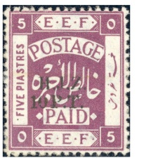
#133 Jewish History Overview of Palestine and Israel through Holy Land Stamps
Forerunner Period – Revenue Stamps
Hejaz Railway
To help pay for the railroad
Slide 13
Notes:
Slide 13: Hejaz Railway stamps. The Ottoman Empire was nearly bankrupt during the latter part of the nineteenth century. One way to raise money was to require the usage of revenue stamps on nearly everything. Again, the revenue stamps are an interesting study in and of themselves. I will just show you three examples

Slide 16
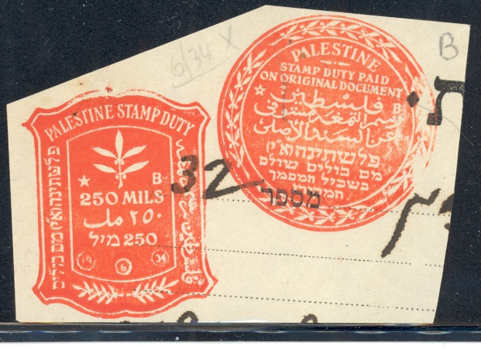
#133 Jewish History Overview of Palestine and Israel through Holy Land Stamps
Forerunner Period – Revenue Stamps
Stamp Duty
Slide 14
Notes:
Slide 14: Duty Stamp. The Ottoman Empire was nearly bankrupt during the latter part of the nineteenth century. One way to raise money was to require the usage of revenue stamps on nearly everything. Again, the revenue stamps are an interesting study in and of themselves. I will just show you three examples

Slide 17
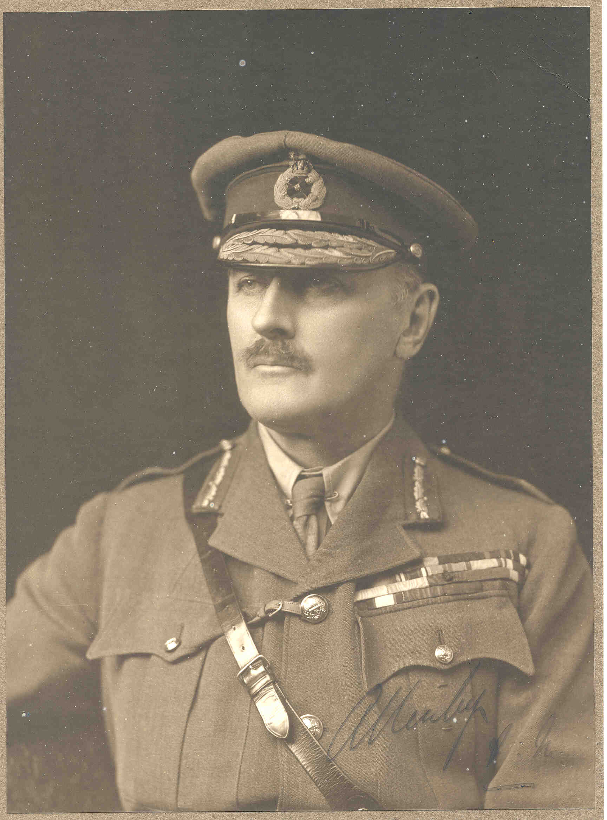
#133 Jewish History Overview of Palestine and Israel through Holy Land Stamps
Mandate Period – EEF
Autographed photo
of General Allenby
Slide 15
Notes:
Slide 15: Mandate – photo of General Allenby. During World War One, the Ottoman Empire collapsed. All foreign post offices were closed at the end of the war, in 1917.
Under British command, the military Egyptian Expeditionary Forces occupied and controlled Palestine at the end of the war.

Slide 18
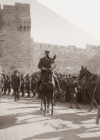
#133 Jewish History Overview of Palestine and Israel through Holy Land Stamps
Mandate Period – EEF
Photo of
General Allenby
Entering Jerusalem
Slide 16
Notes:
Slide 16: Photo of General Allenby entering Jerusalem. The League of Nations mandated Palestine to Great Britain in June 1922. For philatelic purposes, the MANDATE PERIOD is considered to have begun at the end of World War I. By the way, the Mandate area also included TransJordan (what is now called Jordan) which is on the East bank of the Jordan River. TransJordan was to be the Palestinian state and Palestine was to be the Jewish state.
On November 2, 1917, Lord James Balfour wrote a letter to Walter Rothschild, a leader of the British Jewish community. It contained what has come to be known as the BALFOUR DECLARATION. In part it read, “His Majesty's government view with favour the establishment in Palestine of a national home for the Jewish people.”

Slide 19
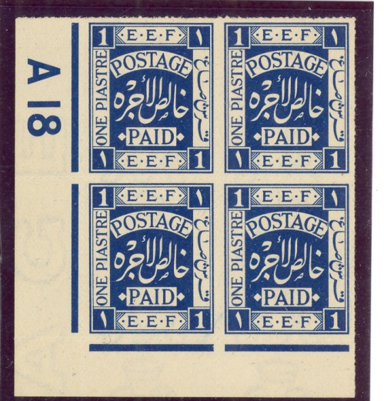
#133 Jewish History Overview of Palestine and Israel through Holy Land Stamps
Mandate Period – EEF
Blues issued in 1917
Slide 17
Notes:
Slide 17: Mandate – EEF Blue stamps. The first set of British stamps for Palestine, called the BLUES, was issued in 1917. In lieu of country name, they had in the design EEF which stands for Egyptian Expeditionary Forces

Slide 20
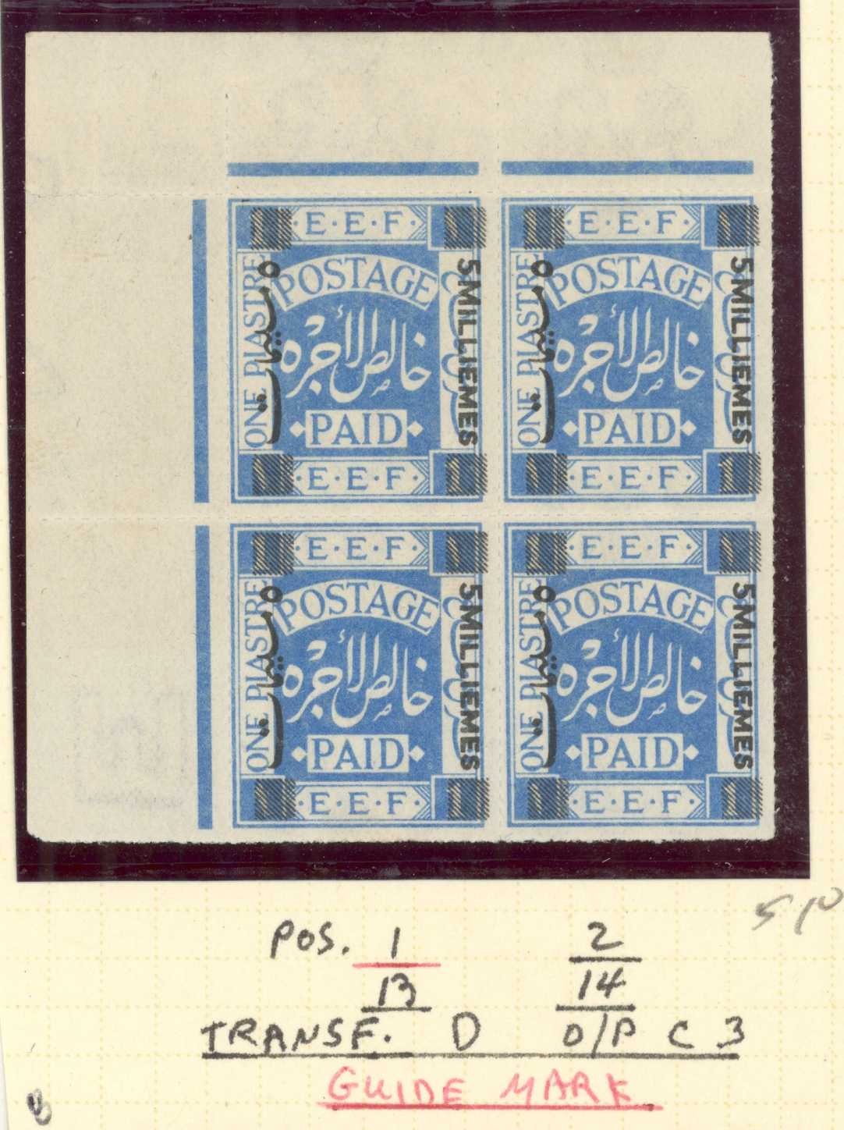
#133 Jewish History Overview of Palestine and Israel through Holy Land Stamps
Mandate Period – EEF
Second stamp overprinted
to change value
Slide 18
Notes:
Slide 18: Mandate EEF. Second stamp overprinted to change value. The first set of British stamps for Palestine, called the BLUES, was issued in 1917. In lieu of country name, they had in the design EEF which stands for Egyptian Expeditionary Forces

Slide 21
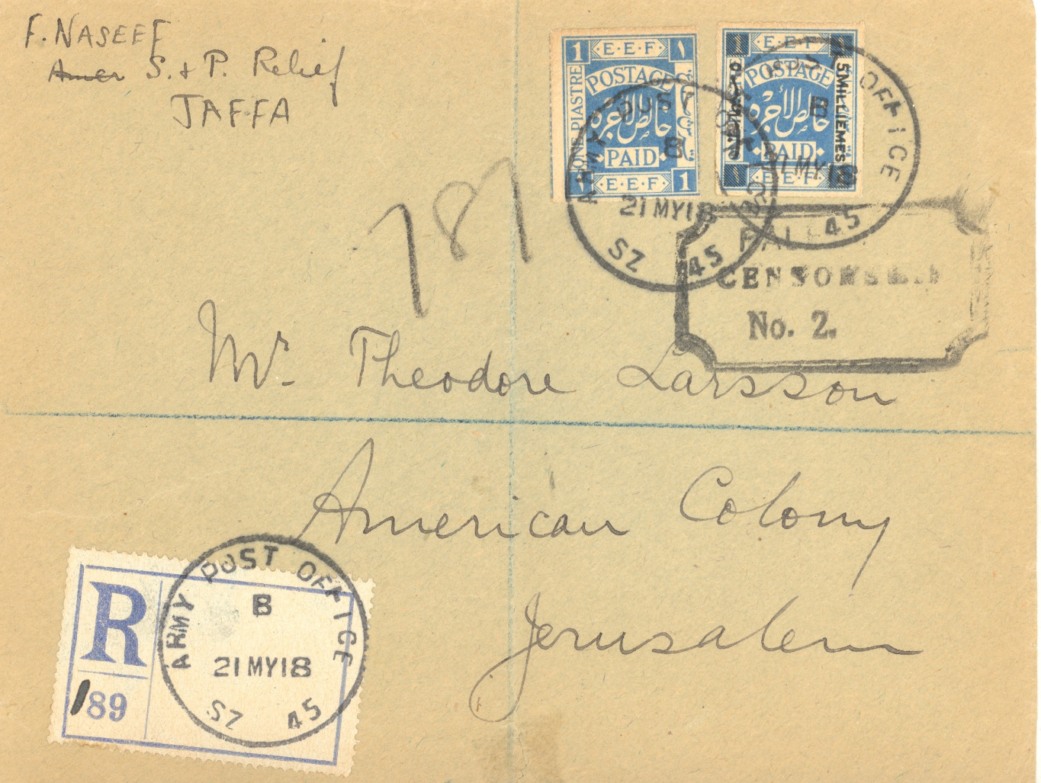
#133 Jewish History Overview of Palestine and Israel through Holy Land Stamps
Mandate Period – EEF
Civilian use of military posts
Lasted until 1920
Slide 19
Notes:
Slide 19: Civilian use of military posts lasted until 1920.

Slide 22
#133 Jewish History Overview of Palestine and Israel through Holy Land Stamps
Mandate Period – EEF
Typographs mid to late 1910
Slide 20
Notes:
Slide 20: Typograph stamp. The next set, called the TYPOGRAPHS were issued in mid to late 1910. Typography is a method of printing stamps. We will not get into that tonight.

Slide 23
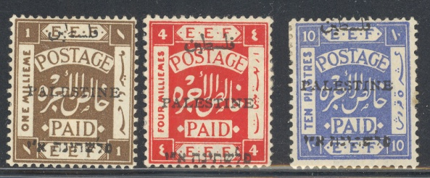
#133 Jewish History Overview of Palestine and Israel through Holy Land Stamps
Mandate Period – Overprints
Top line is Arabic for Palestine
Second line is English
Third line Hebrew for Palestine
Jerusalem overprint
serifs
Slide 21
Notes:
Slide 21: Mandate – Overprints. Over the next 10 years, these stamps were re-issued with various overprints. The top line is Arabic for PALESTINE. The second line is in English. The third line is in Hebrew. It reads PALESTINE. After that word are the Hebrew letters ALEPH and YUD. These stand for ERETZ ISRAEL – The Land of Israel. There are two main types of overprints. Jerusalem The first overprint was made in JERUSALEM. The letters have serifs. There are three sub-types. The second type was made in LONDON.

Slide 24
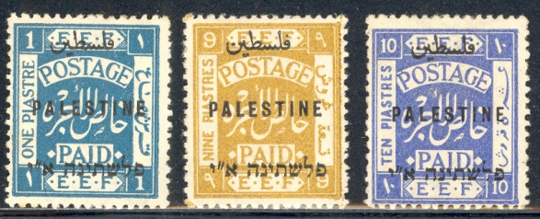
#133 Jewish History Overview of Palestine and Israel through Holy Land Stamps
Mandate Period – Overprints
Top line is Arabic for Palestine
Second line is English
Third line Hebrew for Palestine
London overprint
No serifs
Slide 22
Notes:
Slide 22: EEF London overprint. Over the next 10 years, these stamps were re-issued with various overprints. The top line is Arabic for PALESTINE. The second line is in English. The third line is in Hebrew. It reads PALESTINE. After that word are the Hebrew letters ALEPH and YUD. These stand for ERETZ ISRAEL – The Land of Israel. There are two main types of overprints. London The letters do not have serifs. There are two sub-types. Here is a “cheat sheet” showing how to tell them apart.

Slide 25
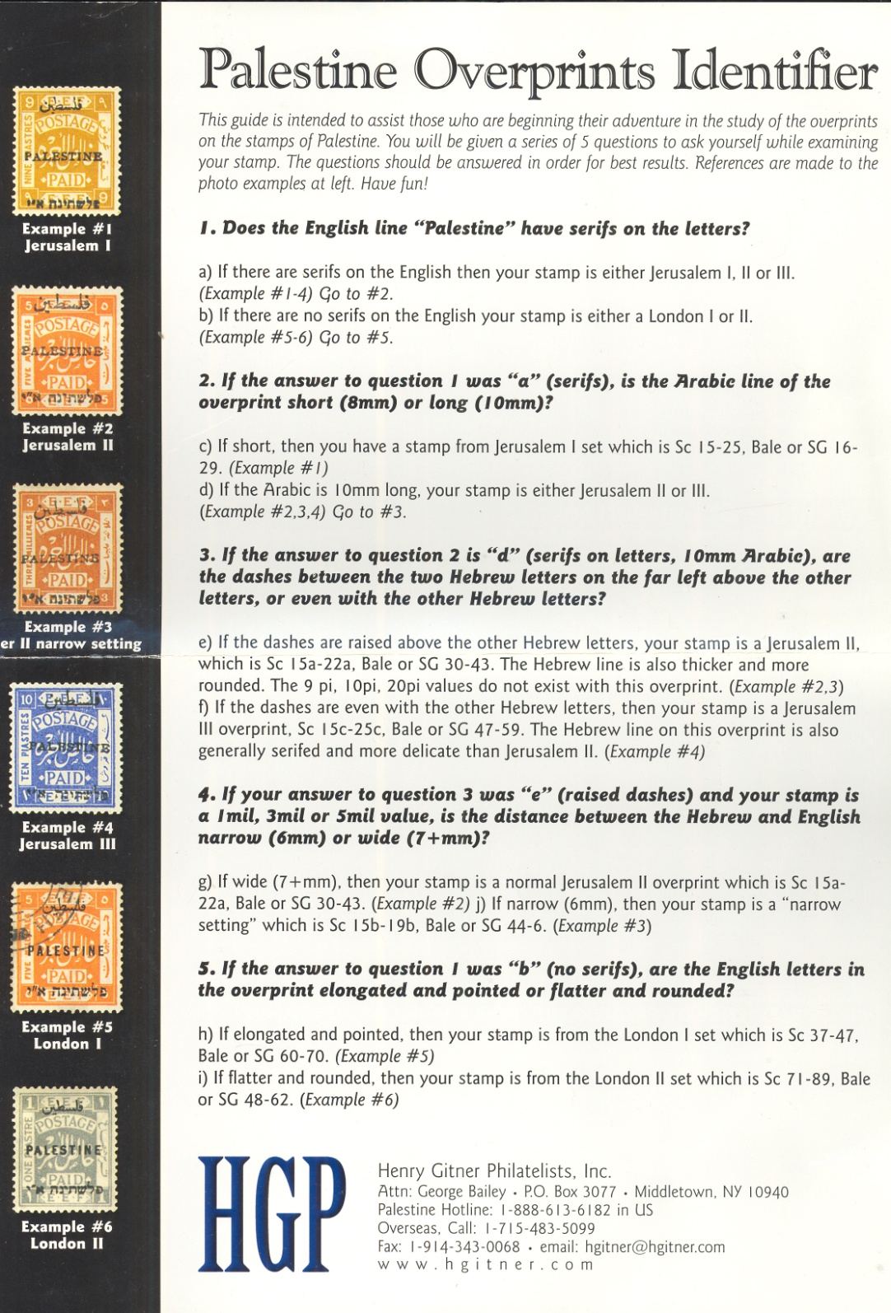
#133
Mandate Period – Overprints
Cheat Sheet
Slide 23
Notes:
Slide 23: Cheat sheet to identify overprints.
Specialists – with very good eyesight and/or a powerful magnifying glass – have field days checking these stamps for the many varieties and errors. I will not delve into this.

Slide 26
#133 Jewish History Overview of Palestine and Israel through Holy Land Stamps
Mandate Period – Pictorials
Rachel’s Tomb
Bethlehem
Dome of the Rock
Jerusalem
Tower of David
Old City - Jerusalem
Tiberias
Sea of Galilee
Began in 1927
Slide 24
Notes:
Slide 24: Mandate Pictorials. In 1927, the PICTORIAL issue began. These remained in use till the establishment of the State of Israel in 1948. Four views of Palestine were used: Rachel's Tomb in Bethlehem, The Dome of the Rock (Mosque of Omar) in Jerusalem, The Tower of David on the Walls of the Old City of Jerusalem, and the city of Tiberias on the Sea of Galilee. There are many color shadings and FIVE types of paper: thin, vertical ribbed, wove, horizontal ribbed, and transparent. There is also a coil.
In this time period, the population of Palestine grew. Many Jews decided to move there. New towns and kibbutzim were founded. Commerce grew quite rapidly.

Slide 27
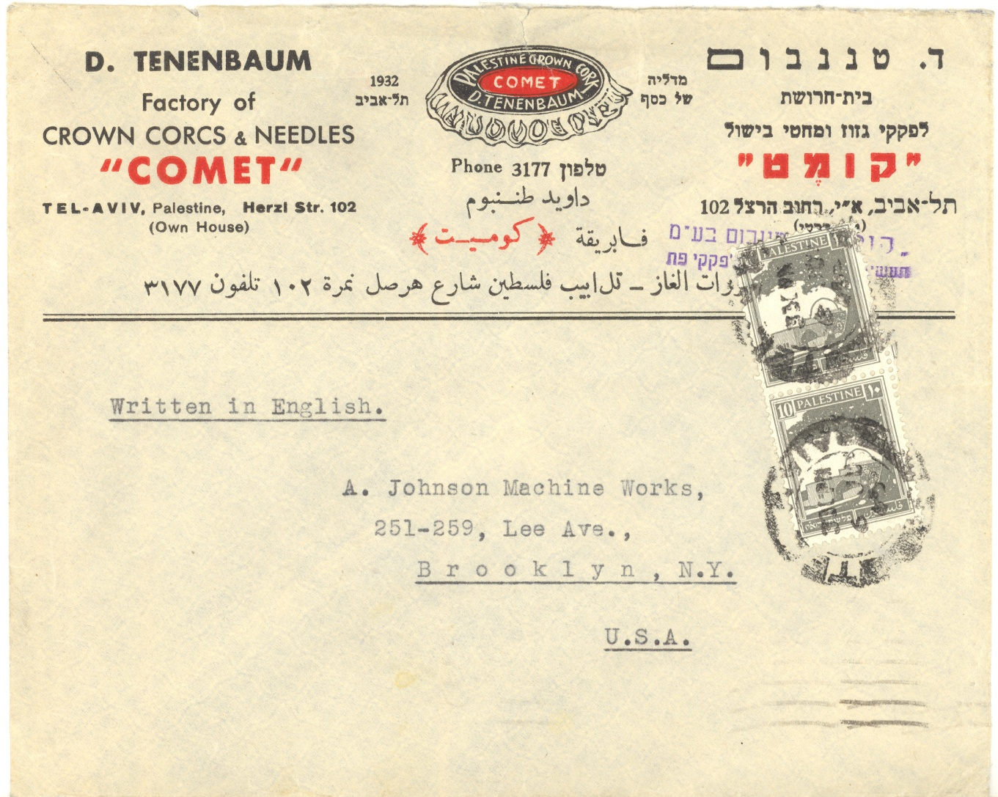
#133 Jewish History Overview of Palestine and Israel through Holy Land Stamps
Mandate Period – Business Use
Advertising
Cover
Slide 25
Notes:
Slide 25: Business use. Here is an advertising cover from a business in Tel Aviv The word COVER means the envelope used to mail the letter. It includes the stamps and any postal markings.

Slide 28
#133 Jewish History Overview of Palestine and Israel through Holy Land Stamps
Mandate Period – Levant Fair Label
Slide 26
Notes:
Slide 26: Levant Fair label; International trade fairs were also held

Slide 29
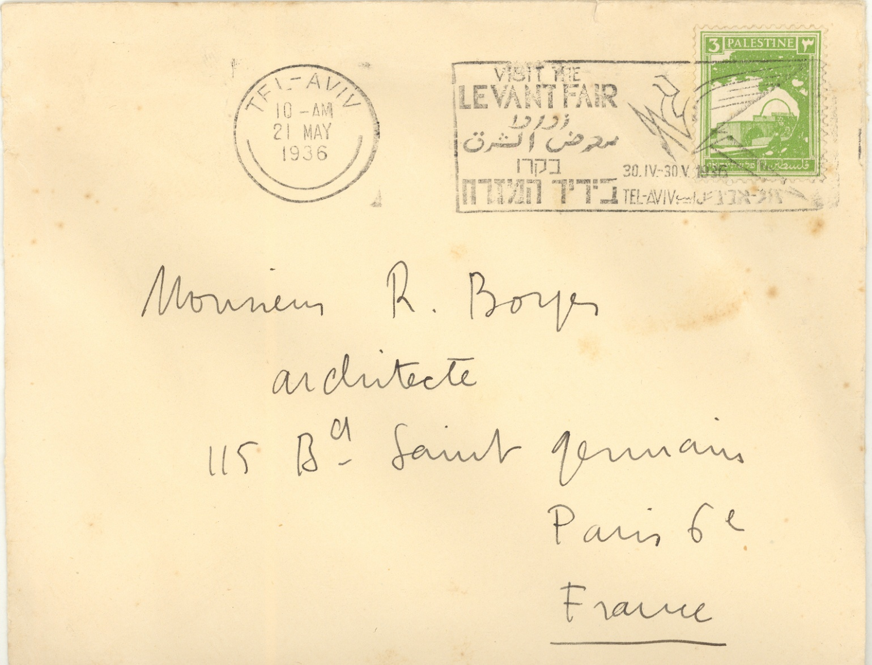
#133 Jewish History Overview of Palestine and Israel through Holy Land Stamps
Mandate Period – Levant Fair special postmark
Slide 27
Notes:
Slide 27: Levant Fair special postmark

Slide 30
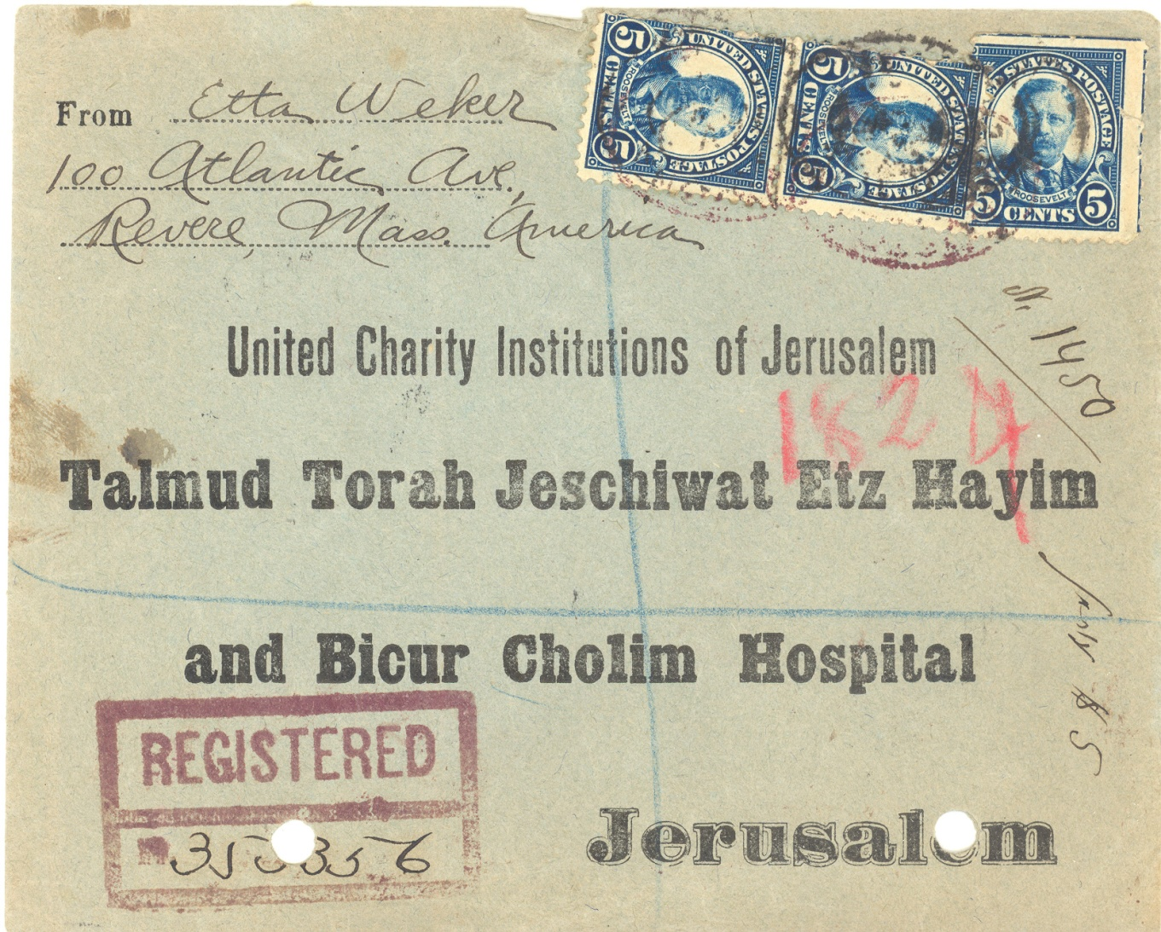
#133 Jewish History Overview of Palestine and Israel through Holy Land Stamps
Mandate Period – Schnorer Covers
Slide 28
Notes:
Slide 28: Schnorer Covers. Religious schools were established. One interesting area of these is what collectors euphemistically call SHNORER COVERS. By SHNORER we mean the response envelopes for a religious establishment asking for money. Schnorer. Some religious or service organizations also issued fund raising labels.

Slide 31
#133 Jewish History Overview of Palestine and Israel through Holy Land Stamps
Mandate Period – Kern Tel Chai Charity label
Slide 29
Notes:
Slide 29: Kern Tel Chai Charity label. One of these was KEREN TEL CHAI

Slide 32
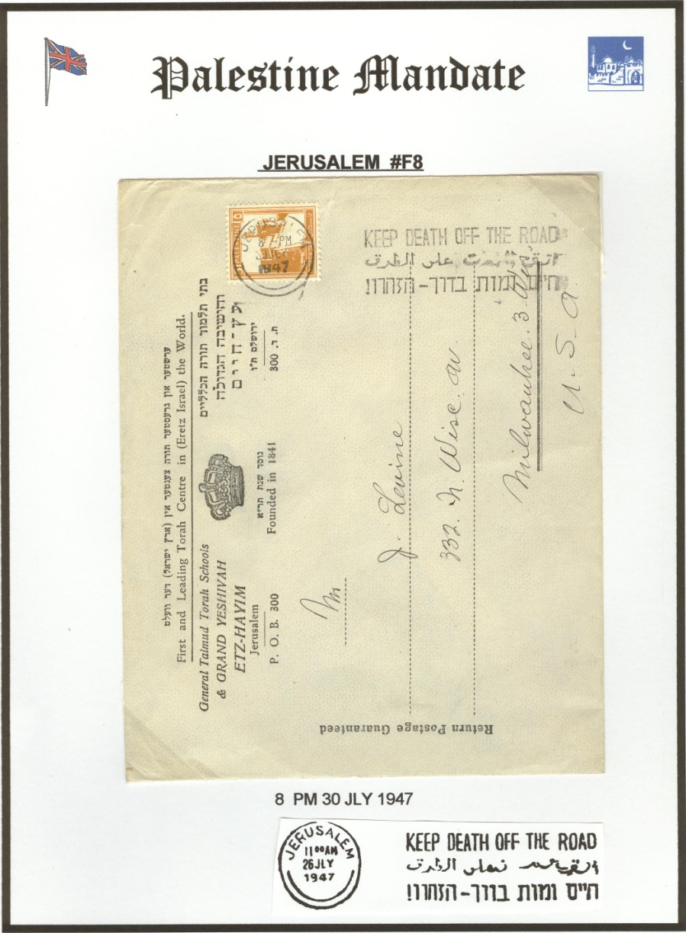
#133 Jewish History Overview of Palestine and Israel through Holy Land Stamps
Mandate Period – Postmark used in Jerusalem
Slide 30
Notes:
Slide 30: Jerusalem city postmark. Jerusalem - The various postmarks used in each city (Jaffa, Tel Aviv, Jerusalem, and Haifa) are also the subject of detailed study. These can be quite complicated as the spellings of some of the town names were changed and new canceling devices used. The various postal rates are also studied.

Slide 33
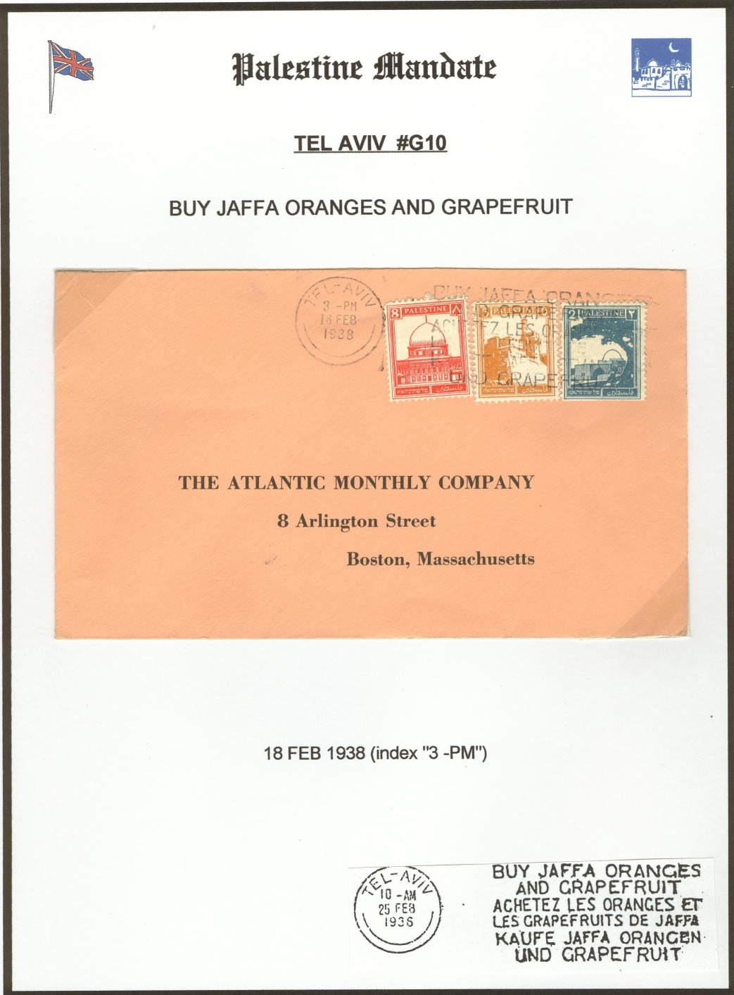
#133 Jewish History Overview of Palestine and Israel through Holy Land Stamps
Mandate Period – Postmark
used in Tel Aviv
Slide 31
Notes:
Slide 31: Tel-Aviv city postmark. Tel-Aviv - The various postmarks used in each city (Jaffa, Tel Aviv, Jerusalem, and Haifa) are also the subject of detailed study. These can be quite complicated as the spellings of some of the town names were changed and new canceling devices used. The various postal rates are also studied.

Slide 34
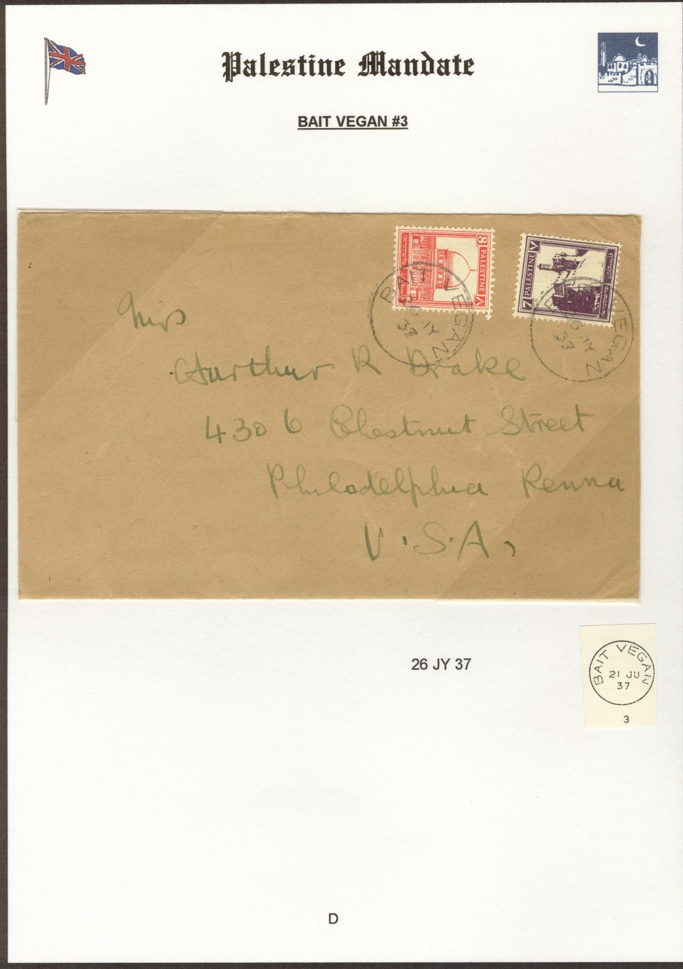
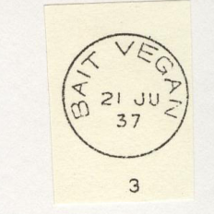
#133 Jewish History Overview of Palestine and Israel through Holy Land Stamps
Mandate Period – Postmark
used in Bait Vegan
Slide 32
Notes:
Slide 32: Bait Vegan city postmark. Bait Vegan - The various postmarks used in each city (Jaffa, Tel Aviv, Jerusalem, and Haifa) are also the subject of detailed study. These can be quite complicated as the spellings of some of the town names were changed and new canceling devices used. The various postal rates are also studied.

Slide 35
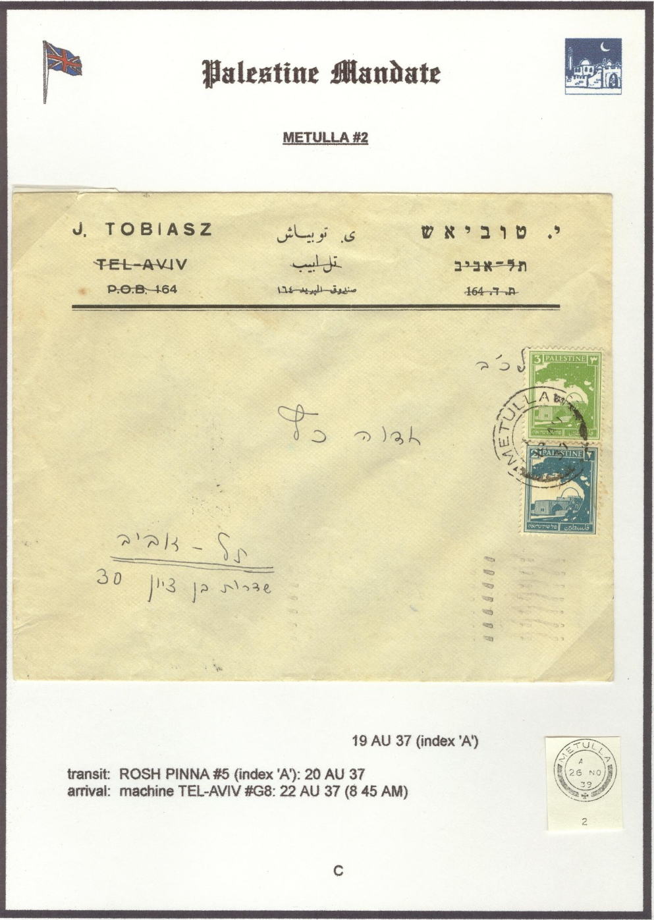
#133 Jewish History Overview of Palestine and Israel through Holy Land Stamps
Mandate Period – Postmark
used in Metulla
Slide 33
Notes:
Slide 33: Metulla city postmark - The various postmarks used in each city (Jaffa, Tel Aviv, Jerusalem, and Haifa) are also the subject of detailed study. These can be quite complicated as the spellings of some of the town names were changed and new canceling devices used. The various postal rates are also studied.

Slide 36
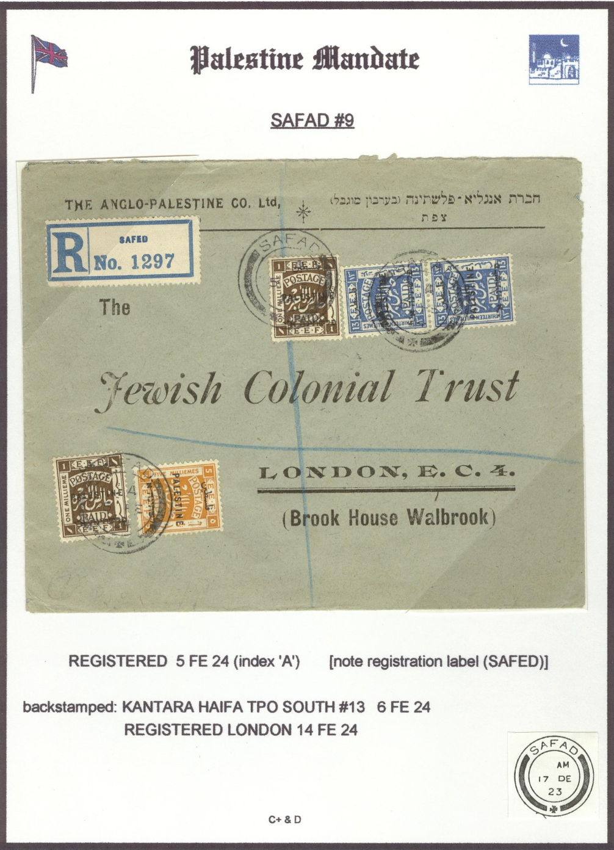
#133 Jewish History Overview of Palestine and Israel through Holy Land Stamps
Mandate Period – Postmark
used in Safad
Slide 34
Notes:
Slide 34: Mandate period – SAFAD postmark. SAFAD The various postmarks used in each city (Jaffa, Tel Aviv, Jerusalem, and Haifa) are also the subject of detailed study. These can be quite complicated as the spellings of some of the town names were changed and new canceling devices used. The various postal rates are also studied.

Slide 37
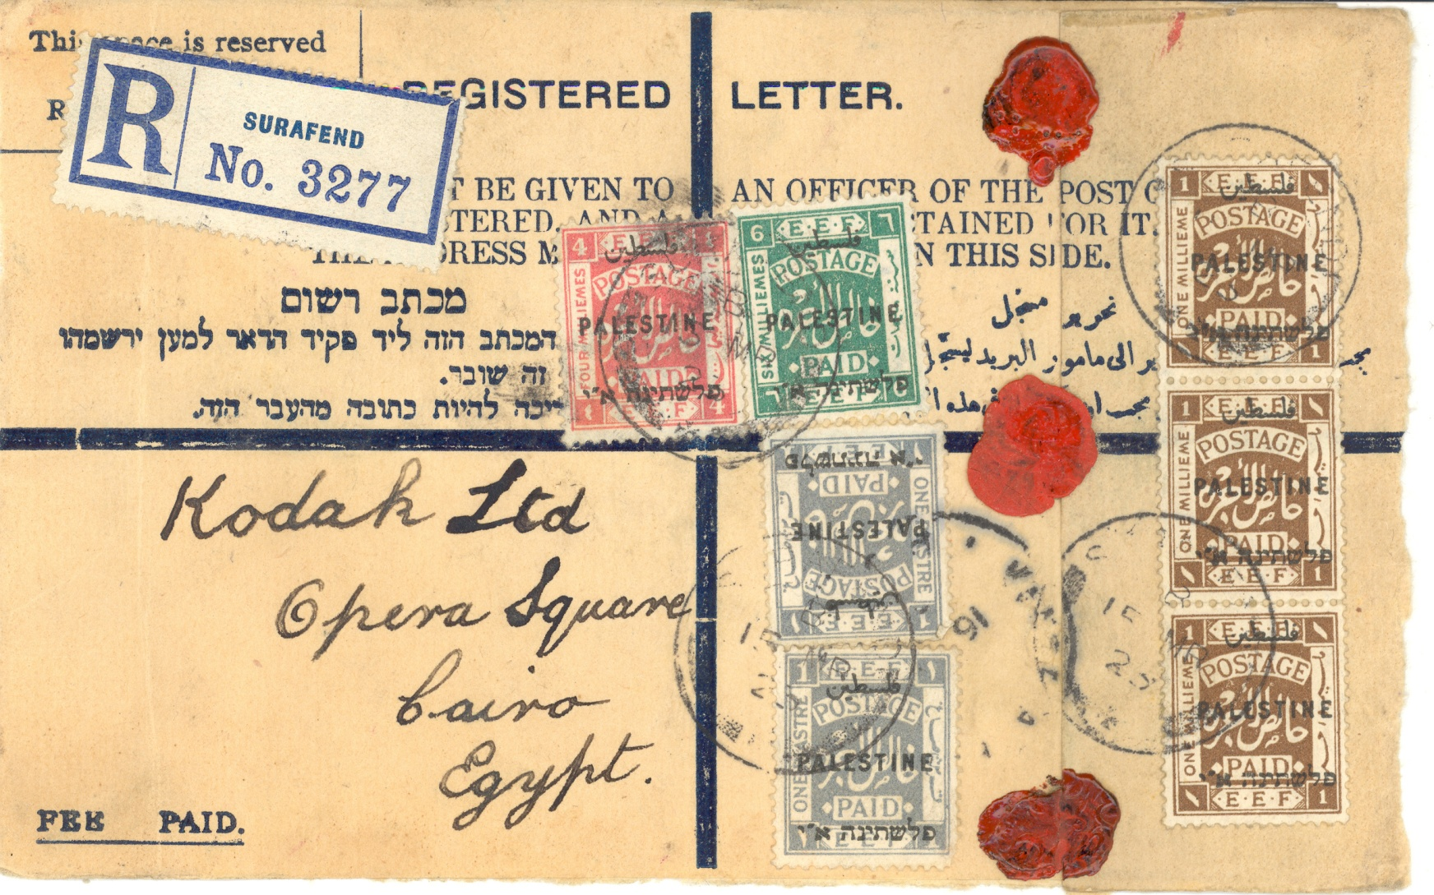
#133 Jewish History Overview of Palestine and Israel through Holy Land Stamps
Mandate Period – Postal Stationery – Registered Entire
Slide 35
Notes:
Slide 35: Postal Stationery. Many stationery items were also issued: postal cards, registered entires and various types of letter sheets. Here are is example of a registered entire.
Stationery was provided by the post office to mail valuables. We now move the clock forward to World War II.

Slide 38
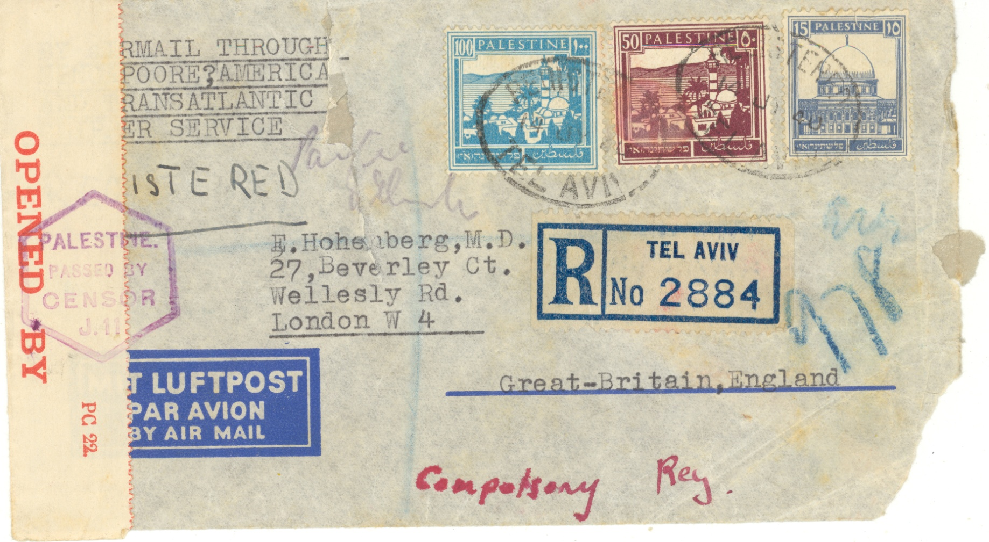
#133 Jewish History Overview of Palestine and Israel through Holy Land Stamps
World War II – Pacific Route - Front
From Tel Aviv via Singapore to Great Britain
Slide 36
Notes:
Slide 36: Pacific Route mail WWII. The war had an effect on Palestine. Prior to the start of the war, mail for the United States and England was sent thru Europe. But, during the war, some mail had to take the long way route – via the Pacific Ocean.
Slides 36 & 37: Pacific Route; this went via Singapore to England

Slide 39
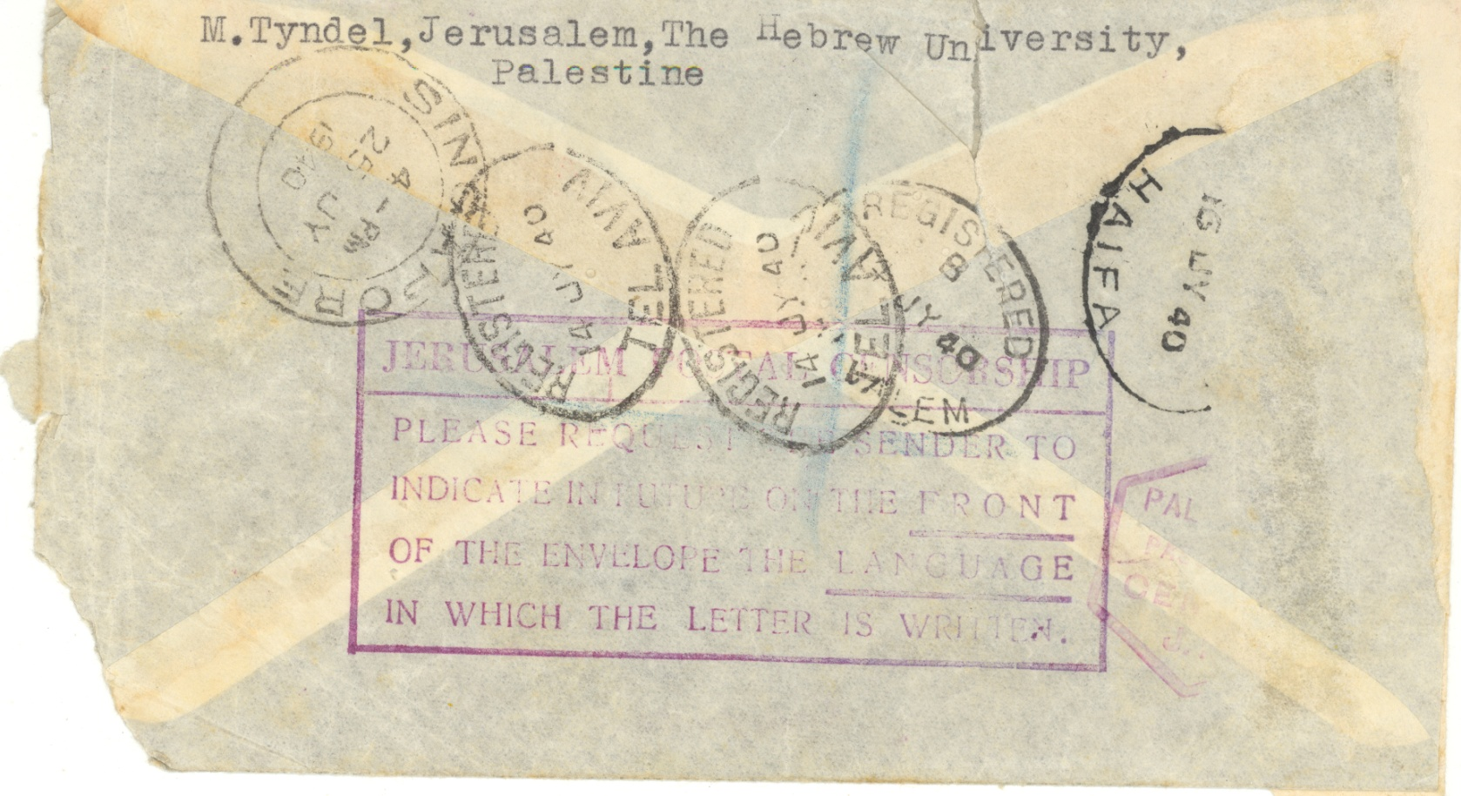
#133 Jewish History Overview of Palestine and Israel through Holy Land Stamps
World War II – Pacific Route – Back
From Jerusalem via Tel Aviv, Haifa and Singapore to Great Britain
Slide 37
Notes:
Slide 37: Pacific Route mail WWII. The war had an effect on Palestine. Prior to the start of the war, mail for the United States and England was sent thru Europe. But, during the war, some mail had to take the long way route – via the Pacific Ocean.
Slides 36 & 37: Pacific Route; this went via Singapore to England

Slide 40
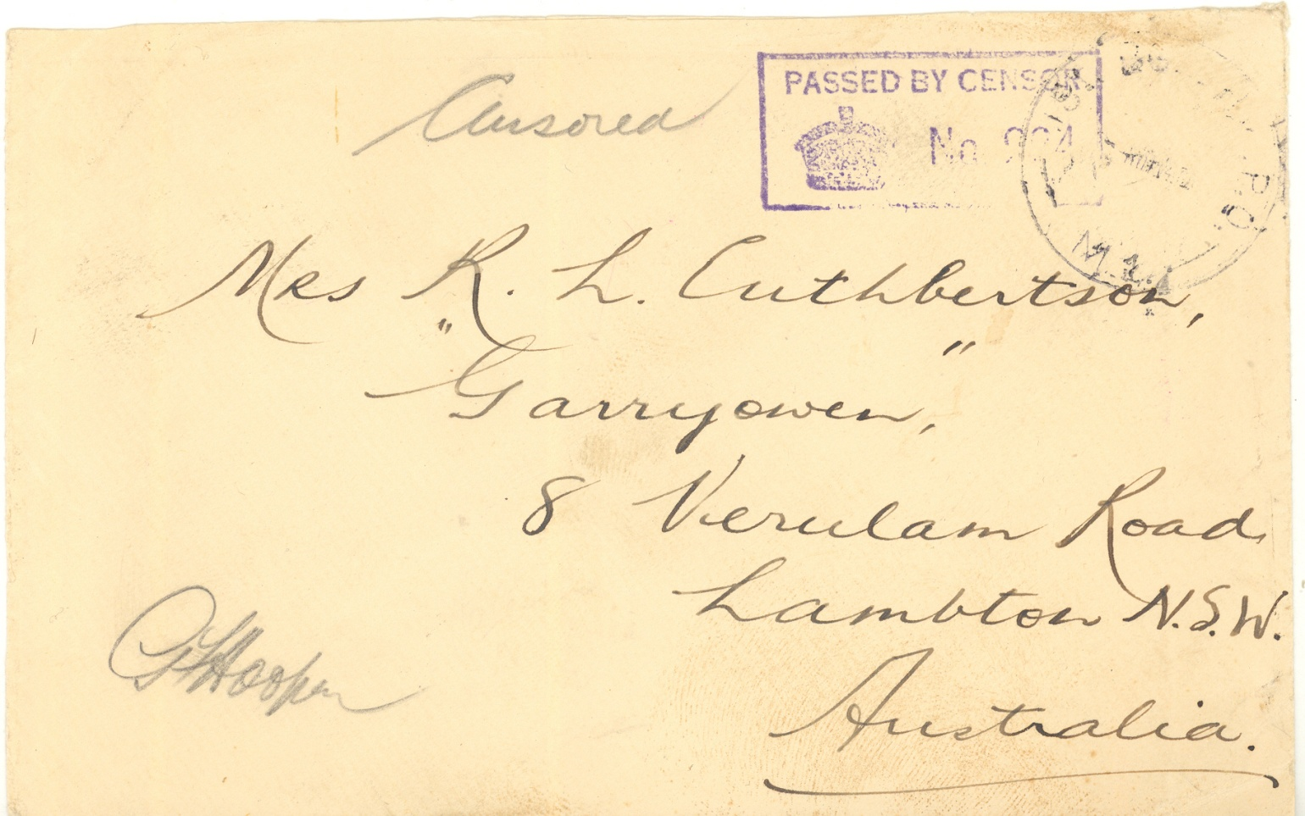
#133 Jewish History Overview of Palestine and Israel through Holy Land Stamps
World War II – Jewish Brigade
Members of YISHUV (Jewish Settlements in Palestine) formed the Jewish Brigade.
Slide 38
Notes:
Slide 38: Jewish Brigade. Members of the YISHUV (the Jewish Settlements in Palestine) volunteered for service. They formed the Jewish Brigade

Slide 41
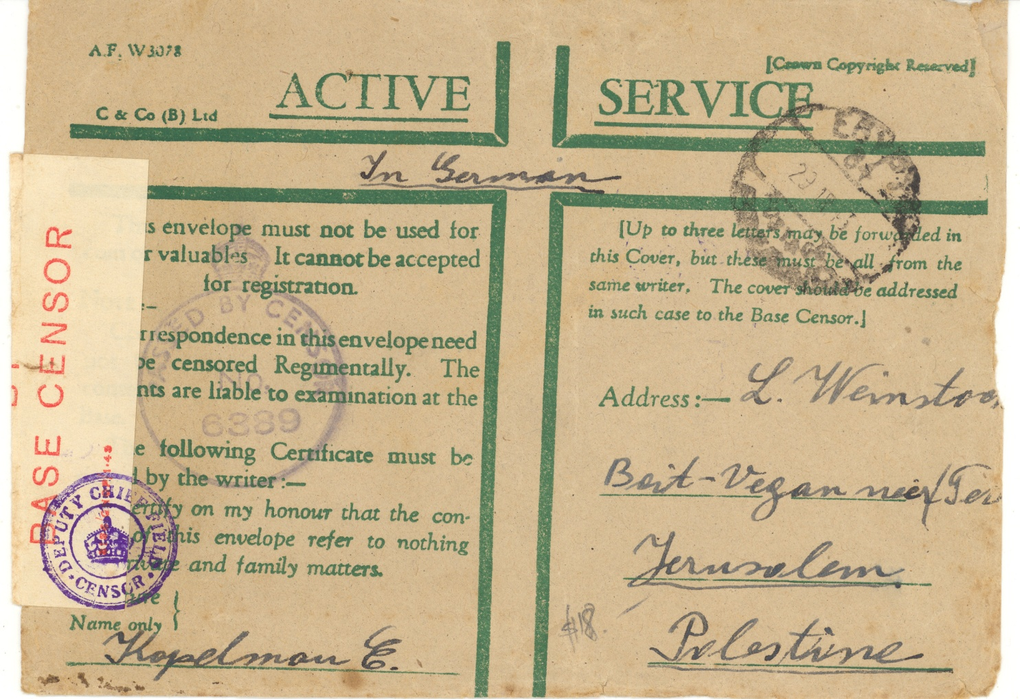
#133 Jewish History Overview of Palestine and Israel through Holy Land Stamps
World War II – Jewish Brigade
Usage of a British military envelope
Slide 39
Notes:
Slide 39: Usage of a British military envelope. Members of the YISHUV (the Jewish Settlements in Palestine) volunteered for service. They formed the Jewish Brigade.

Slide 42
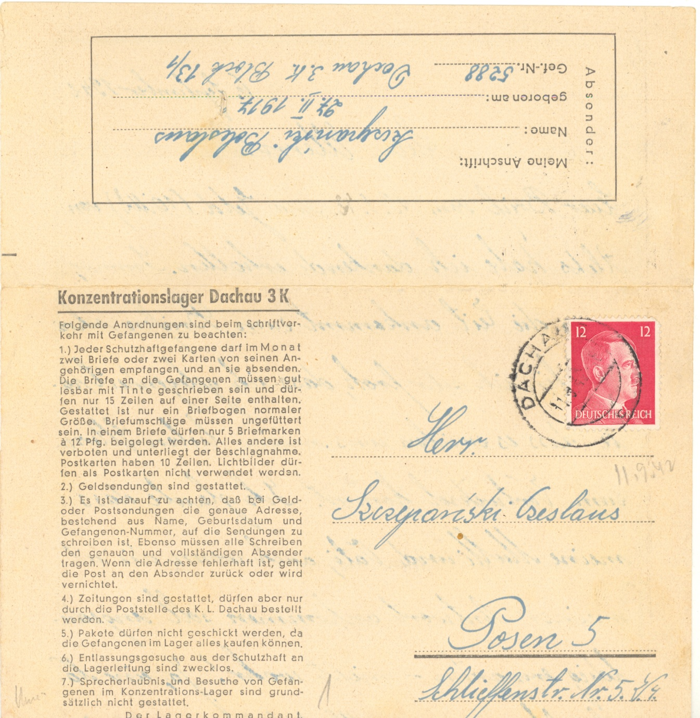
#133 Jewish History Overview of Palestine and Israel through Holy Land Stamps
World War II – Holocaust
Holocaust
Dachau
letter sheet
Slide 40
Notes:
Slide 40: Holocaust mail Dachau. Now, please permit me to go off subject for a moment. I would be remiss if I did not mention the Holocaust. While in the various concentration camps, the inmates could send and receive a very limited number of mail pieces or packages a month. The Germans had some very strict regulations regarding the mail. Here are two examples. Slide 40: Dachau letter sheet

Slide 43
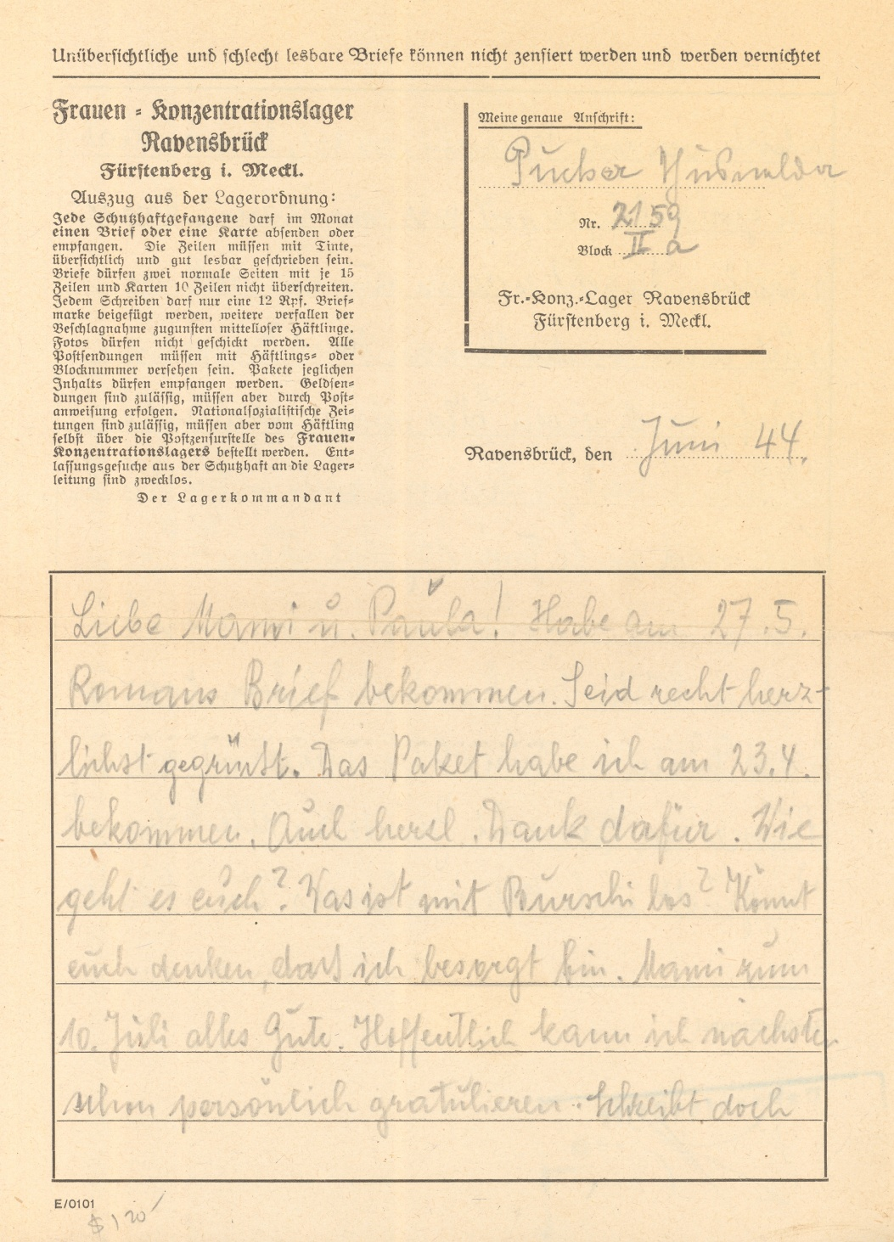
#133 Jewish History Overview of Palestine and Israel through Holy Land Stamps
World War II – Holocaust
Ravensbruk
Slide 41
Notes:
Slide 41: Holocaust mail Ravensbruk. Now, please permit me to go off subject for a moment. I would be remiss if I did not mention the Holocaust. While in the various concentration camps, the inmates could send and receive a very limited number of mail pieces or packages a month. The Germans had some very strict regulations regarding the mail. Here are two examples. Slide 40: Dachau letter sheet

Slide 44
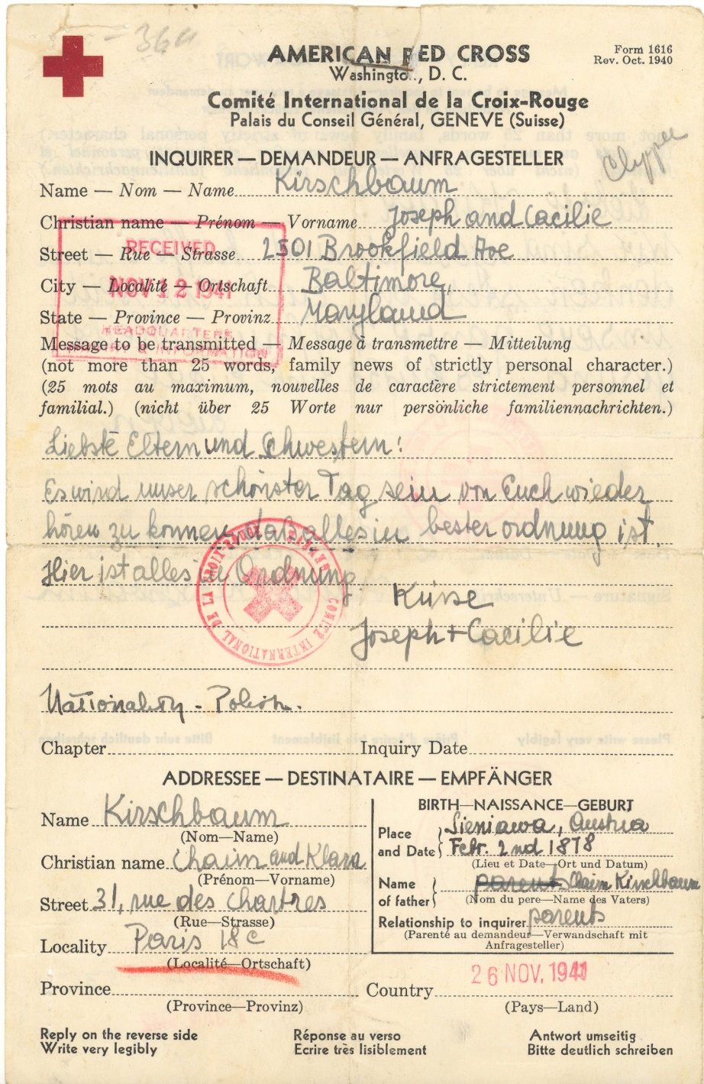
#133 Jewish History Overview of Palestine and Israel through Holy Land Stamps
World War II – Holocaust
Red Cross Form
Inquiry about a relative
Displaced person
Aid Organizations
Slide 42
Notes:
Slide 42: Red Cross Form – inquiry about a relative
Slide 42: Red Cross Form – inquiry about a relative
After the war, many former inmates were in Displaced Person Camps. While there, they wrote letters to various organizations that aided them. I will show just two items.

Slide 45
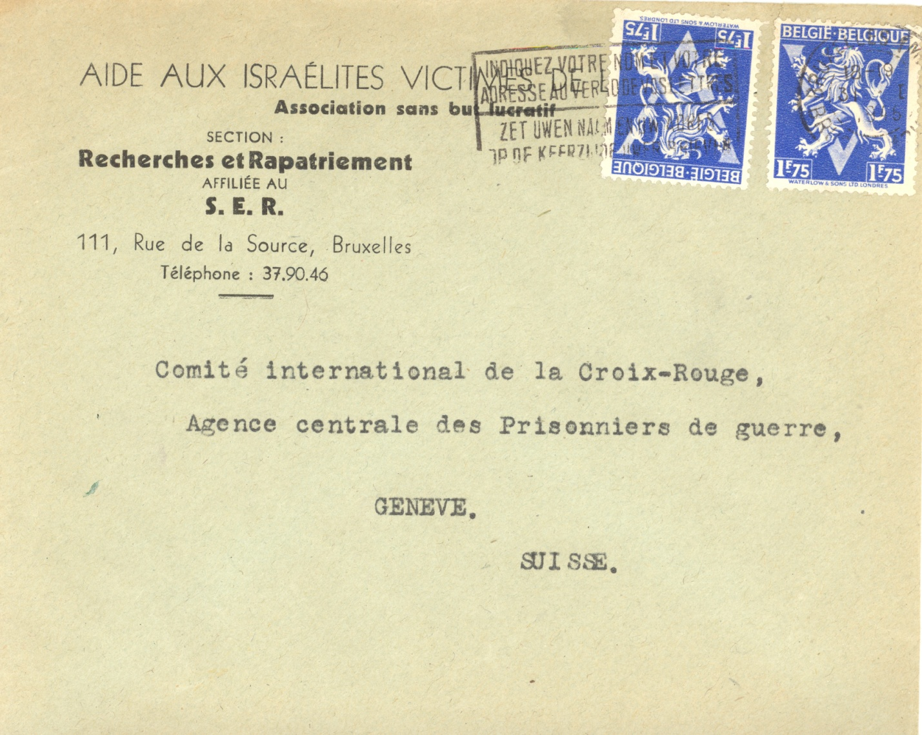
#133 Jewish History Overview of Palestine and Israel through Holy Land Stamps
World War II – Displaced Person Camps
Aid to Jewish
Victims
Displaced person
Aid Organizations
Slide 43
Notes:
Slide 43: Aid to Jewish Victims. After the war, many former inmates were in Displaced Person Camps. While there, they wrote letters to various organizations that aided them. I will show just two items.

Slide 46
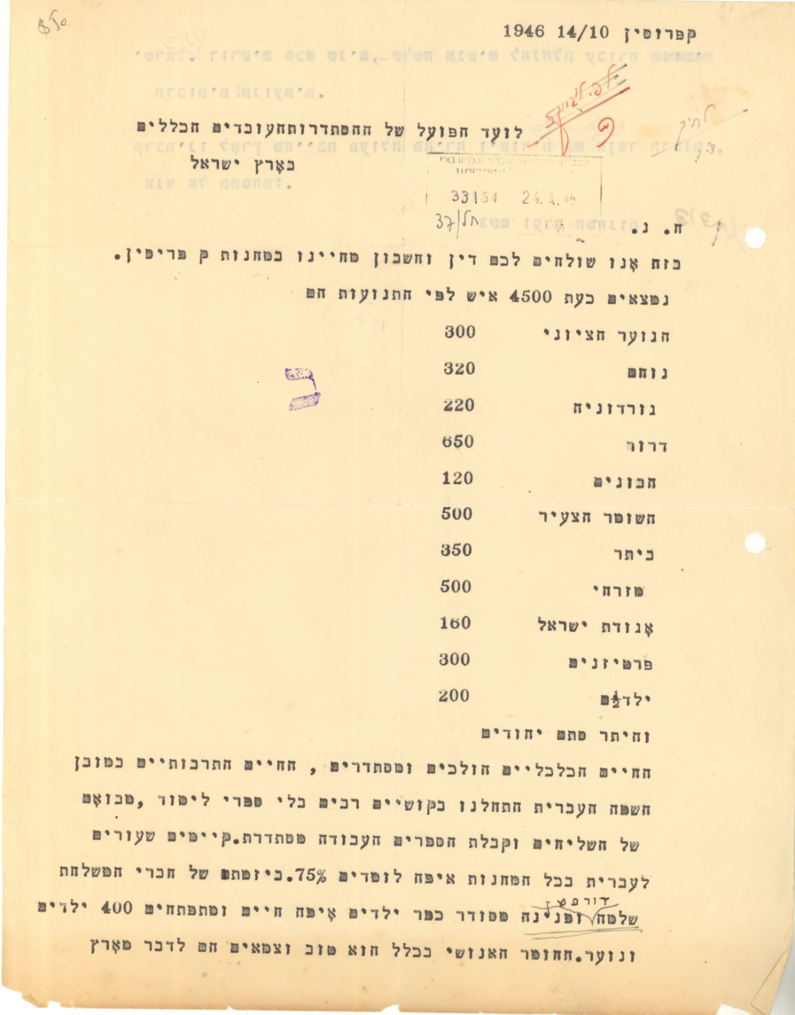
#133 Jewish History Overview of Palestine and Israel through Holy Land Stamps
World War II –
Displaced Person Camps
Cyprus Camp
document listing
total of inhabitants
Slide 44
Notes:
Slide 44: Cyprus camp document Oct 1946 to Histadrut, listing total of inhabitants. Many Displaced Persons tried to reach Palestine. Unfortunately, the British intercepted many of the ships and sent the refugees to camps in Cyprus. Here is a document in Hebrew related to a Displaced Person camp

Slide 47
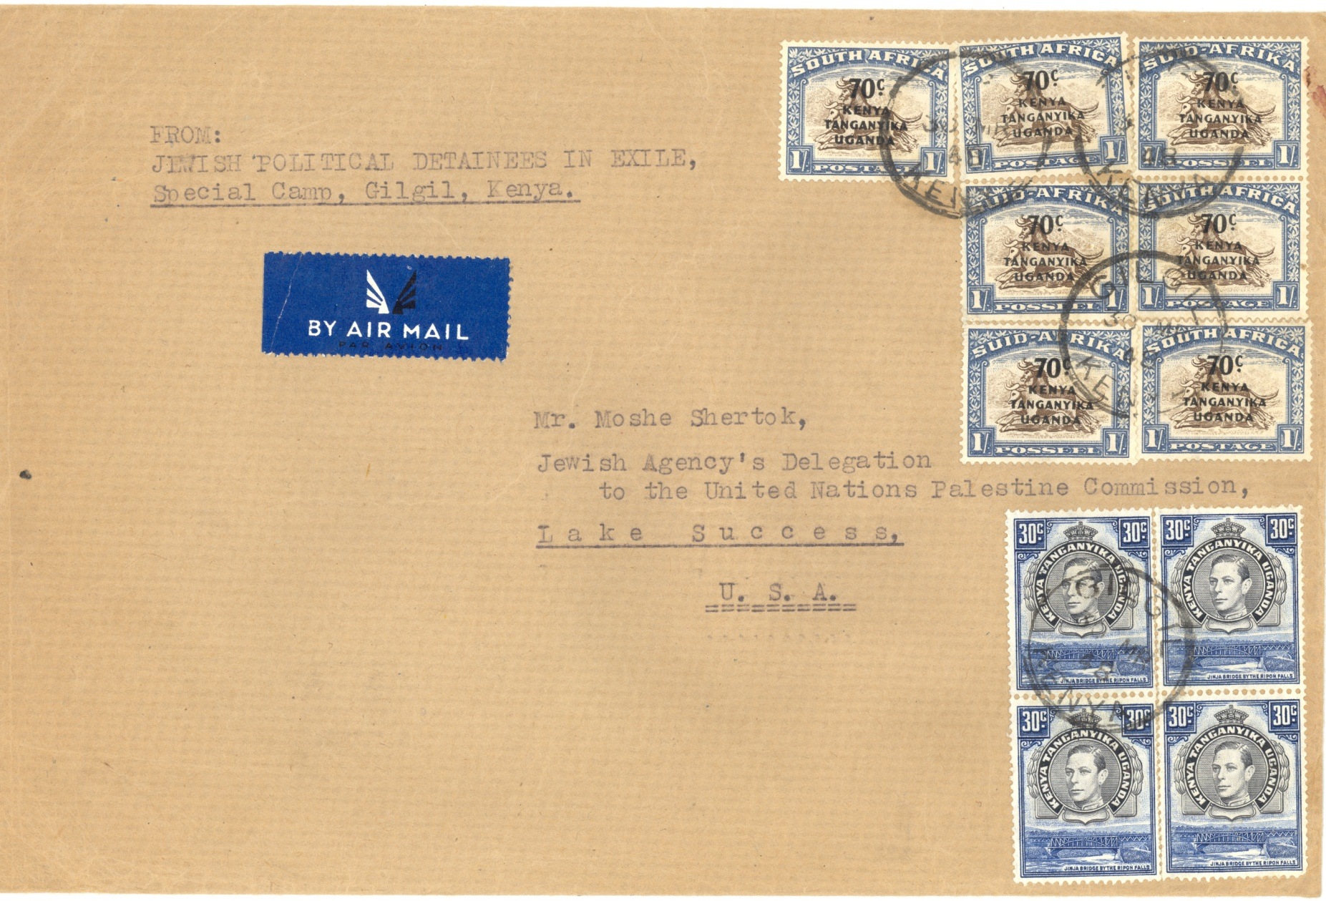
#133 Jewish History Overview of Palestine and Israel through Holy Land Stamps
World War II – Displaced Person Camps
Camp in Gilgil, Kenya
Slide 45
Notes:
Slide 45: Camp In Gilgil, Kenya. The British also sent refugees to a camp in Gilgil, Kenya where the British were also sending those who were intercepted.

Slide 48
#133 Jewish History Overview of Palestine and Israel through Holy Land Stamps
Interim Period April 15 through May 15, 1948
On November 17, 1947, the United Nations General assembly voted to partition Palestine into two states: Jewish and Arab.
The end of the British Mandate rule was set for May 14, 1948.
The British, instead of providing for a gradual and orderly takeover of the administration of the postal system (as well as the government itself) by the new state, abruptly closed all post offices between April 15 and May 14, 1948. These four weeks are known as the INTERIM PERIOD.
Slide 45a
Notes:
Slide 45: Interim Period

Slide 49
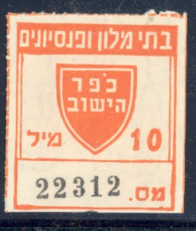
#133 Jewish History Overview of Palestine and Israel through Holy Land Stamps
Mandate Period – Jewish Agency-issued Revenue Stamps
Used for hotel
Slide 46
Notes:
Slide 46 – Mandate Hotel revenue stamp. Let me go back in time for a moment. During the Mandate, the Jewish Agency was formed. It provided for the needs of the Jews and acted as a Provisional Government for Jews in Palestine. To raise funds, the agency as well as various cities and towns issued numerous revenue stamps. These were used for nearly everything.

Slide 50
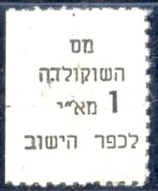
#133 Jewish History Overview of Palestine and Israel through Holy Land Stamps
Mandate Period – Jewish Agency-issued Revenue Stamps
Used for chocolate
Slide 47
Notes:
Slide 47: Mandate – Chocolate revenue stamp. Let me go back in time for a moment. During the Mandate, the Jewish Agency was formed. It provided for the needs of the Jews and acted as a Provisional Government for Jews in Palestine. To raise funds, the agency as well as various cities and towns issued numerous revenue stamps. These were used for nearly everything.

Slide 51
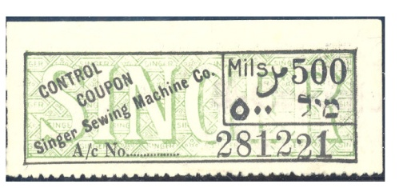
#133 Jewish History Overview of Palestine and Israel through Holy Land Stamps
Mandate Period – Jewish Agency-issued Revenue Stamps
Used for Singer
sewing machine
Slide 48
Notes:
Slide 48: Singer Sewing Machine revenue stamp. Let me go back in time for a moment. During the Mandate, the Jewish Agency was formed. It provided for the needs of the Jews and acted as a Provisional Government for Jews in Palestine. To raise funds, the agency as well as various cities and towns issued numerous revenue stamps. These were used for nearly everything.

Slide 52
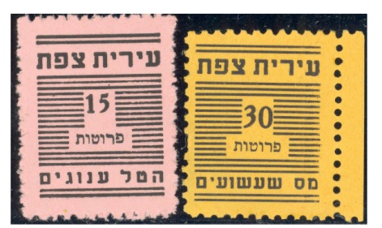
#133 Jewish History Overview of Palestine and Israel through Holy Land Stamps
Mandate Period – City-Issued Revenue Stamps
Safad
Slide 49
Notes:
Slide 48: City issued revenue stamp - Safad. Let me go back in time for a moment. During the Mandate, the Jewish Agency was formed. It provided for the needs of the Jews and acted as a Provisional Government for Jews in Palestine. To raise funds, the agency as well as various cities and towns issued numerous revenue stamps. These were used for nearly everything.

Slide 53
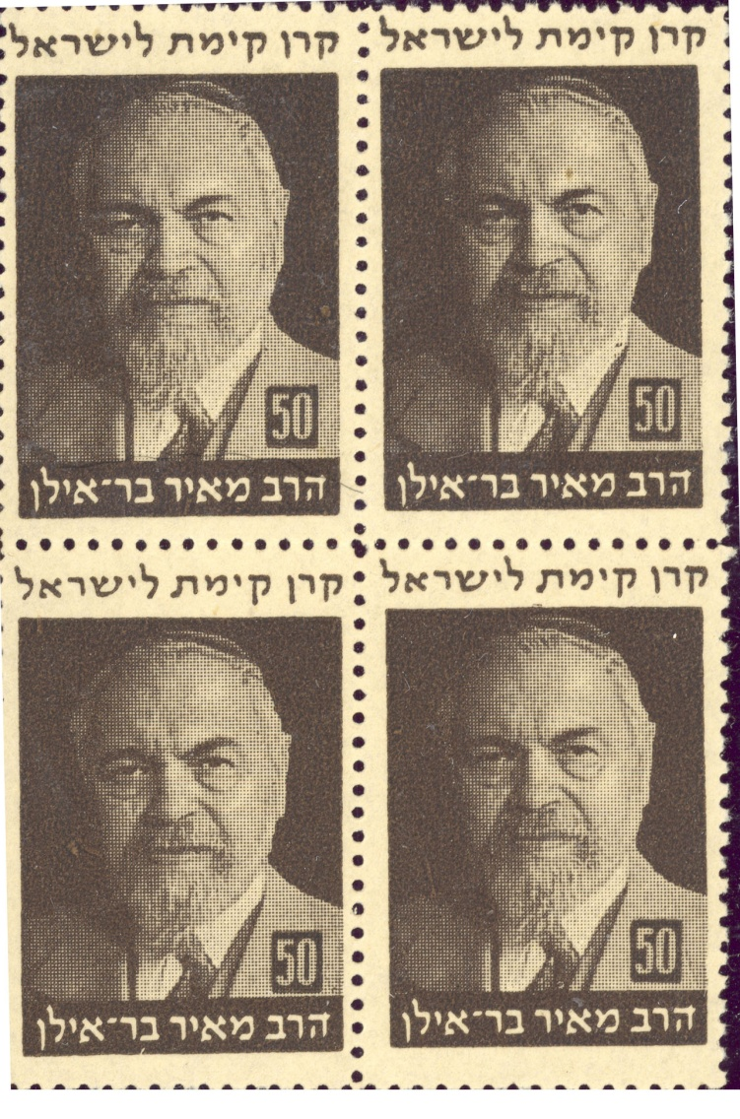
#133 Jewish History Overview of Palestine and Israel through Holy Land Stamps
JNF – Jewish National Fund Stamps
Bar Ilan
JNF stamps raised funds for land purchase in
Palestine
In Hebrew, JNF is
Keren Kayemet
Le Yisrael or KKL
Slide 50
Notes:
Slide 50: JNF revenue stamps. Bar Ilan Now, we need to go further back in history. Dr. Theodore Herzl founded the modern Zionist movement. The first Zionist Congress was held in Basel, Switzerland in 1897. At the fifth Zionist Congress in 1901, a fund raising arm was established: The Jewish National Fund, or JNF. In Hebrew it is Keren Kayemet Le Yisrael or KKL. Its main aim was to raise funds for the purchase of land in Palestine. One of the methods used to raise funds was the issuance of stamps (or labels), tags, and other items. The first stamps were issued in 1902.

Slide 54
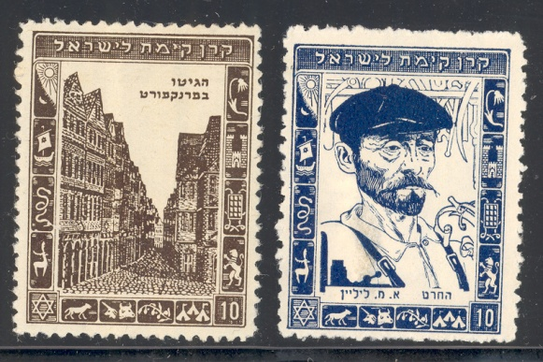
#133 Jewish History Overview of Palestine and Israel through Holy Land Stamps
JNF – Jewish National Fund Stamps
Diaspora Jewry
Slide 51
Notes:
Slide 51: JNF stamps - Diaspora Jewry. Now, we need to go further back in history. Dr. Theodore Herzl founded the modern Zionist movement. The first Zionist Congress was held in Basel, Switzerland in 1897. At the fifth Zionist Congress in 1901, a fund raising arm was established: The Jewish National Fund, or JNF. In Hebrew it is Keren Kayemet Le Yisrael or KKL. Its main aim was to raise funds for the purchase of land in Palestine. One of the methods used to raise funds was the issuance of stamps (or labels), tags, and other items. The first stamps were issued in 1902.

Slide 55
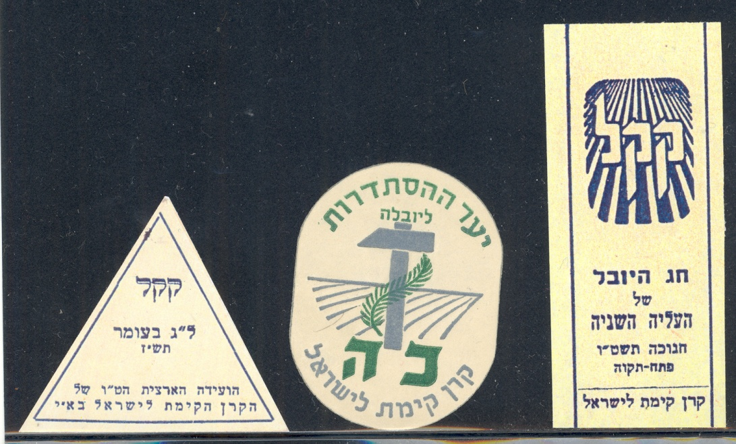
#133 Jewish History Overview of Palestine and Israel through Holy Land Stamps
JNF – Jewish National Fund Stamps
Various Tags
Slide 52
Notes:
Slide 52: Various tags Now, we need to go further back in history. Dr. Theodore Herzl founded the modern Zionist movement. The first Zionist Congress was held in Basel, Switzerland in 1897. At the fifth Zionist Congress in 1901, a fund raising arm was established: The Jewish National Fund, or JNF. In Hebrew it is Keren Kayemet Le Yisrael or KKL. Its main aim was to raise funds for the purchase of land in Palestine. One of the methods used to raise funds was the issuance of stamps (or labels), tags, and other items. The first stamps were issued in 1902.

Slide 56
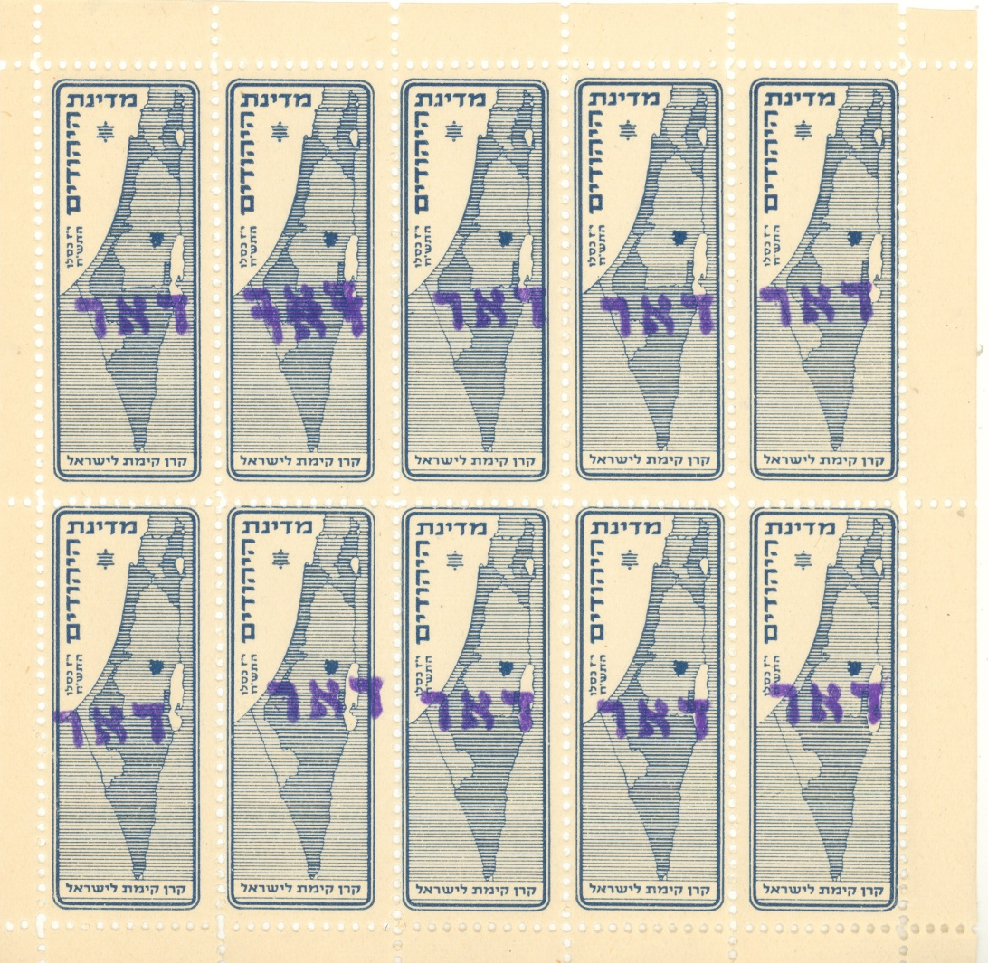
#133 Jewish History Overview of Palestine and Israel through Holy Land Stamps
Interim Period - JNF overprints - DOAR
Jewish Agency (Minhalelet Ha’am) kept postal services going.
Tel Aviv
Jewish Agency overprinted JNF stamps with Hebrew word for posts – DOAR.
Tel Aviv stamps – straight line overprint
Slide 53
Notes:
Slide 53: Tel Aviv. Ok back to 1948. It was the Jewish Agency (or MINHALELET HA’AM in Hebrew) that stepped in to fill this void in government and the postal services. The Jewish Agency ordered all postal employees in the proposed Jewish areas of Palestine to remain on the job after April 15, 1948. The Agency took various JNF stamps and overprinted them with the Hebrew word for posts or mail DOAR. There are two basic types of overprints. Those made in Tel Aviv have a straight line. This stamp shows the map of the proposed Jewish State.

Slide 57
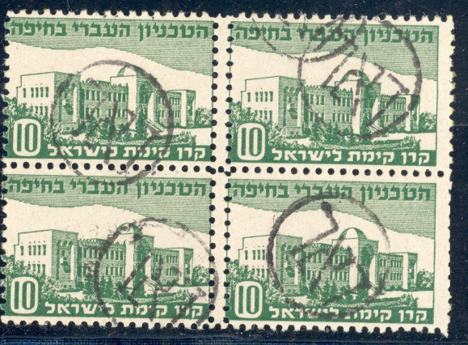
#133 Jewish History Overview of Palestine and Israel through Holy Land Stamps
Interim Period - JNF overprints - DOAR
Haifa
DOAR in a circle
Slide 54
Notes:
Slide 54: Haifa. Those from Haifa have DOAR in a circle.
These were valid for domestic postage only. However, some did get used in international mail. These stamps were used in 80 different cities and towns to mail letters.

Slide 58
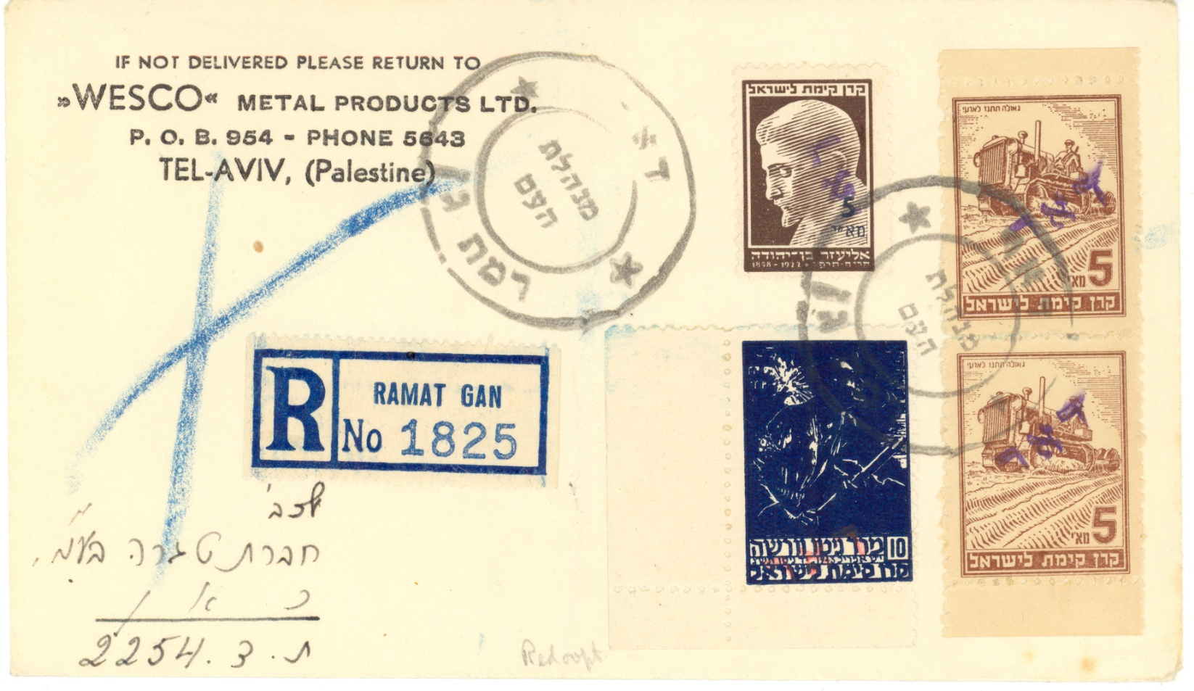
#133 Jewish History Overview of Palestine and Israel through Holy Land Stamps
Interim Period - JNF overprints - DOAR
Ramat Gan
Slide 55
Notes:
Slide 55: from Ramat Gan

Slide 59
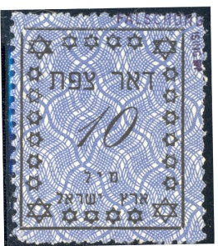
#133 Jewish History Overview of Palestine and Israel through Holy Land Stamps
Interim Period – Siege Cities
Cities under Arab Siege printed their own stamps and set up their own postal systems.
Safad
Slide 56
Notes:
Slide 56: Safad. During this time many areas of the country were under Arab siege. In order to provide postal services, the local authorities printed their own stamps and set up their own postal systems. The siege cities included: SAFAD, north of the Sea of Galilee, NAHARIYA north of Haifa, RISHON LE ZION south east of Tel Aviv, and JERUSALEM.

Slide 60
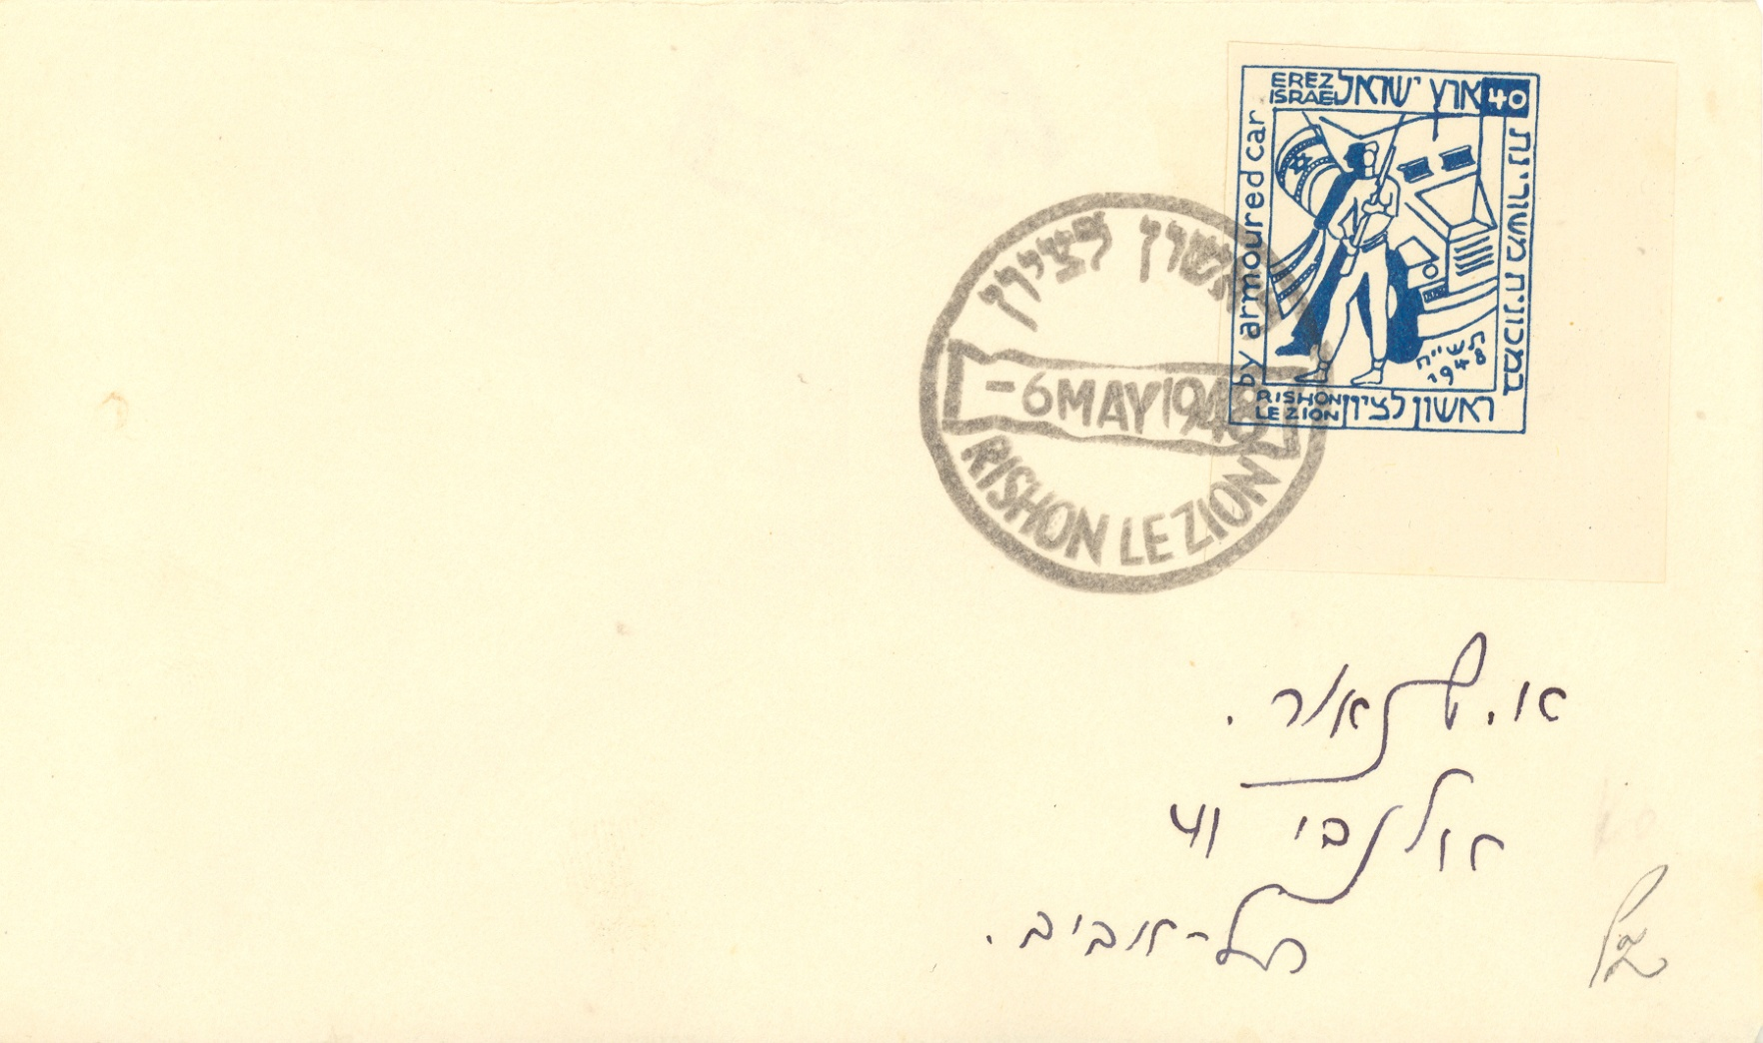
#133 Jewish History Overview of Palestine and Israel through Holy Land Stamps
Interim Period – Siege Cities
Cities under Arab Siege printed their own stamps and set up their own postal systems.
Rishon Le Zion
Slide 57
Notes:
Slide 57: Rishon Le Zion Be careful if you collect the INTERIM material. There is much fraudulent and faked material in this period. There is also much philatelic material. That is many covers have the stamp and postmark only – they did not go thru the mails. Pure commercial usage (like the one I showed you from Ramat Gan) is hard to find. More often than not the covers that you see, even though they may have gone thru the mail, were created by or for the philatelist. In fact, if it were not for these covers, we may not have anything.

Slide 61
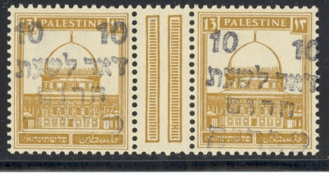
#133 Jewish History Overview of Palestine and Israel through Holy Land Stamps
Interim Period – Emergency Post
Mandate pictorial stamps overprinted in Hebrew EMERGENCY POST
Slide 58
Notes:
Slide 58: Emergency Post. Two areas I want to show you are the EMERGENCY POST and PATCO labels. The Mandate pictorial stamps were overprinted in Hebrew, EMERGENCY POST in NAHALAL, AFULA, and TIBERIAS

Slide 62
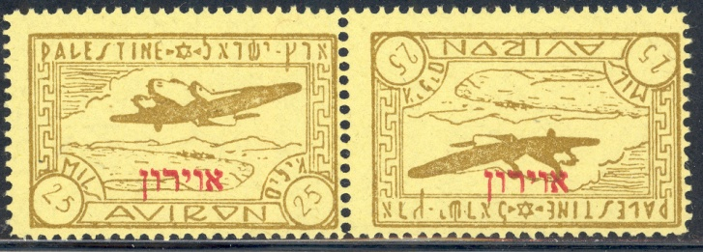
#133 Jewish History Overview of Palestine and Israel through Holy Land Stamps
Interim Period – PATCO
Palestine Air Transport Company labels - pure philatelic creations but they are collected.
Slide 59
Notes:
Slide 59: PATCO. Labels featuring a plane were overprinted PATCO for Palestine Air Transport Company. These are pure philatelic creations. However, they are collected. Be very careful if you should buy any of this material.

Slide 63
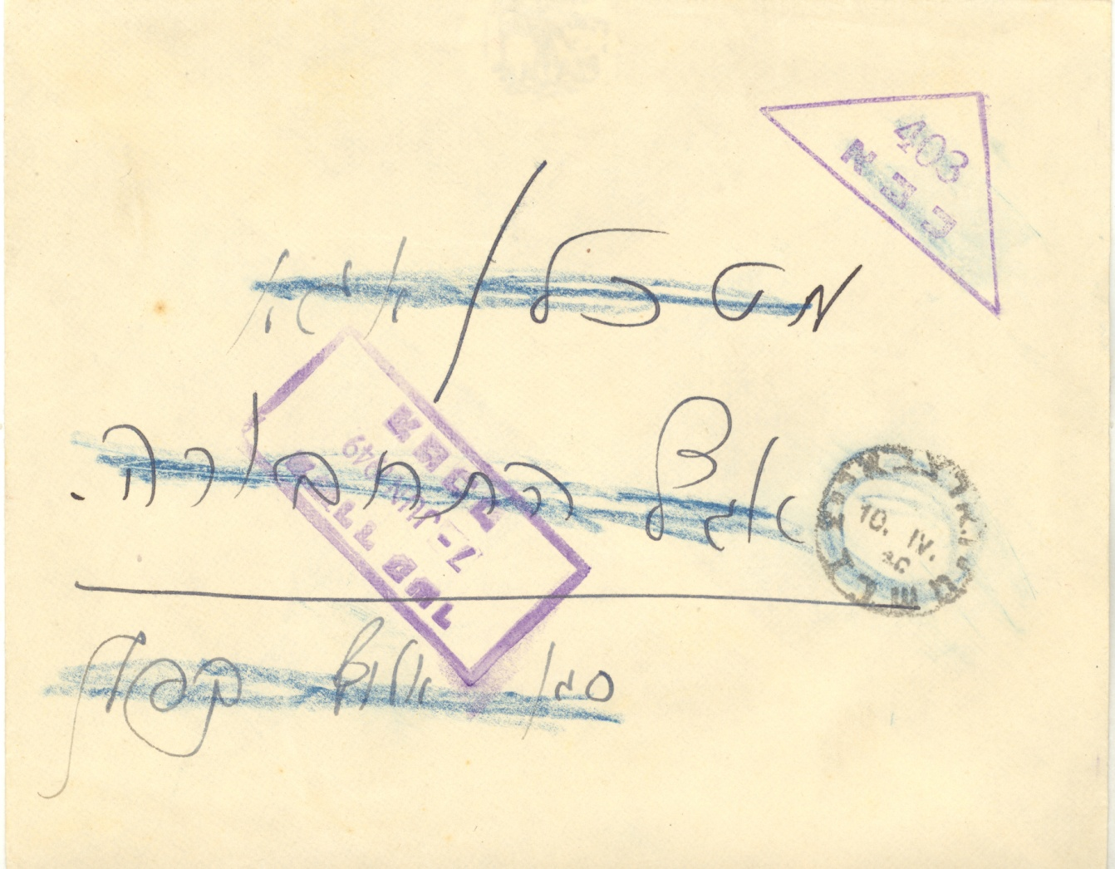
#133 Jewish History Overview of Palestine and Israel through Holy Land Stamps
Modern Israel – Military Mail
Military set up its own postal service.
Slide 60
Notes:
Slide 60: MILITARY MAIL We now come to the MODERN ISRAEL period. The Jewish state of Israel was proclaimed on Friday May 14, 1948. This was also a time of war. The nascent state was invaded by five Arab armies. The military set up its own postal service. This is a story in itself.

Slide 64
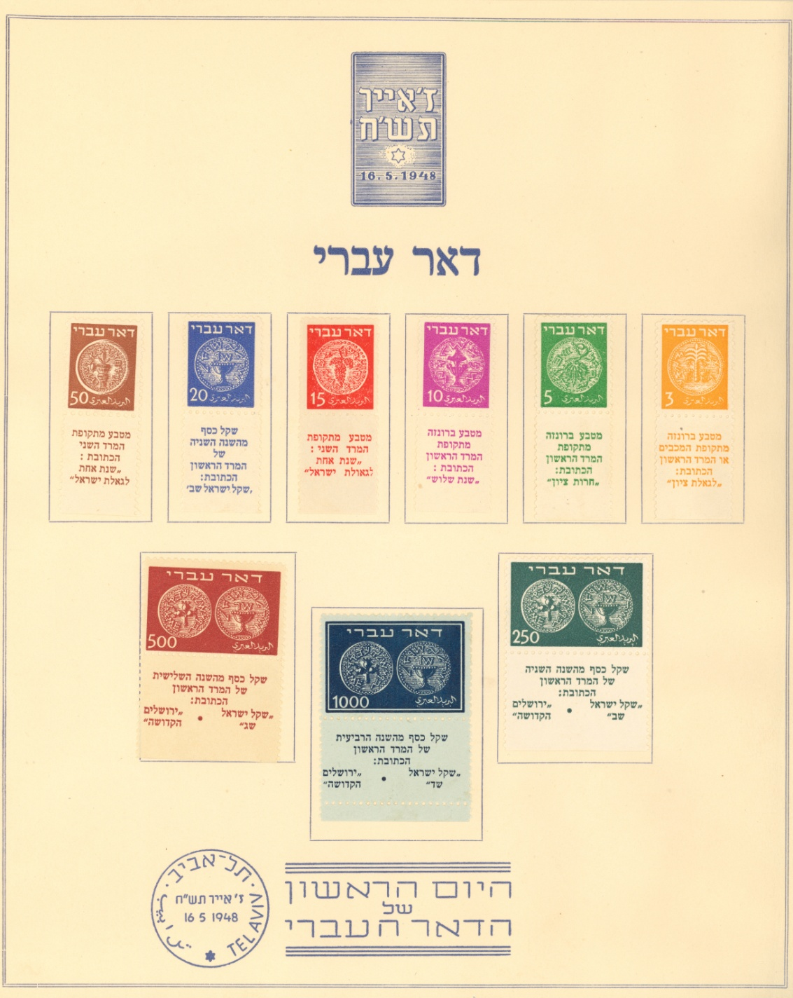
#133 Jewish History Overview of Palestine and Israel through Holy Land Stamps
Modern Israel – May 14, 1948
First issue on presentation sheet
Hebrew Post – DOAR IVRI
First stamps issued on Sunday, May 16, 1948
Slide 61
Notes:
Slide 61: First Issue on presentation sheet. The production of Israel’s first postage stamps is a most interesting story. During the Interim Period, a few people gathered at the Government Printing Press factory and worked hard under the dangers of war to prepare and produce stamps for the new State soon to be proclaimed. The stamp designs chosen were those of the ancient coins from 1800 years ago when the Jews were struggling for freedom from Rome. They started printing the stamps on May 4th by typographical process. As the new name of the State had not yet been decided, they inscribed the words DOAR IVRI, "Hebrew Post", in Hebrew and Arabic and the value was printed in figures only. At the time, the unit of currency was in milliemes (or mils).
The people creating the stamps were not experienced printers and had very little technical equipment or the appropriate paper and ink for the job. They collected whatever stocks of paper were available locally. The printing and perforation of the stamps was primitive, as the situation prevented them from paying much attention to the process of printing. As a result, there are many printing and paper varieties.
As the proclamation was not issued until later in the day on Friday May 14 and no work could (or would) be done on the Sabbath, the first stamps were issued on Sunday May 16.

Slide 65
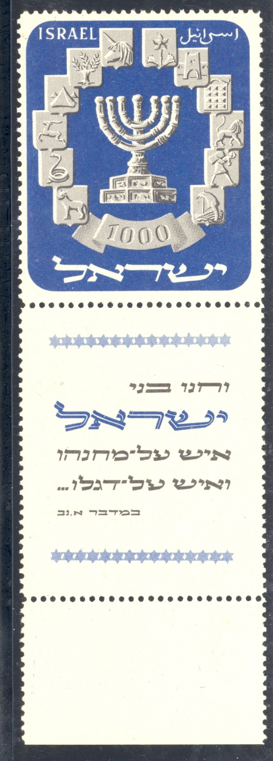
#133 Jewish History Overview of Palestine and Israel through Holy Land Stamps
Modern Israel – Tabs
Two-Part Tab
NOTE TO COLLECTORS: Both the descriptive tab and the selvege must be kept.
Tabs: Margins around the stamp sheet describing the stamps.
Slide 62
Notes:
Slide 62: Two part tab. As many people would not understand the words on the ancient coins, it was decided to print a description of the bottom row of the selvege – what collectors call the margins around the sheet of stamps. Thus the TAB was born. In the early years, collectors did not know what to make of the tabs so many tabs were torn off.
These tabs continue to this day. Now please note this. On some early issues the tab came in two parts: the descriptive tab itself and a small piece of selvege. BOTH must be kept.

Slide 66
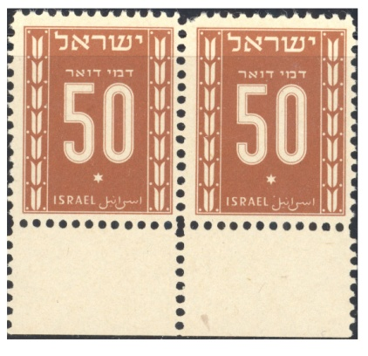
#133 Jewish History Overview of Palestine and Israel through Holy Land Stamps
Modern Israel – Tabs
Blank Tab
On POSTAGE DUES and OFFICIAL STAMPS, selvege is blank but treated as tab.
Slide 63
Notes:
Slide 63: Blank Tab. On POSTAGE DUES and OFFICIAL stamps, nothing was printed in the selvege. Nevertheless, the blank selvege is collected as if it were a tab.
Since 1948 there have been a few currency systems in Israel. The government kept dividing by 10, 100 or 1000. The current currency, in use since 1986, is NEW ISRAEL SHEKELS (NIS).

Slide 67
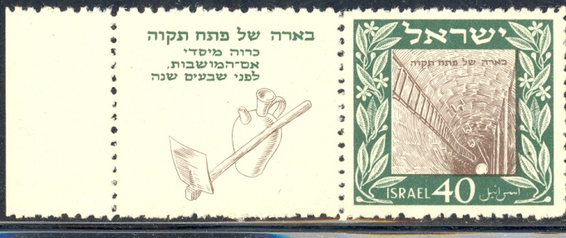
#133 Jewish History Overview of Palestine and Israel through Holy Land Stamps
Modern Israel – Topical Stamps
Petach Tikvah
Slide 64
Notes:
Slide 64: Petach Tikvah. In its 60 years, Israel has issued many beautiful stamps. The most frequent topics have been the various Jewish Holidays, Memorial Day, Independence Day, many personalities, and history.

Slide 68
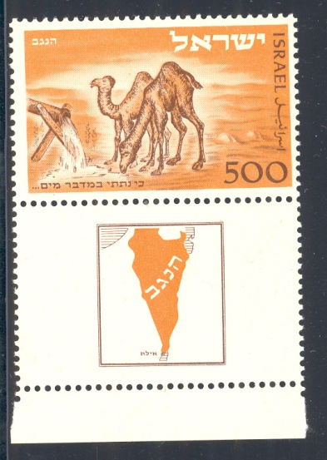
#133 Jewish History Overview of Palestine and Israel through Holy Land Stamps
Modern Israel – Topical Stamps
Negev Camel
Slide 65
Notes:
Slide 65: Negev Camel. In its 60 years, Israel has issued many beautiful stamps. The most frequent topics have been the various Jewish Holidays, Memorial Day, Independence Day, many personalities, and history.

Slide 69
#133 Jewish History Overview of Palestine and Israel through Holy Land Stamps
Modern Israel – Topical Stamps
High Holidays
Slide 66
Notes:
Slide 66: High Holidays. In its 60 years, Israel has issued many beautiful stamps. The most frequent topics have been the various Jewish Holidays, Memorial Day, Independence Day, many personalities, and history.

Slide 70
#133 Jewish History Overview of Palestine and Israel through Holy Land Stamps
Modern Israel – Topical Stamps
Clock Towers
Slide 67
Notes:
Slide 67: Clock Towers. In its 60 years, Israel has issued many beautiful stamps. The most frequent topics have been the various Jewish Holidays, Memorial Day, Independence Day, many personalities, and history.

Slide 71
#133 Jewish History Overview of Palestine and Israel through Holy Land Stamps
Modern Israel – Topical Stamps
3000 years Jerusalem
Slide 68
Notes:
Slide 68: 3000 Years Jerusalem In its 60 years, Israel has issued many beautiful stamps. The most frequent topics have been the various Jewish Holidays, Memorial Day, Independence Day, many personalities, and history.

Slide 72
#133 Jewish History Overview of Palestine and Israel through Holy Land Stamps
Modern Israel – Topical Stamps
Personalities
Slide 69
Notes:
Slide 69: Personalities. In its 60 years, Israel has issued many beautiful stamps. The most frequent topics have been the various Jewish Holidays, Memorial Day, Independence Day, many personalities, and history.

Slide 73
#133 Jewish History Overview of Palestine and Israel through Holy Land Stamps
Modern Israel – Topical Stamps
770 Eastern Parkway or Chabad
Slide 70
Notes:
Slide 70: 770 Eastern Parkway or Chabad. In its 60 years, Israel has issued many beautiful stamps. The most frequent topics have been the various Jewish Holidays, Memorial Day, Independence Day, many personalities, and history.

Slide 74
#133 Jewish History Overview of Palestine and Israel through Holy Land Stamps
Modern Israel – Definitives
Coin Stamp
Slide 71
Notes:
Slide 71: Coin Stamp definitive Israeli stamps can be divided into two categories: commemorative and definitives. The commemoratives are issued just once. Commemoratives as the name implies, mark an event.
Definitives are regular issue stamps. The definitive are issued many times. These are quite collectible as there are differences in paper and most notably phosphor tagging, used by the automated sorting and cancelling machines. The same basic stamp can have no phosphor bars, a bar on the right, a bar on the left or two bars. The differences were required due to changing postal rates.

Slide 75
#133 Jewish History Overview of Palestine and Israel through Holy Land Stamps
Modern Israel – Definitives
Shekel Stamp
Slide 72
Notes:
Slide 72: Shekel Stamp definitive Israeli stamps can be divided into two categories: commemorative and definitives. The commemoratives are issued just once. Commemoratives as the name implies, mark an event.
Definitives are regular issue stamps. The definitive are issued many times. These are quite collectible as there are differences in paper and most notably phosphor tagging, used by the automated sorting and cancelling machines. The same basic stamp can have no phosphor bars, a bar on the right, a bar on the left or two bars. The differences were required due to changing postal rates.

Slide 76
#133 Jewish History Overview of Palestine and Israel through Holy Land Stamps
Modern Israel – Definitives
Landscape - Elat
Slide 73
Notes:
Slide 73: Landscape Elat definitive Israeli stamps can be divided into two categories: commemorative and definitives. The commemoratives are issued just once. Commemoratives as the name implies, mark an event.
Definitives are regular issue stamps. The definitive are issued many times. These are quite collectible as there are differences in paper and most notably phosphor tagging, used by the automated sorting and cancelling machines. The same basic stamp can have no phosphor bars, a bar on the right, a bar on the left or two bars. The differences were required due to changing postal rates.

Slide 77
#133 Jewish History Overview of Palestine and Israel through Holy Land Stamps
Modern Israel – Stationery
Stationery includes: air letter sheets, postal cards and envelopes.
Slide 74
Notes:
Slide 74: Stationery. Israel has also issued stationery. These include air letter sheets, postal cards, picture postal cards, and envelopes. I wrote the book on the subject many years ago. It is in desperate need of an update.
Definitives are regular issue stamps. The definitive are issued many times. These are quite collectible as there are differences in paper and most notably phosphor tagging, used by the automated sorting and cancelling machines. The same basic stamp can have no phosphor bars, a bar on the right, a bar on the left or two bars. The differences were required due to changing postal rates.

Slide 78
#133 Jewish History Overview of Palestine and Israel through Holy Land Stamps
Modern Israel – Jordan Stamps
Jordan controlled West Bank of the Jordan River 1948-1967 and overprinted their stamps for West Bank.
Slide 75
Notes:
Slide 75: Jordan (Transjordan) stamps. After the War of Independence, Jordan was in control of the West Bank of the Jordan River. Between 1948 and 1967, Jordan overprinted their stamps for the West Bank of the Jordan.

Slide 79
#133 Jewish History Overview of Palestine and Israel through Holy Land Stamps
Modern Israel – Egypt Stamps
Egypt controlled Sinai and Gaza 1948-1967 and overprinted their stamps for these areas.
Slide 76
Notes:
Slide 76: Egypt stamps. Egypt did likewise for Sinai and Gaza. These stamps and the covers are considered as part of Holy Land Philately. After the June 1967 War, Israel won Gaza and the Sinai Peninsula from Egypt, the West Bank of the Jordan from Jordan and the Golan Heights from Syria.

Slide 80
#133 Jewish History Overview of Palestine and Israel through Holy Land Stamps
Modern Israel – Radio Revenue Stamps
Slide 77
Notes:
Slide 77: RADIO REVENUES
Israel has also issued many revenue stamps. These are used on nearly every thing.

Slide 81
#133 Jewish History Overview of Palestine and Israel through Holy Land Stamps
Modern Israel – Purchase Revenue Stamps
Slide 78
Notes:
Slide 78: PURCHASE REVENUES
Israel has also issued many revenue stamps. These are used on nearly every thing.

Slide 82
#133 Jewish History Overview of Palestine and Israel through Holy Land Stamps
Modern Israel – Special Revenue Stamps for areas won in 1967
Military Revenues for West Bank
Slide 79
Notes:
Slide 79: MILITARY REVENUES FOR WEST BANK
There are special revenue stamps for the areas won in 1967

Slide 83
#133 Jewish History Overview of Palestine and Israel through Holy Land Stamps
Modern Israel – Special Revenue Stamps for areas won in 1967
Exit Pass from West Bank with Israel Revenues
Slide 80
Notes:
Slide 80: EXIT PASS FROM WEST BANK WITH ISRAEL REVENUES
There are special revenue stamps for the areas won in 1967
Holyland Philately is a very rich area for collecting and study.

Slide 84
#133 Jewish History Overview of Palestine and Israel through Holy Land Stamps
Just a small taste of what is involved in Holy Land philately.
Thank you!
Slide 80
Notes:
You can get a good knowledge of Jewish history from the stamps and mails. It spans hundreds of years and includes some very nice collectible material. In this slide show, I did not cover every aspect. I hope that I have given you a small taste of what is involved.

