Slide 1
#86 – The History of Zionism through the Stamps of Israel by Bea Stadtler

Slide 2
#1
Notes:
Postage stamps are not just tiny bits of colored paper used for sending writing of one sort or another from one place to another. They are much more. To collectors, or philatelists, stamps are a whole world of knowledge. The way a stamp is cancelled and the postmark on the envelope all mean something to a collector. But the stamps themselves are most important.

Slide 3
1970 issue – Jabotinsky Defense of Jerusalem in 1920
#1A
Notes:
Don’t forget that stamps are permitted entry into every country I the world, so they can carry a message with them. This way they become tools of propaganda—sometimes good and sometimes bad. But they are also tools for the Educator. They tell the history and geography of a country. Biography of famous citizens are told through stamps, and one can even tell the politics of a country by the stamps they issue. For instance, a stamp of Jabotinsky was only printed in 1970 when David Ben Gurion was out of power. (Jabotinsky [Defense of Jerusalem in 1920] 1970 issue).

Slide 4
Personality Series – 1978 issue
#1B
Notes:
Just recently Yair or Avraham Stern appeared on a stamp in a series which included five of the underground military heroes of Israel in British Mandate times and during the War of Independence. Stern was the head of the Stern Gang also know as Lehi. His picture would probably never have been included except that the Herut Party is in power. The others in the series are Eliyahu Golomb, David Raziel, Dr. Moshe Sneh and Yitzhak Sadeh. [1978 Personalities Series]

Slide 5
#1C
Notes:
Israel’s Postal Service began to operate May 16, 1948, the day after the State was established. Two weeks before, Jewish leaders in Palestine began planning for the postal needs of their country. Usually it takes months to make a stamp. It must be designed, colors must be chosen, and the printing is very involved. But this first stamp was brought out in less than 12 working days. The first stamps did not carry the name of Israel, for they were prepared before the state was named, so the first stamps just say ‘Doar Ivri’ –Hebrew Mail.

Slide 6
Ha-Kotel Victory Issue
#1D
Notes:
The State of Israel, although so small and you, issues stamps that are considered to be among the most beautiful in the world. Israeli stamps tell the story of that proud nation from Biblical times to the present. And Israeli stamps can be used to teach --in addition to teaching history, geography, and biography, Israeli stamps can also tell the story of Zionism. Zionism is many different things to many different people. Zionism is the tears wept at the Kotel Ha-Maaravi – the Western Wall – the first time you are there—for YOU are there after 2,000 years (Ha-Kotel Victory Issue).

Slide 7
1968 issue – 100th Anniversary
#1E
Notes:
Zionism is staring in awe at the beauty of the Jezreel Valley from Mt. Tabor, and Zionism is that swelling in the throat when you sing Hatikva (1968 100th Anniversary).

Slide 8
#1F
Notes:
The story of Zionism can also be told in many ways – in history books, political science debates, geography lectures, biographical sketches, but today we are going to tell the story of Zionism through Israeli stamps. Zionism is a word that is very much in the news these days, so it would appear that Zionism is a new word. And it is – but it is also a very old word. The modern word Zionism, was coined by Nathan Birnbaum in the 19th century. It means a movement whose goal is the return of the Jewish people to Eretz Yisrael, its ancient homeland.
But Zion is also a very ancient word. It comes from the name of a fortress – one of the strongest defenses of the city of Jerusalem when King David took over this city from the Jebusites in the 10th century BCE, almost 3,000 years ago.

Slide 9
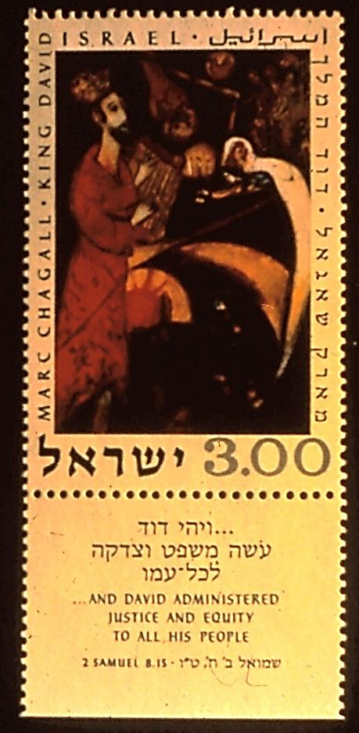
1960 Festival Series
1969 issue
#2,3
Notes:
The Festival Stamps… 1968. Portrayals of King David as a youth and an old man are shown on stamps of the 1960 Festival Series and on an issue of 1969. The latter is based on a painting by Marc Chagall.

Slide 10
Isaiah – stamp issued 1973
#4
Notes:
As time went on, both names, Zion and Jerusalem were used in referring to this city. The Hebrew Prophets, especially referred to the city in this way. Isaiah, for instance, says “For out of Zion shall go forth the Law and the Word of the Lord from Jerusalem” (Isaiah Stamp 1973). In time, Zion also became the poetic name for the entire Promised Land.

Slide 11
Father Abraham
Stamps honoring art of E.M. Lilien, issued in 1977
#5
Notes:
And yet, Zionism began even earlier, for we remember God telling our Father Abraham (in 1977 a set of stamps showing the works of artist E.M. Lillien appeared, one of this set being a sketch of Abraham), the initiator of monotheism, “and I will give to you and your children after you, the land where you are a stranger, all the land of Canaan (another name for the Holy Land), for an everlasting possession; and I will be your God. “ Genesis 17:18

Slide 12
Matriarchs – 1977 Festival Issue
#6
Notes:
“And the Lord said unto Abram…lift up your eyes and look from the place where you stand—northward and southward and eastward and westward—to you will I give it and to your children forever “ (Gen. 13:14-15). Abraham and Sara (Sara appears as one of the Matriarchs show on the 1977 Festival Issue).
“And the Lord said unto Abram…lift up your eyes and look from the place where you stand—northward and southward and eastward and westward—to you will I give it and to your children forever “ (Gen. 13:14-15). Abraham and Sara (Sara appears as one of the Matriarchs show on the 1977 Festival Issue).

Slide 13
12 Tribes – Definitives – stamps issued 1956
Reuben, Levi, Naphtali, Asher
#7
Notes:
The great-grandchildren of Abraham and Sara were the 12 sons of Jacob. The 12 sons became the 12 Tribes. The 12 Tribes of Israel appear on the Definitives of 1956, showing the emblems of the Tribes based on Biblical quotations.

Slide 14
12 Tribes – Definitives – stamps issued 1956
Zebulun, Gad, Judah, Simeon
#8
Notes:
The great-grandchildren of Abraham and Sara were the 12 sons of Jacob. The 12 sons became the 12 Tribes. The 12 Tribes of Israel appear on the Definitives of 1956, showing the emblems of the Tribes based on Biblical quotations.

Slide 15
12 Tribes – Definitives – stamps issued 1956
Benjamin, Joseph, Issachar, Dan
#9
Notes:
The great-grandchildren of Abraham and Sara were the 12 sons of Jacob. The 12 sons became the 12 Tribes. The 12 Tribes of Israel appear on the Definitives of 1956, showing the emblems of the Tribes based on Biblical quotations.

Slide 16
Asher, Dan, Benjamin
#10
Notes:
The 12 Tribes of Israel Stamps in 1973 as portrayed by Marc Chagall in stained glass windows for the synagogue of the Hadassah Hospital in Jerusalem.

Slide 17
12 Tribes – Chagall stained glass windows – stamps issued 1973
Gad, Naphtali, Joseph
#11
Notes:
The 12 Tribes of Israel Stamps in 1973 as portrayed by Marc Chagall in stained glass windows for the synagogue of the Hadassah Hospital in Jerusalem.

Slide 18
12 Tribes – Chagall stained glass windows – stamps issued 1973
Issachar, Zebulun, Reuben
#12
Notes:
The 12 Tribes of Israel Stamps in 1973 as portrayed by Marc Chagall in stained glass windows for the synagogue of the Hadassah Hospital in Jerusalem.

Slide 19
12 Tribes – Chagall stained glass windows – stamps issued 1973
Simeon, Levi, Judah
#13
Notes:
The 12 Tribes of Israel Stamps in 1973 as portrayed by Marc Chagall in stained glass windows for the synagogue of the Hadassah Hospital in Jerusalem.

Slide 20
Passover Stamps of 1972
#14
Notes:
God pledges this land to Abraham, not once or twice, but many times in the Biblical book of Genesis. Perhaps God, too, is a Zionist. After Joseph, the second youngest son of Jacob was sold into slavery by his brothers, the Jews came down to Egypt because there was a drought in Canaan. And the Jews became slaves to Egyptians, building their pyramids and palaces. Then came Moses, who somewhat reluctantly led them out of the land of Egypt and back to Canaan (one of the Passover Stamps of 1972) shows the Jews departing from Egypt.

Slide 21
1954 Festival Stamp – spies carrying the grapes
#14a
Notes:
But on the way, Moses was commanded by God to send spies into the land of Canaan. Joshua and Caleb, two of the spies came back from the place they called the Valley of Eshcol (which means cluster) with a cluster of grapes. So fertile was the land and so large the cluster that it took the two men to carry the grapes on a pole between them. And Joshua and Caleb reported “we came into the land where you sent us and surely it is a land flowing with milk and honey,” (1954 Festival Stamp –spies carrying the grapes) and the Israelites lived in Canaan for hundreds of years.

Slide 22
Stamps honoring art of E.M. Lilien, issued in 1977
#15
Notes:
But in 586 B.C.E., the Babylonians conquered the Holy Land, destroyed the temple and took many Jewish captives to Babylon. By the waters of Babylon, there they wept as they remembered Zion. (A painting “By the Waters of Babylon” is one of the set of stamps honoring the art of E.M. Lilien, issued in 1977).

Slide 23
Operation Ezra and Nehemia Stamp Commemorating the 20th Anniversary of the Exodus of the Jews from Iraq – issued in 1970
#16
Notes:
It was Nehemia, cupbearer to the King of Babylon, who was appointed governor of Jerusalem and returned to rebuild that city, taking with him hundreds of Jewish exiles. Much later, in about 1950, a group of Jews came to Israel from Iraq. This exodus from Iraq was called Operation Ezra and Nehemia (Operation Ezra and Nehemia Stamp commemorating the 20th anniversary of the exodus of the Jews from Iraq, issued in 1970).

Slide 24
Heroes of Israel Festival stamps - 1961
Judah Maccabee and Simon Bar Kochba
#17
Notes:
The desire to return to the land and the need to fight for freedom in their own land was really Zionism, so that the Maccabees too, were Zionists when they broke the yoke of Syrian Greek tyranny in the Holy Land in 165 B.C.E. (In 1961, a set of three stamps honoring heroes of Israel was issued to mark that year’s festival. Included in the set were portrayals of Judah Maccabee and Simon Bar Kocha.)

Slide 25
Masada - issued 1965
#18
Notes:
Those Jews who later fought with Simon Bar Kochba against the Roman idolators, and those Jews who perished by their own hand on Masada were Zionists, too. (Three stamps showing two views of the mountain itself and one view of one of the palaces, issued in 1965.) The Romans made an effort to wipe from the face of the earth and the memory of man, the Jewish name of the land –Eretz Yisrael (the land of Israel), and Zion. In this way, they thought they would also banish the legal claim of the Jews to the land. To do this they brought back the name of an ancient people who had lived on the seacoast and who had been completely destroyed centuries earlier – the Philistines, or as they Romanized the name – Palestine.

Slide 26
Festival Stamps of 1958 & 1959 – Seven agricultural species of the land
#19
Notes:
Through all the ensuing years, Jews remained on the land—not always many, but always some. Also, during the ensuing years, Jews returned to the land from the diaspora—from Spain, from East Europe, from West Europe and other lands—always they wanted to sit under their vine and fig tree in their own homeland (the Festival Stamps of 1958 and 1959 featured the seven agricultural species of the land which included the grape vine and olive tree).

Slide 27
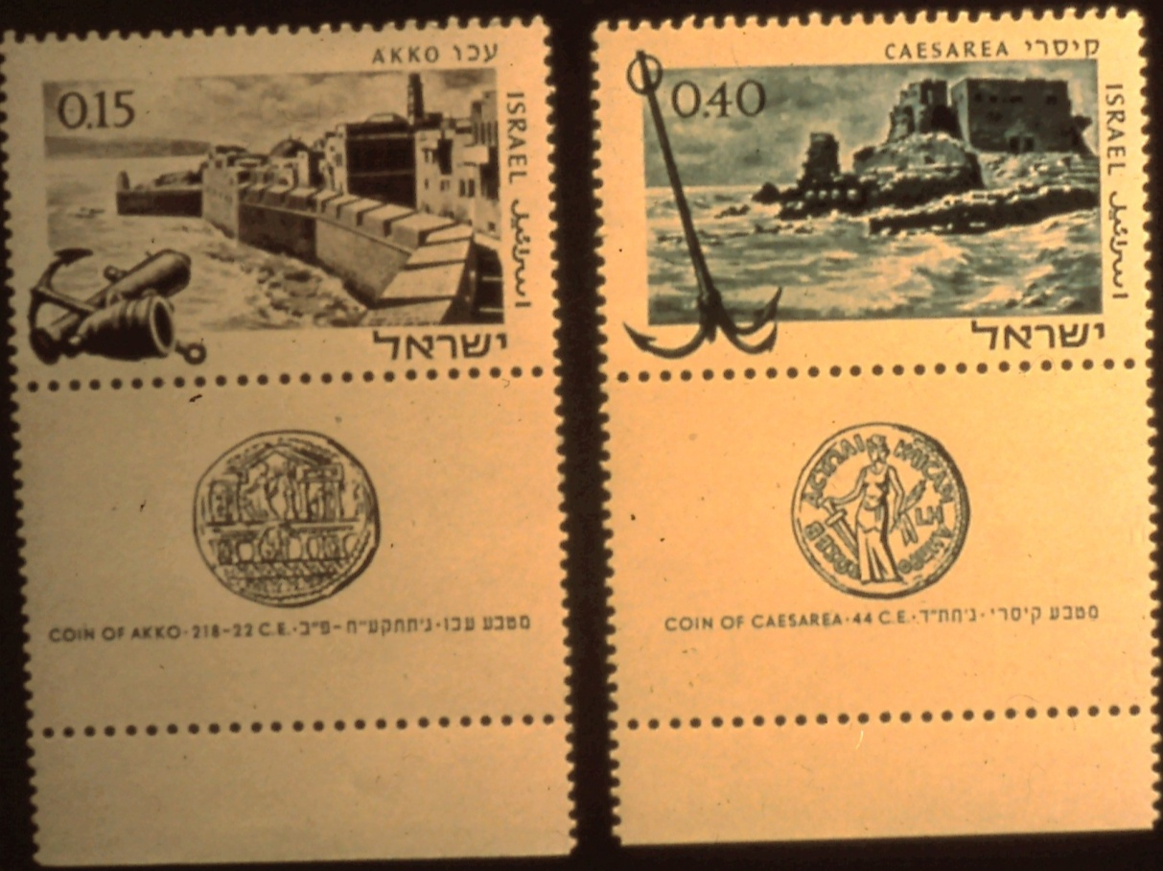
1967 Ports of Israel Issue
Jaffa
Akko
Caesarea
#20-21
Notes:
Mostly, when the Jews returned, they came through the ancient port of Jaffa, but at times, they also came through Akko or Caesarea (the Ancient Ports of Jaffa, Akko and Caesarea appear on the 1967 Ports of Israel issue).
Some came as individuals and some came in groups. There is a special word related to coming to the land. It is Aliya and it means “to go up.” Aliya is a holy act. Usually people made Aliya to the Holy Land, and then they made Aliya to Jerusalem, the holiest of the cities to the Jews. Also, when a Jew goes up to the Torah in the synagogue, he is making an Aliya—this too is a holy act.

Slide 28
Eliezer Ben Yehuda –
Stamp honoring centenary
Of his birth issued 1959
#22
Notes:
In 1881, Eliezer Ben Yehuda (honored with a stamp in 1959 on the occasion of the centenary of his birth) made Aliya to Eretz Yisrael. It was through his intense efforts that the Hebrew language became the accepted language of the newcomers, for he made the ancient Biblical Hebrew into a modern living language, dealing with all aspects of life.

Slide 29
1952 – 70th Anniversary of the BILU movement
#23
Notes:
In 1881, mainly as a result of the pogroms in Russia, a group of young Zionists known as BILU came up to the land. BIL refers to the Hebrew phrase, “Come, let us go up to the House of Jacob.” (In 1952, a stamp was issued on the occasion of the 70th anniversary of the BILU movement.)

Slide 30
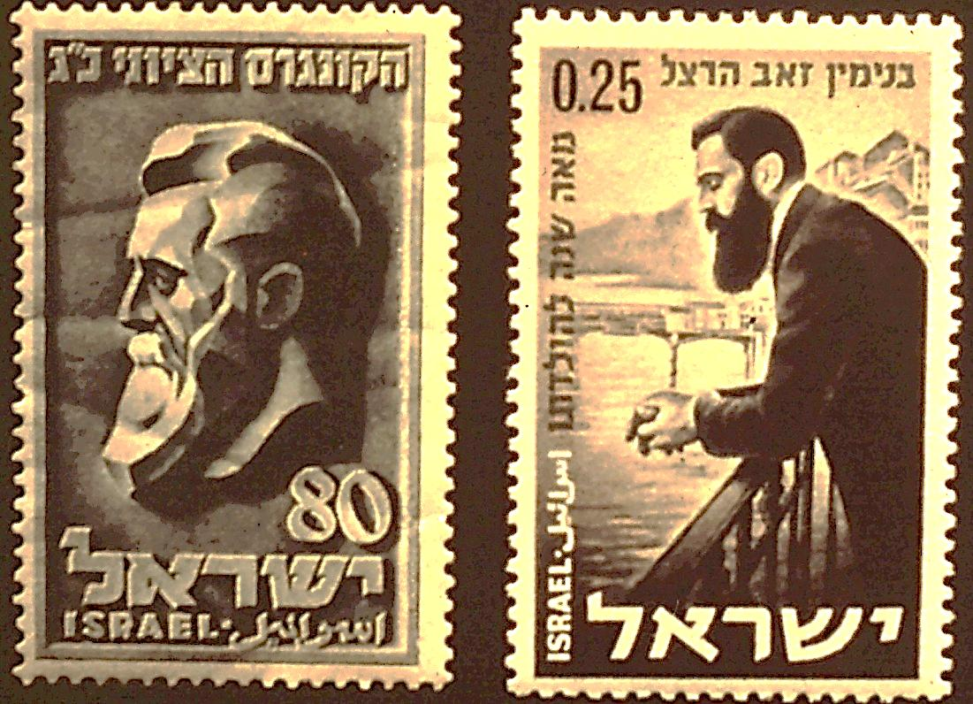
Herzl stamps – 1960 (centenary of his birth and 1978 – 30th anniversary of Israel
Herzl stamps – 1954 – 50th anniversary of his death
#24
Notes:
Earlier in 1880, was born the man whose name became synonymous with modern Zionism, Theodor Herzl. (Herzl, the Father of Modern Political Zionism has been honored with stamps four times –in 1951 on the occasion of the 23rd Zionist Congress, in 1954 on the 50th Anniversary of his death, in 1960, on the centenary of his birth and in 1978 for the 30th anniversary of the state of Israel).

Slide 31
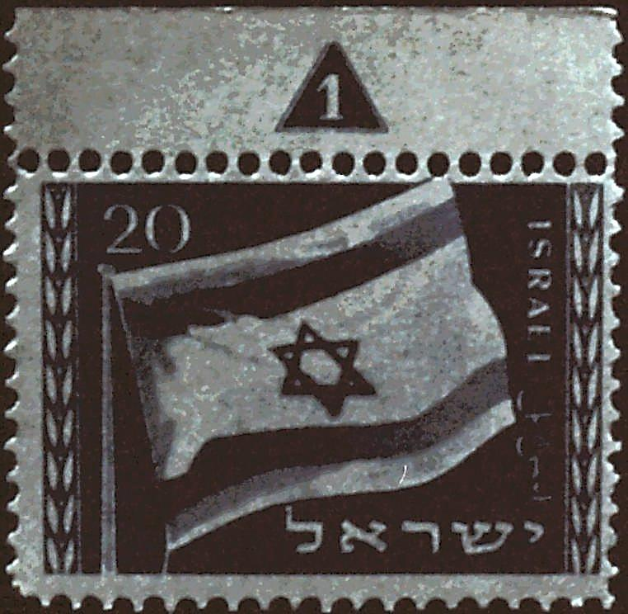
Flag stamp - 1949
#25
Notes:
It was Herzl, who in his book, “The Jewish State,” discusses the flag of the future Zionist land. “and you ask in mockery—a flag, what is that! A stick with a cloth rag? No, a flag is more than that. With a flag you can lead men where you will—even into the Promised Land.”
But it was David Wolfssohn who created the flag of Zion, modeling it on the Tallit. For it was the Tallit that, after all, through the centuries was the flag of the Jewish people (Flag stamp, 1949).

Slide 32
1974 issues honoring David Ben Gurion
#26
Notes:
Those who came to the land were not scholars and Rabbis. These were people who wanted to settle “the land” and work it with their own hands. David Ben Gurion, a fervent Zionist, who came in 1906 and 42 years later became the first Prime Minister of the State of Israel, said on this occasion: “A homeland is not given or received as a gift…it is made with the sweat of the brow. If a people has the right to say ‘this is my own, my native land,’ it can only be because this people has created it…” (David Ben Gurion was honored with an issue of two stamps in 1974).

Slide 33
Jewish National Fund – 50TH Anniversary stamp issued 1951
#27
Notes:
And the hands that worked the land were Jewish hands. Keren Keyemet—the Jewish National Fund was established to buy land and plant on it and make it green and productive (the 50th anniversary of the Jewish National Fund was observed with an issue of three stamps. The Stamps depict the activities of the J.N.F., namely land reclamation and cultivation. The designs show a tree, tractor and plowing of the land. The background of the high values shows the first JNF stamp of 1902).

Slide 34
1970 issue stamp – honoring 50th Anniversary of Ha-Shomer “Watchmen” group
- Manya Shocat
#28
Notes:
In those early years, malaria and the marauding, looting and murderous Arabs struck at many agricultural settlements, killing and wounding many, destroying crops and stealing animals. But it was not long before the Jews formed their own “Shomer-Watchmen” group, with women serving in this capacity as well as men. One of these courageous, enterprising women was Manya Shocat. (The 50th Anniversary of Ha-Shomer was noted in 1970 with a stamp portraying Manya Shocat, one of the founders and defenders of Jewish settlements.

Slide 35
Image on stamps unavailable – Pioneer Issue 1976
#28A
Notes:
Jews persevered to clear and plant land, to establish settlements and plant vineyards, citrus groves and develop agricultural schools and to set up villages overnight. (Pioneer Issue 1976 – clearing rocks and ploughing).

Slide 36
2nd Airmail Series, issued 1956
Hula Valley
#29
Notes:
A malarial swamp, known as the Hula Valley was also conquered and today one looks down at this green, flourishing valley in the Galilee and thanks God who imbued those early Zionist pioneers with the guts and courage to conquer this murderer, too. (The Hula Valley appears on the 750 Purtot stamp of the 2nd Airmail Series, issued in 1956.).

Slide 37
stamp issued in 1962 – commemorating the
80th Anniversary of the founding of Rosh Pinna
#30
Notes:
One of the early Jewish settlements in Eretz Yisrael was Rosh Pinna, established in 1882 on deserted rocky land. It was the first colony in the Galilee. The name Rosh Pinna came from the Psalms “the stone which the builders rejected became the chief cornerstone” (the 80th Anniversary of the founding of Rosh Pinna was marked with a single stamp in 1962.)

Slide 38
Coat of Arms of Rishon L’Zion – issed in 1966 from the “Coat of Arms Definitive Series”
#31
Notes:
Rishon L’Zion (first in Zion), another settlement established in 1882, was and still is an important wine producing colony. Wines from these cellars are exported all over the world (among the Coat of Arms Definitive Series is found the Coat of Arms of Rishon L’Zion, issued in 1966).

Slide 39
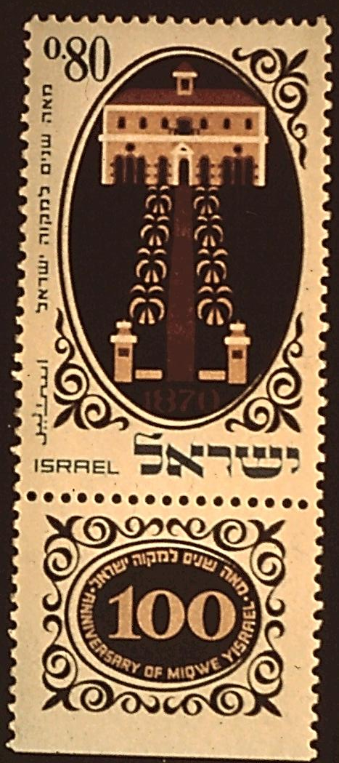
100th Year of Mikve Israel – issued in 1970 - Charles Netter stamp and first building of the school.
#32-33
Notes:
The first agricultural school in the country, Mikve Israel, was founded even earlier than Rishon L’Zion in 1870. The Turkish government, which was then the ruling power in the Holy Land, granted the land to this institution, which has raised generations of farmers and introduced to Israel’s climate many useful plants and trees. Charles Netter was the founder of Mikve Israel, devoting himself to the task of building up this agricultural school and colony (stamps commemorating the 100th year of Mikve Israel – issued in 1970 – one showing Charles Netter and the other the first building of the school).

Slide 40
100th Anniversary of Petach Tikva – issued in 1977
#34
Notes:
Still another of the colonies founded by those early Zionists in 1878 was Petach Tikva. This was another section of malarial swamps, which is now a huge citrus growing area (a single stamp was issued in 1977 to mark the 100th Anniversary of Petach Tikva).

Slide 41
Commemorating 1953 “Conquest of the Desert” exhibition
#35
Notes:
The early Zionists conquered the swamps, making them into fertile producing fields. The later Zionists turned their attention to the desert, establishing settlements in the midst of sun and sand, growing fruits, vegetables and flowers with a minimum of water in man-built oases—in short, making the desert bloom (an exhibition in 1953, the “conquest of the Desert” brought a stamp portraying the desert blooming).

Slide 42
Rabbi Kook – 1978 Personalities Series
#35A
Notes:
In 1904, Ha Rav Avraham Isaac Kook came to Eretz Yisrael. In 1919, he was invited to become the Chief Rabbi of Jerusalem and in 1921, assumed the duty of the First Chief Ashkenazic Rabbi of the Holy Land, which duties he performed until his death in 1935. Kook was known as the farmer’s friend. It was he who opposed the other Orthodox Rabbis in Eretz Yisrael when he suggested in 1909 that the farmers make certain changes in the way they harvested their crops, and continue to do this, even during the Shmitta year. This was the 7th year when the land and crops were to lay fallow according to Biblical law. However, if this law would be observed, all the Halutzim and all the work of the pioneers would have been in vain. Rabbi Kook felt the most important mitzva was the development of the land—not Shmitta—a real breakthrough (Rabbi Kook – 1978 Personalities Series).

Slide 43
50th Year of Jewish Settlements in the Modern Era – Degania Kibbutzim, one of three Kibbutzim shown on the stamps.
#36
Notes:
The Kibbutz way of life about which we hear so much is epitomized by early Zionists in the settlement of Degania, the first of the Kibbutzim. This was a pure pioneering effort set in a desolate, swamp-infested, tropical climate. Looting Bedouins, as well as their own lack of agricultural knowledge, made things very difficult for the pioneers at first. By trial and error, these settlers not only worked out their living arrangements, but gained agricultural expertise as well (Degania was one of the three Kibbutzim shown on stamps marking the 50th year of Jewish settlements in the modern era). Today, Degania, known as the mother of the Kibbutzim, has flourishing orchards and gardens and is still a model Kibbutz.

Slide 44
Stamps issued in 1955 marking the 20th Year of Youth Aliya
#37
Notes:
In the late 30’s and until 1945, Hitler and the German Nazis occupied most of Europe, with one of their main purposes being to rid that continent of Jews. Concentration camps and gas chambers, starvations, shooting and beating did eliminate six million Jews, among them one million children. But some children were saved by an organization called Youth Aliya. (in 1955, stamps were issued to mark the 20th year of Youth Aliya. The six stamps showed the arrival of children to Israel and various types of work in which they engaged or for which they were trained.)

Slide 45
Henrietta Szold honored on the centenary of her birth – stamp issued in 1960.
#38
Notes:
Youth Aliya was created by Recha Freier, a German rebetzim who worked night and day to get the children out of Europe and out of Hitler’s clutches. Recha Freier also made Aliya and lives in Katamon, a suburb of Jerusalem. Somehow most of the honor for youth Aliya, though, seems to reflect to the credit of Henrietta Szold, a school teacher from Baltimore, Maryland. Henrietta was a staunch Zionist and not only went to live in what was then called Palestine, but became involved in the rescue of the children, receiving them when they came to Palestine from Europe. (in 1960 Henrietta Szold was honored on the occasion of the centenary of her birth.)

Slide 46
The 1950 Independence Day stamps show two views of immigration—the 20 Pruta stamp shows the open shores of the land welcoming the Jews to their ancient homeland
#39
Notes:
The ingathering of the Exiles was part of the rescue operation of illegal immigration in to the Holy Land, to try to save a few hundred lives form Hitler’s raging furnaces (the 1950 Independence Day stamps show two views of immigration—the 20 Pruta stamp shows the open shores of the land welcoming the Jews to their ancient homeland). The immigration was illegal because the British, who held the Mandate on the land at that time, refused to open the doors for these poor, homeless, persecuted people who had no place to go.

Slide 47
Stamp commemorating 30th Anniversary of rescue of Jews in Denmark
#40
Notes:
The one nation in Europe that did defend its Jews was Denmark. (The rescue of the Danish Jews by the people of Denmark was noted on its 30th Anniversary with a stamp portraying the event.) Small fishing boats took many of these unfortunate people to Sweden and others were hidden by the kind and brave Danes. Few of Denmark’s Jews were murdered.

Slide 48
Stamp issued in 1964 to honor the runners of the British blockade.
#41
Notes:
Even after the war was over, the British refused to allow the remnants of the Holocaust into their own homeland, so the Jews developed a system of blockade runners to bring in those who would otherwise have no place to go. (A stamp showing a ship crowded with refugees running the British blockade of Palestine was issued in 1964 to honor all those who had been engaged in this humanitarian task.)

Slide 49
Stamp issued in 1970
Marking 20th Anniversary of
exodus of Jews from Yemen – Operation Magic Carpet
#42
Notes:
Still another group of people who made Aliya to the Holy Land –were the Yemeni Jews of Operation Magic Carpet (to mark the 20th Anniversary of the exodus of the Jews from Yemen, an Operation Magic Carpet stamp was issued in 1970).

Slide 50
Independence Day Souvenir sheet 1973 –
Shows signers of the Proclamation of Independence
#42A
Notes:
On May 15, 1948, the State of Israel was established. Besides the Doar Ivri stamps and a flag, the State had a Proclamation of Independence, some of which read: “…we, the members of the people’s council, representatives of the Jewish community of Eretz Yisrael and of the Zionist movement are here assembled on the day of the termination of the British Mandate over Eretz Yisrael and by virtue of our natural and historic right…hereby declare the establishment of a Jewish state in Eretz Yisrael, to be known as the State of Israel.” (Independence Day souvenir sheet 1973 shows signers of the Proclamation of Independence.)

Slide 51
1973 Festival Stamps -- Prophets Ezekiel, Jeremiah and Isaiah
#43-44
Notes:
And 30 years later our state with its beautiful people and beautiful stamps is still going strong. And from the time of Abraham until today, there has been a constant flow of Zionists going up to Zion and perhaps the teaching of the Prophets Ezekiel and Jeremiah, as well as Isaiah will be heard: (Ezekiel , Jeremiah and Isaiah appear on stamps of the 1973 Festival stamps).
And He shall judge between the nations and decide for many peoples; and they shall beat their swords into plowshares and their spears into pruning hooks; nation shall not lift up sword against nation, neither shall they learn war any more.

