Slide 1
The ABC’s of Collecting British Mandate Palestine Stamps
Dr. A. Friedberg April 1966
Society of Israel Philatelists
www.israelstamps.com
Notes:
The Egyptian Expeditionary Force crossed the Egypt-Palestine Border on January 9, 1917, conquered the southern part of Palestine in the latter part of 1917, and completed the occupation of Palestine in 1918.
Until some time after the armistice, only military Post Offices were working in the occupied zone. For the Armed Forces, ordinary letters were accepted free of charge, while additional services (registration, parcels, etc.) had to be paid for by stamps. British and Indian, and Australian military Post Offices existed. When the old Turkish Post Offices were closed down with the advance of the Allied Forces, the civilian need for postal services became imminent. The future of the country at the time was uncertain.
Since the Allied Forces were composed of contingents of various nations, an overprinting of the old Turkish stamps was found to be unsuitable and a neutral design seemed desirable (from the specialized catalog “The Stamps of Palestine” by Dr. W. Hoexter and S. Lachman, Haifa, Israel).

Slide 2
The ABC’s of Collecting British Mandate Palestine Stamps
Notes:
The first stamps of Palestine were issued during the period of the Military Administration (Dec. 1918 – July 1, 1920) when Palestine was considered as “Occupied Enemy Territory.” As early as 1917, when only the southern part of Palestine was in the hands of the Egyptian Expeditionary Forces (EEF), the director of the Army Postal services requested the Egyptian Survey Office in Cairo to design and print a 1 Piastre stamp for use in the Occupied Territory.
A design was chosen out of three suggestions and the stamps were printed in sheets of 120 stamps *10 rows of 12 stamps) with the control “A18” at the lower left. The first stamp was printed on different dates by photo-lithography and exists in shades of indigo, deep blue and blue.

Slide 3
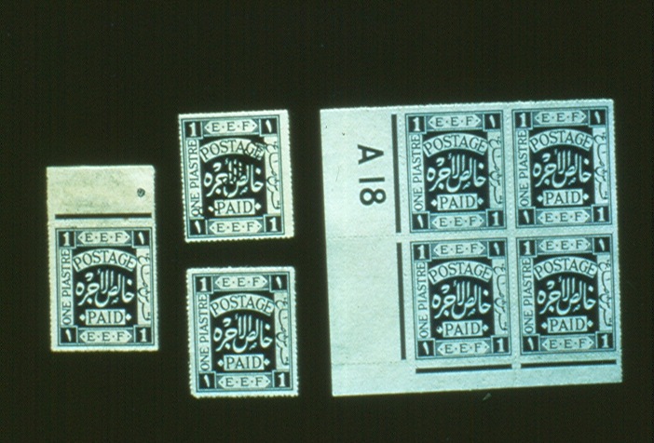
Slide 1
Notes:
Slide 1
This slide shows a top margin copy of the first stamp at the left, 2 single stamps immediately adjacent to the margin copy with the upper stamp overprinted “Specimen,” and a plate block of Palestine # 1 with the control “A18.”
The stamp was issued on Feb. 10, 1918. A total of 1,748 sheets were printed for this stamp, totaling 209,760 stamps. The stamp was issued ungummed, rouletted (since modern perforating machines were not available in Egypt), and on water-marked paper (Royal Cypher in column). At the outset, as a precautionary measure against the purchase of stamps for other than immediate use, and the possibility of the limited stocks being absorbed, the stamps were not placed on public sale in the ordinary way but were affixed by the postal authorities to civilian letters only, upon which postage in cash had already been paid.

Slide 4
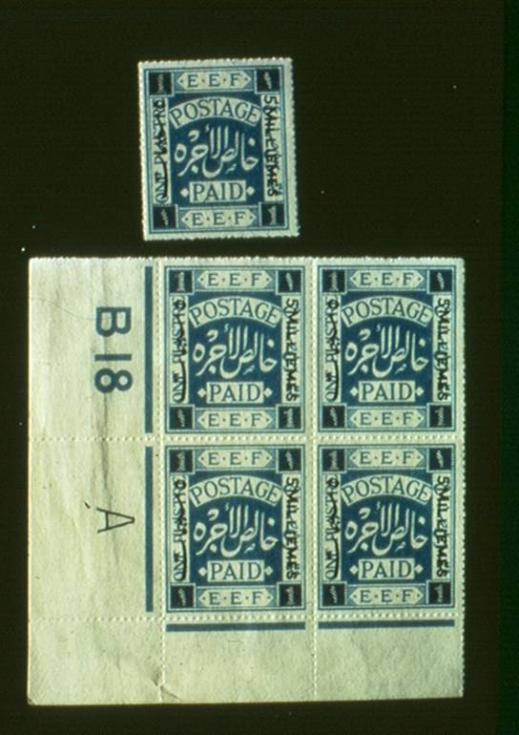
Slide 2
Notes:
Slide 2
Since one Piastre was the foreign rate, a stamp for internal use in Palestine became a necessity. Since it was found that the postmarks were not legible on the dark blue color of the one Piastre stamp, an appreciably lighter blue was adopted for the future printings of the one Piastre stamp and this also became the color of all printings of the surcharged “5 milliemes” stamps. These lithographed stamps and the following sets were “Royal Cypher” watermarked.
This slide shows a single copy and a plate block of the second stamp that was issued on Feb. 16, 1918. The stamp was similar in design to the first stamp but was cobalt blue in color and was overprinted with the surcharge “5 milliemes.” The stamp was issued unngummed, rouletted, and on similar watermarked paper as the first stamp. This issue had the control “B 18 A” at the lower left and consisted of 419 sheets, for a total of 50,280 stamps. The paper used for the printing of this stamp contains some substance similar to quartz. If the stamp is held with the back upward at an angle to the light, a frosted effect should be seen.

Slide 5
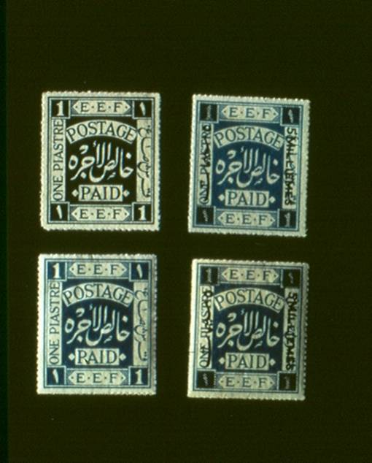
Slide 3
Notes:
Slide 3
Two stamps were issued on March 5, 1918. A one Piastre stamp that was ultramarine in color, rouletted, and gummed appears at the lower left on this slide. A second surcharged stamp of “5 milliemes” on ultramarine, rouletted, and gumemd appears at the lower right. Palestine #1 (issued on Feb. 10) appears at the upper left, and the first surcharged stamp appears at the upper right. Notice the similarity between the two surcharged stamps! The frosted effect described on the previous slide is very important in differentiating between these stamps in mint condition. The only way of truly detecting the difference between these two stamps at the right when in “used” condition is by the postmark. If the postmark is prior to March 5, 1918 (between Feb. 16-Mar. 4, 1918), then you have the first surcharged stamp. If the date is Mar. 5, 1918 or later, then you cannot assume that you have anything other than the second surcharged stamp. Once on cover or postcards, you cannot detect the frosted effect! Once the stamps are off-cover, traces of gum can cause additional confusion, so as a result, the date of the postmark is most important.

Slide 6
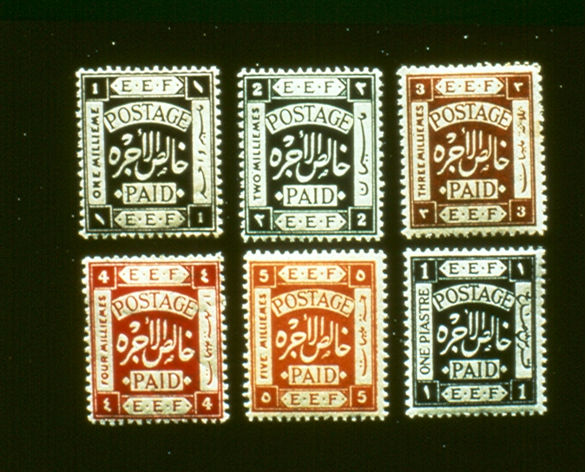
Slide 4
Notes:
SLIDES 4 & 5
Since two values only could not meet the increasing demand for stamps, a set of eleven denominations was ordered. The stamps were released over a period of several months. The stamps were released Jul. 18, 1918.
The same design was used as on the first four stamps issued earlier in the year, but these stamps were perforated and appeared in eleven colors representing eleven denominations. These stamps were issued in perf. 15X14. These stamps were printed by Typography and we call them “The Typos.”

Slide 7
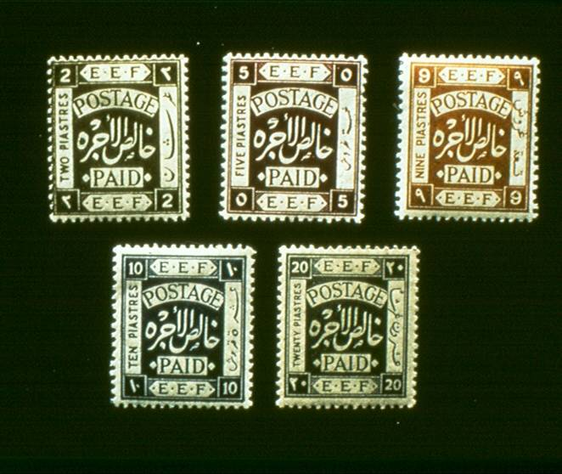
Slide 5
Notes:
SLIDE 5
See text for slide 4.

Slide 8
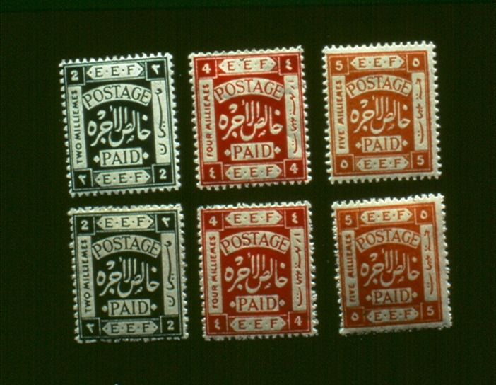
Slide 6
Notes:
SLIDE 6
Eight values of this set were issued in rough perforations.
This slide shows 3 values in the upper row with the regular perforations. The lower row shows the same 3 values with the rough perforations.

Slide 9
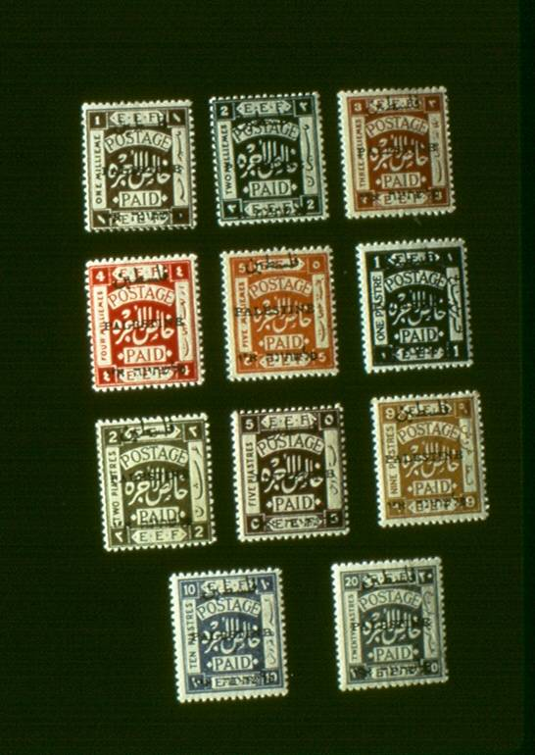
Slide 7
Notes:
Slide 7
On July 1, 1920, Palestine came under Civilian Administration with the appointment of the first High Commissioner, Sir Herbert Samuel. The typographed stamps, issued under the military administration, remained in use until Aug. 31, 1920. The new administration considered it the best solution to overprint the stamps of the previous issue with the name of the country in the 3 official languages: Arabic, English, and Hebrew. The inscription was to read “Palestine” in all 3 languages, but in the case of the Hebrew inscription was followed by the Hebrew letters for the abbreviation of “Eretz Israel (the land of Israel). The Greek Orthodox Convent Press in Jerusalem was instructed to make the necessary overprints on the current stamps. Shown on this slide are the eleven values of the first local overprint issued on Sep. 1, 1920. The Arabic inscription is 8 millimeters in length, the English 14-3/4 mm., and the Hebrew 13-3/4 mm. There are 2 different types of settings of the Arabic 8 mm. overprint, but this differentiation would be for a specialist in this field. All values exist in perf. 15 X 14, 3 values also exist in perf. 14, and several values exist with rough perforations.
This first set of overprints is called “Jerusalem One.” For those interested in the 2 different settings of this 8 mm. Arabic overprint, I recommend the two specialized catalogs: the Dorfman catalog and the Bale Palestine catalog.

Slide 10
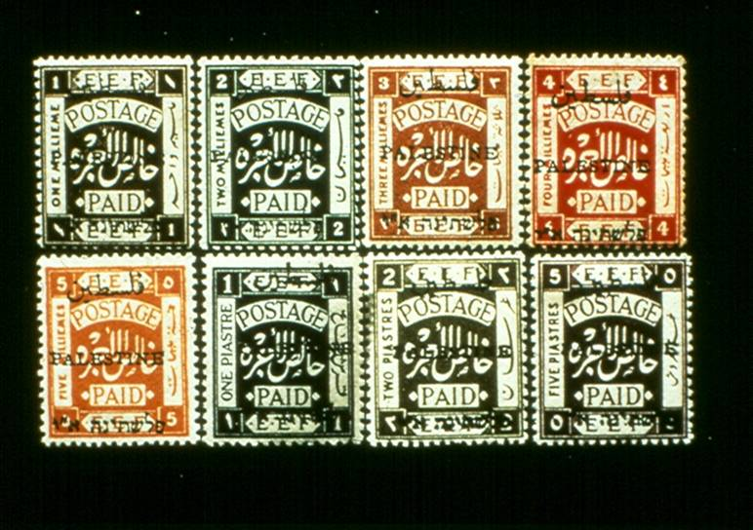
Slide 8
Notes:
Slide 8
The British Mandate Administration of Palestine was not satisfied with the printing of the first overprinted issue. The Arabs protested against the Hebrew inscription on the stamp, and then protested that the Arabic overprint was too short in comparison to the Hebrew overprint.
The Greek Orthodox Convent Press was ordered to make a new overprint and on the new set, the Arabic overprint was 10 mm, the English was 15 mm, and the Hebrew varied from 13-3/4 to 15 mm. The distance between the 2 groups of Hebrew characters varies between 1 and 2 mm. There are 8 values to this set of stamps in perf. 15 X 14, and six of these same values are also perf. 14.
Shown on this slide is one stamp of each denomination, without regard to whether the stamp is perf. 15 X 14 or perf. 14. This second Jerusalem overprint is called “Jerusalem Two.” The first denomination to appear was the 2 milliemes value on 19 Nov, 1920, not three weeks after Jerusalem One was issued. The other milliemes values were issued on December 27, 1920 and the 1, 2 and 5 three piastres values in May and June 1921.

Slide 11
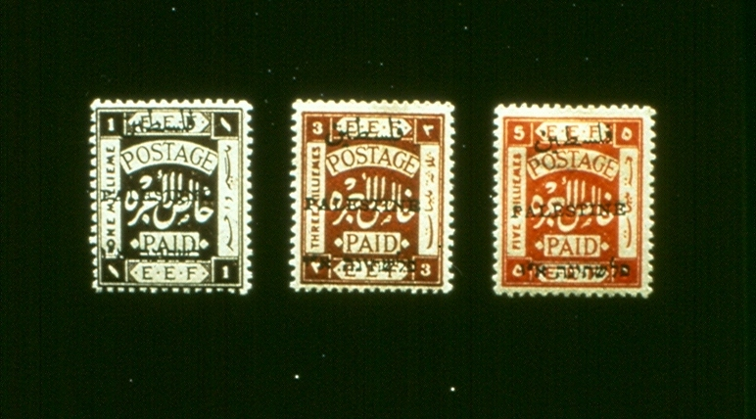
Slide 9
Notes:
Slide 9
The great demand for some of the low values necessitated a new overprint shortly after the appearance of the “Second Jerusalem Overprint.” Stamps with this new overprint were issued as early as December 1920. The Arabic overprint again measures 10 mm., but the vertical height of the whole overprint is 19 mm. against 20 mm. in the preceding issue. The distance of the Hebrew line from the English line is 6 mm instead of 7 mm.
This overprint is sharper than the two previous sets of stamps. This issue of 3 low values is referred to as the narrow setting. The 5 mil value in mint condition is a difficult stamp to find. The 5 mil value exists perf. 14 and perf. 15 X 14. The latter perforation is a very great rarity with less than 10 copies known (mint & used combined).

Slide 12
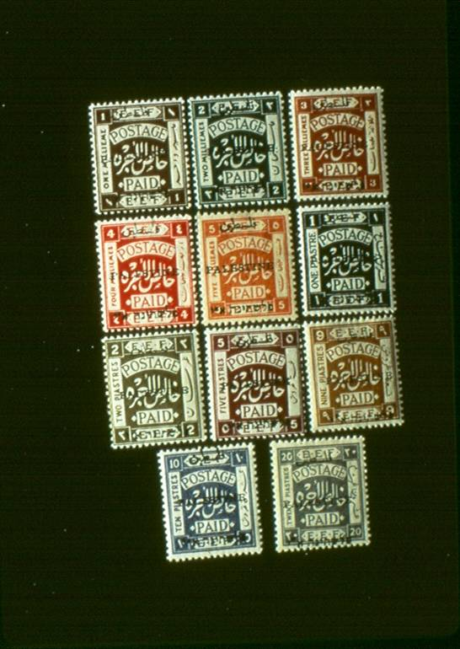
Slide 10
Notes:
Slide 10
The mandatory authorities were not satisfied with the overprinting done by the Greek Orthodox Convent, and the Convent once again came up with the Third Jerusalem (or local) overprint. The new overprint on the eleven values of this set is deep black, and is clear and pointed. The space between the two Hebrew and English lines of the overprint measure 7.5 mm. The Arabic measures 10 mm., the English 14-3/4 mm., and the Hebrew 14-3/4 mm. The distance between the two groups of Hebrew characters is constant at 1-7/8 mm. This constant 1-7/8 mm. will also help you to differentiate between this issue and the second Jerusalem issue (where the spacing between the 2 groups of Hebrew characters varied from 1 to 2 mm., and where the Hebrew varied from 13-3/4 to 15 mm. The 1 mils and 20 Piastre values also exist in perf. 14 and are among the greatest rarities of British mandate Palestine. All values exist in perf. 15 X 14. A method of differentiating Jerusalem Two stamps from those in Jerusalem Three is by measuring distances between the elements of the overprint. On Jerusalem Two, the dashes between the Aleph and the Yod are usually raised above the two letters. In Jerusalem Three, the tops of the dashes are level with the tops of the Aleph and the Yod.

Slide 13
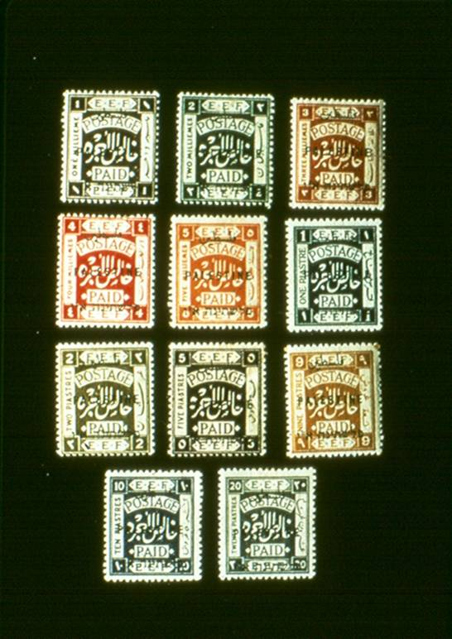
Slide 11
Notes:
Slide 11
This slide shows the eleven values of the first London overprint printed by Somerset House in England. The main difference in this overprint is the English “Palestine” is in block letters (without serifs). The earlier overprints done in Jerusalem all had serifs on the English letters. In addition, the color of the 1 Piastre value was changed from indigo to a bright turquoise blue. This is the last set to use the “Royal Cypher” watermark. The new set began to arrive in Palestine in September 1921. The stamps of “Jerusalem 3” overprint and “London I (Somerset House)” overprint were often used side by side, and neither the public nor the postal authorities kept both issues strictly apart. The English inscription in this overprint of the Somerset House is in block letters, the Arabic is 8 mm., and the English and the Hebrew are 14-1/2 mm. long. This issue was perf. 15 X 14 and was watermarked “Royal Cypher in column.”

Slide 14
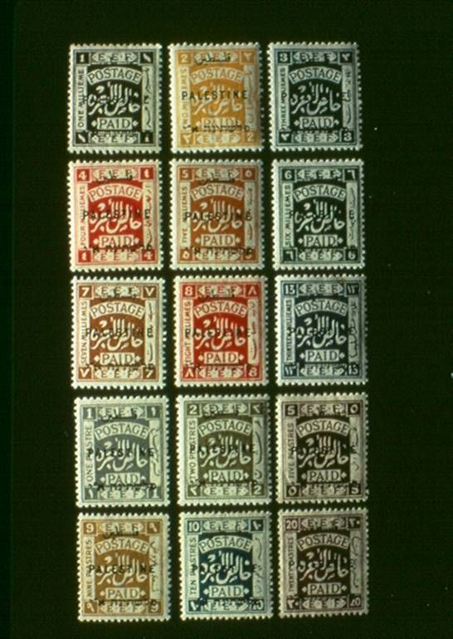
Slide # 12
Notes:
Slide 12
A second set of overprints was ordered from England, and the second London overprint was produced by Waterlow & Sons. A total of 15 different denominations are in this set in perf 14, while the four high values of this set are also in perf. 15 X 14. Once again this slide does not attempt to differentiate between the perforation varieties, but merely shows one stamp of each denomination. These stamps reached Palestine late in 1922 and remained in use for 5 years. The watermark on this set was changed to the multiple script CA.

Slide 15
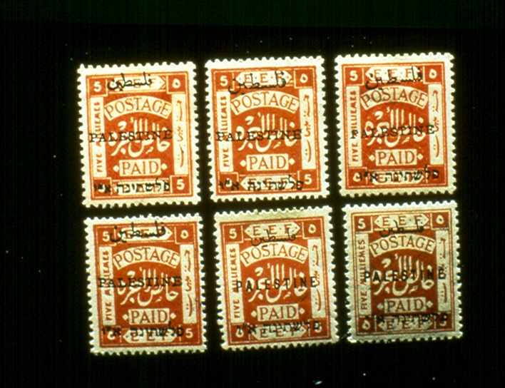
Slide 13
Notes:
Slide 13
Shown here are the various types of overprints shown on the previous slides, but now we have them side by side on the 5 mils value of each set. The top row, from left to right, shows: 1) Jerusalem I issue with Arabic 8 mm; 2) Jerusalem 2 issue with Arabic 10 mm; and 3) the narrow setting, 19 mm vertically instead of 20 mm.
The bottom row, from left to right, shows: 1) Jerusalem 3 issue, with the constant 1-7/8 mm between the Hebrew groupings, and tops of the dashes are level with the tops of the Aleph and Yod; 2) Somerset House overprint with English in block letters and watermarked Royal Cypher in column; and 3) Waterlow overprint with multiple script CA watermark.

Slide 16
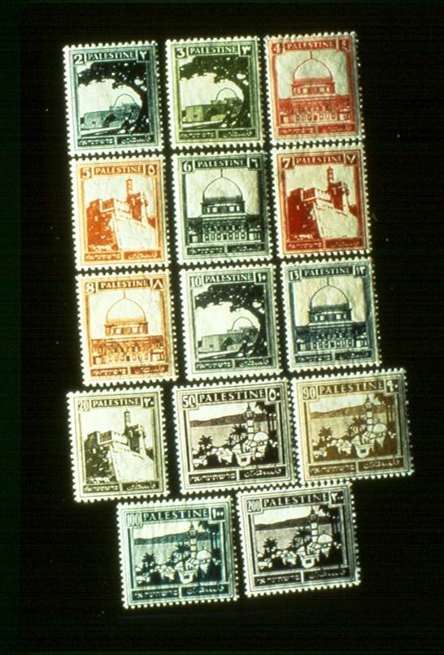
Slide 14
Notes:
Slide 14
The change of currency in the country from Egyptian to Palestinian money in 1927 made it necessary to create a new set of stamps. The old EEF design, originally intended to have only a provisional character and then many times overprinted, was now definitely abolished.
A set of pictorial designs appeared during the summer of 1927. The 2, 3, and 10 mils values show a view of Rachel’s Tomb; the 4, 6, 8, 13, and 15 mils values show the Dome of the Rock in Jerusalem; the 5, 7, and 20 mils values show the Tower of David (also known as the Citadel of Jerusalem); and the 50 mils-1 pound stamps show the Sea of Galilee (Lake Kineret, also known as Lake Tiberias). This slide shows all of the values issued on thin semi-transparent paper in 1927…14 values in all.

Slide 17
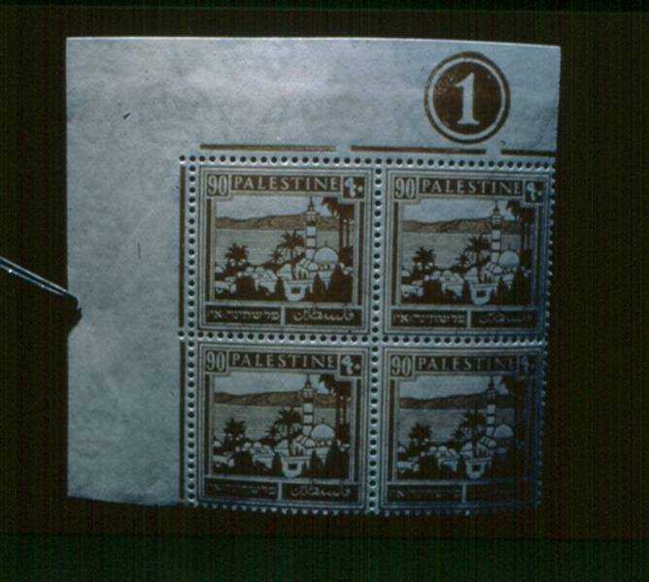
Slide # 14A
Notes:
Slide 14A
The rare 90 mils plate block (thin paper).

Slide 18
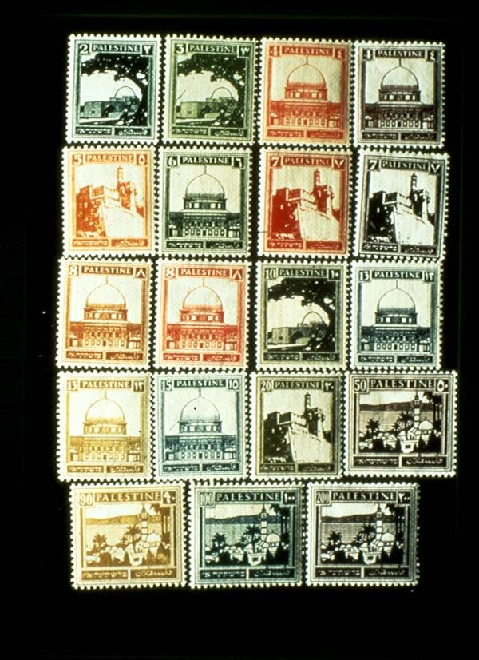
Slide 15
Notes:
Slide 15
From 1928 – 1932, nineteen stamps were issued on vertically ribbed paper. You will notice that several values occur in different colors. These color changes occur because several printings were made of these stamps.

Slide 19
Slide 16
Notes:
Slide 16
In 1936-1938, coil stamps were introduced. These stamps were printed in rolls of 500, and were perforated 14-1/2 X 14. This was a change in the regular perforations of the low values of the pictorial set which had been perforated 13-1/2 X 14 prior to the issue of the coils.

Slide 20
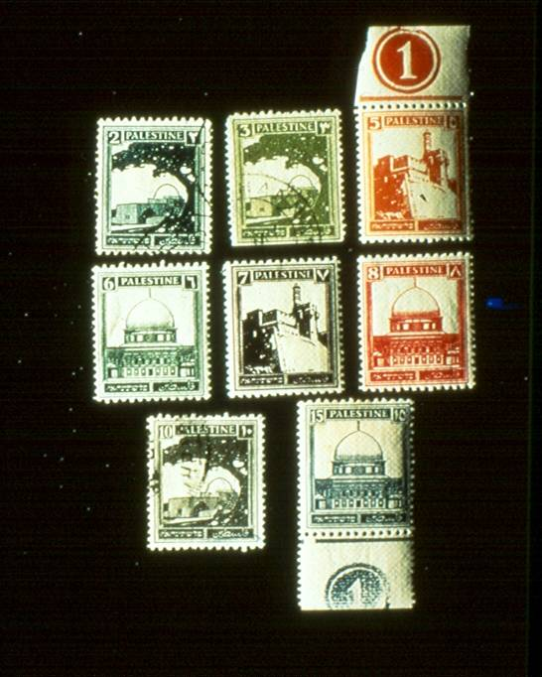
Slide # 17
Notes:
Slide 17
In 1937, eight values were printed on horizontally ribbed paper. Certain values of this set are very difficult to obtain in mint condition.

Slide 21
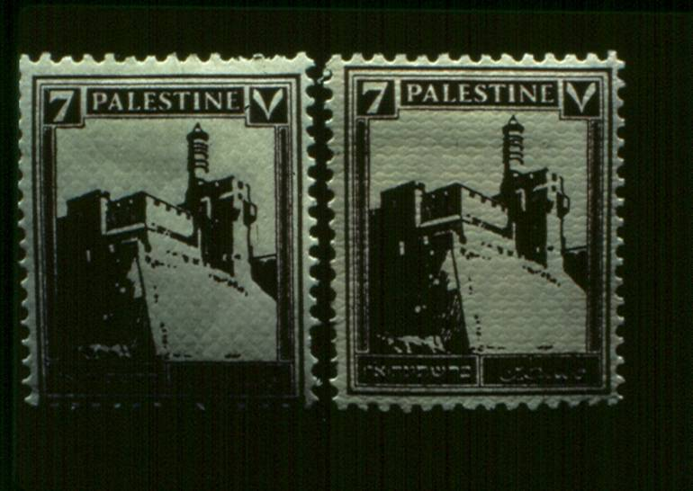
Slide 18
Notes:
Slide 18
Shown here are two copies of the 7 mils stamp. The stamp at the left is on vertically ribbed paper. The stamp at the right is on horizontally ribbed paper.

Slide 22
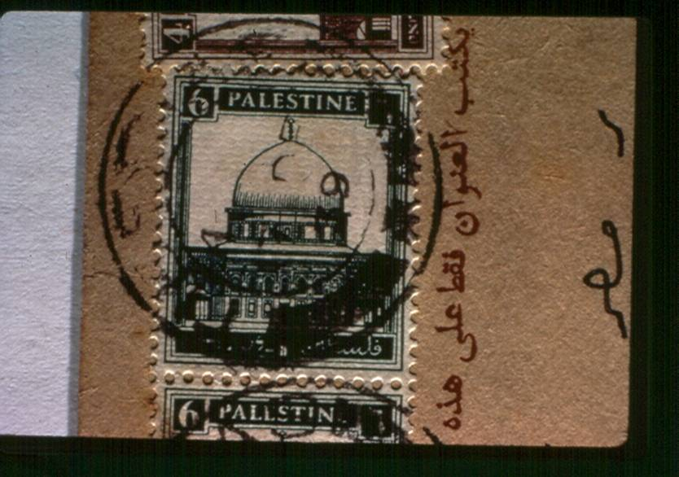
Slide # 18A
Notes:
Slide 18A
Another example of horizontally ribbed paper.

Slide 23
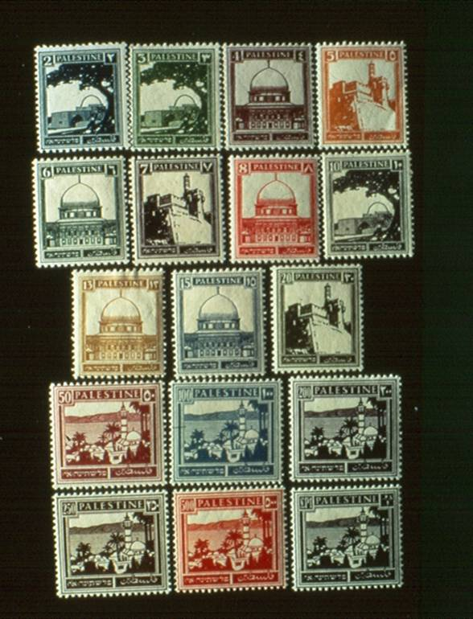
Slide 19
Notes:
Slide 19
This slide shows the 17 values on white wove paper (thick white paper). These stamps were in use from 1940-1948.

Slide 24
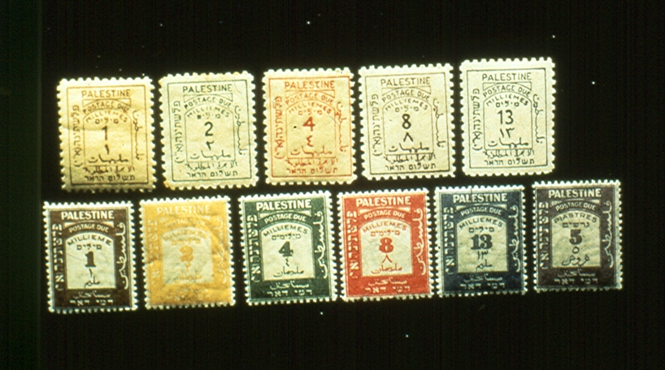
Slide 20
Notes:
Slide 20
The 5 stamps in the top row are the first set of postage due stamps issued by the British Mandate in Palestine. These stamps were printed on non-watermarked paper by the Greek Orthodox Convent in Jerusalem and were issued on April 1, 1923. The particular set shown here is very unusual in the fact that it is extremely well-centered for this issue, and for your information, the first postage due set in this condition is worth considerably more in value than the average set of first postage dues.
The second row shows the second set of postage due stamps that was printed in London. The second postage due set was issued Dec. 1, 1924 on watermarked paper, multiple script CA. The first set of postage due stamps was perf. 11, and the second set was perf. 14.

Slide 25
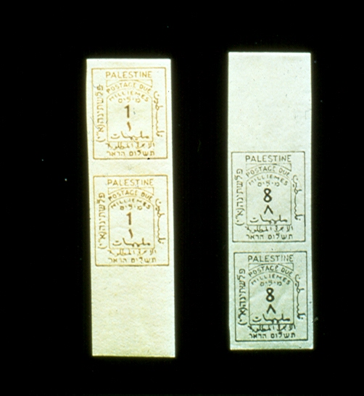
Slide 21
Notes:
Slide 21
Three values (1m, 2m and 8m) exist imperforate. These are now considered plate proofs liberated during Israel’s war for independence. They were printed 2 panes of 100 to a sheet, and gutter pairs pairs of the 8 mils value all show a crease in the gutters.

Slide 26
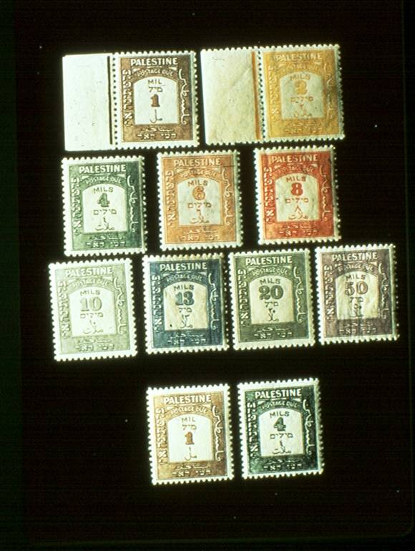
Slide 22
Notes:
Slide 22
The stamps shown here comprise the third postage due set issued from 1928-1933. The upper 3 rows of stamps seen here are perforated 14. The lower two stamps were reprinted in 1945 on very white wove paper and were perforated 14-3/4 X 14.

Slide 27
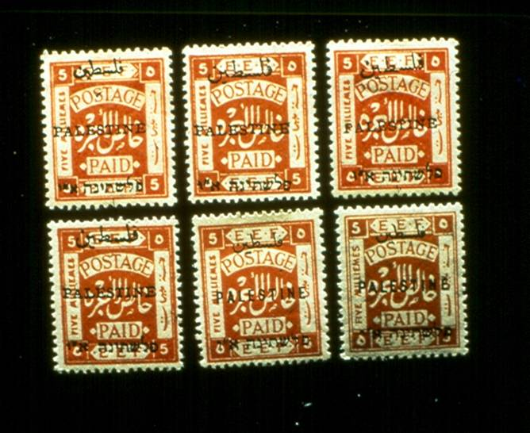
Slide # 22A
Notes:
This slide program is merely an introduction to this particular aspect of Holy Land philately, and that is all that it was intended to be! These stamps have bee ignored by many members of our society who collect the stamps of Israel, but they are interesting from a historical standpoint. Many of these stamps are becoming increasingly difficult to locate. Don’t miss out on them!

