Slide 1
JEWISH NATIONAL FUND
ESSAYS, PROOFS AND THE EARLY ISSUES
BY: HOWARD S. CHAPMAN
#131 Society of Israel Philatelists
www.israelstamps.com

Slide 2
JNF ESSAYS, PROOFS AND EARLY ISSUES
The Jewish National Fund (‘JNF”) was established at the 5th Zionist congress in Basel, Switzerland in 1901 after a very passionate speech for its creation by Theodore Herzl. The fund was to be the property of all the Jewish people and was originally established to purchase land throughout Palestine. Shortly after the establishment of the JNF, the first stamp of the JNF was issued as a source of fund raising.
The following slides present examples of the essays, proofs, color trials and usages of the stamp issues of the JNF. While the stamps of the JNF were issued mostly in Palestine and then Israel, other countries such as the United States, Germany, Poland, Russia, Canada, etc issued many. Like any fund raising label, these stamps were issued to tell a story as well as raise money.
The stamps depict the history of the Jewish people and the State of Israel. The process of printing and approving of JNF stamps were similar to that used by the government printer for the stamps of any country. There was selection of the topic or design to be depicted and then essays, proofs and color trials.

Slide 3
JNF ESSAYS, PROOFS AND EARLY ISSUES
ESSAY - THIS IS A DESIGN WHICH HAS BEEN SUBMITTED FOR CONSIDERATION AND DONE IN THE FORM OF A STAMP BUT WAS NOT ACCEPTED TO BE ISSUED.
PROOF - THIS IS A TRIAL PRINTING MADE FROM A FINISHED PLATE TO DETECT ANY FLAWS IN THE PLATE.
COLOR TRIALS - THESE ARE PRINTINGS MADE IN A NUMBER OF DIFFERENT COLORS OF A STAMP THAT IS TO BE ISSUED. THE ACTUAL COLOR THAT IS TO BE USED IS SELECTED FROM THESE.
While many stamps of the JNF remain readily available today, such as the early Zion stamp, most of the early issues, the essays and usages of JNF stamps on mail are extremely difficult and rare to find.

Slide 4
JNF ESSAYS, PROOFS AND EARLY ISSUES
1
1901 Zion Issue – Essay of the first stamp of the JNF.
Notes:
SLIDE 1
1901 Zion Issue – Essay of the first stamp of the JNF.

Slide 5
JNF ESSAYS, PROOFS AND EARLY ISSUES
2
Notes:
SLIDE 2 1901 Zion Stamp – Proof of the Zion Stamp. There is no serial number in the left side double tab.

Slide 6
JNF ESSAYS, PROOFS AND EARLY ISSUES
3
Notes:
SLIDE 3 1902 Zion Stamp – Color trials of the Zion Stamp. The issued stamp is shown at the top.

Slide 7
JNF ESSAYS, PROOFS AND EARLY ISSUES
4
Notes:
SLIDE 4 1902 Zion Stamp – Color trials of the Zion Stamp.

Slide 8
JNF ESSAYS, PROOFS AND EARLY ISSUES
5
Notes:
SLIDE 5 1908 Jewish Motifs – Essays of Rachel’s Tomb. Jew blowing a Shofar and Olive Grove Stamps.

Slide 9
JNF ESSAYS, PROOFS AND EARLY ISSUES
6
Notes:
SLIDE 6 1908 Jewish Motifs – Forest near Jerusalem. This is an unauthorized revision by the printer’s artist of the stamp designed by the Bezalel Art Institute in Jerusalem.

Slide 10
JNF ESSAYS, PROOFS AND EARLY ISSUES
7
Notes:
SLIDE 7 1909 Herzl Issue – This essay depicts Theodore Herzl leaning on the rail of the balcony of the Three Kings Hotel in Basel, Switzerland at the time of the first Zionist Congress. The issued stamp, also designed by Hans Dieters, is shown at the top.

Slide 11
JNF ESSAYS, PROOFS AND EARLY ISSUES
8
Notes:
SLIDE 8 1909 Herzl Issue – Color trials of the design done by Hans Dieters, based on a photograph made by E.M. Lillien, of Herzl standing on the balcony of the Three Kings Hotel in Basel, with the view of the tower of David substituting for the Rhine River. Plate I, no large bush at the base of the Tower of David.

Slide 12
JNF ESSAYS, PROOFS AND EARLY ISSUES
9
Notes:
SLIDE 9 1909 Herzl Issue – Black proof.

Slide 13
JNF ESSAYS, PROOFS AND EARLY ISSUES
10
Notes:
SLIDE 10 1909 Max Nordau – This essay has the name Max Nordau on it in both Hebrew and Latin letters. The JNF designation does not appear on the essay. The issued stamp is shown at the top.

Slide 14
JNF ESSAYS, PROOFS AND EARLY ISSUES
11
Notes:
SLIDE 11 1909 Max Nordau Issue – Color trials of the stamp issued to honor Max Nordau on his 60th birthday.

Slide 15
JNF ESSAYS, PROOFS AND EARLY ISSUES
12
Notes:
SLIDE 12 1912 Palestine Landscape Issue – Imperforate Essays.

Slide 16
JNF ESSAYS, PROOFS AND EARLY ISSUES
13
Notes:
SLIDE 13 1912 Palestine Landscape Issue – Engraving by Herman Struck. The Palestine landscape stamps were based on this engraving.

Slide 17
JNF ESSAYS, PROOFS AND EARLY ISSUES
14
Notes:
SLIDE 14 1912 Palestine Landscape Issue – Imperforate color trials and/or proofs.

Slide 18
JNF ESSAYS, PROOFS AND EARLY ISSUES
15
Notes:
SLIDE 15 1937 Wing and Wheel – Essays printed on gummed paper.

Slide 19
JNF ESSAYS, PROOFS AND EARLY ISSUES
16
Notes:
SLIDE 16 1937 Aliyah Stamps – Essays. There are no values shown on the essays. The issued stamps have Hebrew letters representing numerals in little circles on both sides of the stamps.

Slide 20
JNF ESSAYS, PROOFS AND EARLY ISSUES
17
Notes:
SLIDE 17 1938 Kibbutz Ner David – Ungummed Imperforate essay in red.

Slide 21
JNF ESSAYS, PROOFS AND EARLY ISSUES
18
Notes:
SLIDE 18 1939 Construction and Defense Series – Black proof of the Tractor Stamp. The design includes the quotation “Thou Shalt Bring Redemption to the Land.”

Slide 22
JNF ESSAYS, PROOFS AND EARLY ISSUES
19
Notes:
SLIDE 19 1939 Construction and Defense Series – Black proof of the Tirat Zvi Stamp. The stamp shows a view of the kibbutz which was also a tower and stockade settlement active in the defense against attacks.

Slide 23
JNF ESSAYS, PROOFS AND EARLY ISSUES
20
Notes:
SLIDE 20 1939 Construction and Defense Series – Black proof of the 50 MILS value of the Huleh Survey Stamp printed with an essay of an unused defense series stamp.

Slide 24
JNF ESSAYS, PROOFS AND EARLY ISSUES
21
Notes:
SLIDE 21 Black Proof of an essay of an unused stamp.

Slide 25
JNF ESSAYS, PROOFS AND EARLY ISSUES
22
Notes:
SLIDE 22 1939 Construction and Defense Series – Black proof of the Hanita Stamp along with essays of the stamp showing a 5 mil value instead of the issued 1 mil value.

Slide 26
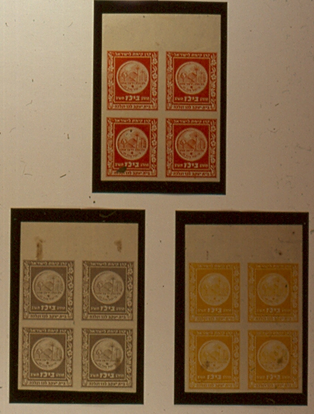
23
Notes:
Slide 23 - 1941 Bilu Issue – Imperforate color trials of the Bilu Stamp.

Slide 27
JNF ESSAYS, PROOFS AND EARLY ISSUES
24
Notes:
Slide 24 - 1944 Chaim Weizmann Issue – Large size proof sheet of the stamp honoring the first president of the State of Israel.

Slide 28
JNF ESSAYS, PROOFS AND EARLY ISSUES
25
Notes:
Slide 25 - 1945 Jewish Sports Issue – Black Proofs and Imperforate Color Trials. Inscribed “Be of Good Courage, and Let Us Prove Strong.”

Slide 29
JNF ESSAYS, PROOFS AND EARLY ISSUES
26
Notes:
Slide 26 - 1946 Anilevitz Issue – Photo of the original design of the Stamp Frame.

Slide 30
JNF ESSAYS, PROOFS AND EARLY ISSUES
27
Notes:
Slide 27 - 1946 Fighters For Freedom Series – Photo of the original design of the Stamp Frame.

Slide 31
JNF ESSAYS, PROOFS AND EARLY ISSUES
28
Notes:
Slide 28 - 1950 Aliyah Issue – Imperforates. Black Proofs.

Slide 32
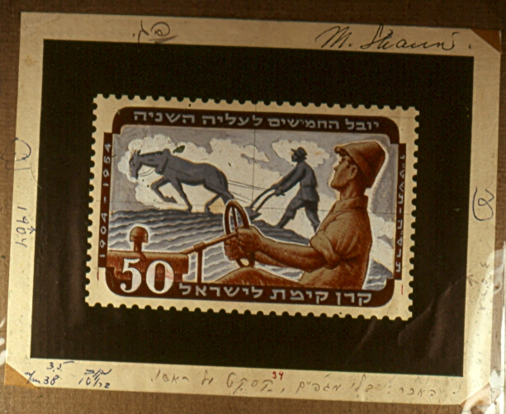
JNF ESSAYS, PROOFS AND EARLY ISSUES
29
Notes:
Slide 29 - 1954 Second Aliyah Issue – Original drawings of the second Aliyah Issue singed by the artist, Maxim Shamir, Tel Aviv, Israel.

Slide 33
JNF ESSAYS, PROOFS AND EARLY ISSUES
30
Notes:
Slide 30 - 1974 Weizmann Centenary Issue – Essay.

Slide 34
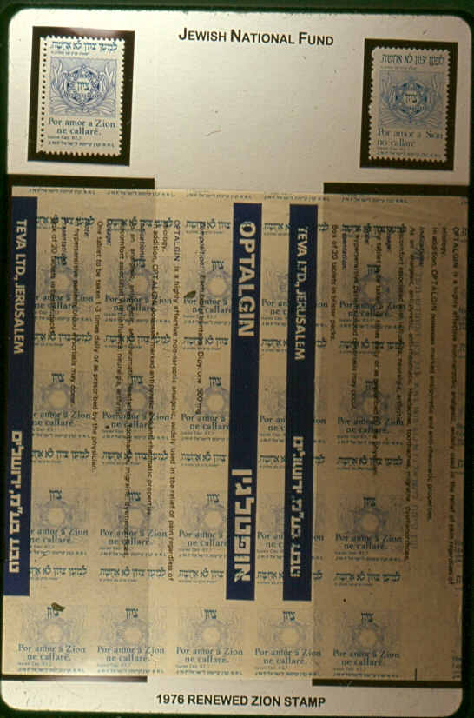
JNF ESSAYS, PROOFS AND EARLY ISSUES
31
Notes:
Slide 31 - 1976 Renewed Zion Stamp – Trial printing of the original Spanish version on reused paper. The original and corrected Spanish versions are at the top.

Slide 35
JNF ESSAYS, PROOFS AND EARLY ISSUES
32
Notes:
Slide 32 - 1906 Star of David Stamp – This is also a collection box control stamp used for sealing National Fund boxes. The stamp is embossed. The stamp exists in red on maroon to red on black, with intermediate shades. Three different colors are shown.

Slide 36
JNF ESSAYS, PROOFS AND EARLY ISSUES
33
Notes:
Slide 33 - 1909 Herzl Issue – The issued stamp in three different formats. With the Bezalel overprint and with the stamp “Made in Germany” on the gummed side, in violet and in maroon.

Slide 37
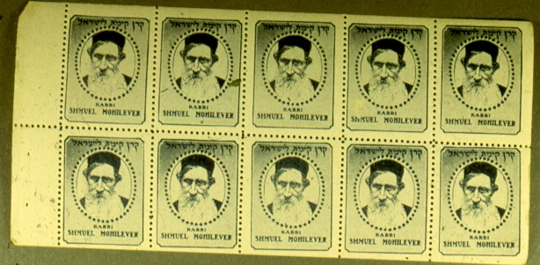
JNF ESSAYS, PROOFS AND EARLY ISSUES
34
Notes:
Slide 34- 1926 Leaders of the Jewish Renaissance Issue of the New York Office – Complete booklet pane of the stamp depicting Rabbi Samuel Mohilever.

Slide 38
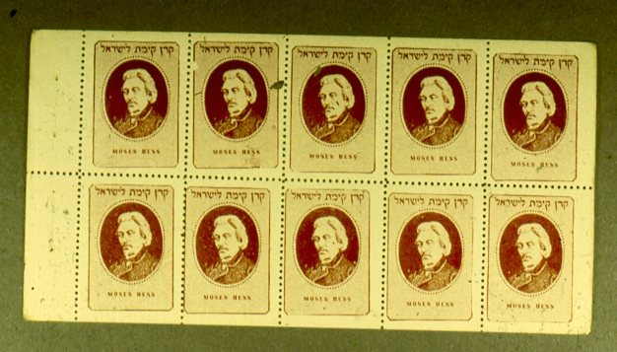
JNF ESSAYS, PROOFS AND EARLY ISSUES
35
Notes:
Slide 35 - 1926 Leaders of the Jewish Renaissance – Complete booklet pane of the stamp depicting Moses Hess.

Slide 39
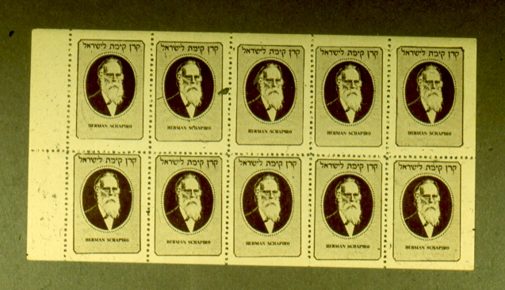
JNF ESSAYS, PROOFS AND EARLY ISSUES
36
Notes:
Slide 36 - 1926 Leaders of the Jewish Renaissance – Complete booklet pane of the stamp depicting Herman Schapira.

Slide 40
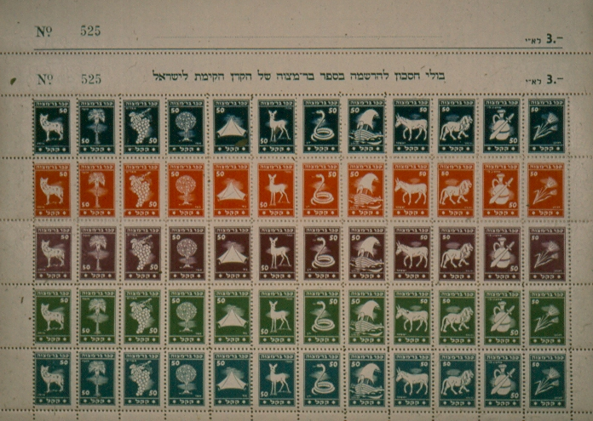
JNF ESSAYS, PROOFS AND EARLY ISSUES
37
Notes:
Slide 37 - 1947 The Twelve Tribes Issue – Complete sheet of the Twelve Tribes of Israel stamps in 5 different colors. A double selvage appears above the sheet of stamps. The top selvedge contains the sheet serial number on the left and the price for the sheet “3 Lirot E.I.” on the right. This was torn off when the sheet was sold. The second selvedge repeats the above and, in addition, contains the text “Savings stamps for registering in the Bar Mitzvah Book of the Jewish National Fund.”

Slide 41
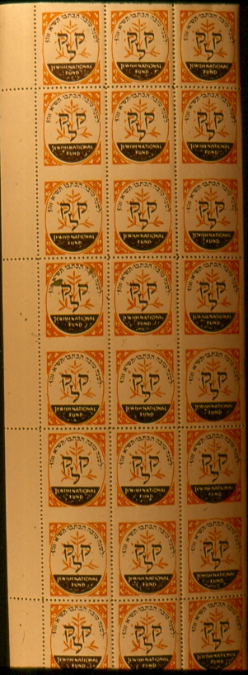
JNF ESSAYS, PROOFS AND EARLY ISSUES
38
Notes:
Slide 38 - 1950 KKL and Tree – Uncut booklet panes. Ordinarily, the panes would be separated along the imperforate horizontal rows. The design is composed of the Hebrew letters KOOF, KOOF, LAMED, on the background of a young tree.

Slide 42
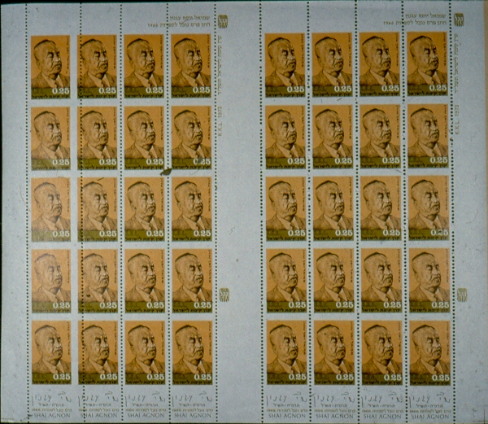
JNF ESSAYS, PROOFS AND EARLY ISSUES
39
Notes:
Slide 39 - 1973 Shai Agnon Issue – Uncut sheets of the 0.25 value of the Shmuel Yosef Agnon Stamp issued to honor the writers receiving the Nobel Prize for Literature in 1965.

Slide 43
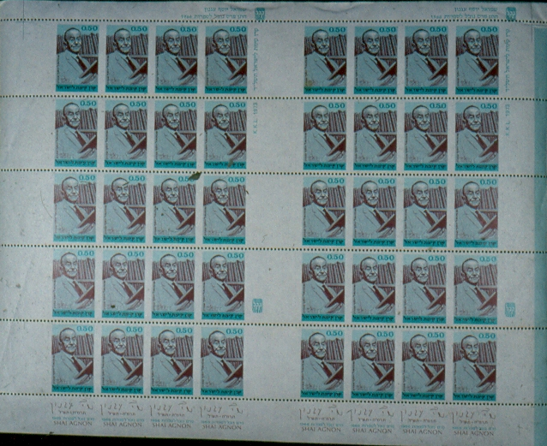
JNF ESSAYS, PROOFS AND EARLY ISSUES
40
Notes:
Slide 40 - 1973 Shai Agnon Issue – Uncut sheets of the 0.50 value of the Agnon Stamp.

Slide 44
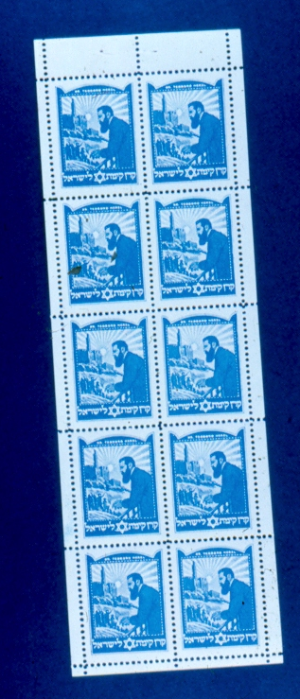
JNF ESSAYS, PROOFS AND EARLY ISSUES
41
Notes:
Slide 41 - 1949 Argentine Herzl Issue – Rare booklet pane 2x5.

Slide 45
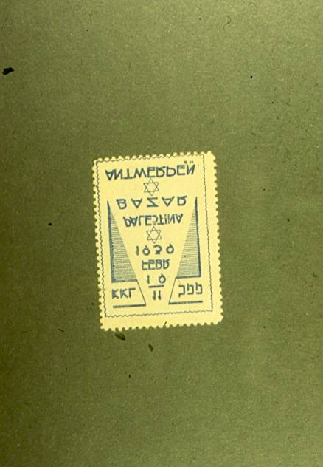
JNF ESSAYS, PROOFS AND EARLY ISSUES
42
Notes:
Slide 42 - 1939 Belgium Bazaar Stamp – Legend on stamp reads “11-19 Febr. 1939, Palestine Bazar, Antwerpen.”

Slide 46
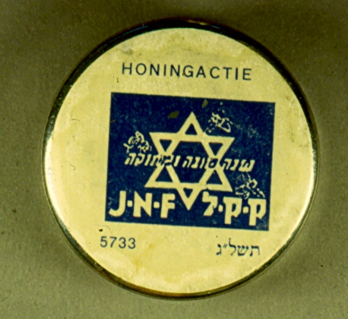
JNF ESSAYS, PROOFS AND EARLY ISSUES
43
Notes:
Slide 43 - 1972 Netherlands Rosh Hashanah Issue – Used as a label on a container of honey as a New Year’s greeting. Note the silver container on which the label is present. The package of honey has a similar label.

Slide 47
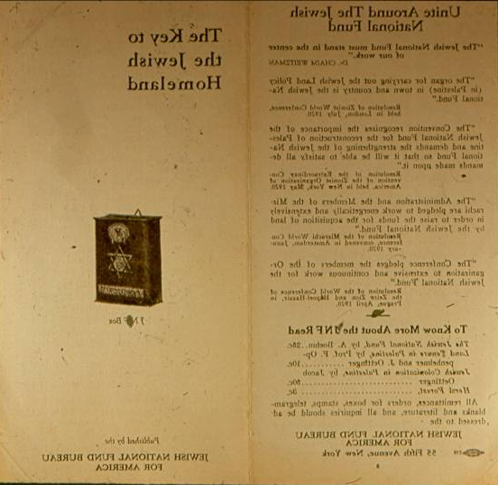
JNF ESSAYS, PROOFS AND EARLY ISSUES
44
Notes:
Slide 44 - Unite Around The Jewish National Fund – Pamphlet published in English by the Jewish National Fund Bureau for America during the early 1920’s. Describes how the JNF will help Palestine to become a Homeland for the Jewish people.

Slide 48
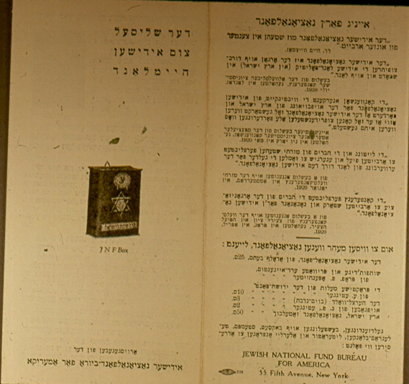
JNF ESSAYS, PROOFS AND EARLY ISSUES
45
Notes:
Slide 45- Unite Around The Jewish National Fund – The same Pamphlet published in Hebrew by the Jewish National Fund Bureau for America during the early 1920’s.

Slide 49
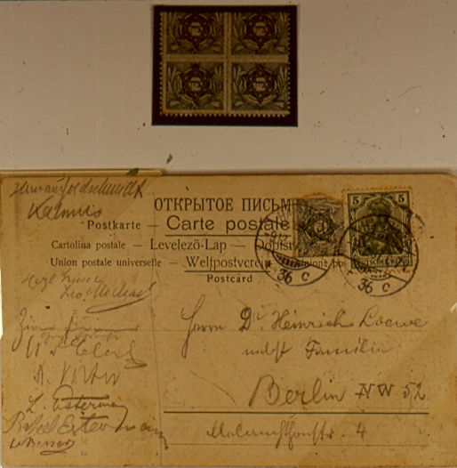
JNF ESSAYS, PROOFS AND EARLY ISSUES
46
Notes:
Slide 46 - 1902-1903 Zion Stamp – Postcard sent from the MACCABIAH Festival 1907 with a JNF Zion Stamp added to the German postage and postmarked Hamburg, December 9, 1907.

Slide 50
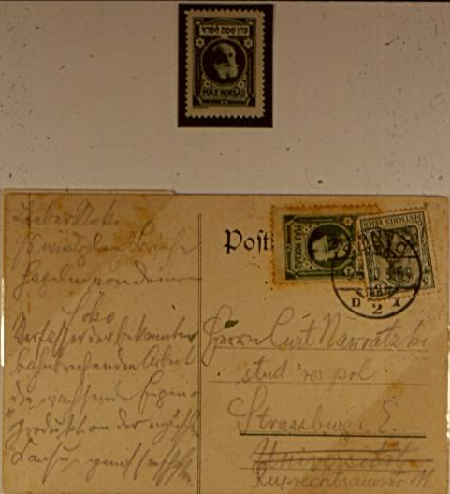
JNF ESSAYS, PROOFS AND EARLY ISSUES
47
Notes:
Slide 47 - 1909 Max Nordau Stamp – Postcard sent from a fencing contest or exhibition in Germany to Strasburg, Vienna with a May 5, 1910 cancellation tying a cologne head office Max Nordau JNF label to the cover.

Slide 51
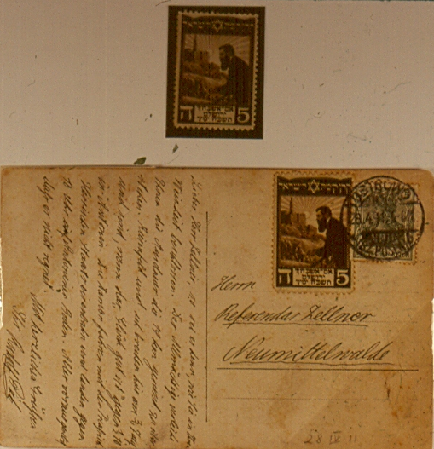
JNF ESSAYS, PROOFS AND EARLY ISSUES
48
Notes:
Slide 48 - 1909 Herzl Issue – Postcard mailed within Germany with the April 28, 1911 postmark tying the Herzl stamp to the card. The 5 Pfenig stamp was intended for use in Germany.

Slide 52
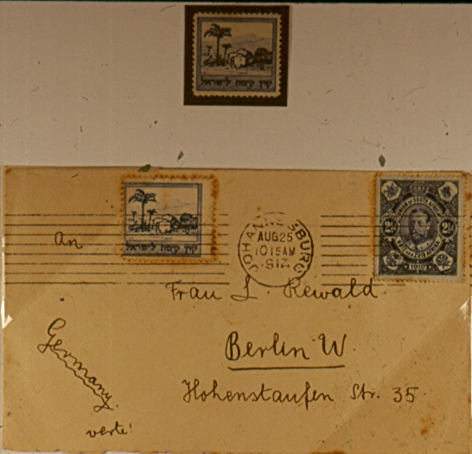
JNF ESSAYS, PROOFS AND EARLY ISSUES
49
Notes:
Slide 49 - 1911 Land of Israel Landscape – Cover mailed from Johannesburg, South Africa to Berlin, Germany, postmarked August 25, 1912, tying a cologne head office JNF label to the cover.

Slide 53
JNF ESSAYS, PROOFS AND EARLY ISSUES
50
Notes:
Slide 50 - 1911 Land of Israel Landscape – Postcard mailed within Serbia, May 11, 1912, with a local Yeshiva cancellation tying a cologne head office JNF label to the cover.

Slide 54
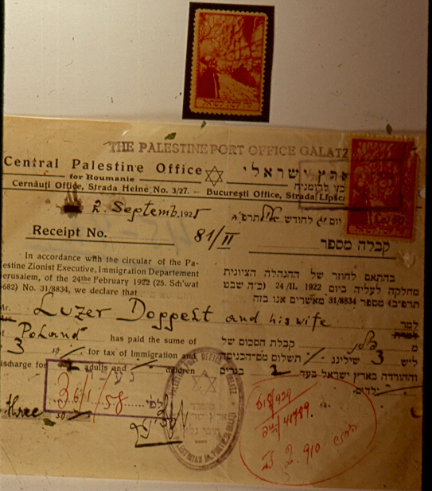
JNF ESSAYS, PROOFS AND EARLY ISSUES
51
Notes:
Slide 51 - 1913 Western Wall Stamp – Receipt from the Palestine Post Office Galatz dated September 2, 1925, acknowledging payment of Immigration and Discharge Tax for two adults. The Cologne Head Office stamp is hand overprinted “50 LEI”, Romanian currency.

Slide 55
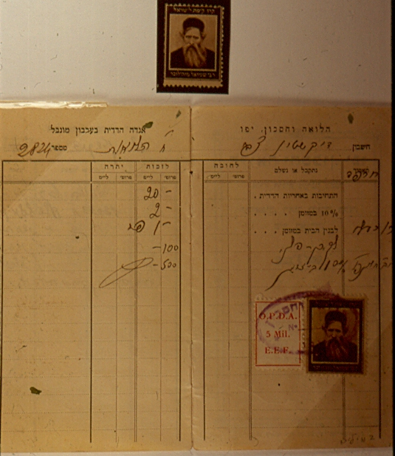
JNF ESSAYS, PROOFS AND EARLY ISSUES
52
Notes:
Slide 52 - 1916 Pioneers of Zionism – Bankbook showing a 7 MILIM tax paid by a 5 MIL. O.P.D.A., E.E.F. Revenue Stamp and a Rabbi Samuel Mohilever JNF stamp with a 2 MILIM overprint. The Pioneers of Zionism stamps were issued by the JNF head office in the Hague.

Slide 56
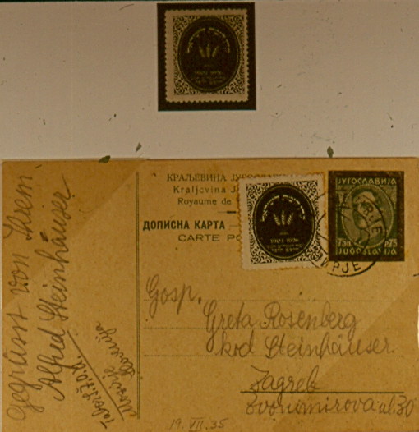
JNF ESSAYS, PROOFS AND EARLY ISSUES
53
Notes:
Slide 53 - 1926 Twenty Fifth Anniversary of JNF Issue – Yugoslavia Postal Card with a twenty fifth anniversary of JNF stamp added to the postage and postmarked Mozirje, July 19, 1935.

Slide 57
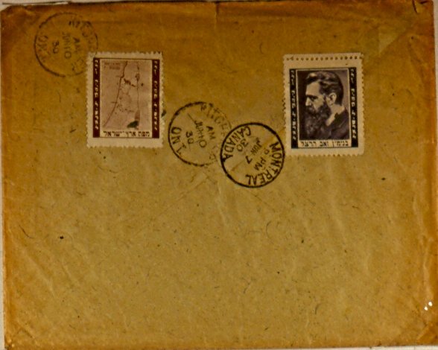
JNF ESSAYS, PROOFS AND EARLY ISSUES
54
Notes:
Slide 54 - 1927 Herzl & Map of Eretz Israel – Registered cover from Czechoslovakia to Canada backstamped Montreal, Canada, June 7, 1930, and Ritchener, Ont., June 10, 1930, tying two Poland office JNF labels to the cover.

Slide 58
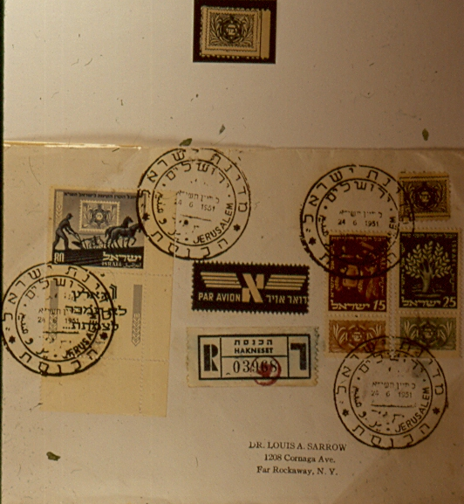
JNF ESSAYS, PROOFS AND EARLY ISSUES
55
Notes:
Slide 55 - 1927 Zion Stamp – Registered first day cover with full tab singles of the Israel 50th anniversary of JNF stamps postmarked with a Jerusalem Knesset cancellation, June 24, 1951. The cancellation ties the 1927 New York office Zion Stamp to the cover.

Slide 59
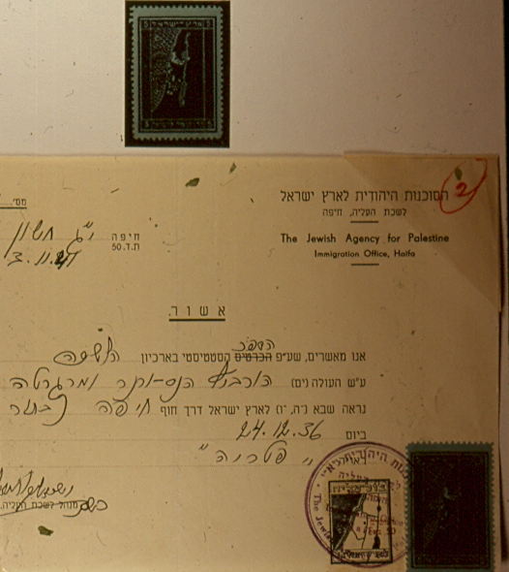
JNF ESSAYS, PROOFS AND EARLY ISSUES
56
Notes:
Slide 56 - 1935 Map of JNF Land – Immigration document from 1941 with tax paid by a 50 MILIM BUL ALIA Tax Stamp and a 5 MILIM Map of JNF Land Stamp.

Slide 60
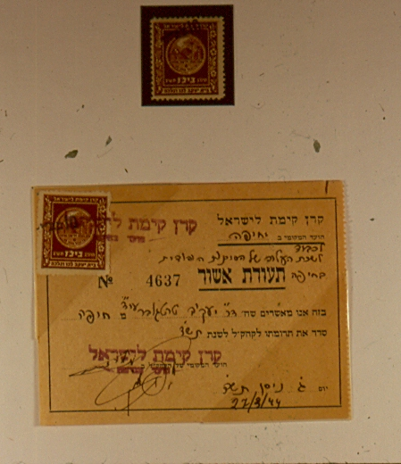
JNF ESSAYS, PROOFS AND EARLY ISSUES
57
Notes:
Slide 57 - 1941 Bilu Issue – A 1944 School Certificate of Achievement with a Palestine Bilu JNF label, overprinted 10 MILS, ties to the document receipting a 10 MILS Tax.

Slide 61
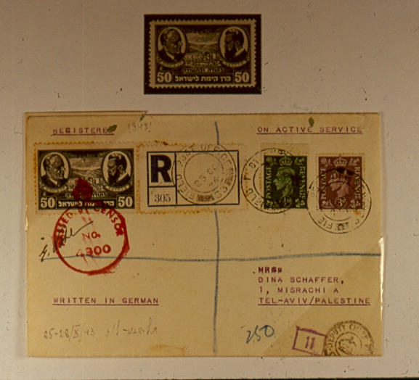
JNF ESSAYS, PROOFS AND EARLY ISSUES
58
Notes:
Slide 58 - 1943 Bialik and Herzl Issue – Registered censored cover mailed through British Field Post Office October 25, 1943 to Tel Aviv, Palestine. The censor mark ties the Bialik and Herzl stamp to the cover.

Slide 62
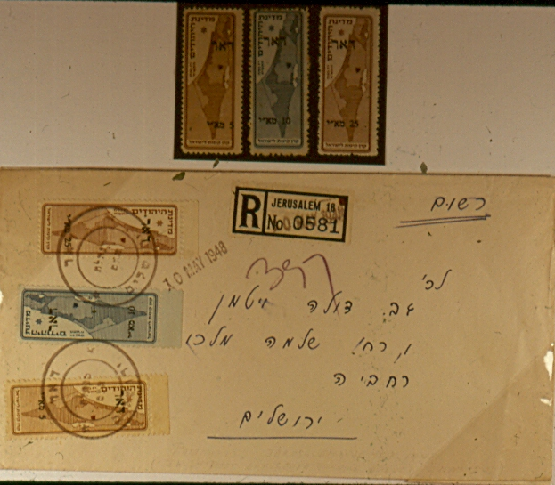
JNF ESSAYS, PROOFS AND EARLY ISSUES
59
Notes:
Slide 59 - Jerusalem Locals 2nd Issue – After the phase out of the British Mandate Postal Administration and prior to the commencement of the Israel Postal Authority, JNF overprinted labels were used as postage. Jerusalem was under siege by the Arabs and JNF labels depicting the partition map of the Jewish State according to UN partition plan were overprinted as Jerusalem locals for postage. Registered cover with a full set of 2nd issue Jerusalem locals mailed within Jerusalem, cancelled May 10, 1948, first day of the stamps.

Slide 63
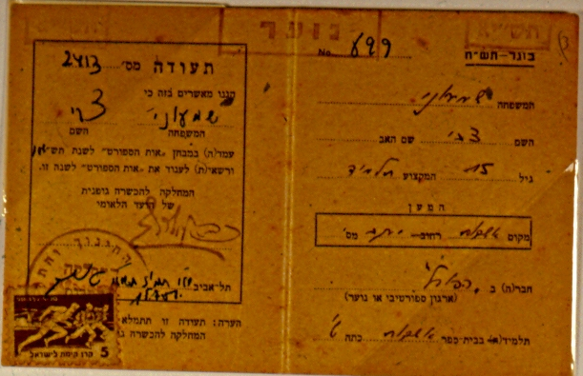
JNF ESSAYS, PROOFS AND EARLY ISSUES
60
Notes:
Slide 60 - 1954 Fourth Maccabiah Stamp – Athletic pass for an athlete to participate in a sporting event in Tel Aviv. The fourth Maccabiah JNF label is tied with a local cancellation.

Slide 64
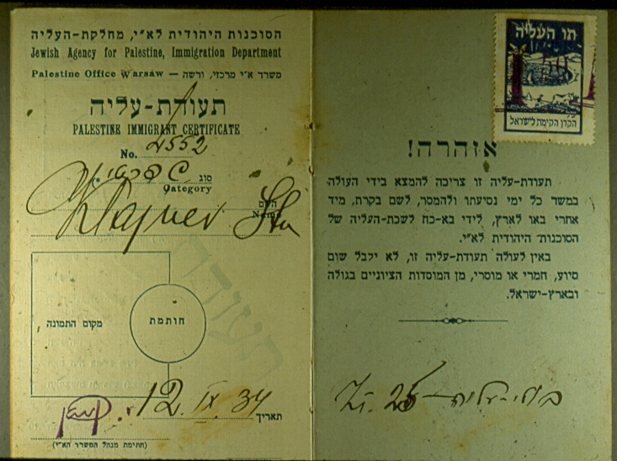
JNF ESSAYS, PROOFS AND EARLY ISSUES
61
Notes:
Slide 61 - 1925 Aliyah Stamp – Polish Aliyah Stamp depicting a view of Haifa Bay with a palm tree on the left and a man plowing with oxen in the foreground. Overprinted “1.5” in violet.

