Slide 1
THE HENNENBERG CACHETS
Stamps Carry a Message:
Cachets Tell the Rest of the Story
Under then President of the Society of Israel Philatelists (S.I.P.) Cleveland Chapter, the first label was designed by Jacob Hennenberg, followed by many more Cachets.
Society of Israel Philatelists
www.israelstamps.com

Slide 2
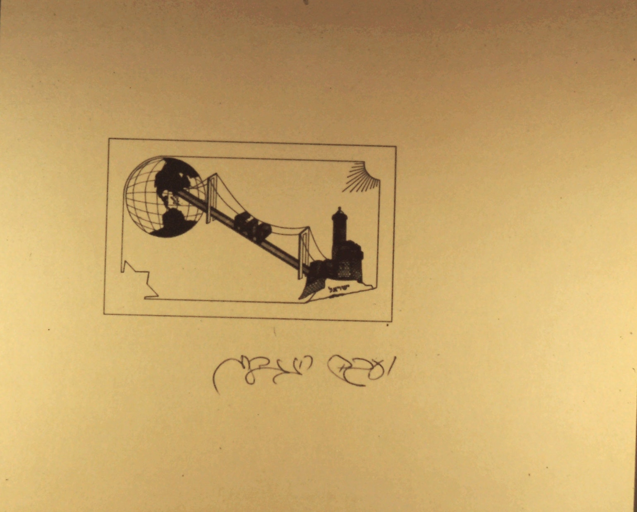
The Hennenberg Cachets
Slide 1
Notes:
Slide 1: First design of the label. It portrays the connection between U.S.A. and Israel through Holy Land philately. It created furor in the Arab newspapers because at that time the Tower of David (depicted in the label) was in Jordanian occupied Jerusalem. Maybe Mr. Hennenberg’s depiction was a prediction of what would become Israeli territory after the 1967 War to the present.

Slide 3
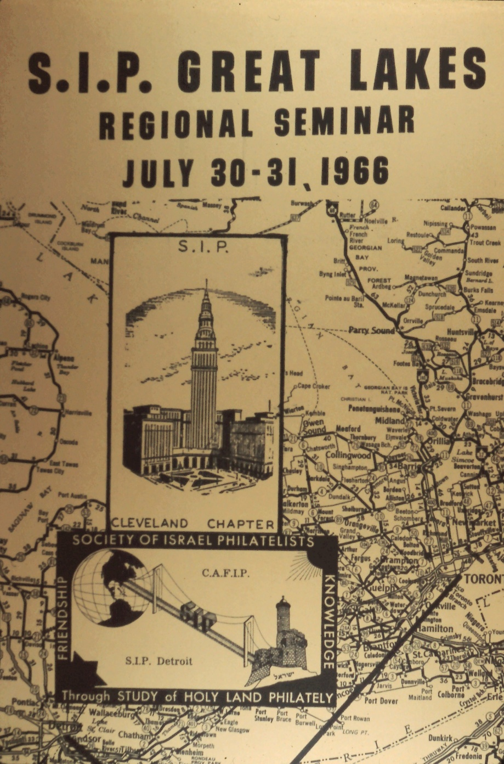
The Hennenberg Cachets
Slide 2
Notes:
Slide 2: S.I.P. Great Lakes Regional Seminar in 1966.

Slide 4
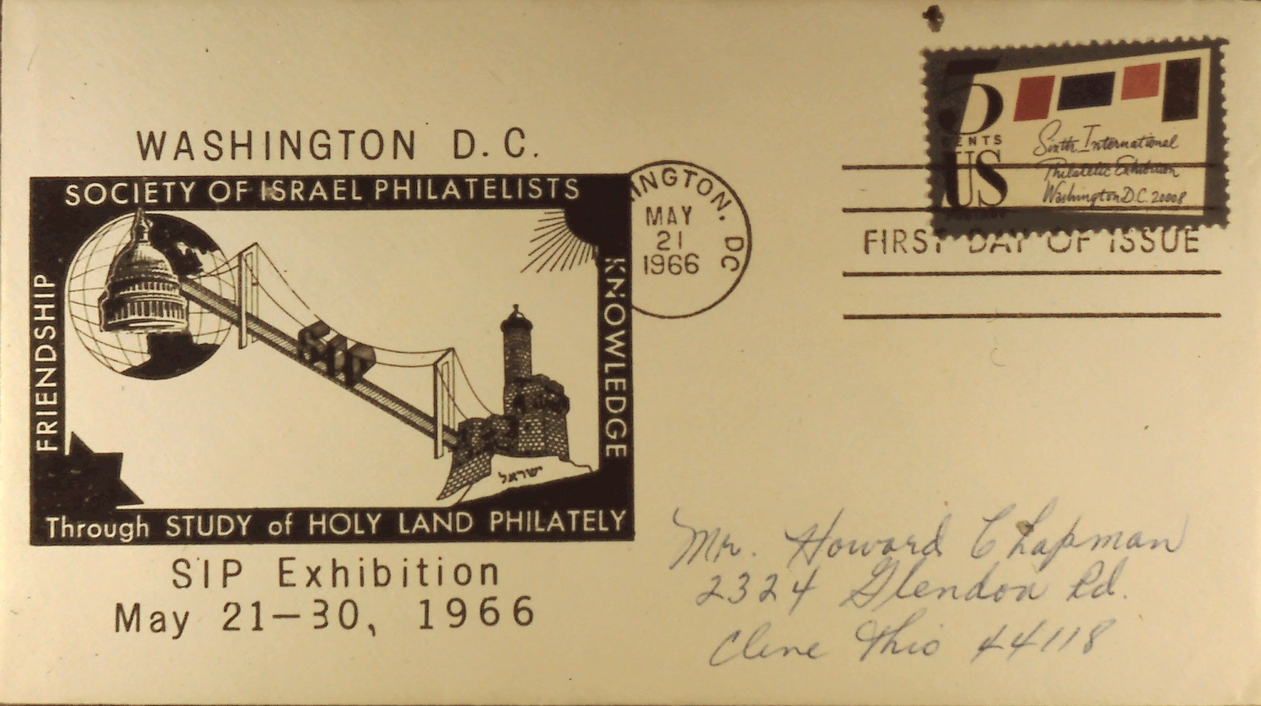
The Hennenberg Cachets
Slide 3
Notes:
Slide 3: Washington, D.C. S.I.P. Exhibition 1966.

Slide 5
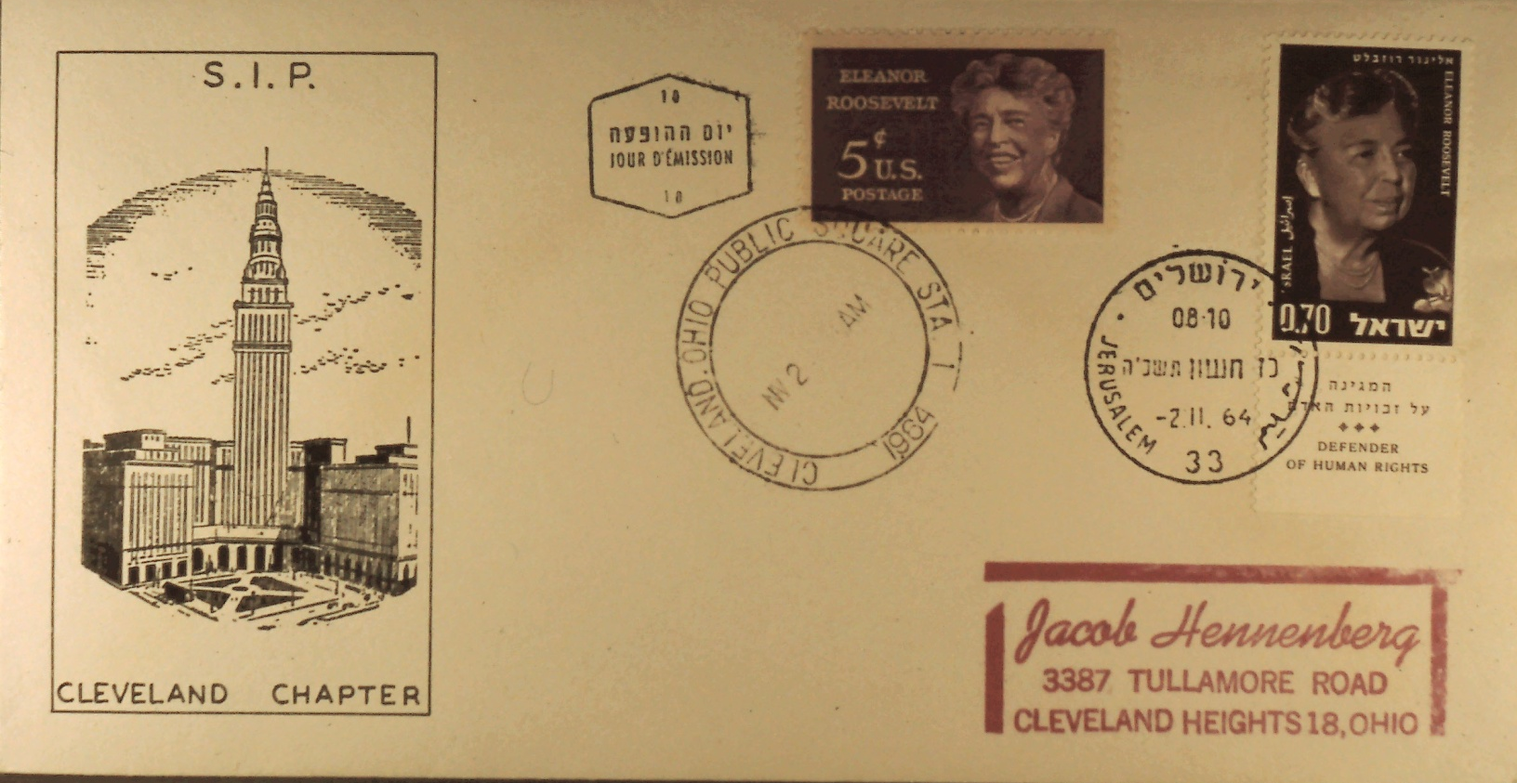
The Hennenberg Cachets
Slide 4
Notes:
Slide 4: First day issue with Cleveland Chapter Cachet honoring Eleanor Roosevelt – cancelled in Israel and the U.S. with the same date.

Slide 6
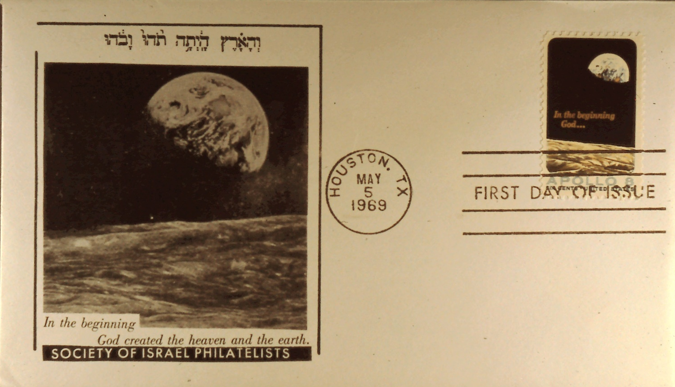
The Hennenberg Cachets
Slide 5
Notes:
Slide 5: Cachet in honor of the Americans landing on the moon.

Slide 7
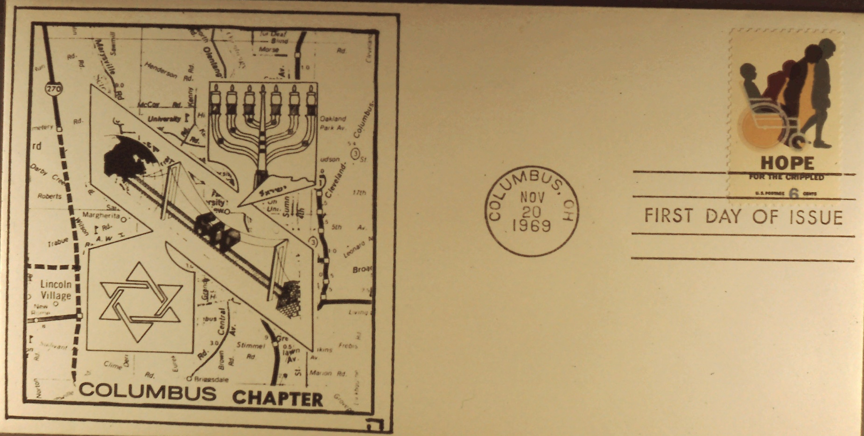
The Hennenberg Cachets
Slide 6
Notes:
Slide 6: Honoring Columbus, Ohio S.I.P. Chapter November 20, 1969 led by then President Howard Chapman.

Slide 8
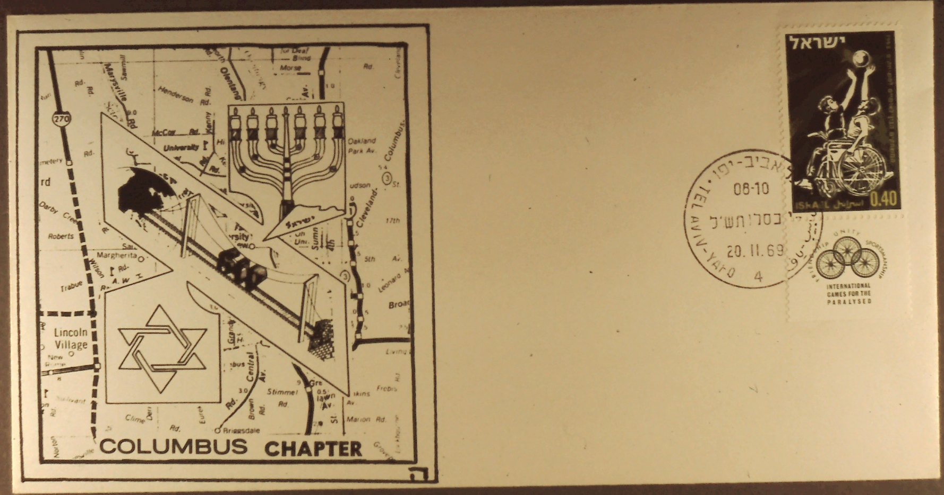
The Hennenberg Cachets
Slide 7
Notes:
Slide 7: Same design as previous slide cancelled Tel Aviv – Yafo November 20, 1969.

Slide 9
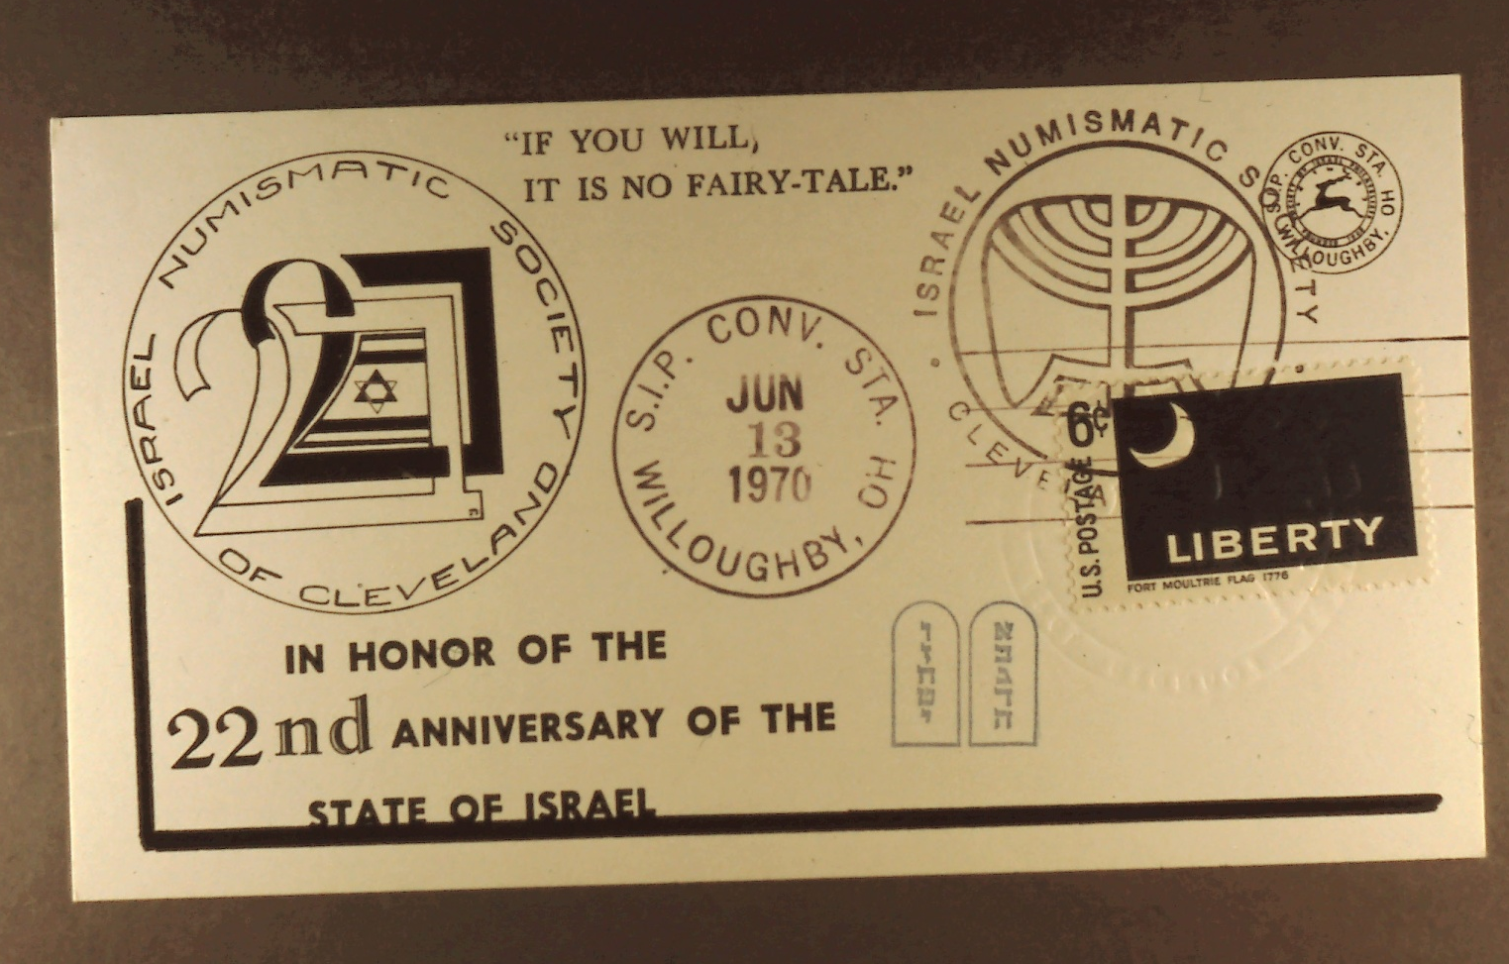
The Hennenberg Cachets
Slide 8
Notes:
Slide 8: Postcard in honor of the 22nd anniversary of the State of Israel cancelled June 13, 1970 at the S.I.P. Convention Station, Willoughby, Ohio. Held in conjunction with the Israel Numismatic Society.

Slide 10
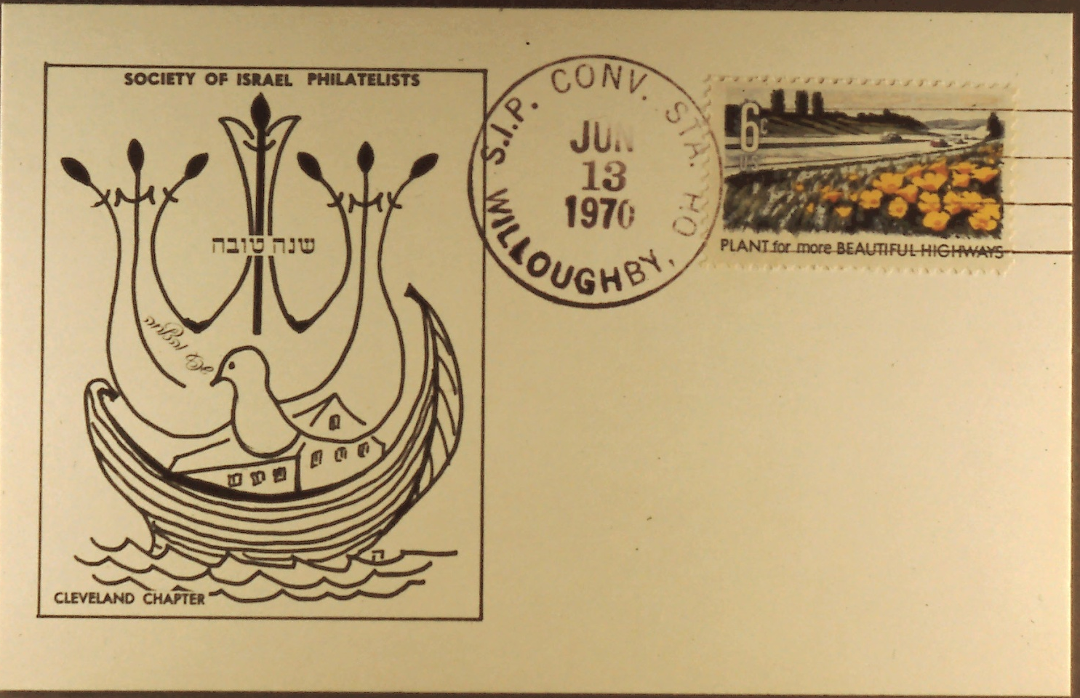
The Hennenberg Cachets
Slide 9
Notes:
Slide 9: Postcard cancelled June 13, 1970 at the S.I.P. Convention Station, Willoughby, Ohio.

Slide 11
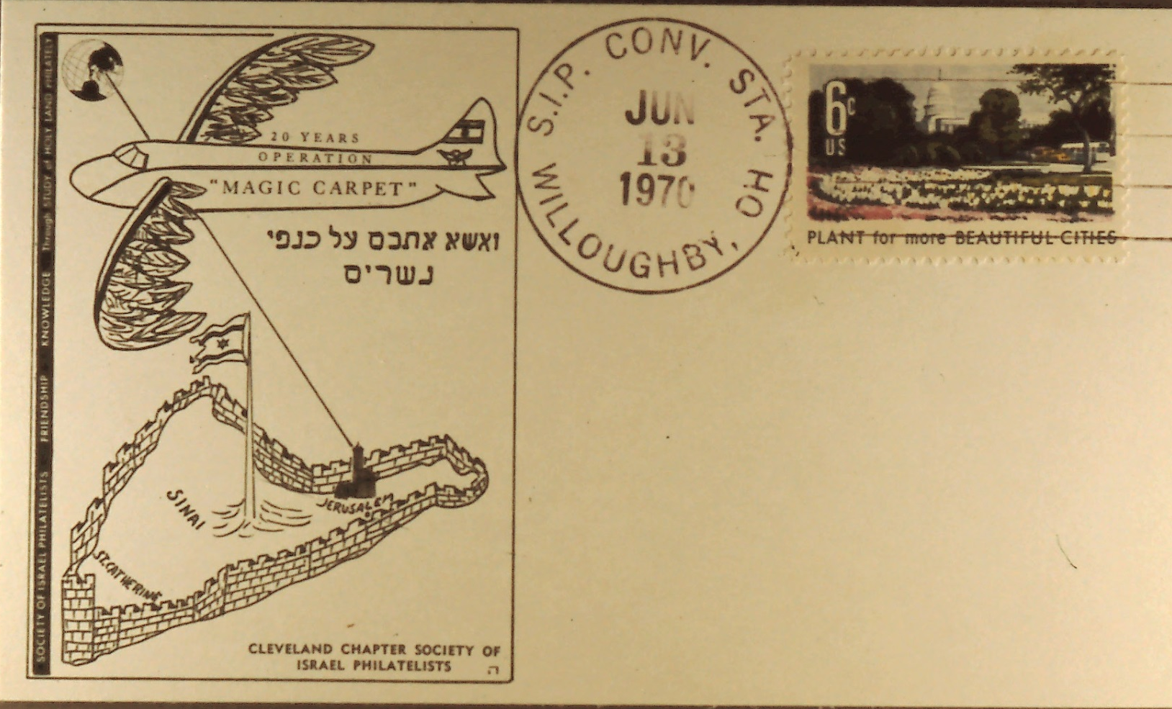
The Hennenberg Cachets
Slide 10
Notes:
Slide 10: Design in honor of “the flying carpet” bringing the Jews out of Yemen. Mr. Hennenberg modified the wings of the plane with wings of a bird. The Jews of Yemen were supposed to come to a gathering point traveling through the desert. Israel supplied the trucks to bring them to the assembly point. They refused to enter the trucks; they preferred walking through the desert. When the Jewish Yemenites arrived at the airport they did not hesitate to go into the plane. Their explanation was with the prophecy of our teachings declaring “On the wings of the eagles I will bring you home.” (Psalm). Cancelled June 13, 1970, S.I.P. Convention Station, Willoughby, Ohio.

Slide 12
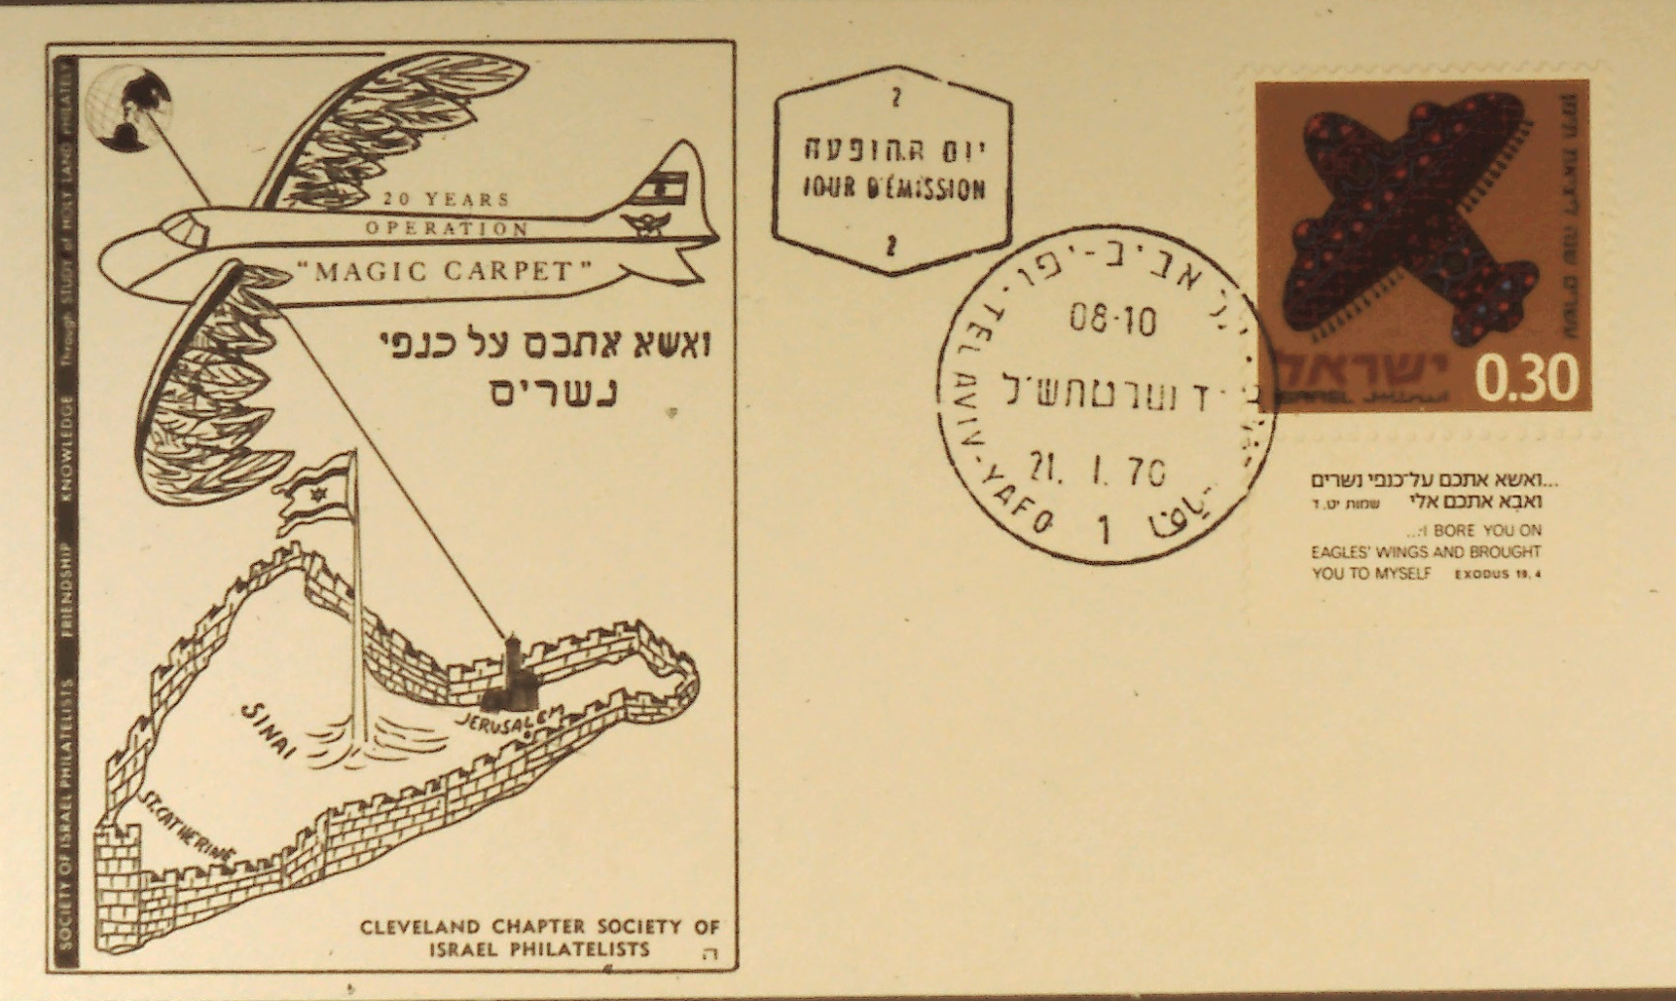
The Hennenberg Cachets
Slide 11
Notes:
Slide 11: Magic Carpet: On the Wings of Eagles.

Slide 13
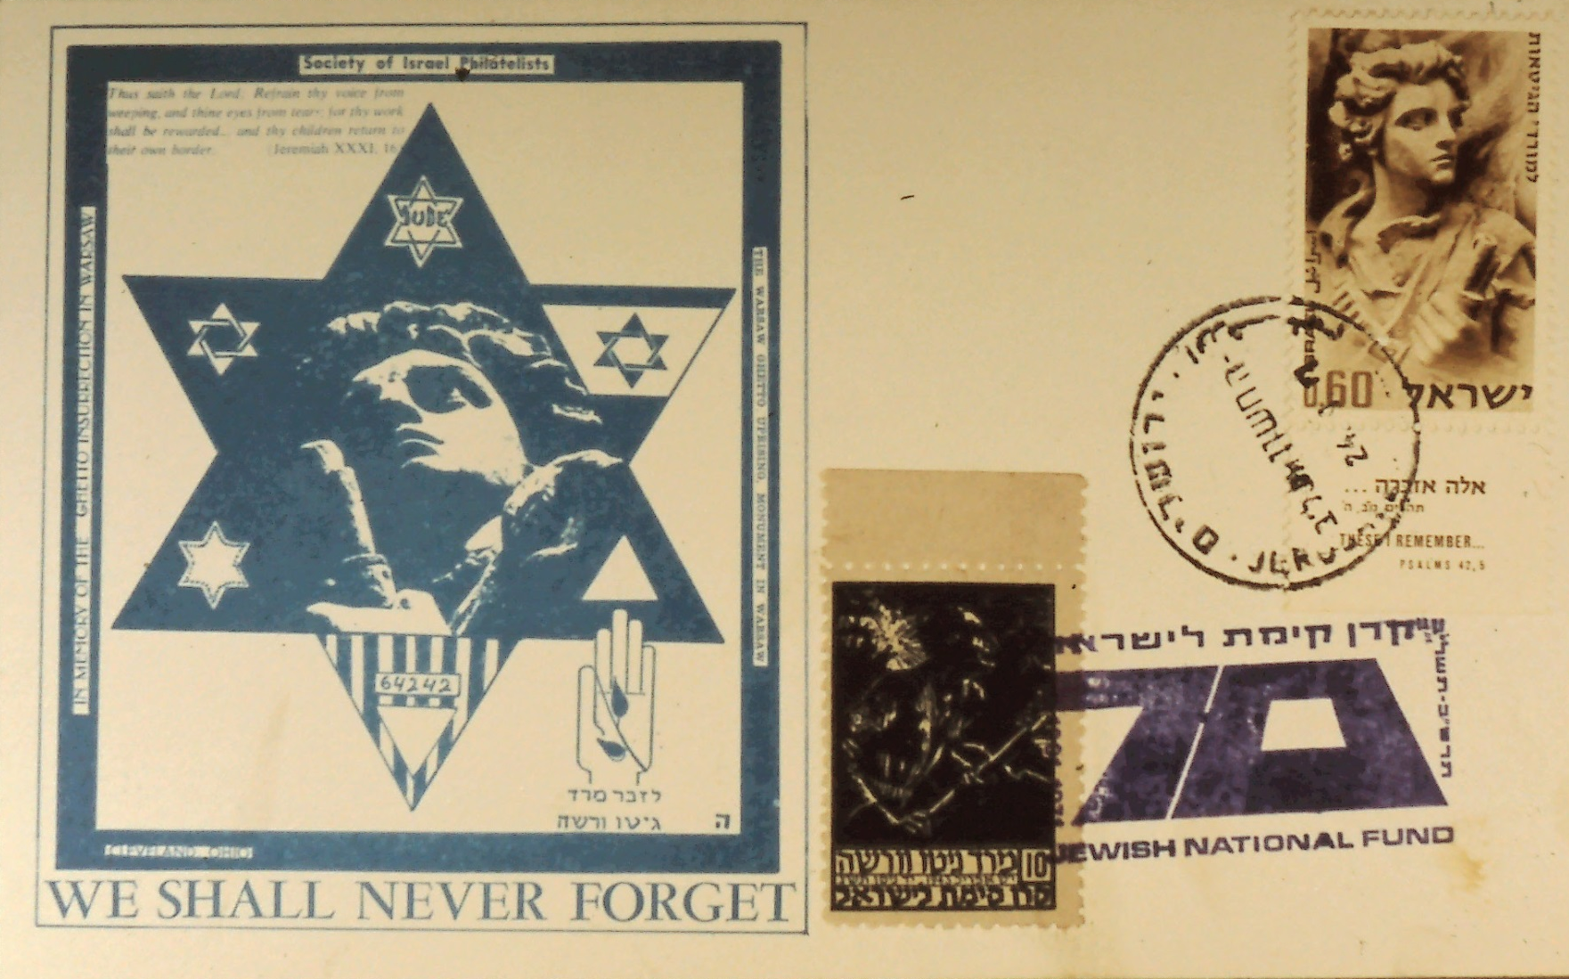
The Hennenberg Cachets
Slide 12
Notes:
Slide 12: Honoring Mordechai Anielewicz, hero of the Warsaw Ghetto Uprising.

Slide 14
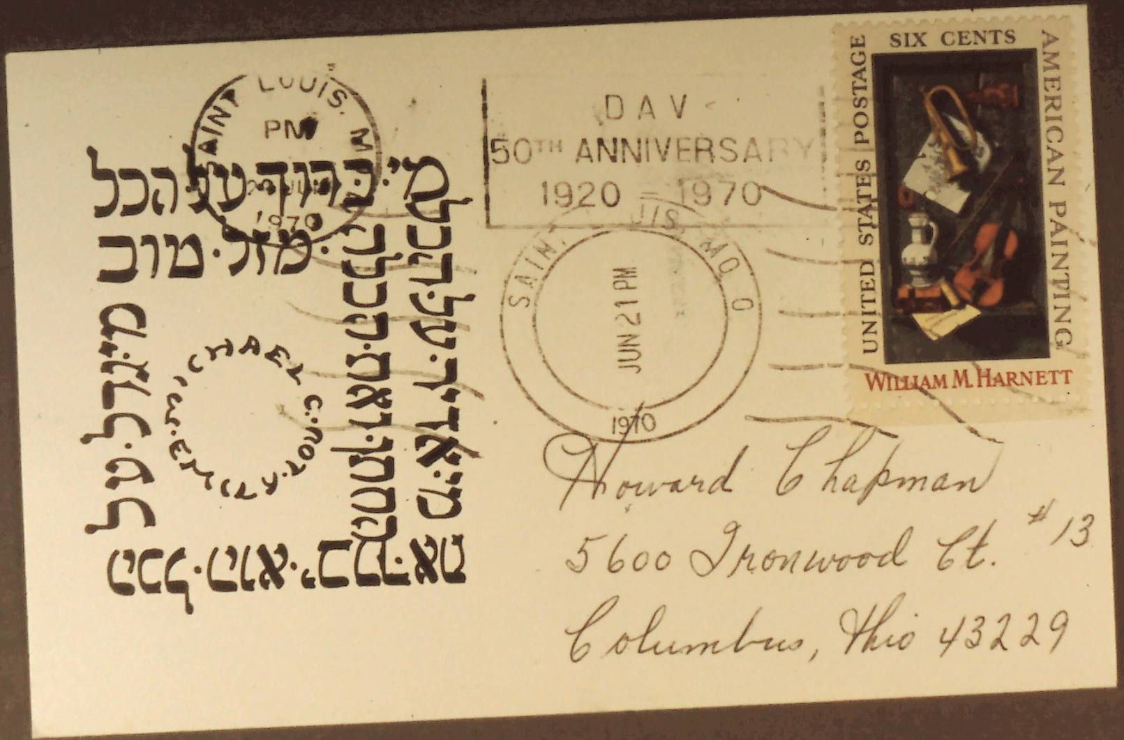
The Hennenberg Cachets
Slide 13
Notes:
Slide 13: Wedding wishes for Michael Hennenberg from St. Louis, Mo. June 21, 1970.

Slide 15
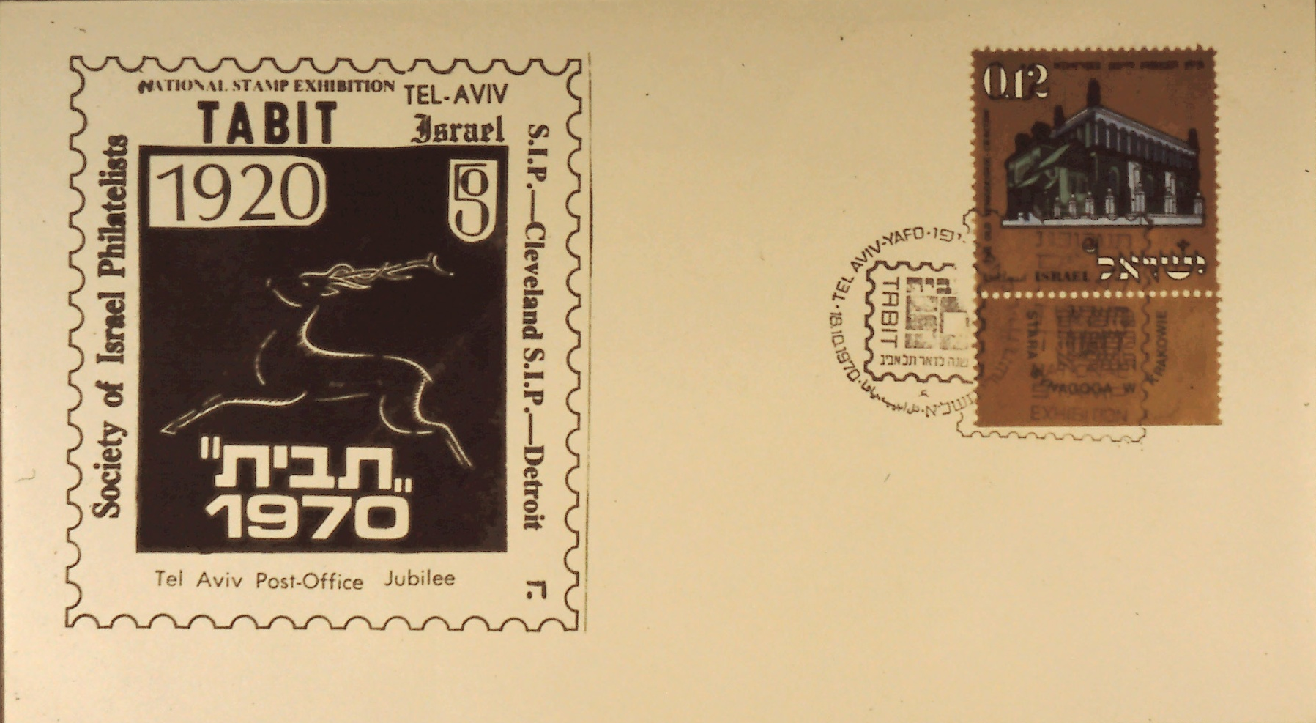
The Hennenberg Cachets
Slide 14
Notes:
Slide 14: Honoring Tabit 1970.

Slide 16

The Hennenberg Cachets
Slide 15
Notes:
Slide 15: Jacob Hennenberg design used in a 1970 Tabit cancellation – cancelled in Jerusalem.

Slide 17
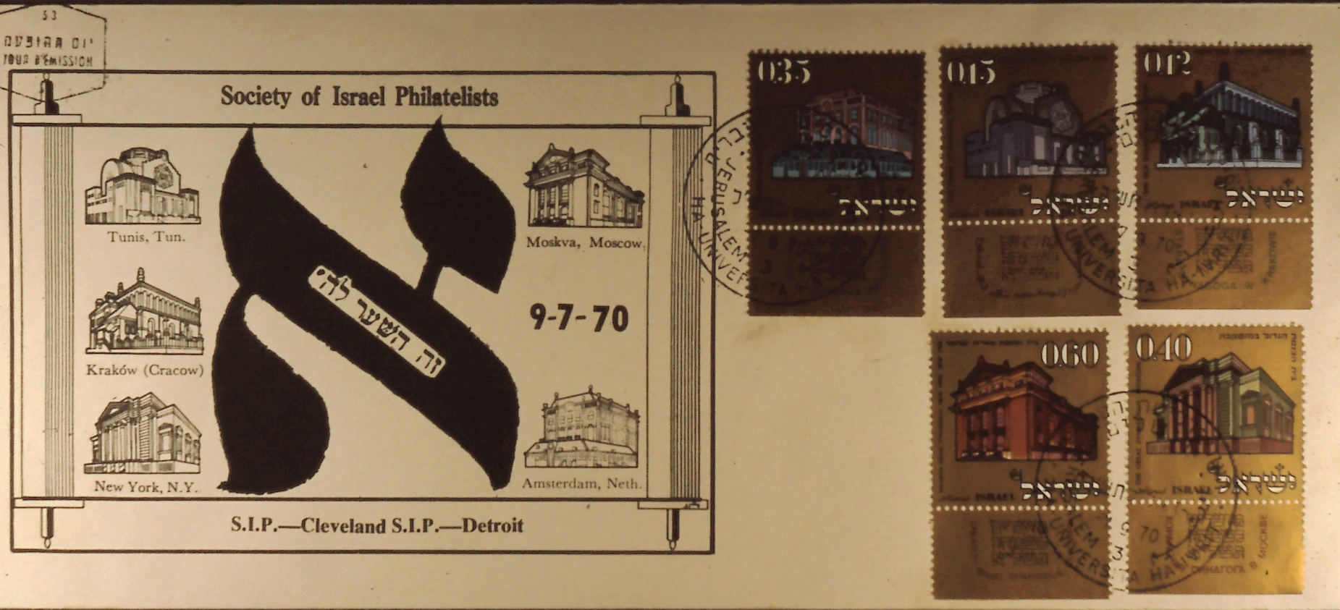
The Hennenberg Cachets
Slide 16
Notes:
Slide 16: Cleveland Chapter Cachet for first day of pre-war European synagogue set 1970.

Slide 18
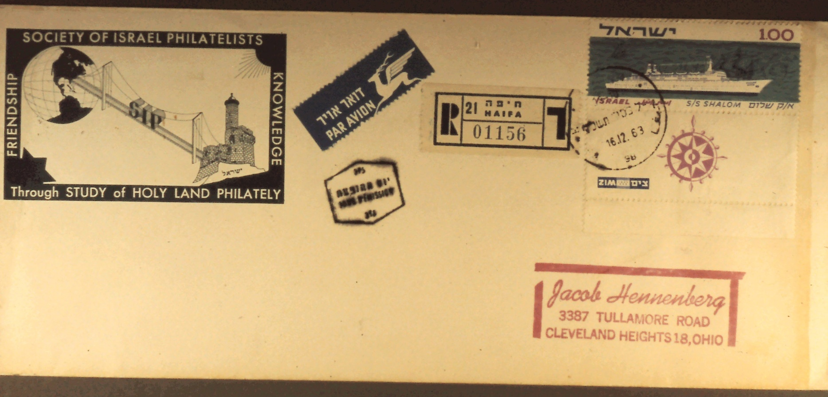
The Hennenberg Cachets
Slide 17
Notes:
Slide 17: Cleveland Chapter S.I.P. label on a first day cover honoring the Israeli ship Shalom.

Slide 19
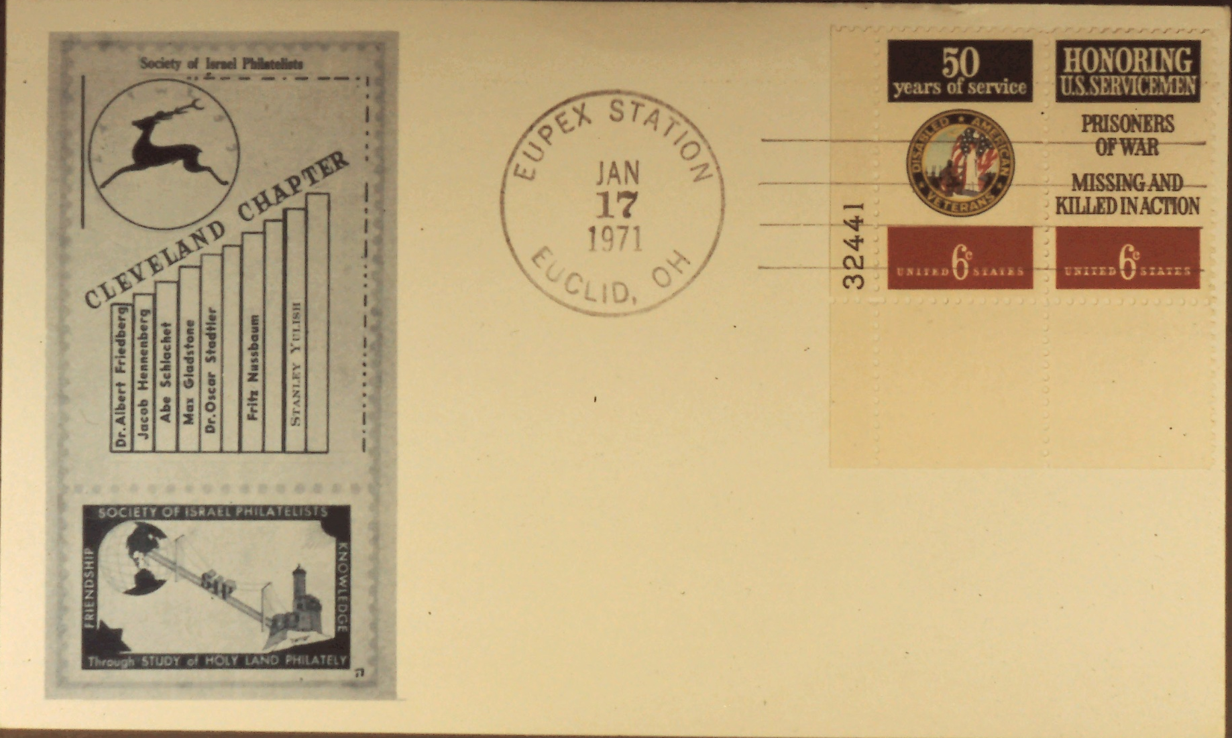
The Hennenberg Cachets
Slide 18
Notes:
Slide 18: Early presidents of the Cleveland S.I.P. Chapter Cachet, cancelled EUPEX Station, Euclid, Ohio, January 17, 1971. Dr. Albert Friedberg was the first Chapter President and Jacob Hennenberg was the second President.

Slide 20
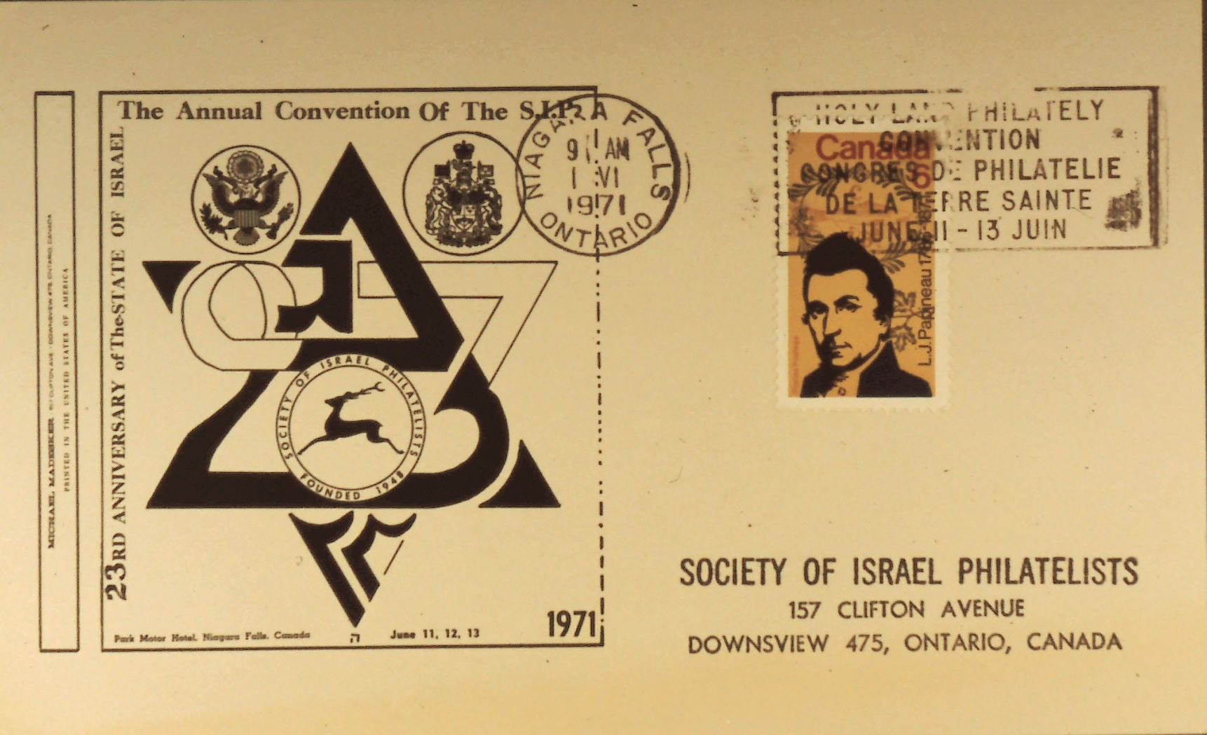
The Hennenberg Cachets
Slide 19
Notes:
Slide 19: Cachet for S.I.P. Columbus Chapter 1971.

Slide 21
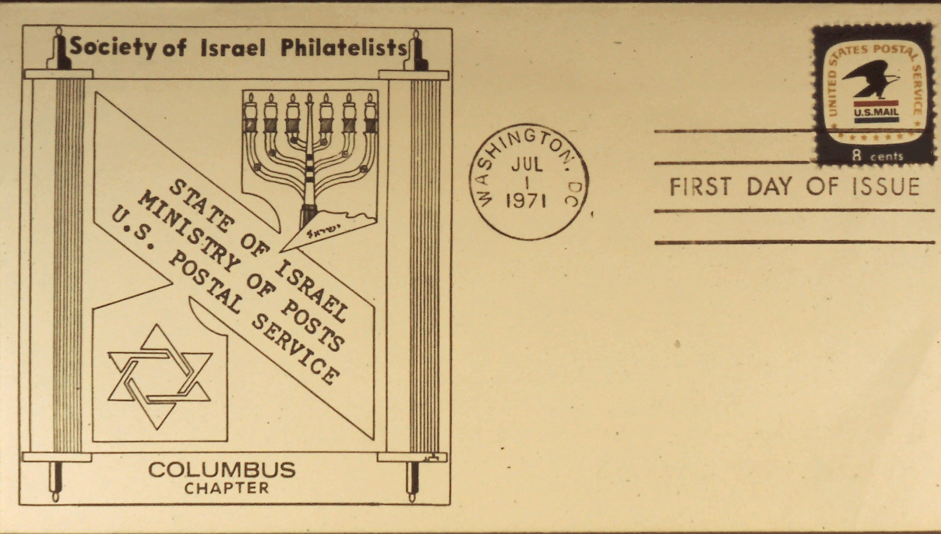
The Hennenberg Cachets
Slide 20
Notes:
Slide 20: Annual S.I.P. Convention in Niagara Falls cancelled with a special postmark for the Convention, June 11, 1971.

Slide 22
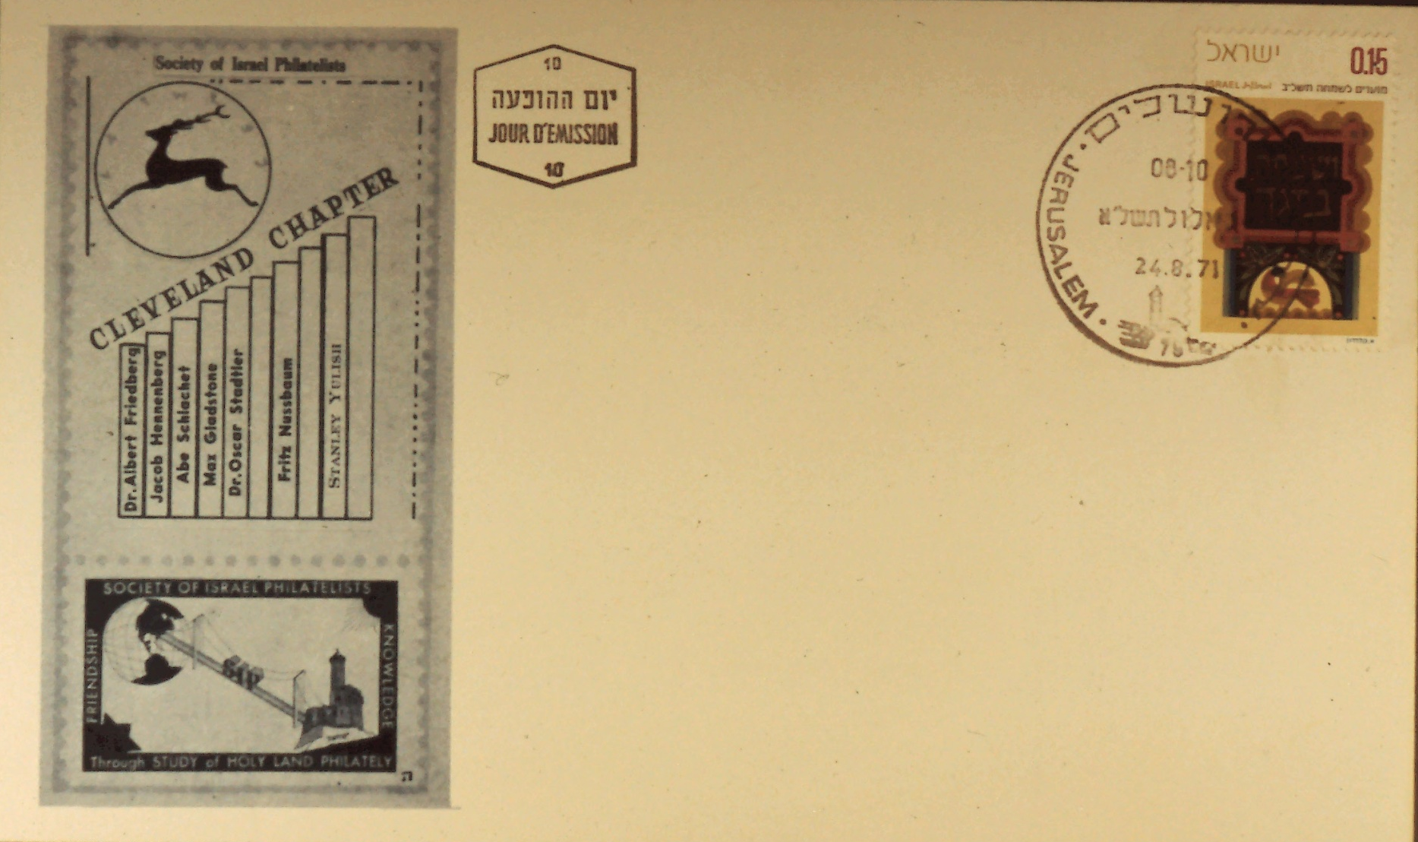
The Hennenberg Cachets
Slide 21
Notes:
Slide 21: Early Presidents of the Cleveland Chapter cancelled August 24, 1971, Jerusalem.

Slide 23
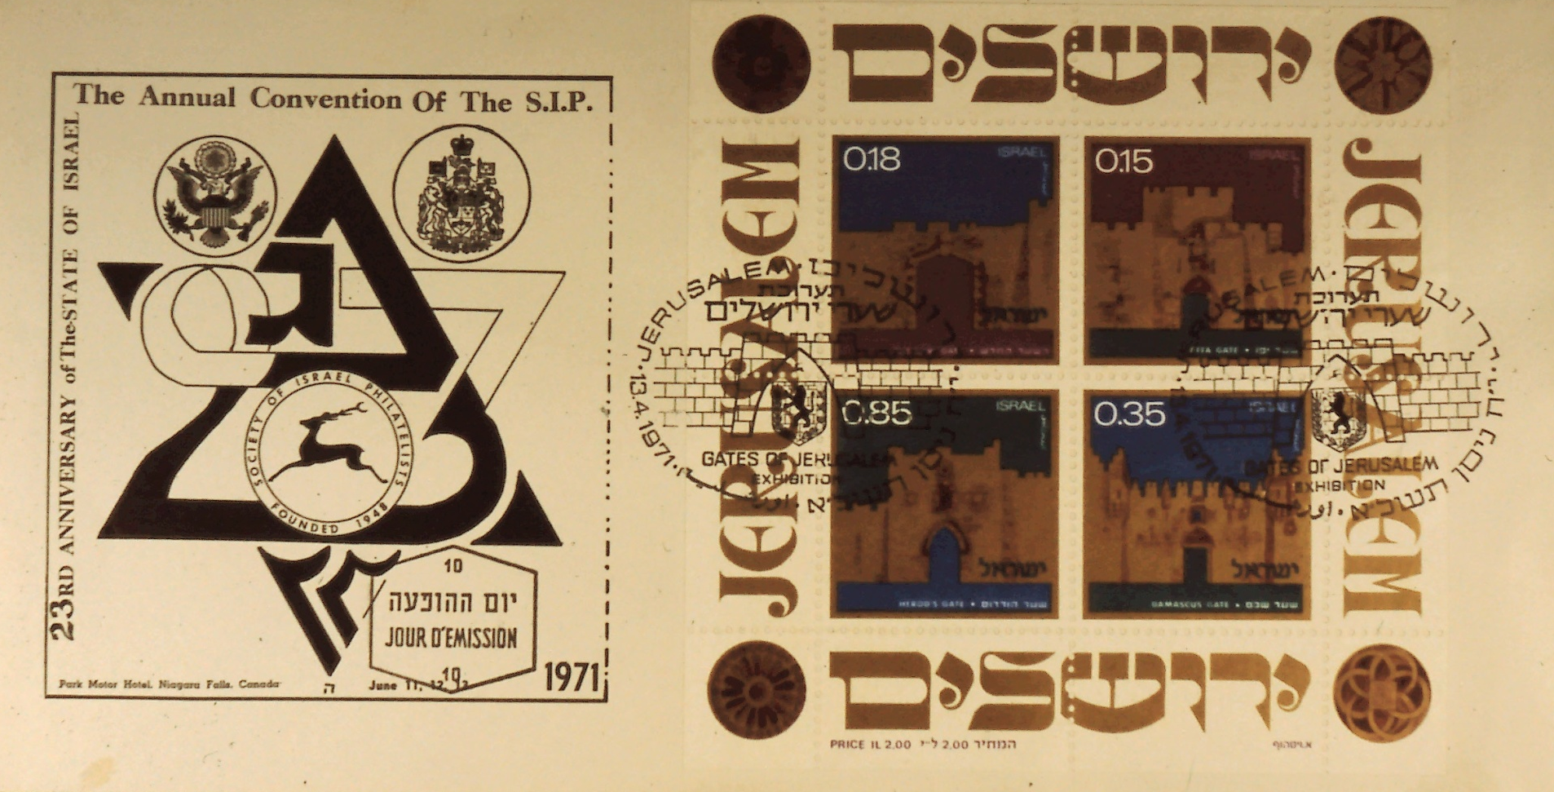
The Hennenberg Cachets
Slide 22
Notes:
Slide 22: Toronto cachet cancelled in Jerusalem first day of the Gates souvenir sheet.

Slide 24
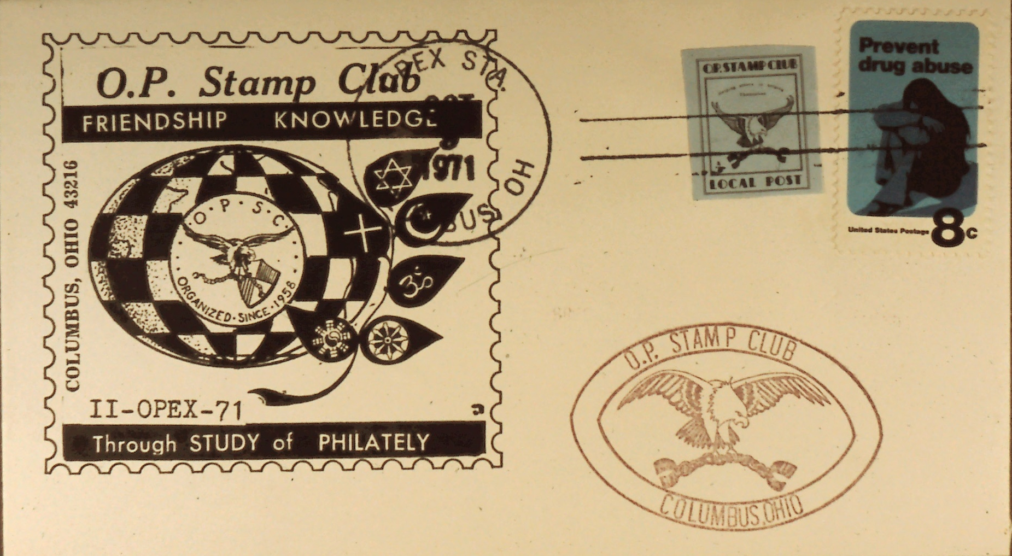
The Hennenberg Cachets
Slide 23
Notes:
Slide 23: Cachet for the Ohio Penitentiary Stamp Club cancelled OPEX, Station, Columbus, Ohio, October 9, 1971.

Slide 25
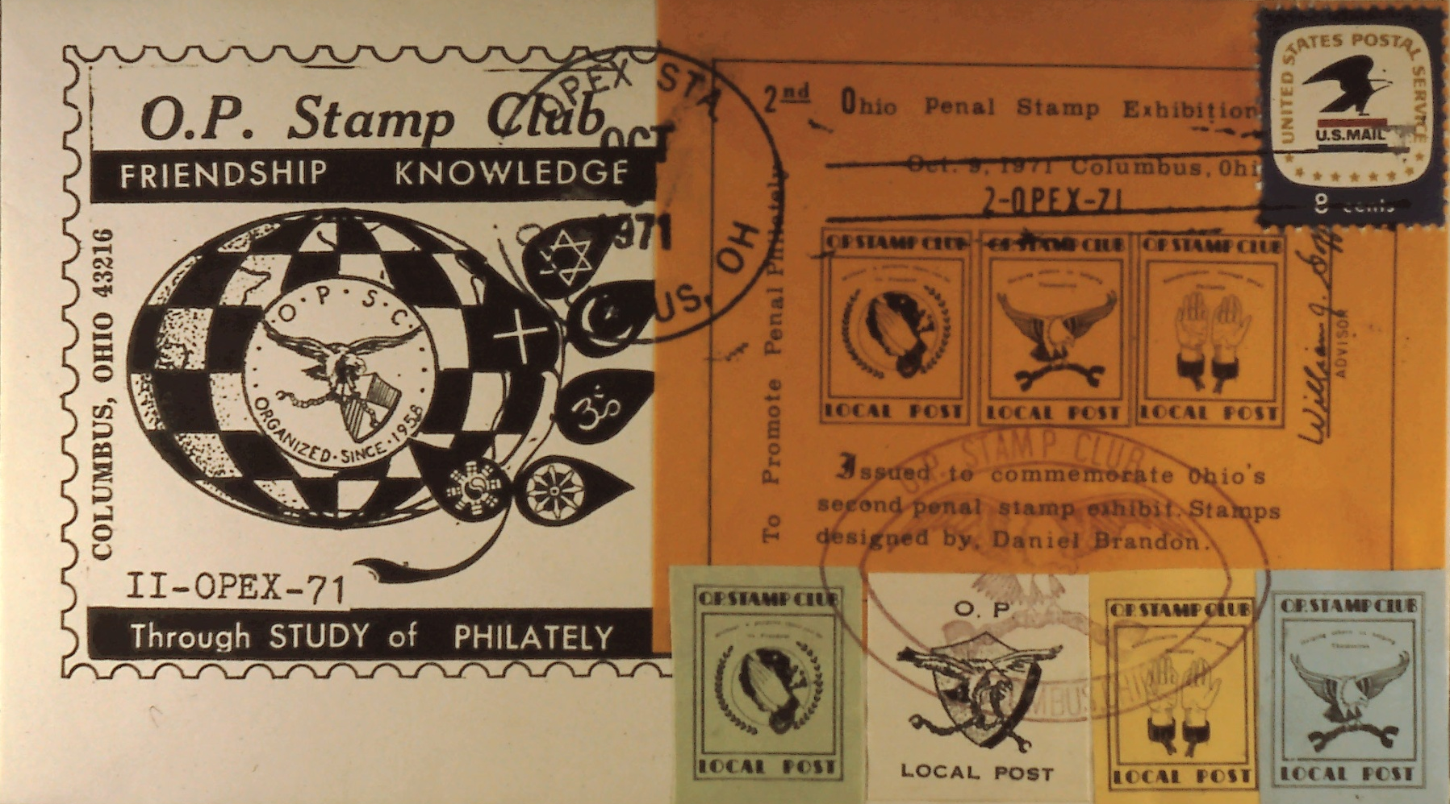
The Hennenberg Cachets
Slide 24
Notes:
Slide 24: Cachet for the Ohio Penitentiary Stamp Club in 1971.

Slide 26
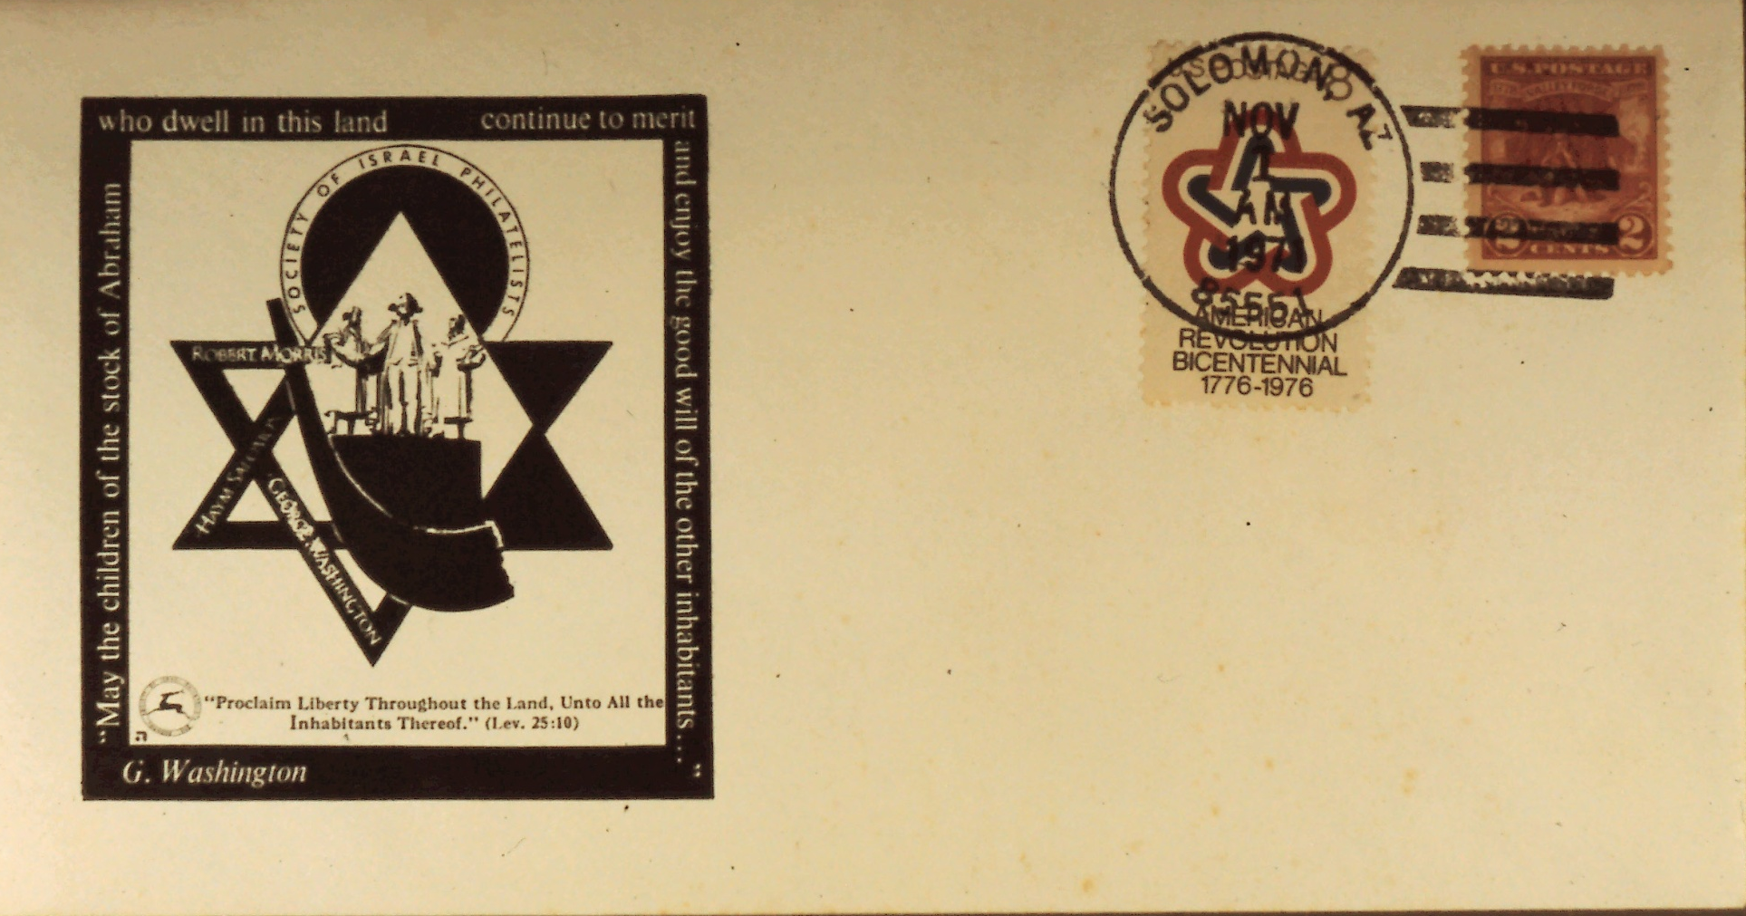
The Hennenberg Cachets
Slide 25
Notes:
Slide 25: Cachet honoring Chaim Solomon cancelled Solomon, Az., November 1, 1971.

Slide 27
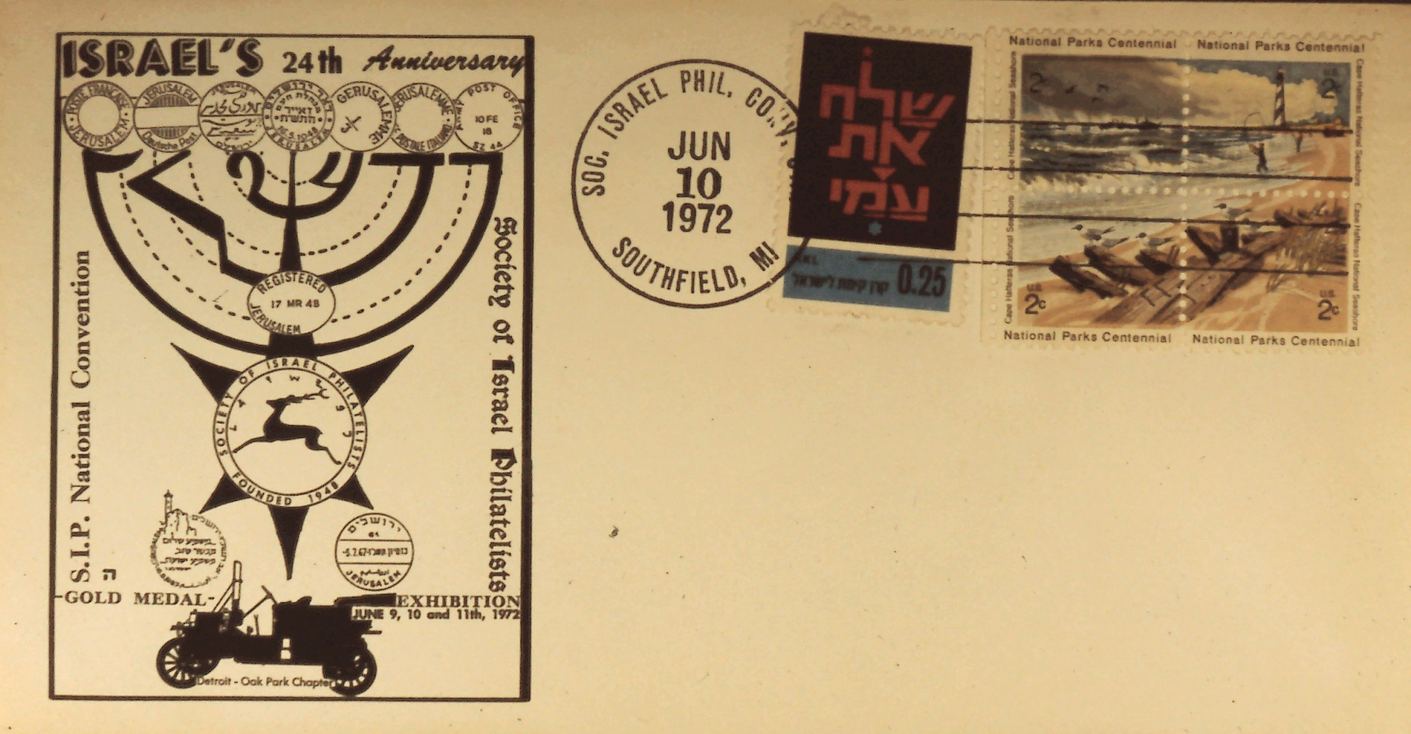
The Hennenberg Cachets
Slide 26
Notes:
Slide 26: S.I.P Convention in Southfield, Michigan honoring Israel’s 24th anniversary.

Slide 28
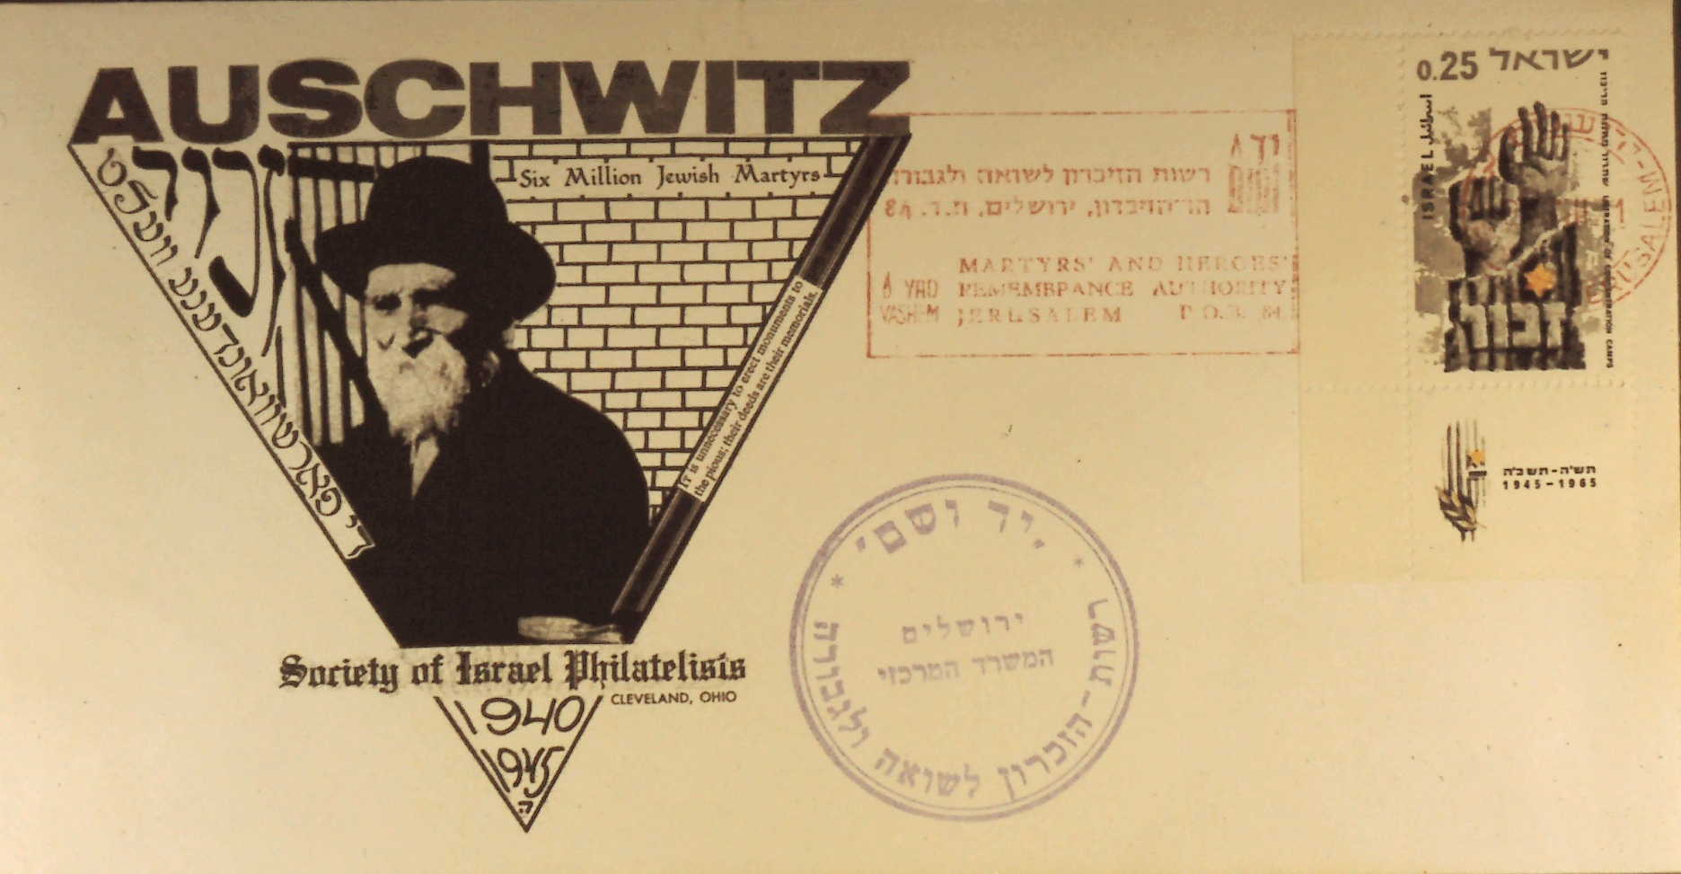
The Hennenberg Cachets
Slide 27
Notes:
Slide 27: Envelope cancelled in Aushwitz and Yad Vashem.

Slide 29
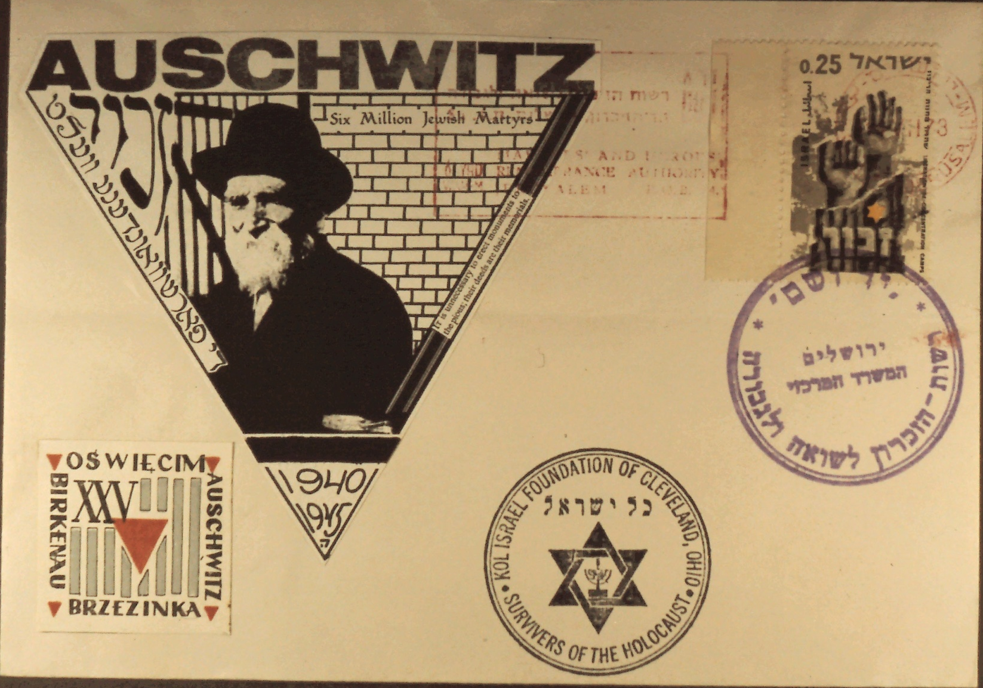
The Hennenberg Cachets
Slide 28
Notes:
Slide 28: Cover cancelled in the Yad Vashem in Jerusalem showing a man that lived in Auschwitz.

Slide 30
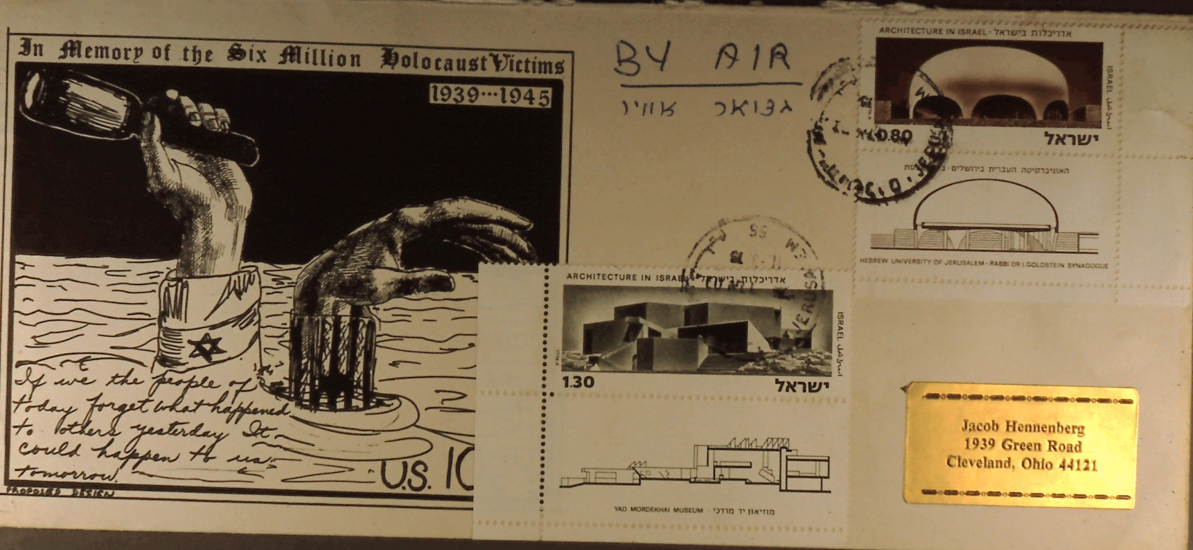
The Hennenberg Cachets
Slide 29
Notes:
Slide 29: Stamp cancelled in Israel – Cachet representing the passive and active resistance against the Nazis.

Slide 31
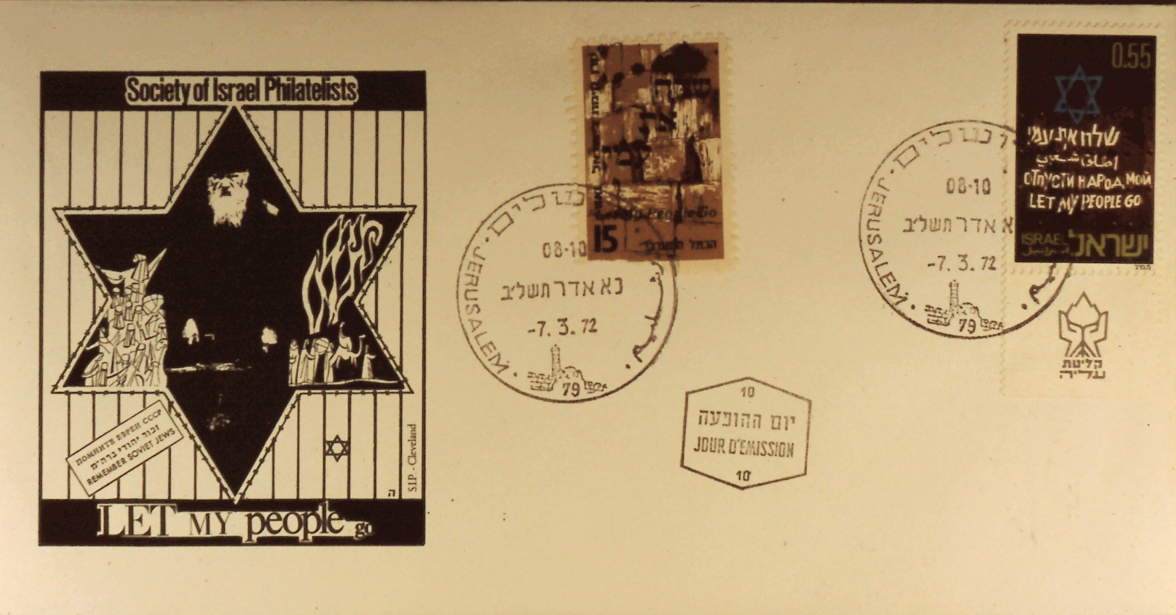
The Hennenberg Cachets
Slide 30
Notes:
Slide 30: 1972 Cachet – “Let my People Go” cancelled Jerusalem, March 7, 1972.

Slide 32
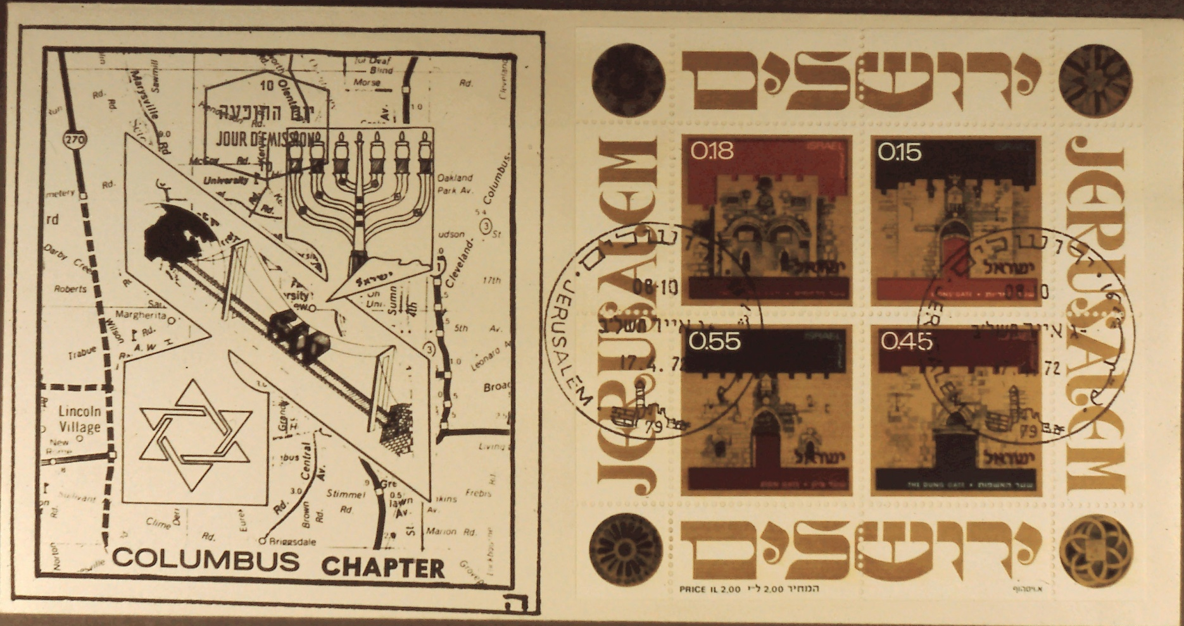
The Hennenberg Cachets
Slide 31
Notes:
Slide 31: Columbus Chapter cachet with the Gates of Jerusalem souvenir sheet cancelled first day.

Slide 33
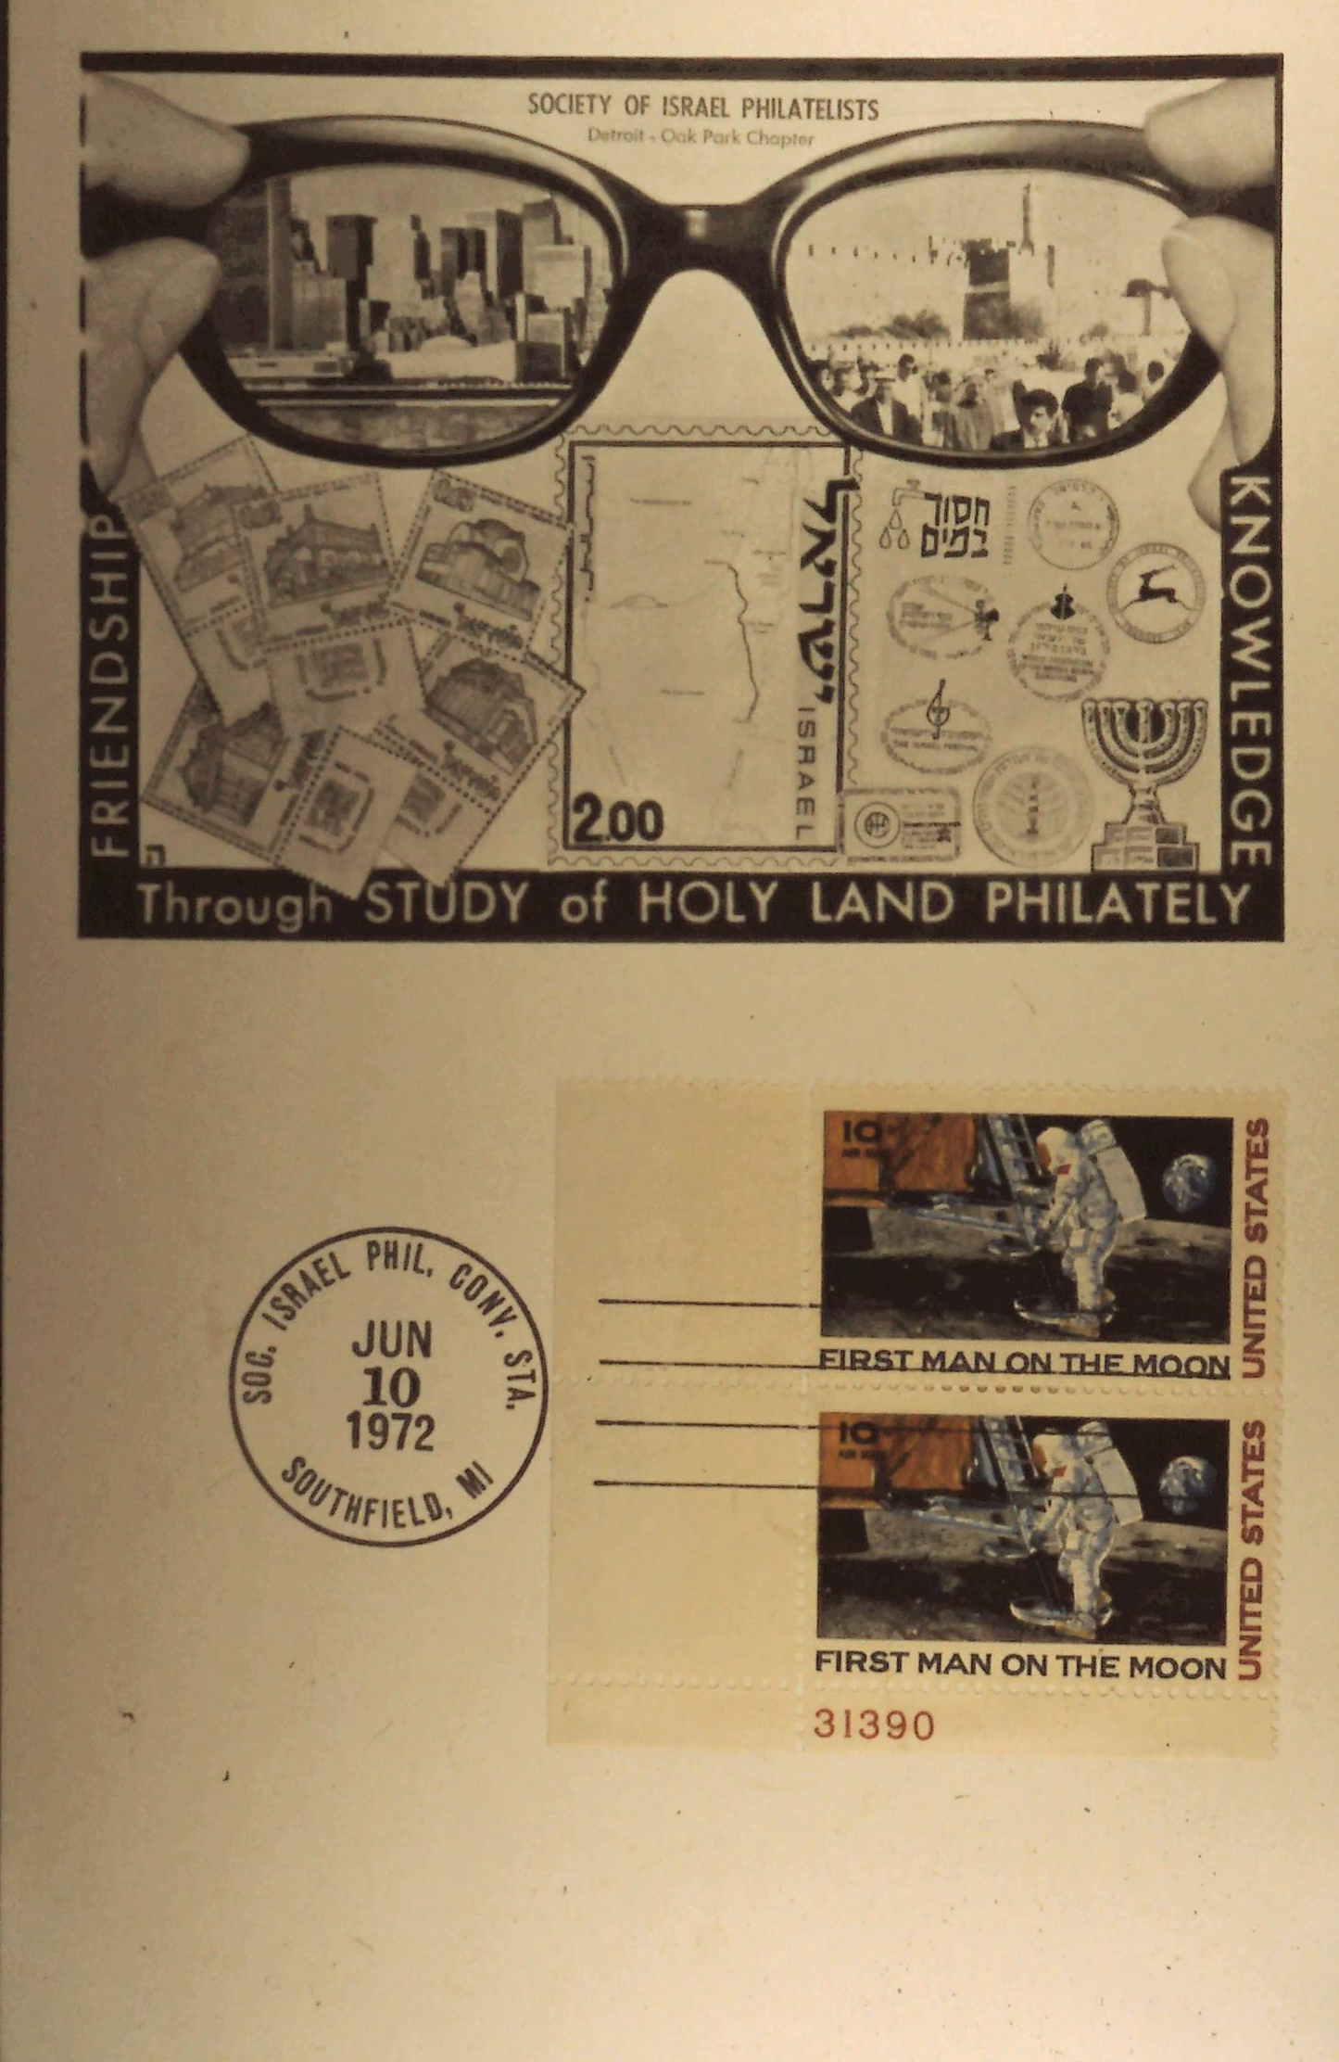
The Hennenberg Cachets
Slide 32
Notes:
Slide 32: Cachet with spectacles looking to the left towards New York and the right towards Israel.

Slide 34
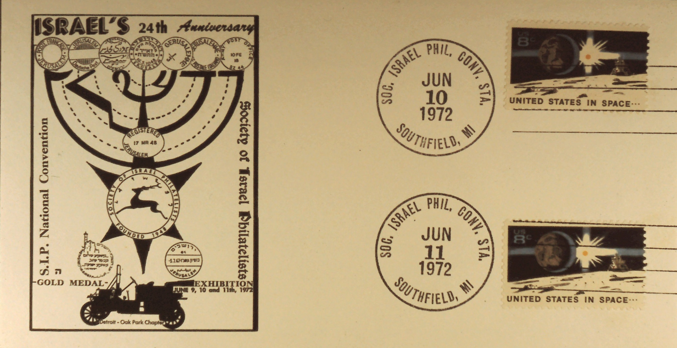
The Hennenberg Cachets
Slide 33
Notes:
Slide 33: S.I.P. Convention Station, Southfield, Michigan, June 10, 1972 and June 11, 1972, honoring Israel’s 24th Anniversary.

Slide 35
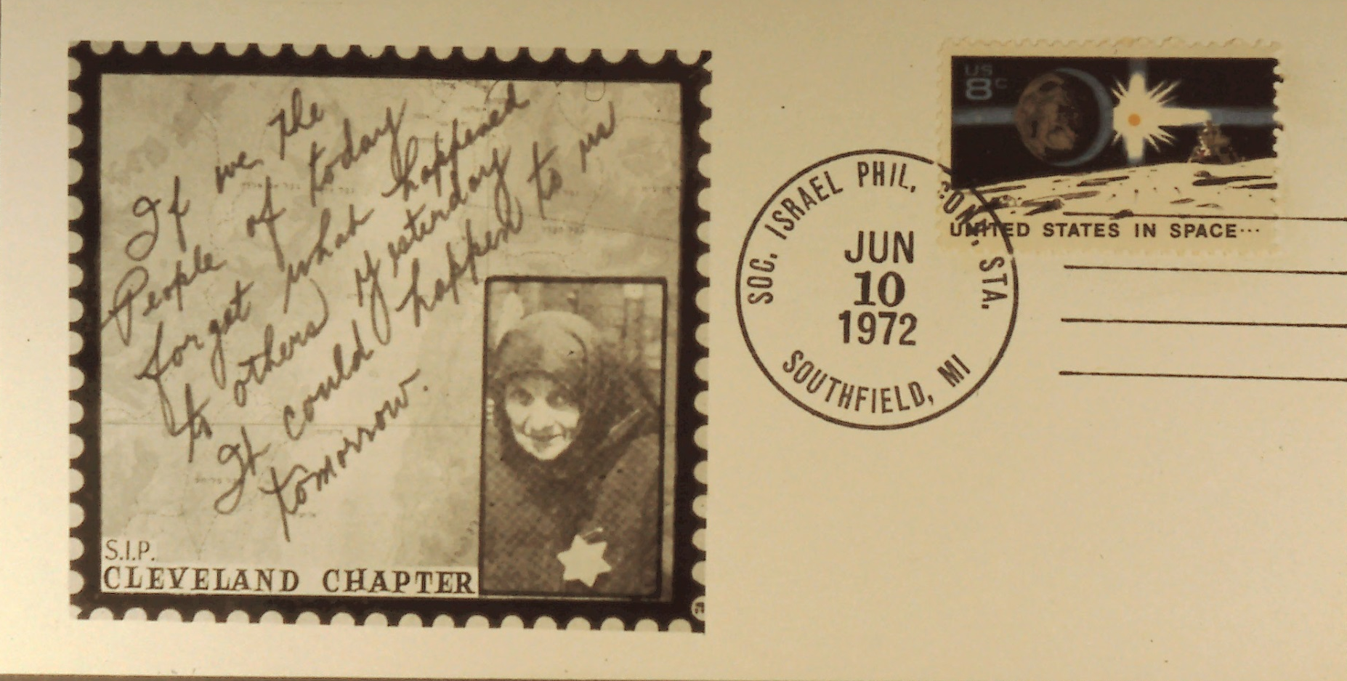
The Hennenberg Cachets
Slide 34
Notes:
Slide 34: Cleveland Chapter Cachet Cancelled Southfield, Michigan, June 10, 1972. The Cachet reads, “If we the people of today forget what happened to others yesterday it could happen to you tomorrow.”

Slide 36
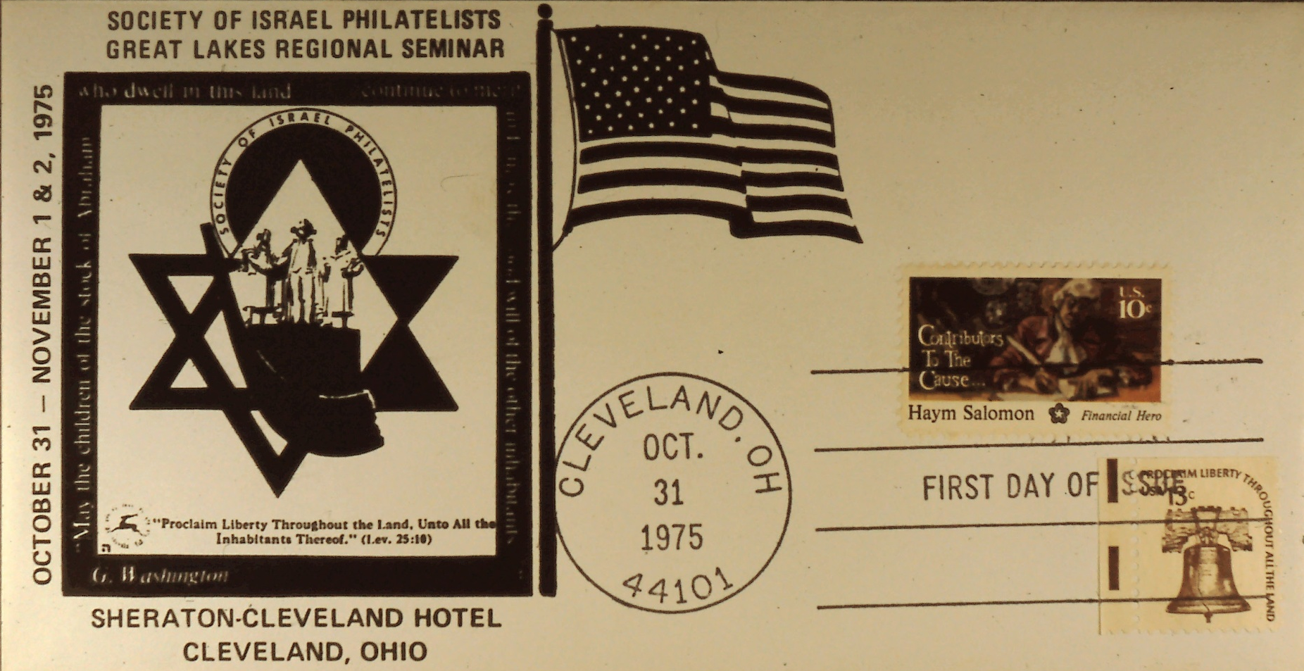
The Hennenberg Cachets
Slide 35
Notes:
Slide 35: Cachet in honor of George Washington and Chaim Solomon cancelled in Cleveland, Ohio, October 31, 1975..

Slide 37
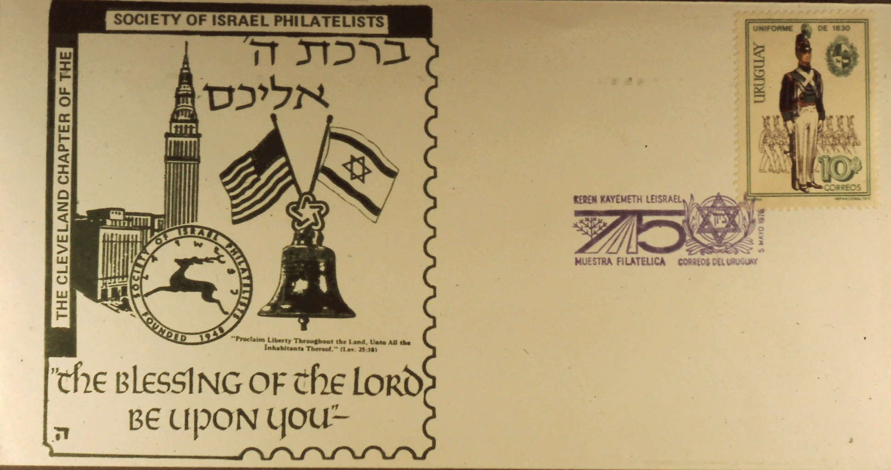
The Hennenberg Cachets
Slide 36
Notes:
Slide 36: Letter cancelled in Argentina – 75th Anniversary of Jewish National Fund.

Slide 38
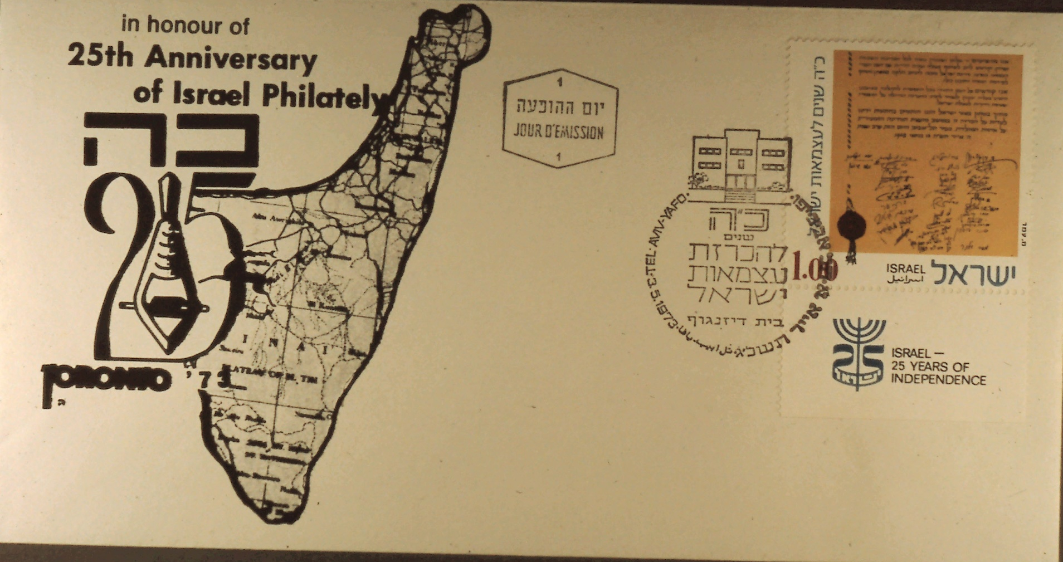
The Hennenberg Cachets
Slide 37
Notes:
Slide 37: 25th Anniversary of the State of Israel – cancelled in Israel first day of the 25th Anniversary stamp.

Slide 39
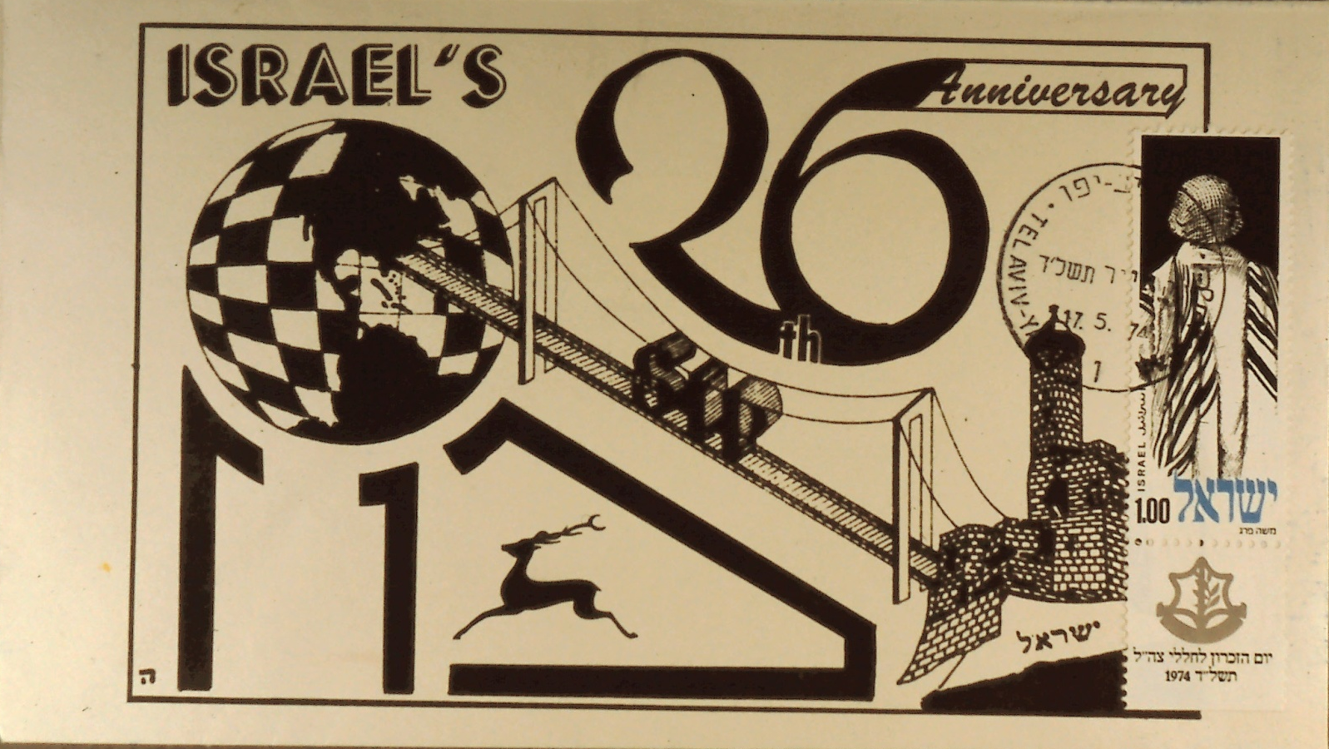
The Hennenberg Cachets
Slide 38
Notes:
Slide 38: Envelope in honor of the 26th anniversary of the State of Israel cancelled May 17, 1974, Tel Aviv – Yafo.

Slide 40
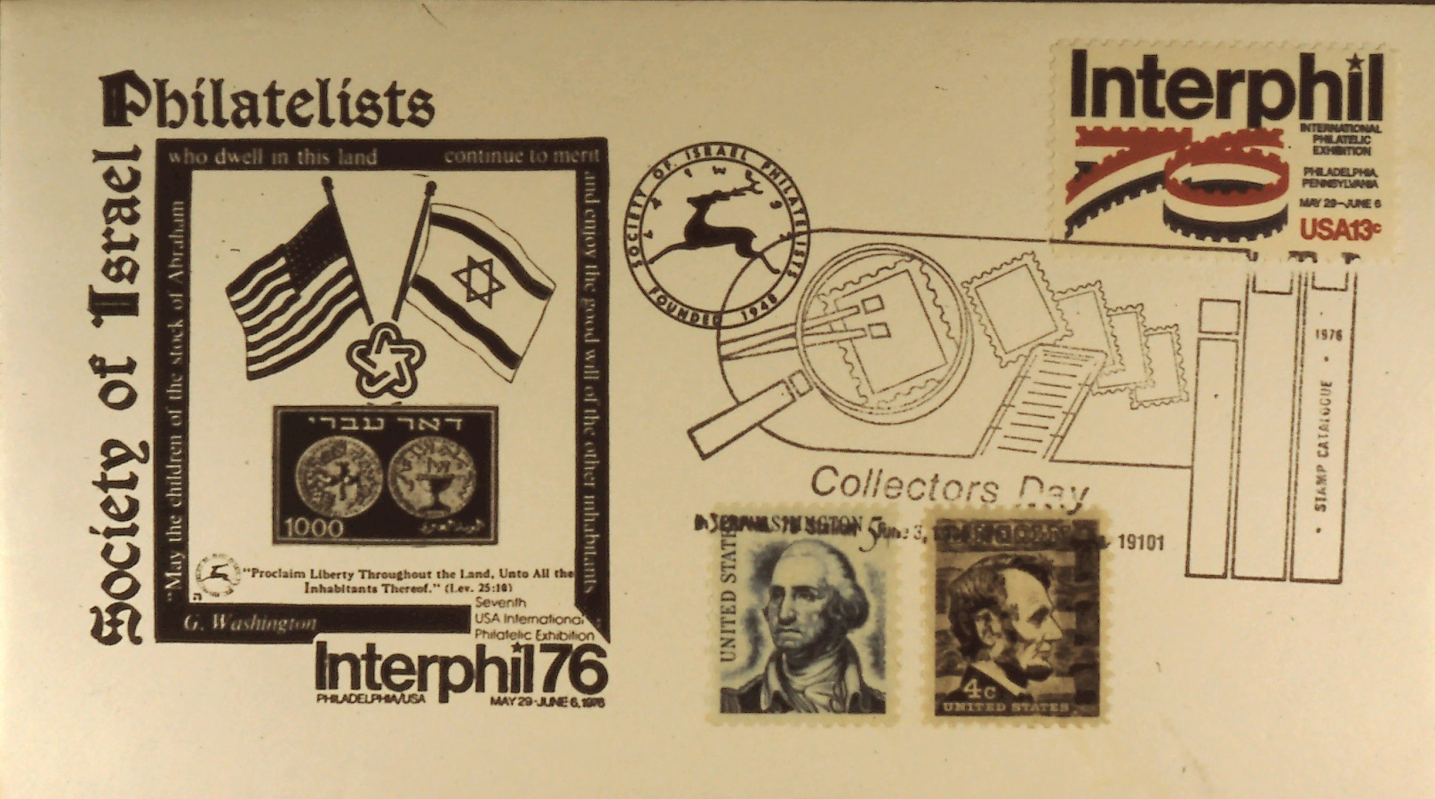
The Hennenberg Cachets
Slide 39
Notes:
Slide 39: Cachet in connection with Interphil76.

Slide 41
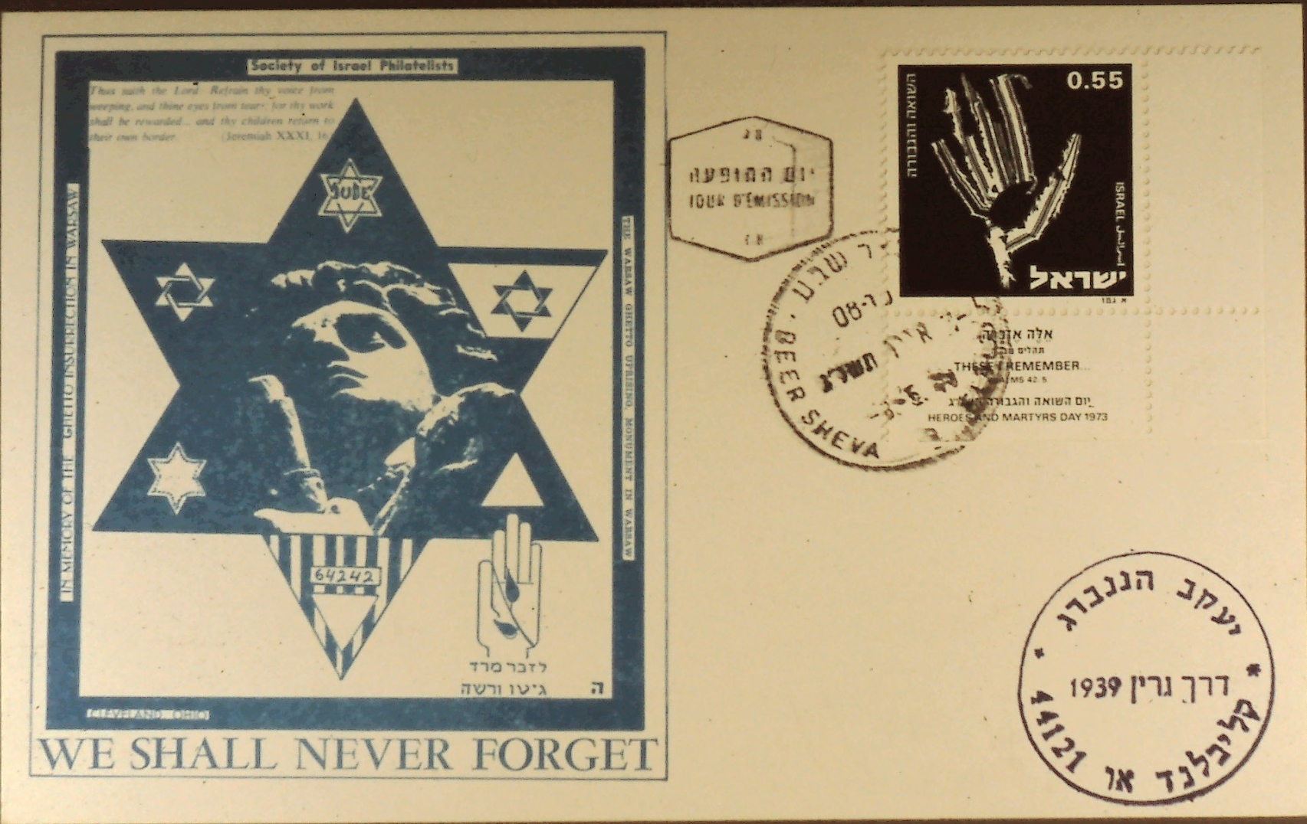
The Hennenberg Cachets
Slide 40
Notes:
Slide 40: Shoah cover picturing Mordechai Anielewicz.

Slide 42
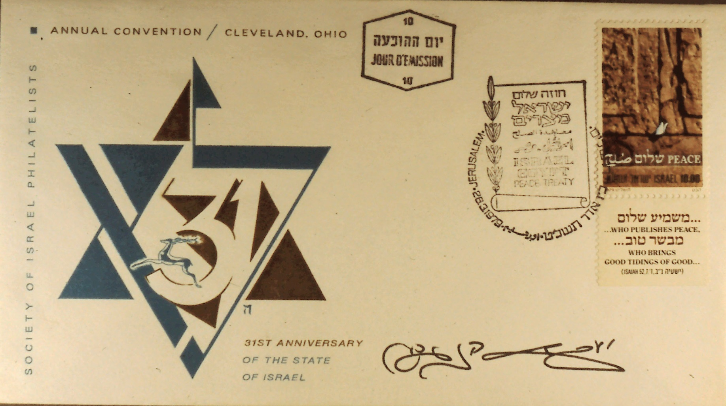
The Hennenberg Cachets
Slide 41
Notes:
Slide 41: Cachet in honor of the 31st anniversary of the State of Israel cancelled Jerusalem, March 26, 1979, autographed by Jacob Hennenberg.

Slide 43
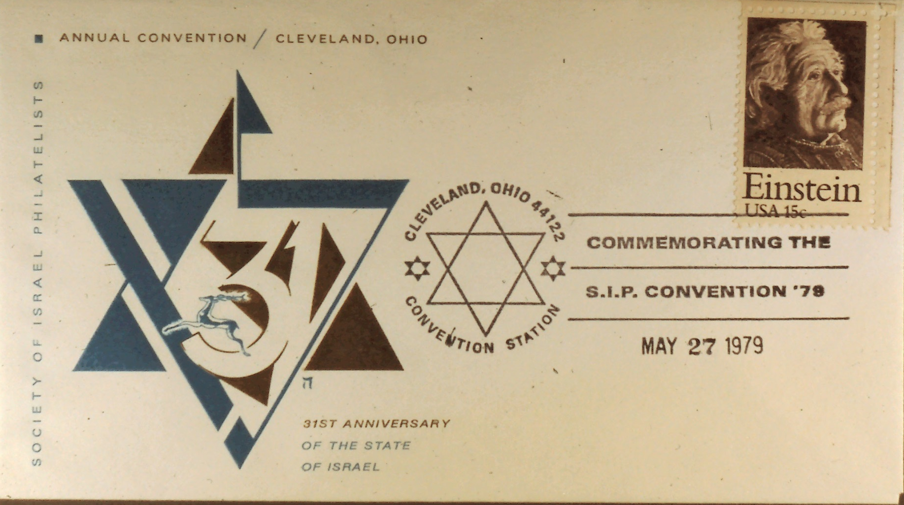
The Hennenberg Cachets
Slide 42
Notes:
Slide 42: In honor of Israel’s 31st anniversary cancelled Cleveland, Ohio Convention Station, May 27, 1979.

Slide 44
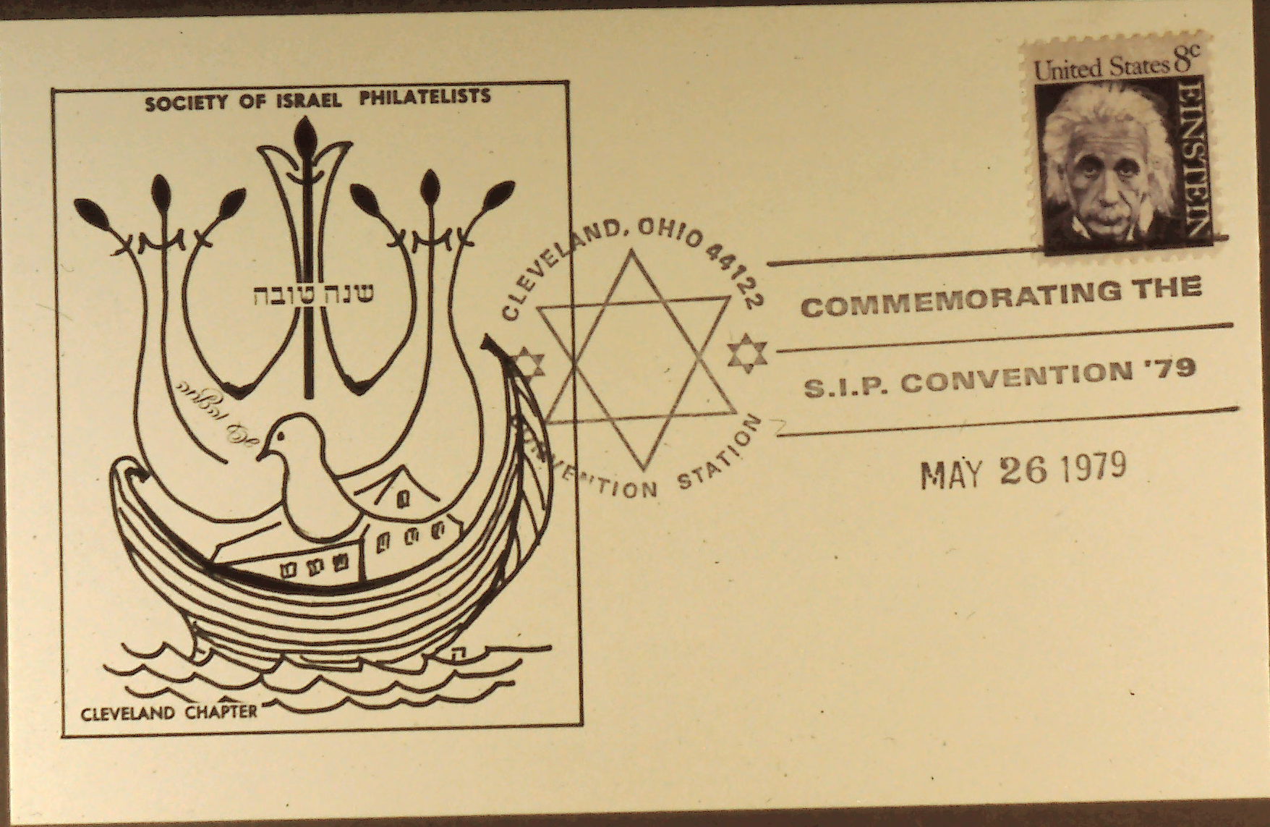
The Hennenberg Cachets
Slide 43
Notes:
Slide 43: Cachet in honor of the New Year – cancelled SIP Convention 79, Cleveland, Ohio, May 26, 1979.

Slide 45
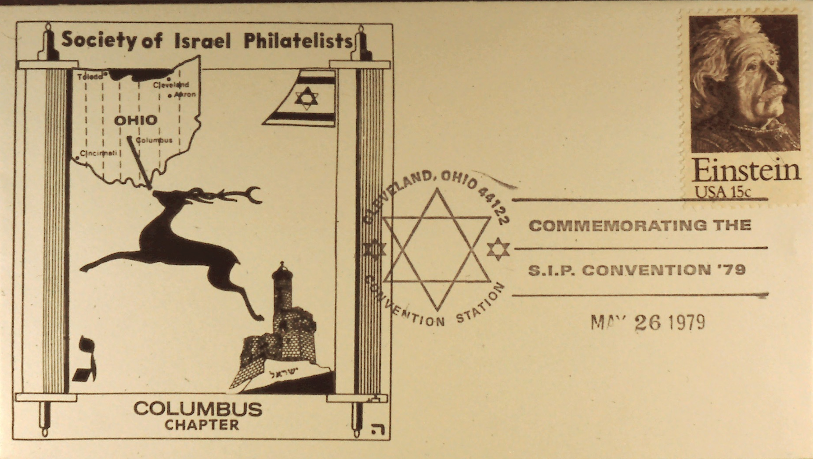
The Hennenberg Cachets
Slide 44
Notes:
Slide 44: The third cachet for the Columbus Chapter.

Slide 46
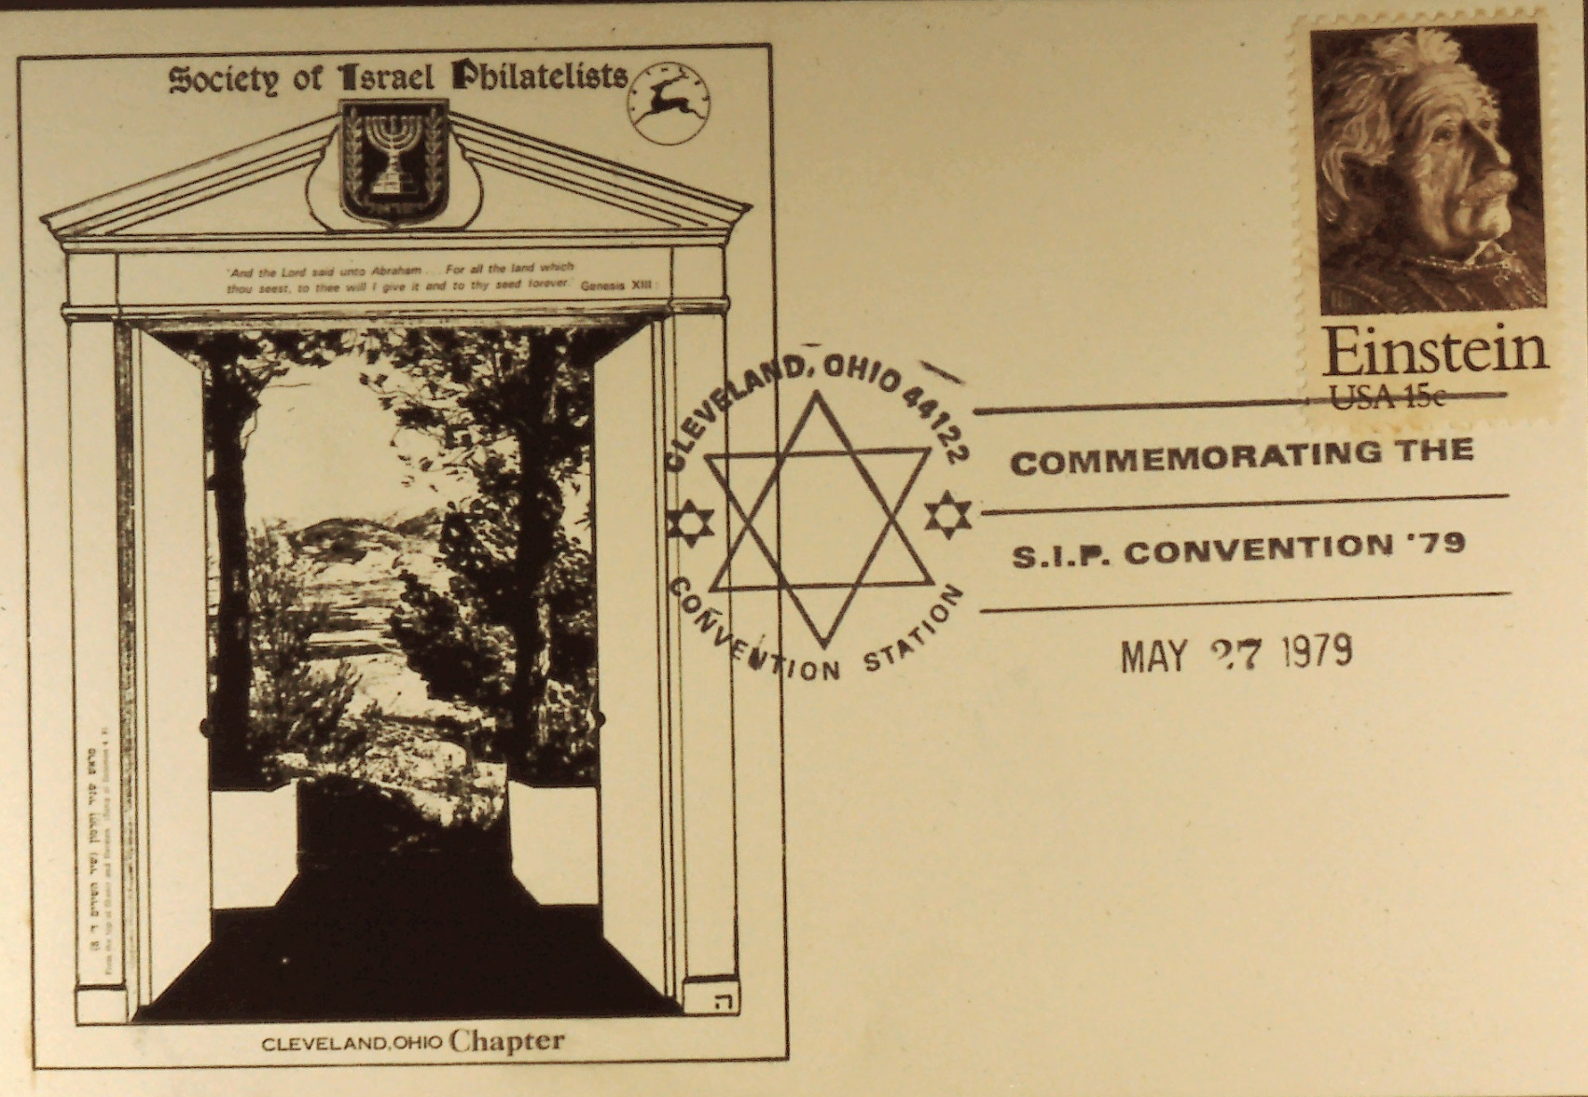
The Hennenberg Cachets
Slide 45
Notes:
Slide 45: S.I.P. Convention 1979.

Slide 47
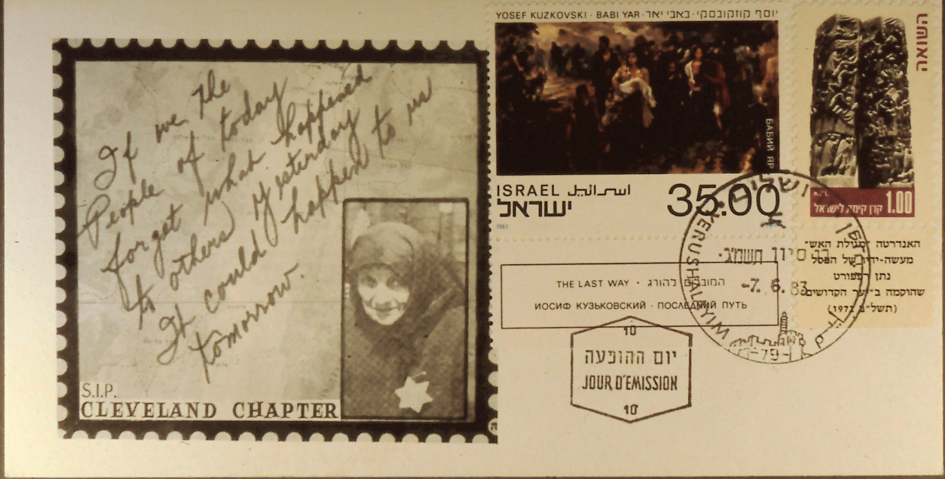
The Hennenberg Cachets
Slide 46
Notes:
Slide 46: Shoah cover showing the tragedy at Babi Yar.

Slide 48
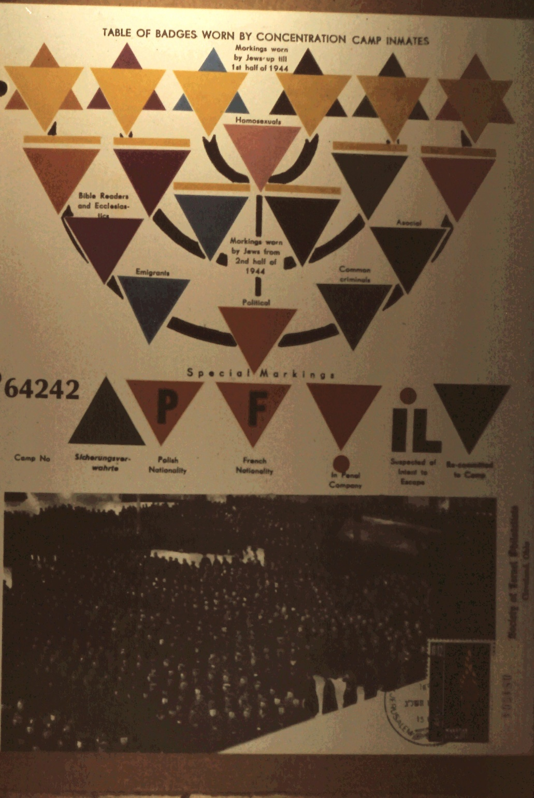
The Hennenberg Cachets
Slide 47
Notes:
Slide 47: Color markings of the concentration camps.

Slide 49
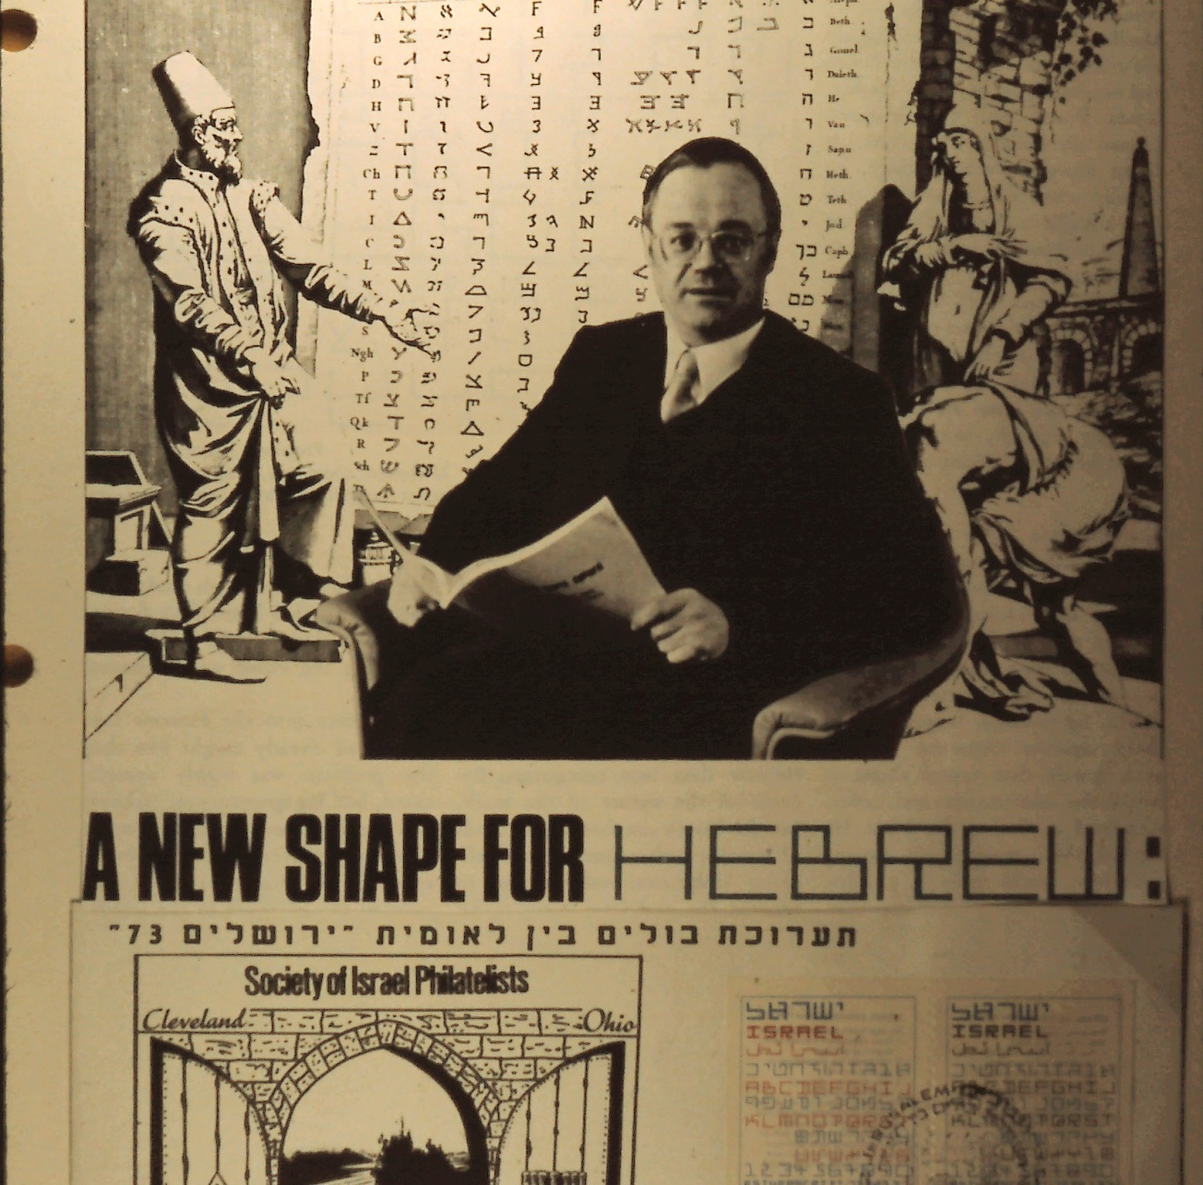
The Hennenberg Cachets
48
Notes:
Slide 48: At the World Gathering a man from Holland suggested a new Hebrew lettering for the computer.

Slide 50
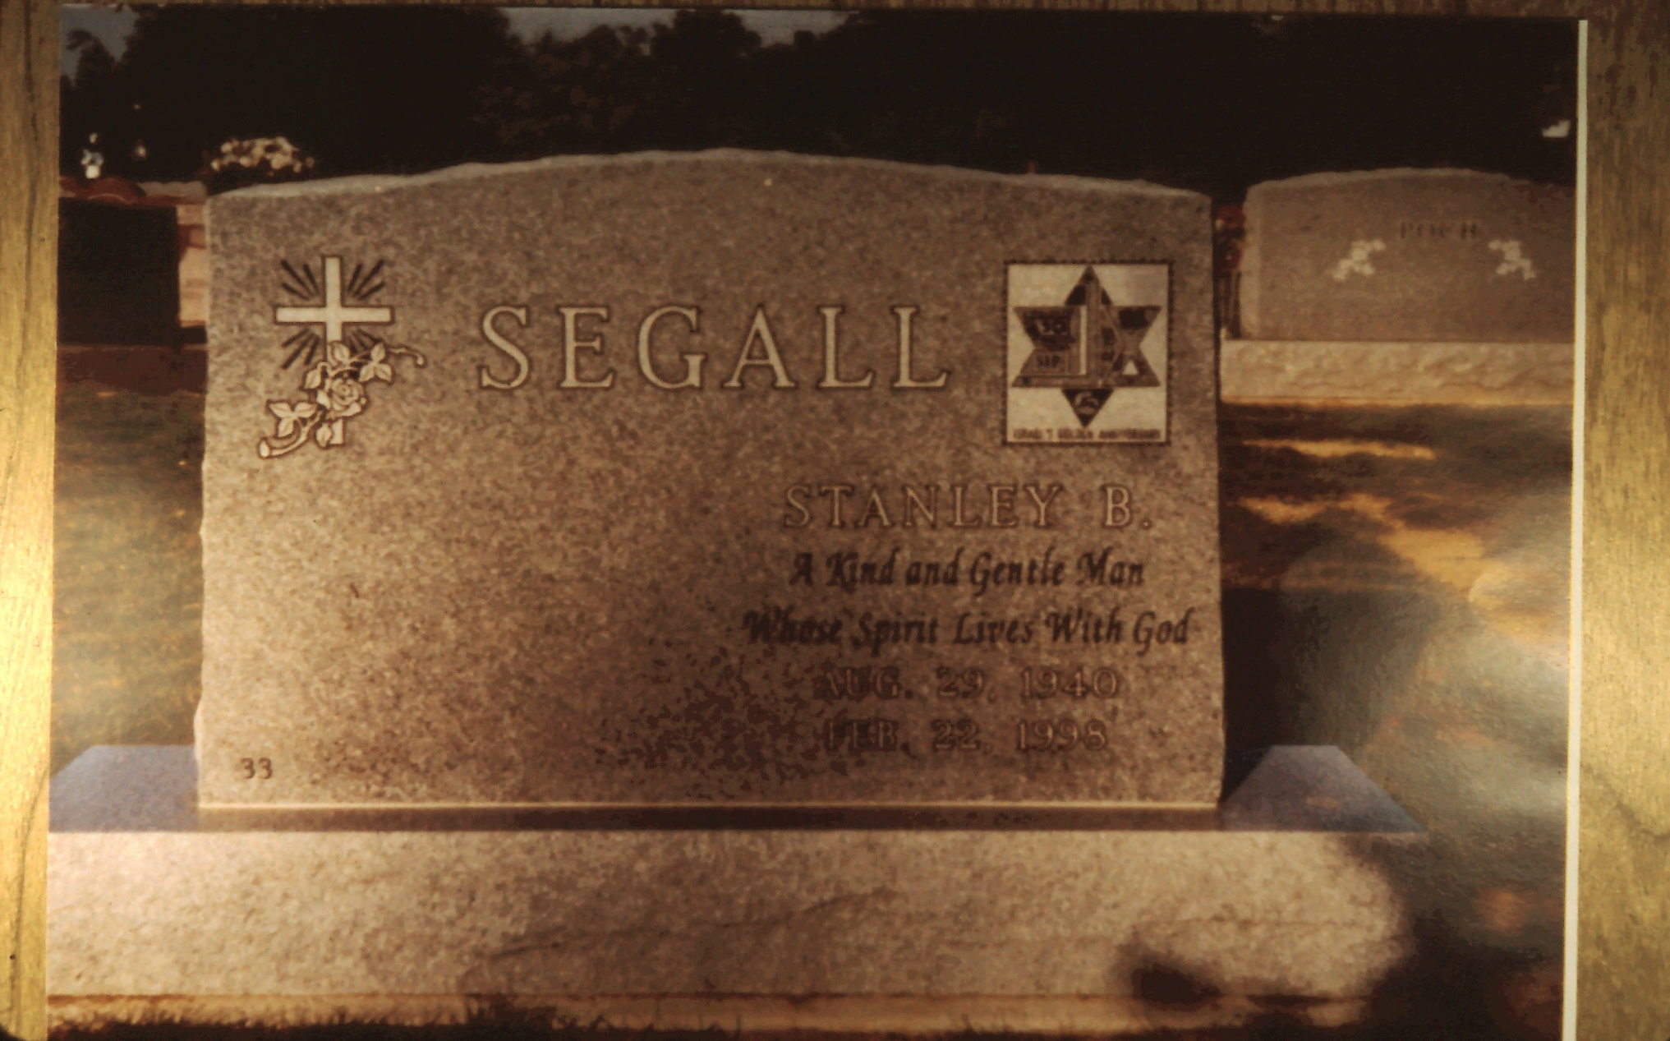
The Hennenberg Cachets
49
Notes:
Slide 49: S.I.P. Cleveland Chapter President Stan Segall, his memorial stone bears the Chapter Cachet.

Slide 51
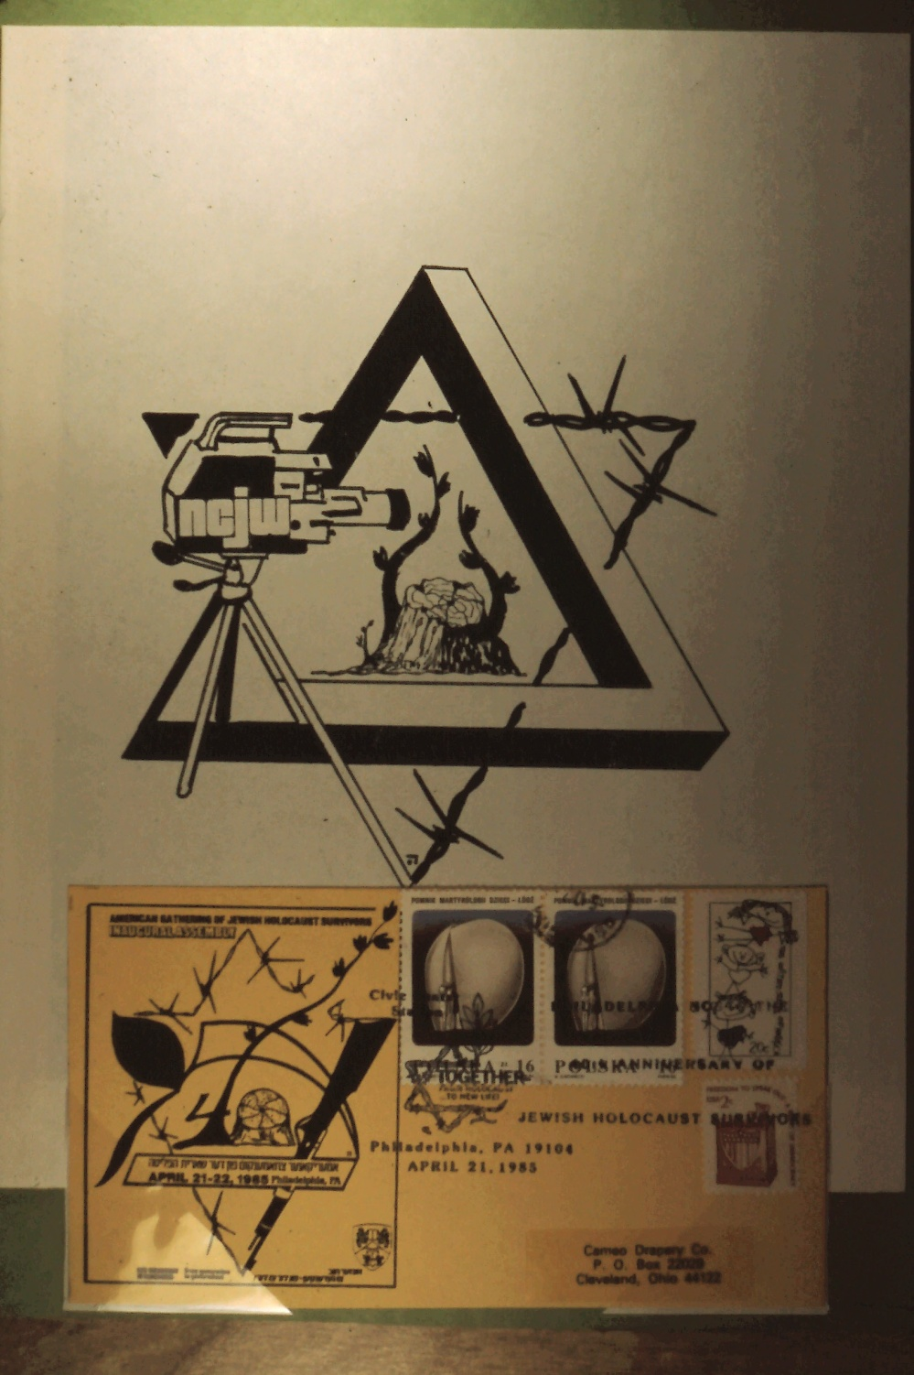
The Hennenberg Cachets
50
Notes:
Slide 50: Design for N.C.J.W. Holocaust project.

Slide 52
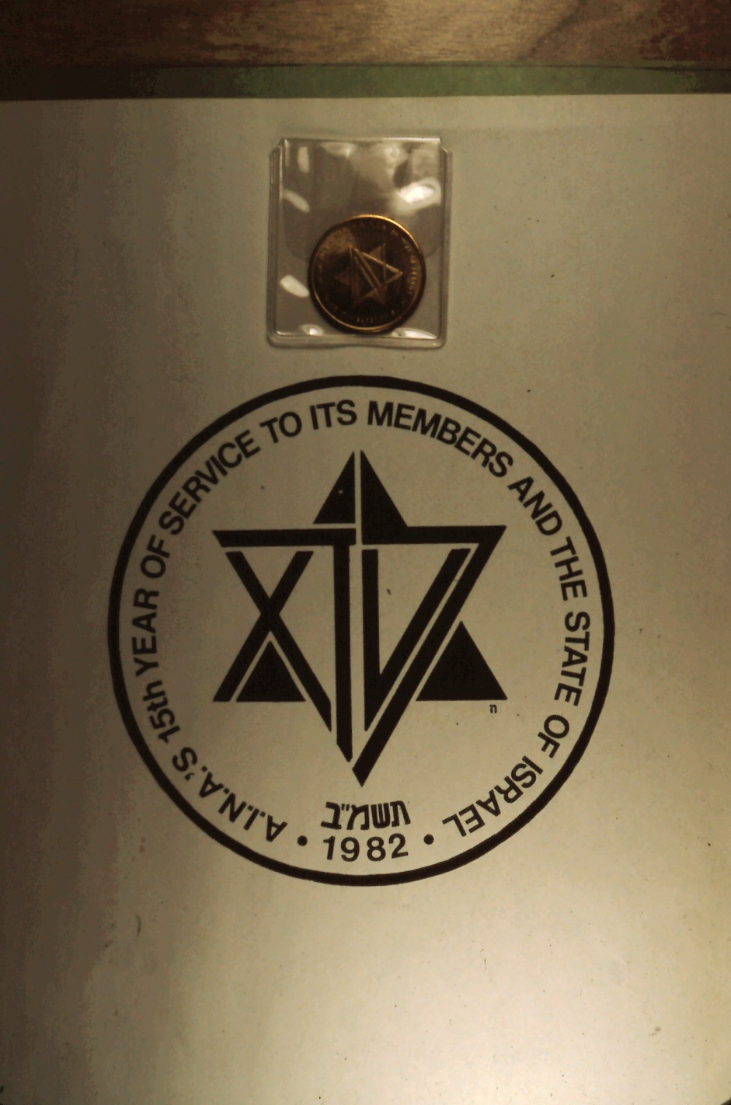
The Hennenberg Cachets
51
Notes:
Slide 51: A.I.N.A.’s 15th year of service to its members, 1982. Coin designed by Jacob Hennenberg.

Slide 53

The Hennenberg Cachets
52
Notes:
Slide 52: Remembering the Holocaust.

Slide 54

The Hennenberg Cachets
53
Notes:
Slide 53: The Gates of Jerusalem souvenir sheet cancelled first day.

Slide 55

The Hennenberg Cachets
54
Notes:
Slide 54: 34th Anniversary of the State of Israel. ISPEX 82.

Slide 56

The Hennenberg Cachets
55
Notes:
Slide 55: Mr. Hennenberg’s design for ISPEX 88, Cleveland, Ohio.

Slide 57

The Hennenberg Cachets
56
Notes:
Slide 56: First day of the Touro synagogue stamp, Newport, Rhode Island, August 22, 1982.

Slide 58

The Hennenberg Cachets
57
Notes:
Slide 57: 35th anniversary of the State of Israel.

Slide 59

The Hennenberg Cachets
58
Notes:
Slide 58: EUPEX ‘87.

Slide 60

The Hennenberg Cachets
59
Notes:
Slide 59: CAPEX ‘87 – special cancel June 13-21, 1987. The Cachet honors ISPEX 87.

Slide 61

The Hennenberg Cachets
60
Notes:
Slide 60: ISPEX ’88.

Slide 62

The Hennenberg Cachets
61
Notes:
Slide 61: ISPEX ’94 – Cleveland Chapter Cachet, cancelled Tel Aviv – Yafo 1994.

Slide 63

The Hennenberg Cachets
62
Notes:
Slide 62: 49th anniversary of the State of Israel, cancelled Parma, Ohio, Exhibition Station November 9, 1997.

Slide 64

The Hennenberg Cachets
63
Notes:
Slide 63: 50th anniversary of the State of Israel – official cancellation by the U.S. Post Office, Parma, Ohio Exhibition Station, July 12, 1998.

Slide 65

The Hennenberg Cachets
64
Notes:
Slide 64: Same as above – official cancellation by the State of Israel, Tel Aviv-Yafo, July 12, 1998.

Slide 66

The Hennenberg Cachets
65
Notes:
Slide 65: Cachet for Cleveland Stamp Fair cancelled, Wickliffe, Ohio Exhibition Station, October 6, 2001.

Slide 67

The Hennenberg Cachets
66
Notes:
Slide 66: 50th Anniversary of liberation.

Slide 68

The Hennenberg Cachets
67
Notes:
Slide 67: Design for the World Philatelic Congress of Israel Holy Land Judaica Societies – cancelled in Austria.

Slide 69

The Hennenberg Cachets
68
Notes:
Slide 68: Stamp of Germany honoring Doctor Leo Beck.

Slide 70

The Hennenberg Cachets
69
Notes:
Slide 69: Moon-landing stamp, cancelled in Jerusalem, Ohio and Jerusalem, Israel – depiction of Theodore Herzl created by the Hebrew words of Genesis on the Chachet.

Slide 71

The Hennenberg Cachets
70
Notes:
Slide 70: Cachet honoring stamp exhibition COMPEX in Chicago.

Slide 72

The Hennenberg Cachets
71
Notes:
Slide 71: Cachet honoring the American Red Magen David (ARMD).

Slide 73

The Hennenberg Cachets
72
Notes:
Slide 72: Cachet honoring the 46th Anniversary of the State of Israel – Stamp remembering the Holocaust.

Slide 74

The Hennenberg Cachets
73
Notes:
Slide 73: Cachet remembering the World Gathering of Jewish Holocaust Survivors cancelled in Jerusalem – stamp of Rabbi Abba Hillel Silver.

Slide 75

The Hennenberg Cachets
74
Notes:
Slide 74: Holocaust commemoration, State of Ohio.

