Slide 1
Israel Celebrates Holidays
Alan Barasch
Saint Louis, Missouri
15 November 2013

Slide 2
Annual Holidays
Rosh Hashanah – New Year
Yom Kippur – Day of Atonement
Sukkot – Harvest Festival
Simchat Torah – Rejoicing with the Torah
Hanukkah – Festival of Lights
Tu Bishvat - New Year of the Trees
Purim – Feast of Esther
Pesach – Passover
Shavuot – Feast of Weeks
Tish B’Av – 9th Day of Av

Slide 3
New Year
Eat apples dipped in honey celebrating the sweetness of New Year
Blow the Shofar or Ram’s horn as call to prayer

Slide 4
Yom Kippur
Chanting of “Kol Nidre” prayer for atonement of sins during past year

Slide 5
Yom Kippur
The Book of Jonah is read during the Yom Kippur afternoon service

Slide 6
Sukkot
Palms, lemons, and other fruits of the harvest

Slide 7
Simchat Torah

Slide 8
Chanukah
Joint issue with India for Joint Festivals of Lights

Slide 9
Chanukah
Symbols of the holiday: Candles, Dreidel, Menorahs

Slide 10
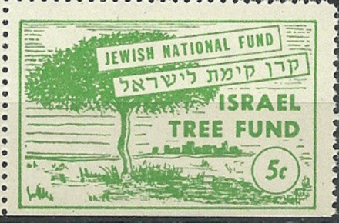
Tu Bishvat
New year for Trees – Support reforestation

Slide 11
Purim
Read from Book of Esther
Dress in costumes
Eat Hamentashen (three cornered cookies)
Celebrate triumph over the evil Haman
Make noise to blot out name of Haman

Slide 12
Tish B’Av
9th Day of Av
First Temple destroyed
Second Temple destroyed
Expulsion from England 1290
Expulsion from Spain 1492
Read from Lamentations

Slide 13
Israeli Holidays
Yom HaShoah: Holocaust Remembrance Day
Yom Hazikaron: Memorial Day
Yom Ha'atzmaut: Israel Independence Day
Yom Yerushalayim: Jerusalem Day

Slide 14
Holocaust Remembrance Day

Slide 15
Yahrzeit Remember loved Ones on Anniversary

Slide 16
Questions?
Alan Barasch
Saint Louis, Missouri
15 November 2013
ALAN@STLCYBERJEW.COM

